Slide 1
LeLocApp
Advanced Web Programming
By HellBoys

Slide 2
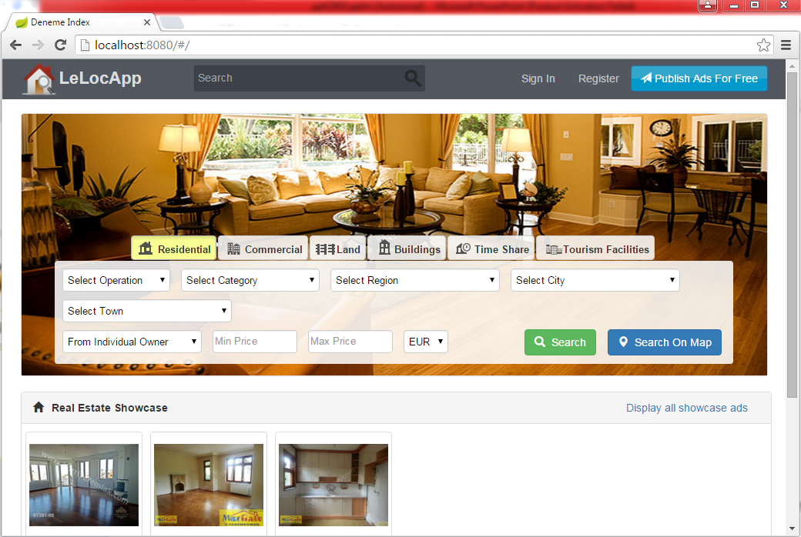
LeLocApp Page

Slide 3
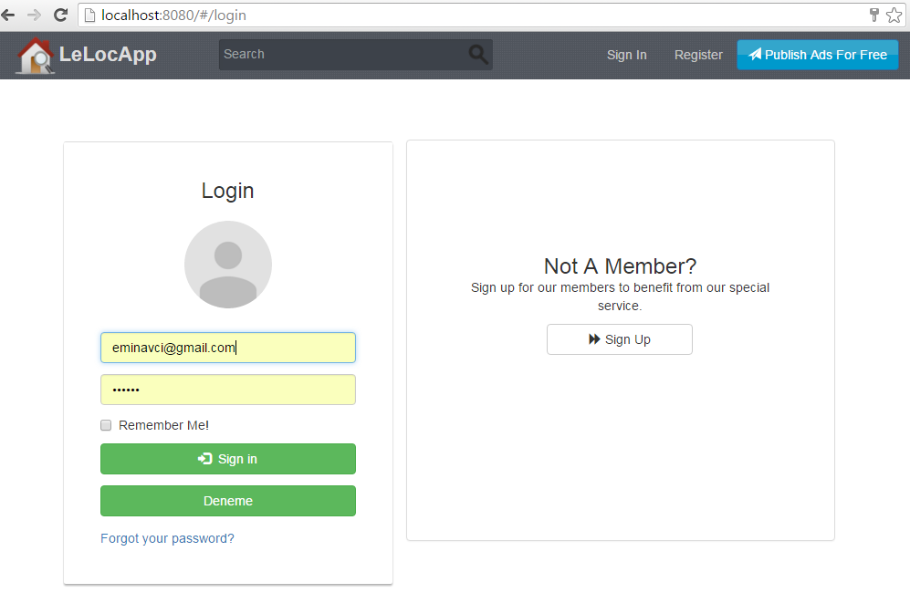
login

Slide 4
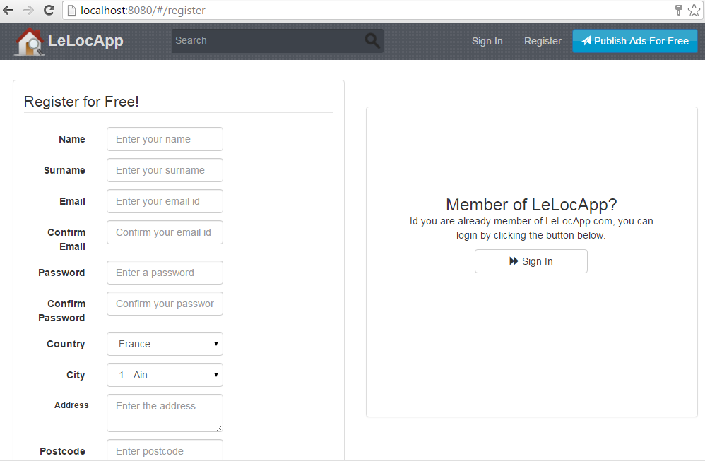
Register

Slide 5
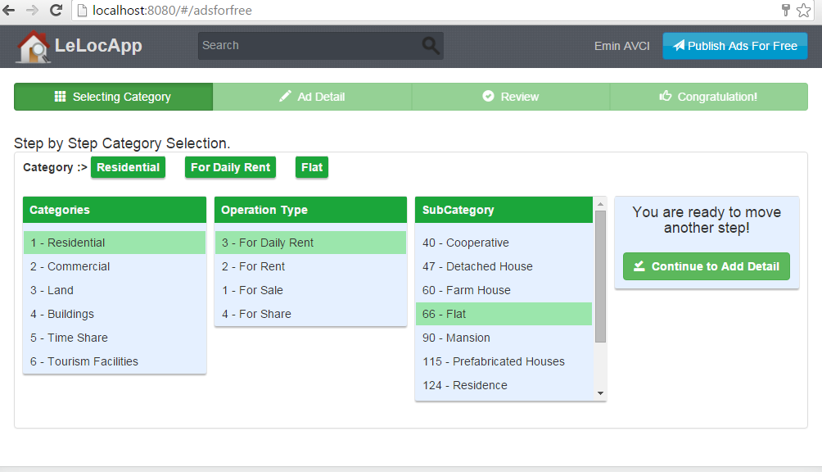
Publish Adds

Slide 6
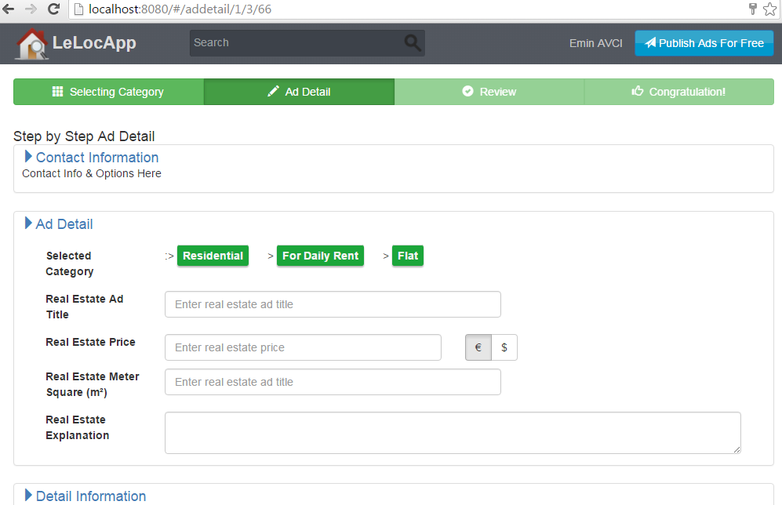
Cont..

Slide 7
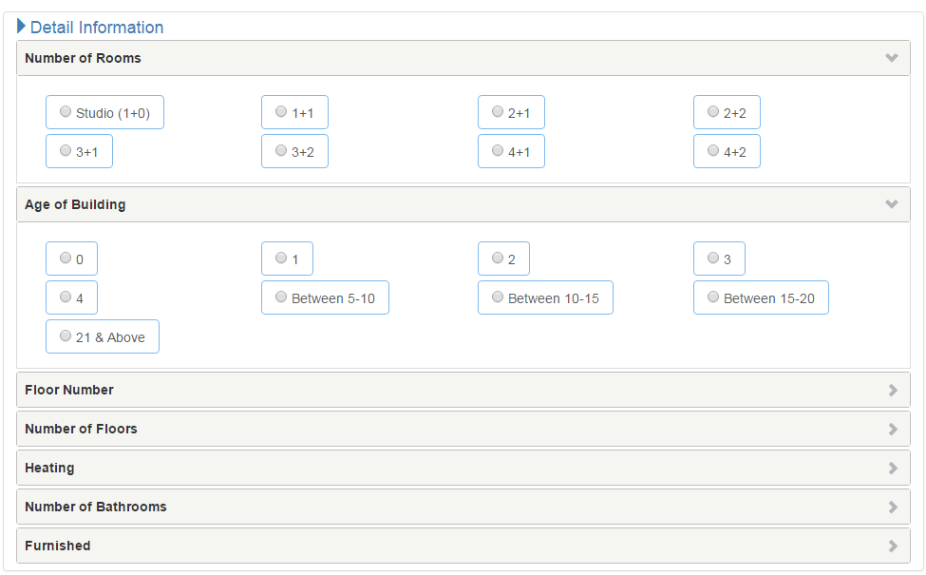
Cont..

Slide 8
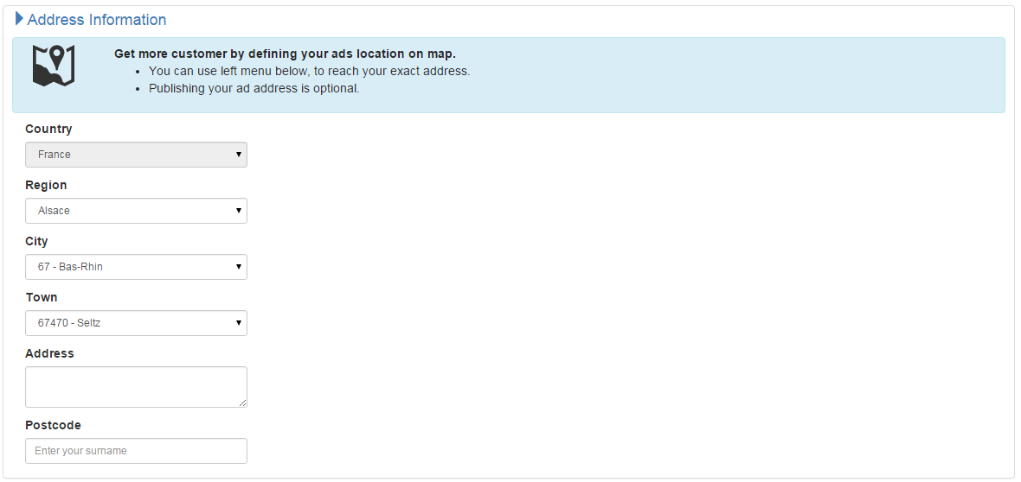
Cont..

Slide 9
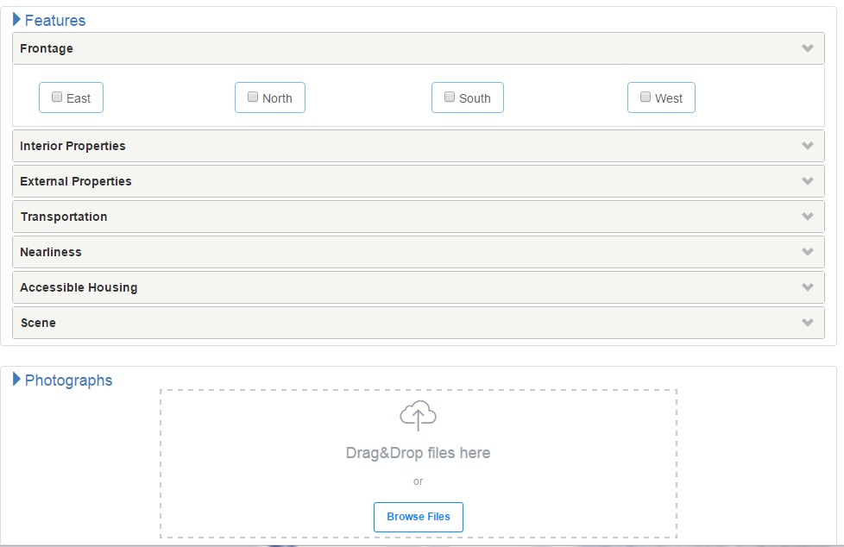
Cont..

Slide 10
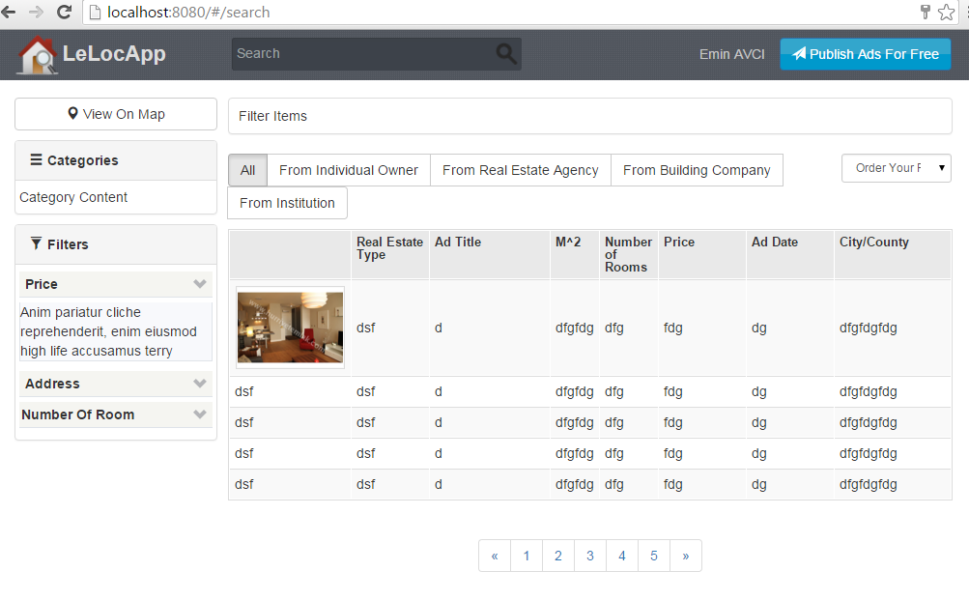
Search

Slide 11
Knowledge gained
We have gone deep in to
  Angularjs
  Spring boot
  Bootstrap
- Spring Security, JPA, Internationalization,...
Git
  Good experience with git
    The errors helped us to learn a lot

Slide 12
Feature work
* We planned to implement the mapping of the addresses but due to time and many other projects, we haven’t implemented it yet
* In the next version. There will be a search mecanism which will depend on many criteries.
* Google Map integration will be added so that user can drag the map where he wants and see the reasult on map dynamically according to the given criterias.

