Slide 1


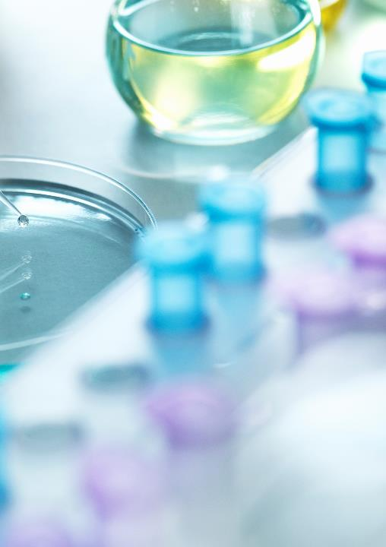
Capstone Project : Malaria Detection Deep Learning
Emine Bayar CILINGIR

Slide 2

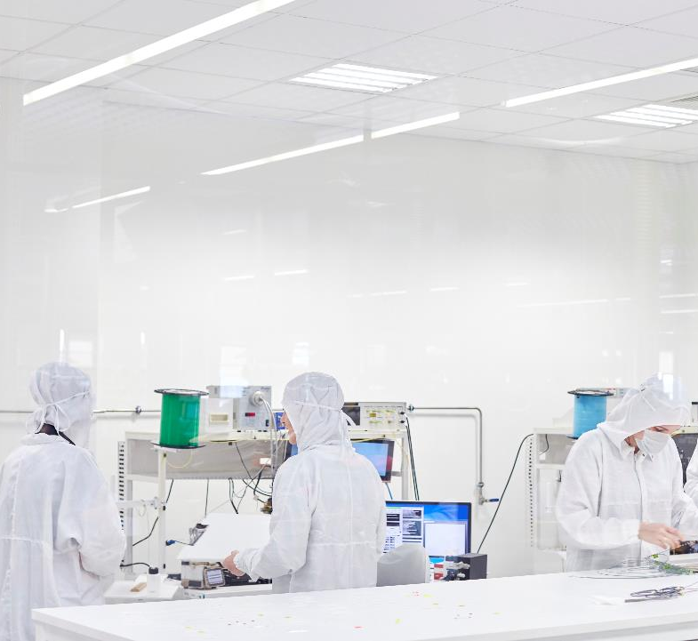
AGENDA
Overview of the problem
Approach for the solution
Key findings & insights
Recommendations and next steps

Slide 3
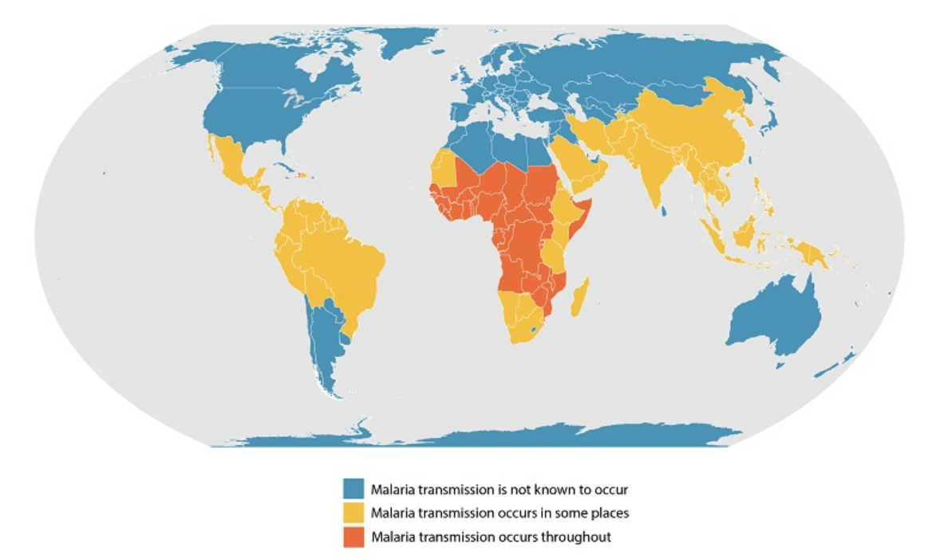
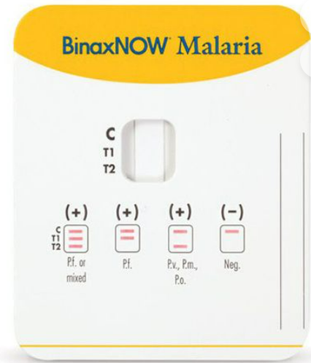
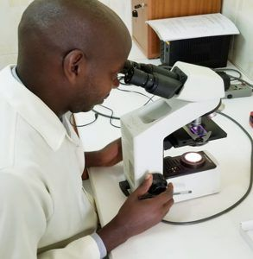
Overview of the problem
What is Malaria?
How to Detect Malaria?
Rapid Diagnostic Test (RDT) : Rapid and Cheap
All positive RDT should be followed by Microscopy
Microscopy: Slow, requires skilled lab technicians
In developed countries, this tests are not done frequently so error risk is high.
Malaria mostly transmitted in tropical regions.
Disease caused by the bite of infected mosquitoes.
In 2021, nearly half of the world's population was at risk of malaria. There were ~247 million cases of malaria worldwide and 619 thousand of death.
Source: CDC and WHO

Slide 4
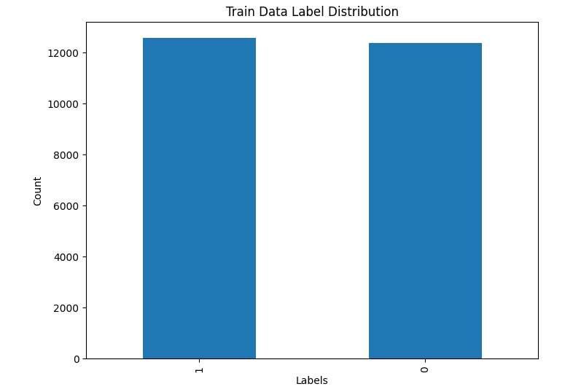
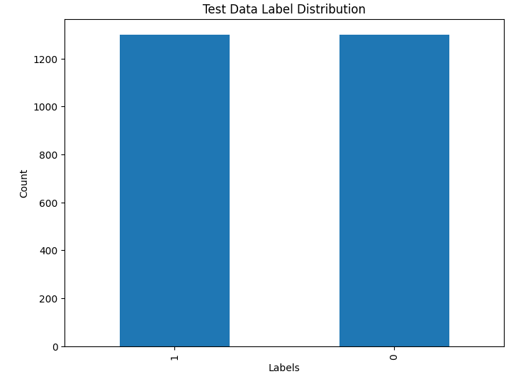
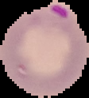
APPROACH FOR the SOLUTION
Input:
Blood Cell Image
CNN Model
(0): Uninfected
(1): Parasitized
24,958 Train and 2,600 Test images.
In total 27,558 images.
Model # | About CNN Models | Test Accuracy | False Negatives
Base Model | Base | 0.99 | 17
Model 1 | Add new layers | 0.97 | 19
Model 2 | LeakyReLU and Batch Normalization | 0.98 | 14
Model 3 | Data Augmentation | 0.98 | 26
Model 4 | Pre-Trained Model (VGG16) | 0.97 | 46

Slide 5
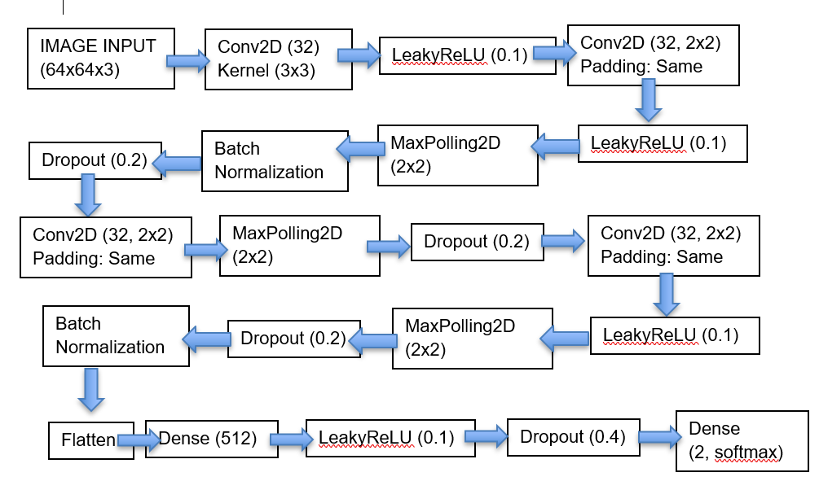
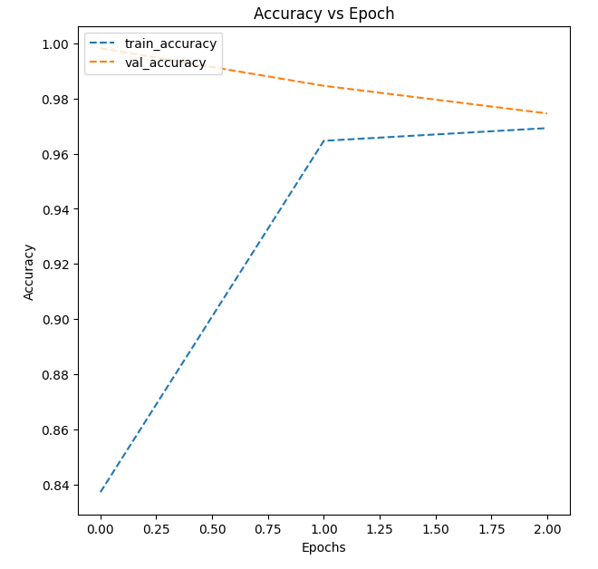
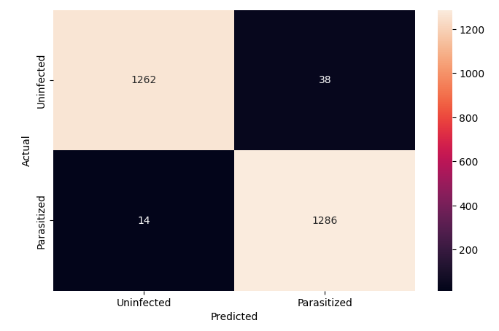
KEY FINDINGS & INSIGHTS
The test accuracy rate is 98% (f1-score is 0.98). Loss rate is 0.09.
Above are confusion matrix and accuracy plot.
Test accuracy merging with the train accuracy as epochs progress.
False Negatives: 14 out of 1300
False Positives: 38 out of 1300
Suggested Model 2 Layers and Filters

Slide 6
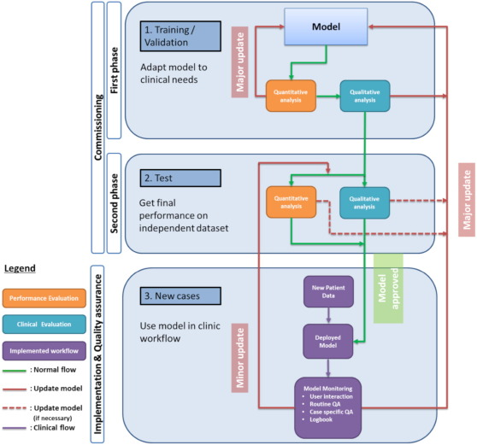
RECOMMENDATIONS and next steps
Key actions for stakeholders:
Physicians and Data Scientist work together for an end-to-end testing
Expected Benefits:
Faster, Lower Cost, Standard result delivery
Expected Costs:
Annual accuracy assessment
Key Risks and Challenges:
Room for Improvement (False Negatives and False Positives)
Further Improvements:
Data sharing agreements among clinics to access more images
Recommended Implementation Flow
Notes:
Key actions for stakeholders:
Before Clinical Implementation, work with cross-functional teams (Physicians and Data Scientist) for an end-to-end testing and collect feedbacks for improvements.
Expected Benefits:
Standardization and acceleration of disease detection process. Decrease people time and cost via faster result delivery
Expected Costs:
Working with data scientist for implementation and Training for Physicians
Annual accuracy assessment will be the regular cost to clinics.
Key Risks and Challenges:
Even though the accuracy of the model is high, and loss is low; there are still misdiagnosed images (False Negatives and False Positives)
Further Improvements:
Using more images can improve the accuracy of the model. Data sharing agreements among clinics would be beneficial.

Slide 7
THANK YOU
Questions ?

