Slide 1

CNN Debayerization
Emine Ezgi Yücel

Slide 2
Outline
Bayer Filter
Debayerization in PyTorch
Debayerization in Ai8x

Slide 3
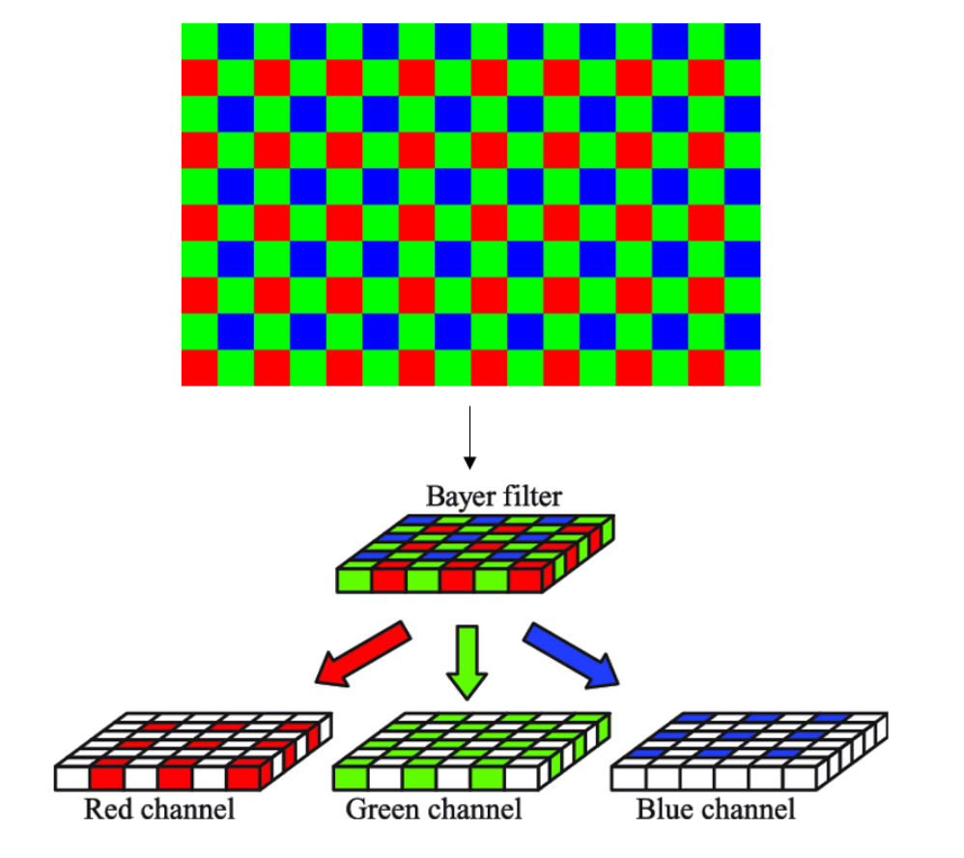

Bayer Filter
Motivation
Record not only the intensity of the light, but also sense the wavelength
Method
By using three channels (RGB) with different patterns, a mosaic image is obtained.
Figure 1. Bayer Filter (Nkansah et. al., 2022)

Slide 4
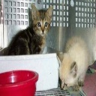
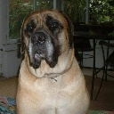

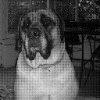
Mosaic Image Samples from Cats vs. Dogs Dataset
Figure 2. Original & Mosaic Images of Cats vs. Dogs Dataset

Slide 5
Debayerization
In order to obtain a RGB image, debayerization must be done. According to Dammer et. al.(2017), there are several debayerization methods.
Bilinear Interpolation
Sequential Demosaicing
Iterative Demosaicing
Machine Learning Methods
Adaptive Color Plane Interpolation

Slide 6
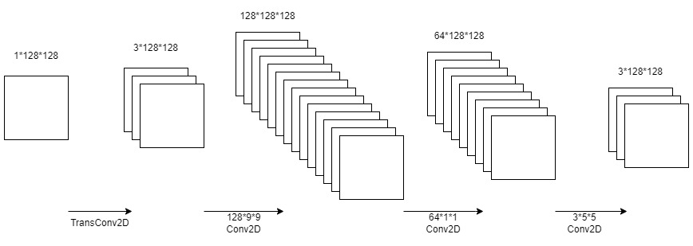
Approach
Converting images from Bayer to RGB format with a CNN architecture
# parameters: 124715
Figure 3. The Network of B2RGBNet (Syu et. al., 2018)

Slide 7
Train Results
Table 2. L2 Loss of B2RGBNet for Two Datasets
 | Only Cats | Cats & Dogs
100 epoch | 97.852 | 93.962
100 epoch w/Xavier Init | 101.573 | 92.138
200 epoch | 89.323 | 88.554
200 epoch w/Xavier Init | 90.533 | 89.372
600 epoch | NA | 80.344

Slide 8
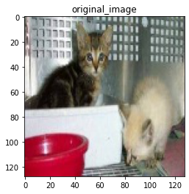
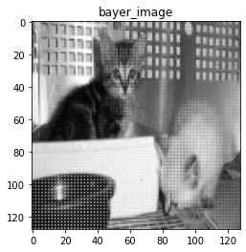
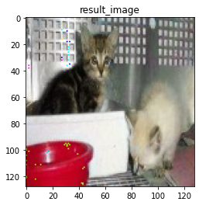
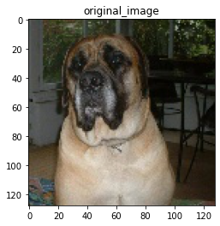
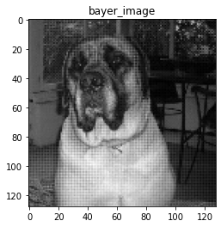
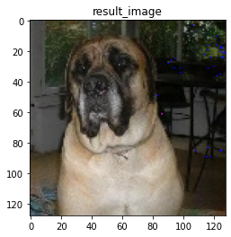
Figure 4. The Test Results of B2RGBNet)

Slide 9
Test Results
A test dataset generated by B2RGBNet is compared with the original test dataset.
Table 3. The Tests Results on Different Datasets
Original Test Dataset (ai85net-cd) | B2RGBNet Test Dataset (ai85net-cd)
90.320 | 90.100
**During the training of ai85net-cd, the script given in the repo is used.

Slide 10
Revision of RGBNet
9*9 to 4*3*3 & 5*5 to 2*3*3 filters
transConv2d to Conv2d in the first layer
additional hidden layer in order to increase # parameters
Conv2d to fill_with_zeros in the first layer

Slide 11
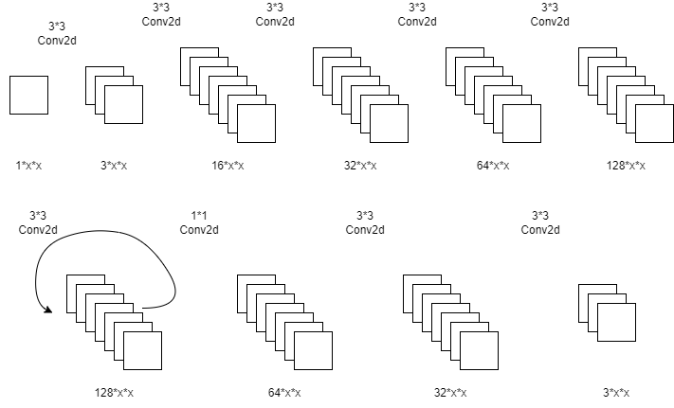
From PyTorch to Ai8x
9*9
fill w/zeros
5*5
Figure 4. The Network of B2RGBNet

Slide 12
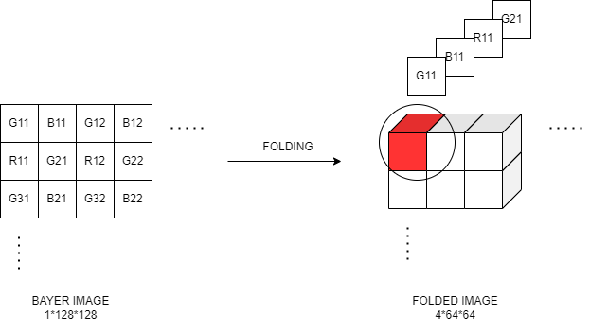
Folding Operation
Figure 5. The Illustration of Folding Operation

Slide 13
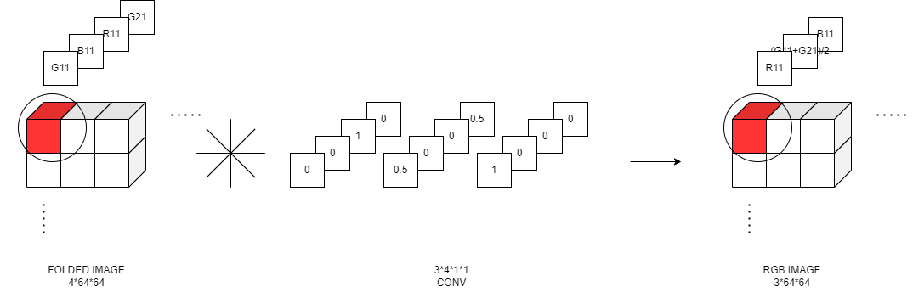
Convolution with Fixed Kernel
Figure 6. The Illustration of Convolution with Fixed Kernel

Slide 14
Table 4. The MSE of ImageNet with Different Bayer-to-RGB Models
 | b2rgb | conv w/fold + transconv | conv w/fold + transconv + conv | conv w/fold + b2rgb | bilinear interpolation
ImageNet | 0.00340 | 0.00934 | 0.00452 | 0.00306 | 0.00582

Slide 15
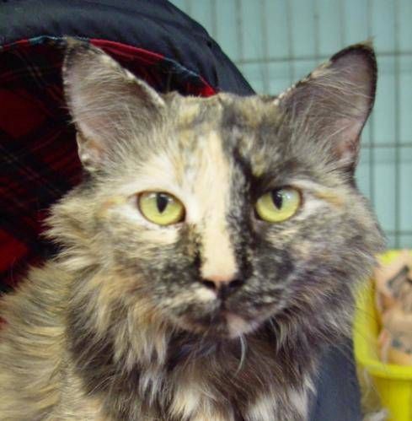
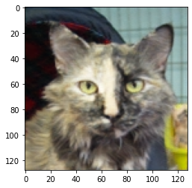
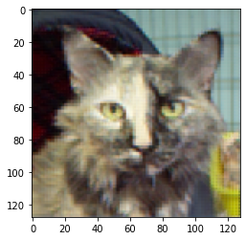

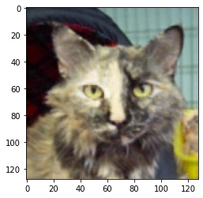

original
acc: 90.52
b2rgbnet
acc: 90.06
conv w/fold + transconv
acc: 89.80
conv w/fold + transconv + conv
acc: 89.90
conv w/fold + b2rgbnet
acc: 89.98
bilinear interpolation
acc: 67.82

Slide 16
Table 5. The Accuracy of Several CNN Models with Different Datasets
 | original | b2rgb | conv w/fold + transconv | conv w/fold + transconv + conv | conv w/fold + b2rgb | bilinear interpolation
Cats_vs_Dogs | 90.52 | 90.06 | 89.80 | 89.90 | 89.98 | 67.82
CIFAR100 | 64.35 | 53.76 | 15.05 | 41.06 | 45.78 | 1.04
CamVid | 90.83 |  | 90.10 | 90.56 | 90.77 | 90.33

