Slide 1
CNN Debayerization
Emine Ezgi Yücel

Slide 2
Outline
Bayer Filter
Debayerization in PyTorch
Debayerization in Ai8x

Slide 3
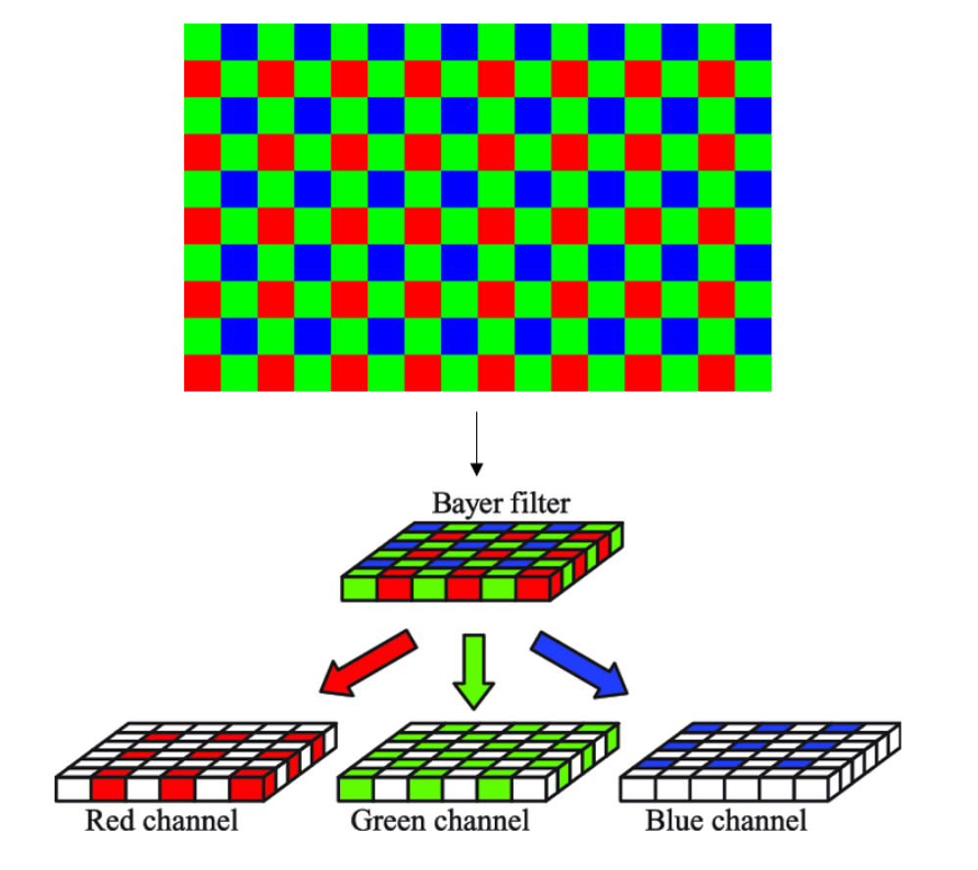
Bayer Filter
Motivation
Record not only the intensity of the light, but also sense the wavelength
Method
By using three channels (RGB) with different patterns, a mosaic image is obtained.
Figure 1. Bayer Filter (Nkansah et. al., 2022)

Slide 4
Debayerization
In order to obtain a RGB image, debayerization must be done. According to Dammer et. al.(2017), there are several debayerization methods.
Bilinear Interpolation
Sequential Demosaicing
Iterative Demosaicing
Machine Learning Methods
Adaptive Color Plane Interpolation

Slide 5
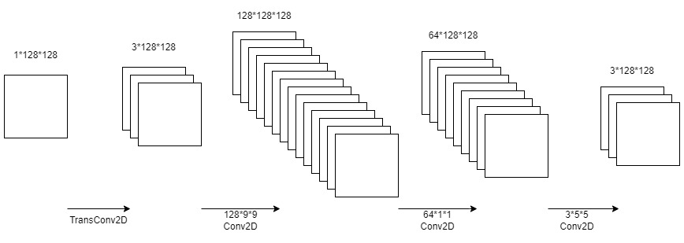
Approach 1
Converting images from Bayer to RGB format with a CNN architecture
# parameters: 124715
Figure 3. The Network of B2RGBNet (Syu et. al., 2018)

Slide 6
Revision of B2RGBNet
9*9 to 4*3*3 & 5*5 to 2*3*3 filters
transConv2d to Conv2d in the first layer
additional hidden layer in order to increase # parameters
Conv2d to fill_with_zeros in the first layer

Slide 7
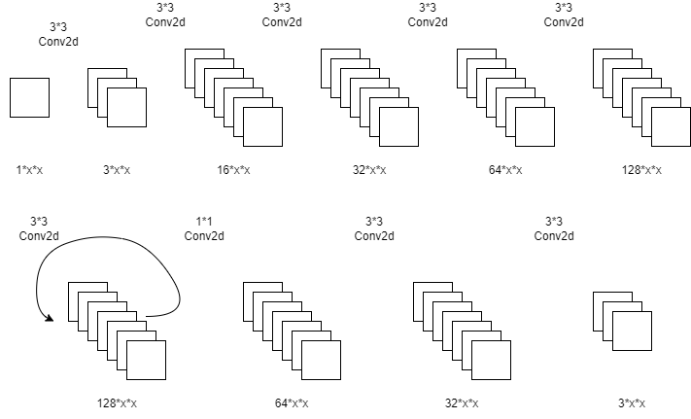
From PyTorch to Ai8x
# parameters: 272144
9*9
fill w/zeros
5*5
Figure 4. The Network of B2RGBNet

Slide 8
Another method is needed because…
The existing method has a huge number of parameters.
It is not working with low resolution images.

Slide 9
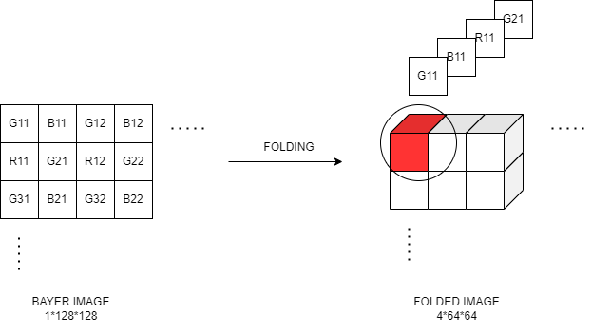
Folding Operation
Figure 5. The Illustration of Folding Operation

Slide 10
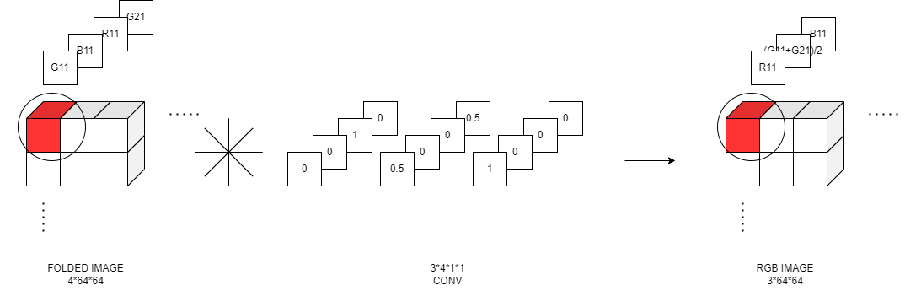
Convolution with Fixed Kernel
Figure 6. The Illustration of Convolution with Fixed Kernel

Slide 11
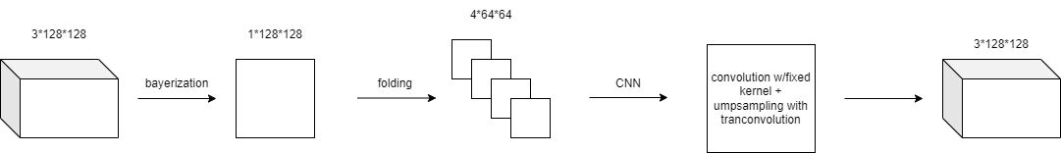
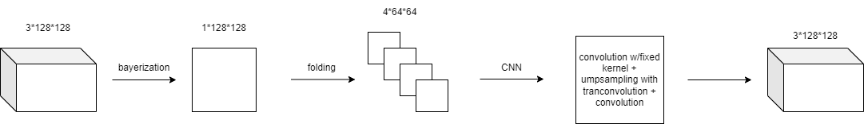
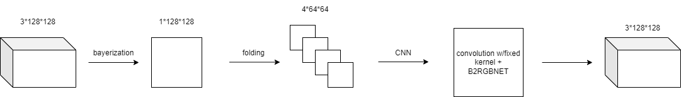
APPROACH 2 - conv w/fold + transconv
# parameters: 85
APPROACH 3 - conv w/fold + transconv + conv
# parameters: 166
APPROACH 4 - conv w/fold + b2rgb
# parameters: 124773

Slide 12
Table 4. The MSE of ImageNet with Different Bayer-to-RGB Models
 | Approach 1 - B2RGBNET | Approach 2 - conv w/fold + transconv | Approach 3 - conv w/fold + transconv + conv | Approach 4 - conv w/fold + B2RGBNET | Existing Method - bilinear interpolation
ImageNet | 0.00340 | 0.00934 | 0.00452 | 0.00306 | 0.00582

Slide 13
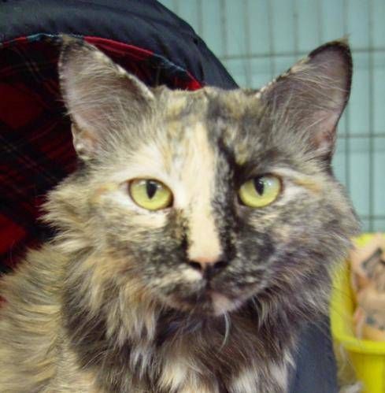
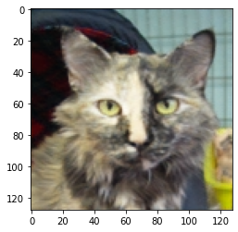
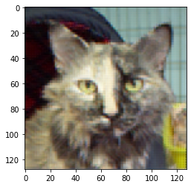

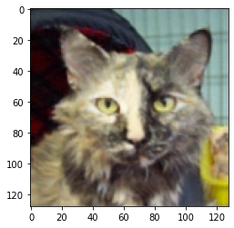

original
acc: 90.52
b2rgbnet
acc: 90.06
conv w/fold + transconv
acc: 89.80
conv w/fold + transconv + conv
acc: 89.90
conv w/fold + b2rgbnet
acc: 89.98
bilinear interpolation
acc: 67.82

Slide 14
Table 5. The Accuracy of Several CNN Models with Different Datasets
 | original | b2rgb | conv w/fold + transconv | conv w/fold + transconv + conv | conv w/fold + b2rgb | bilinear interpolation
Cats_vs_Dogs | 90.52 | 90.06 | 89.80 | 89.90 | 89.98 | 67.82
CIFAR100 | 64.35 | 53.76 | 15.05 | 41.06 | 45.78 | 1.04
CamVid | 90.83 | 90.43 | 90.10 | 90.56 | 90.77 | 90.33

Slide 15
Next…
increasing the test dataset
investigating the poor performance of b2rgb with low resolution images
performing power and speed measurements

