Slide 1
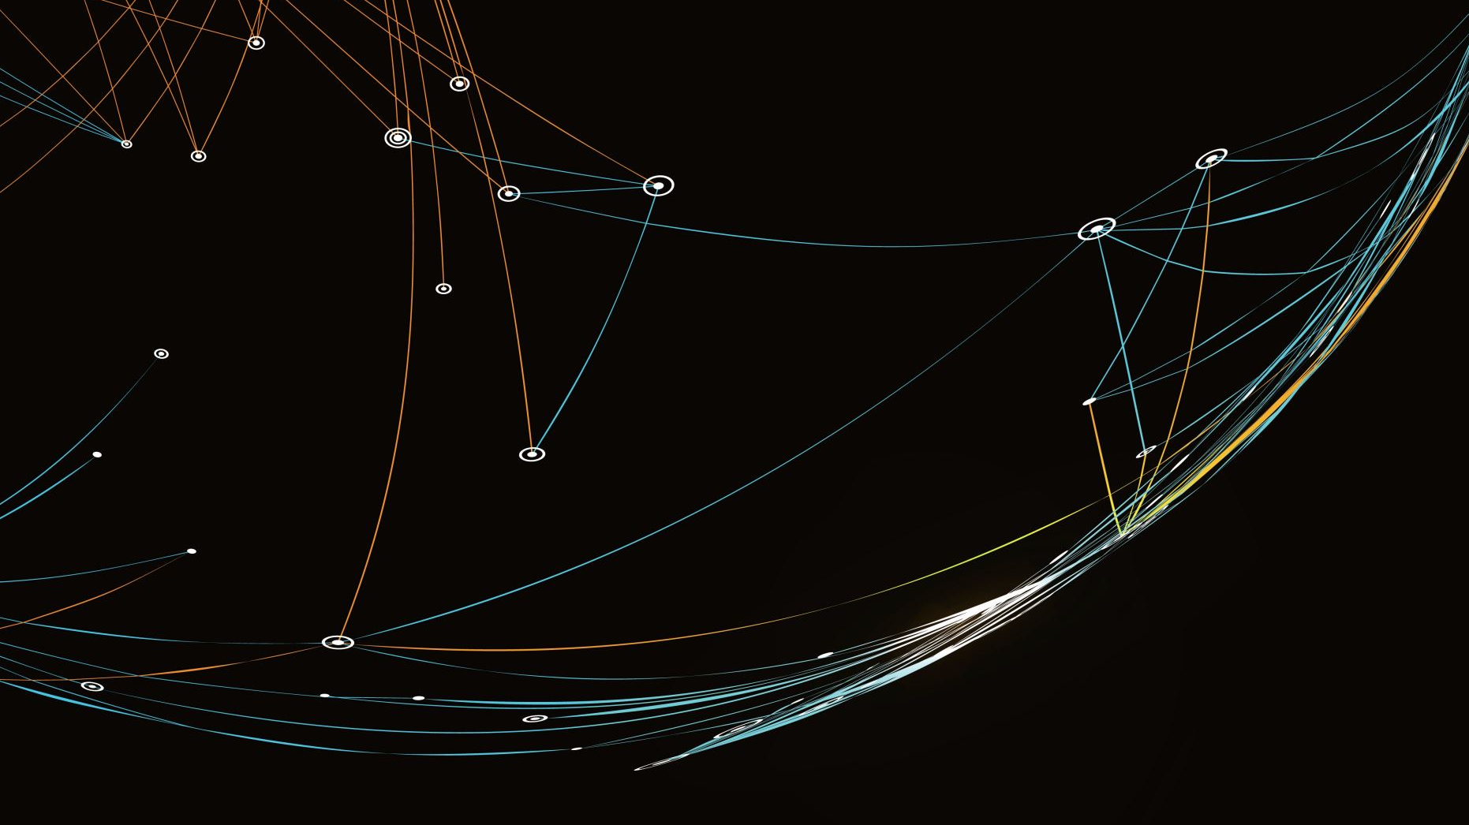
Map Area Calculation from Satellite Photo
Automated Water Body Segmentation & Surface Area Estimation

Slide 2
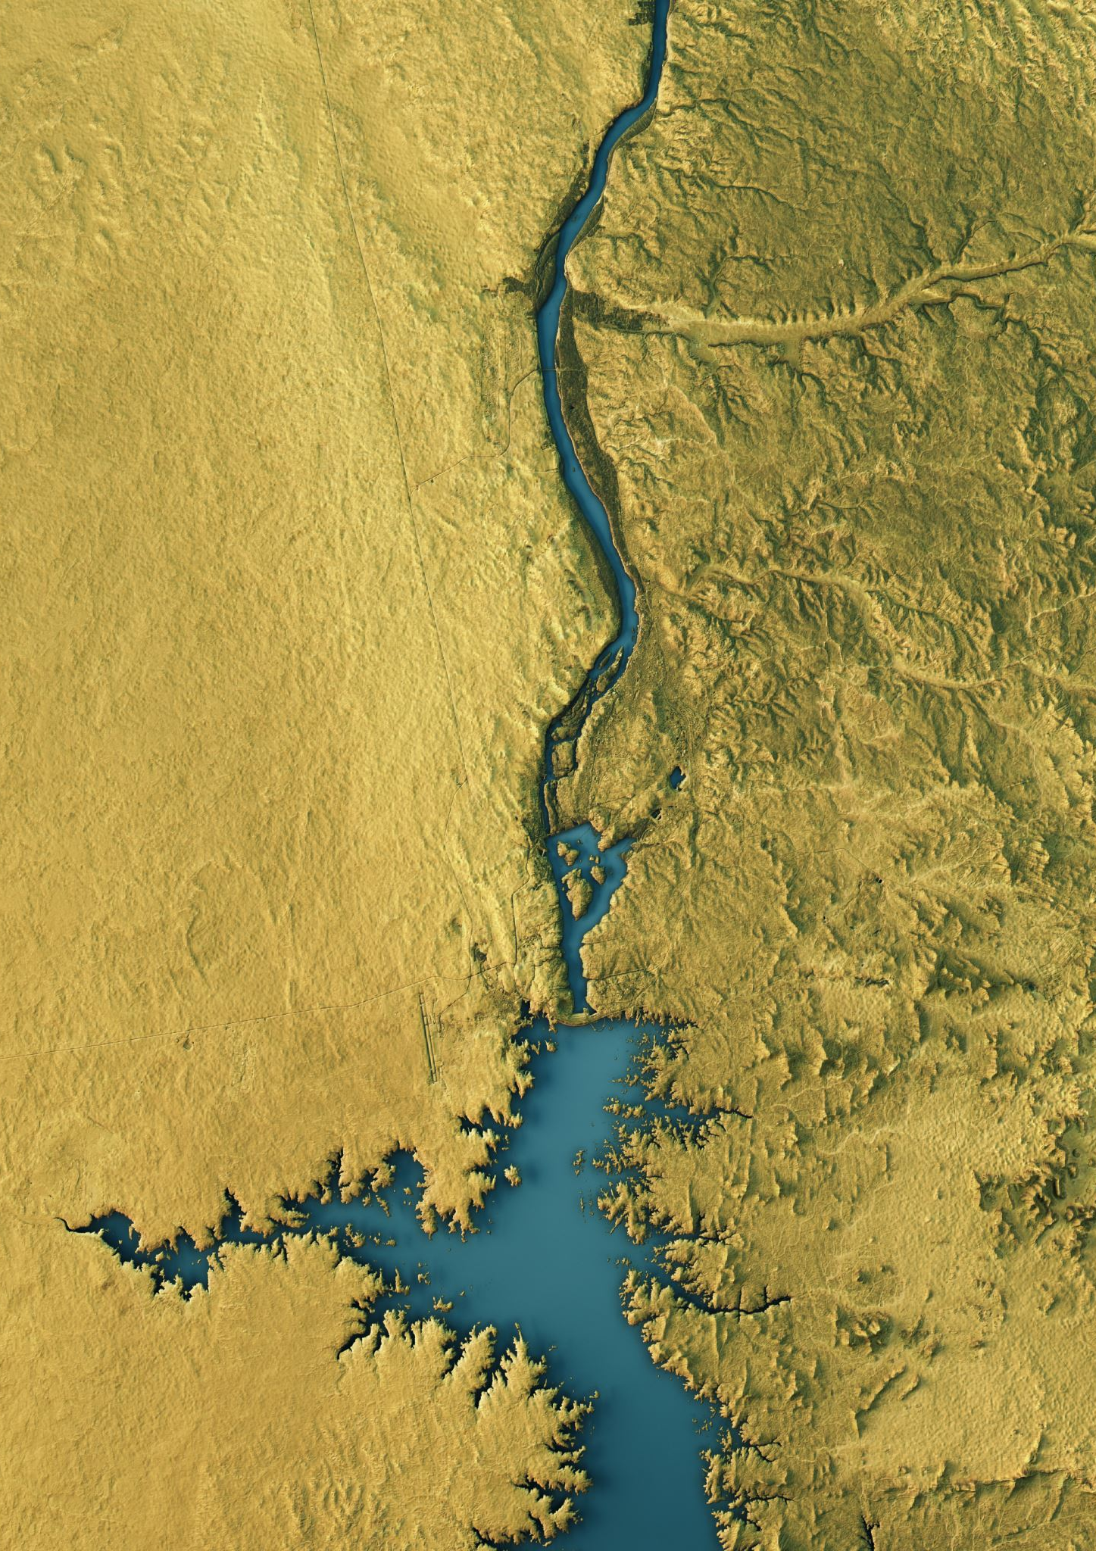
Introduction & Objective
The Goal:
Automate the analysis of Earth’s surface using satellite imagery.
Target Object: Water Bodies (Lakes, Rivers, Reservoirs).
Why Water? Critical resource for environmental monitoring; feasible proof-of-concept for area calculation.
The Challenge:
Manual mapping is slow and prone to human error.
Satellite images vary in lighting, resolution, and color channels.

Slide 3
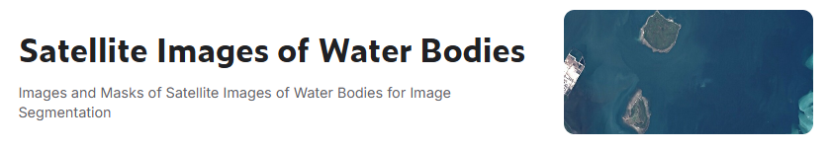
Dataset & Properties
Data Source: Sentinel-2 Satellite Imagery (Kaggle). Ground Sample Distance (GSD): 10 meters per pixel.
This means 1 pixel = 100 square meters of real land.
Inputs:
Images: RGB Satellite Photos.
Labels: Binary Masks (White = Water, Black = Land).

Slide 4
Image Processing Pipeline (OpenCV)
Preprocessing with OpenCV (cv2):
Decoding: cv2.imread() to convert binary files into numerical matrices.
Color Space Conversion:
Problem: OpenCV loads as BGR (Blue-Green-Red).
Solution: cv2.cvtColor(img, cv2.COLOR_BGR2RGB) to match human vision/AI expectations.
3. Dimensionality Reduction:
Loaded Masks as Grayscale (cv2.IMREAD_GRAYSCALE).
Reduces 3D matrix (H x W x 3) to 2D matrix (H x W )
4. Resampling: Bicubic Interpolation to normalize all inputs to 256 x 256.

Slide 5
Model Architecture
Deep Learning Approach: Semantic Segmentation. Architecture: U-Net
Encoder (Backbone): ResNet34 (Pretrained on ImageNet).
Extracts features (shapes, textures, edges).
Decoder: Upsamples features to generate a pixel-perfect mask. Why ResNet34?
Faster convergence than a standard CNN.
Prevents vanishing gradient problem in deep layers.

Slide 6

Methodology - Area Calculation
From Pixels to Kilometers:
The core algorithm converts the segmentation mask into physical units.
Formula:
Given GSD = 10m:
Count non-zero pixels in the predicted mask.
Multiply by 100 (10m x 10m).
Divide by 1,000,000 to convert m^2 to km^2.

Slide 7
Training Configuration
Setup:
Hardware: P100 GPU.
Duration: 50 Epochs.
Batch Size: 32 Images.
Loss Function:
Dice Loss + Binary Cross Entropy (BCE).
Why? Dice Loss prevents the model from ignoring small rivers (Class Imbalance).

Slide 8
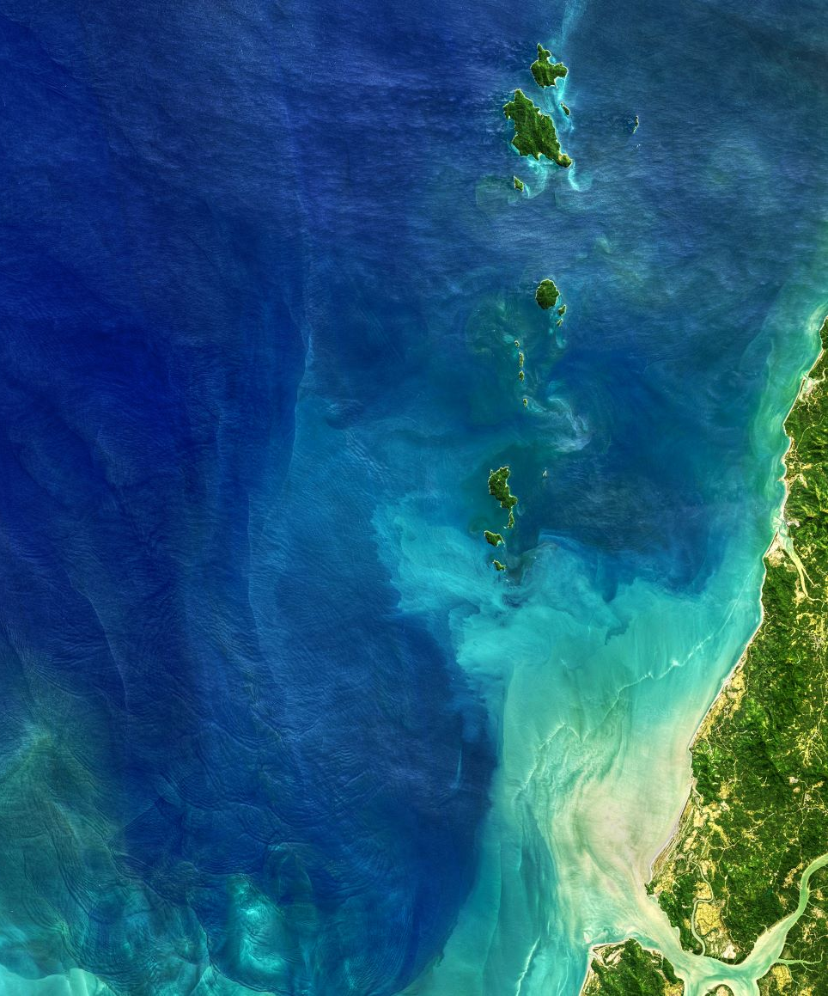
Experimental Results
Performance Metrics (Final Evaluation):
Pixel Accuracy: 94.51%
Validation Loss: 0.1628
Mean IoU (mIoU): 0.8441
Interpretation:
An mIoU of 0.84 is considered State-of-the-Art for satellite segmentation.
The model generalizes well to new, unseen images.

Slide 9
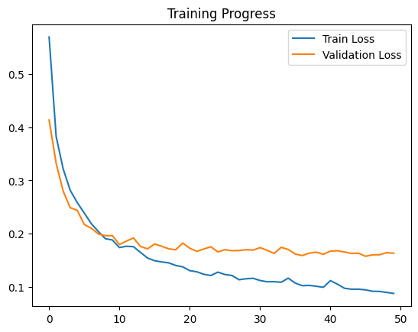
Training Progress and Model Convergence
This figure shows the training and validation loss over successive epochs. Both losses decrease rapidly during the early epochs, indicating that the model effectively learns relevant features for water segmentation from satellite images.
After approximately 10–15 epochs, the validation loss stabilizes while the training loss continues to decrease gradually. This behavior suggests:
Successful model convergence
No severe overfitting
Good generalization to unseen data
The small gap between training and validation loss indicates that the model maintains a balanced learning process and avoids memorizing the training data.

Slide 10
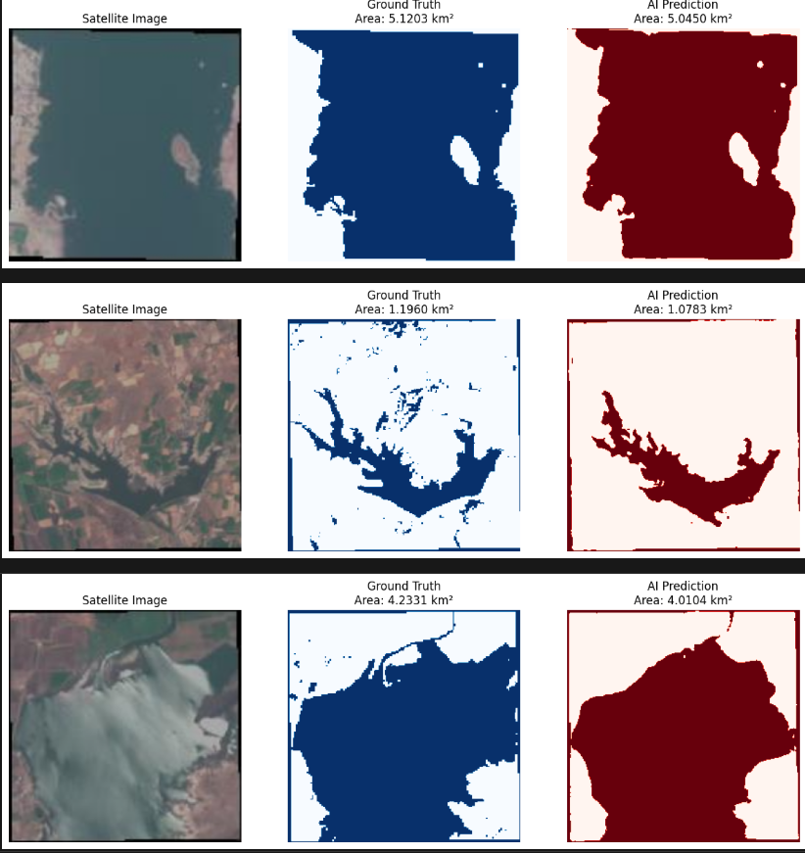
Visual Analysis (Qualitative)
This figure compares satellite images, ground truth water masks, and AI-generated predictions for three different regions. For each sample, the water-covered area (km²) is calculated from both the ground truth and the AI prediction.
The results show that the proposed approach is able to:
Accurately segment water bodies from satellite imagery
Preserve the overall shape and boundaries of water regions
Produce area estimates that are close to the ground truth values
Small differences between ground truth and predictions are mainly caused by:
Irregular shorelines
Thin water branches
Resolution and pixel-level segmentation errors
Overall, the visual and numerical comparisons indicate that the model provides reliable water area estimation while maintaining low error margins.

Slide 11
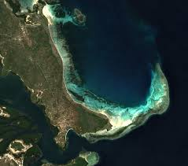
Conclusion & Future Scope
Conclusion:
Successfully automated map area calculation using Deep Learning.
Proven accuracy (0.84 mIoU) and physical measurement reliability.
Future Scope:
Multi-Class: Retrain to detect roads, buildings, and vegetation.
Cloud Removal: Add a preprocessing step to filter out cloud cover.
Real-Time: Deploy as a web app for instant map analysis.

