Slide 1
VerySimpleCPU
Instruction Set Simulator (ISS)
1/7

Slide 2
VerySimpleCPU.exe is an ISS (i.e., simulation model) written in C.
Takes a program file, coded in VerySimpleCPU assembly language, as input,
Reads VerySimpleCPU instructions,
Executes the instructions, and
Writes results on to the command window as well as text files.
Provides a debugging environment for VerySimpleCPU programmers.
How to run:
Download everything through the link at: https://www.dropbox.com/sh/df99f5vrt0wahnw/AAAoo9oXUtwCUq0DKeOjQbg0a?dl=0
Open a cmd window
Type: VerySimpleCPU programFileName.asm then type r
You may also type: VerySimpleCPU programFileName.asm > log then type r
2/7

Slide 3
Input File:
VerySimpleCPU assembly program file
Output Files (in relation to simulation). :
memin.txt: Contains the memory contents before execution of the program.
memoutd.txt: After execution of the program, contains the memory contents in decimal.
memouth.txt: After execution of the program, contains the memory contents in hexadecimal.
In addition, the simulator prints (on the screen) the memory contents before and after execution of each instruction.
3/7

Slide 4
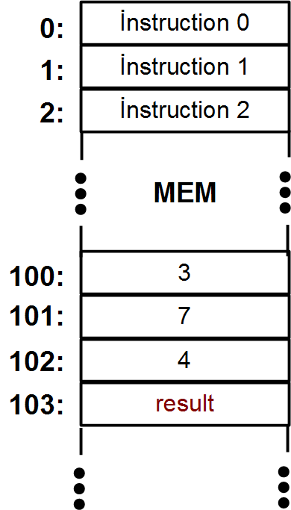
Example: Summation
A code written in a high-level programming language:
*103 = *100 + *101 + *102
Can be also written as
*103 = *100
*103 = *103 + *101
*103 = *103 + *102
3
7
4
4/7

Slide 5
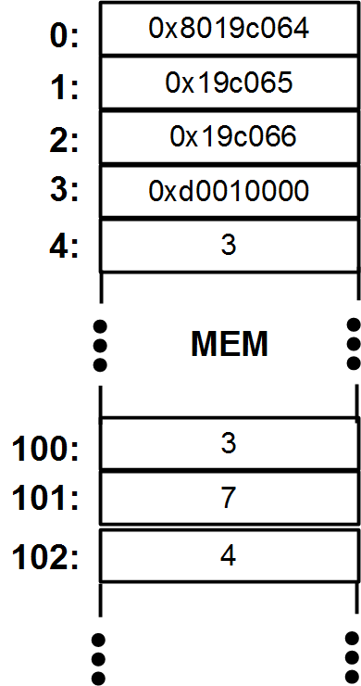
Example: (cont’d)
The program written in VerySimpleCPU assembly language (sample.asm):
0: CP 103 100
1: ADD 103 101
2: ADD 103 102
3: BZJi 4 0
4: 3
100: 3
101: 7
102: 4
5/7

Slide 6
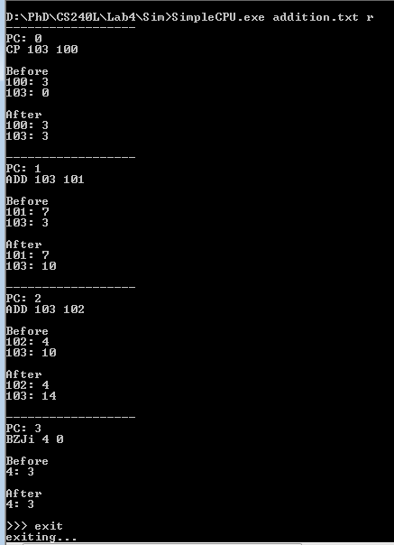
Example: (cont’d)
Running the ISS at command line:
VerySimpleCPU.exe sample.asm r
Output of the simulator
6/7

Slide 7
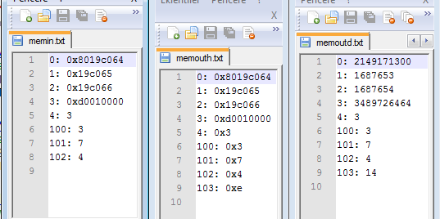
Example: Output Files
7/7

