Slide 1


Kandilli Earthquake Seismic
Data Server and Analysis / SDA
D. Unat, A. S. Balkır, E. Şenay,
C. Özturan
Computer Eng. Dept.
Boğaziçi University, Istanbul, Turkey
M. Yılmazer
Kandilli Observatory and Earthquake
Research Institute,
Boğaziçi Üniversity, Istanbul, Turkey

Slide 2

Agenda
Some Facts About Seismic Data
Project Goals & Why Grid?
Design Architecture
Demo

Slide 3
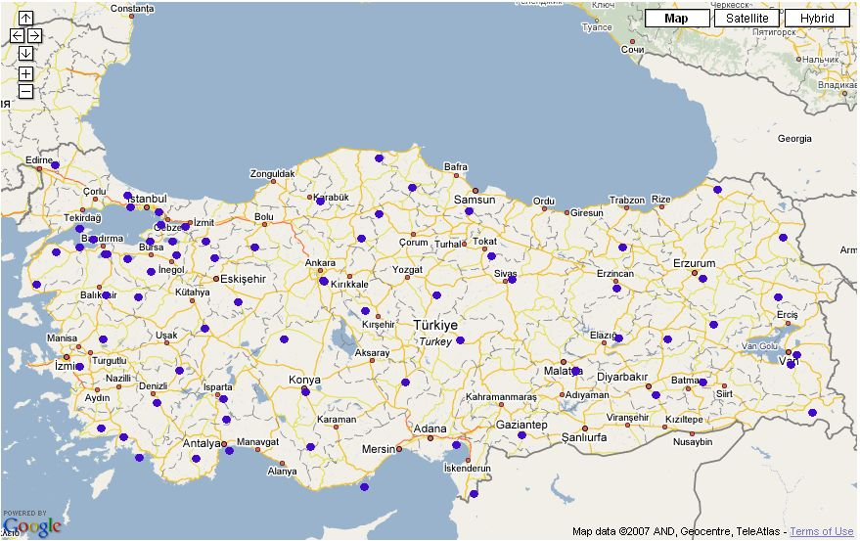
Some Facts About Seismic Data
Data is collected from over 100 stations in Turkey
Data comes in compressed SAC file format
Size of compressed data:
  Hourly : ~75 MB
  Monthly : ~53 GB
  10 Years : ~6.2 TB

Slide 4
Why GRID?
Massive amount of data
  Keeps increasing
Many files
  Over 200 files for each hour
  Easier access
Future GRID applications
  Data readily available
  Functions to access remote data

Slide 5

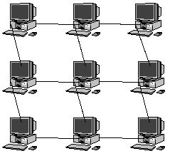
Why GRID?
Single server vs. distributed storage nodes
  Better resource management
  Higher utilization
Kandilli Single Server
GRID
…
…
App.
App.
App.
App.
App.
App.

Slide 6

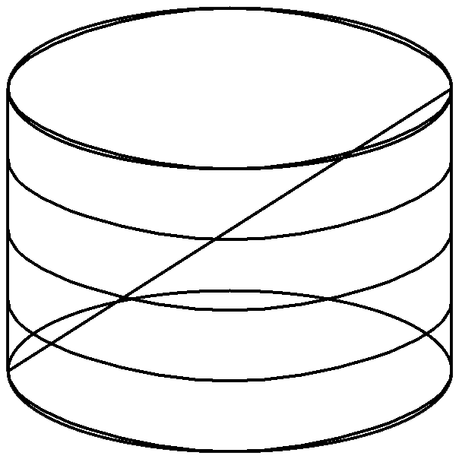


Epicenter App
Cron Job
Run Hourly
Cron Job
Run Hourly
Storage Node
Worker Node
SEE-GRID
Assign Job
Mirror Data
Query
I/O
Database
New Earthquake
Query
Search
Display Results
User
Web Server

Slide 7
Demo
Demo will show the hourly processing and the web query interface
Demo Steps
  Web interface before execution
  Proxy creation
  Job Submission (to seegrid)
  Job execution in RTM
  Web interface after execution
  5.1 Earthquake Results
  5.2 Stations

Slide 8


Slide 9
Questions?

