Slide 1
LODPeas: Like Peas in a LOD (Cloud)
Aidan Hogan, Emir Muñoz, Jürgen Umbrich
Digital Enterprise Research Institute,
National University of Ireland, Galway
(With thanks also to Hugo and Patrick)

Slide 2

Demo …
http://lodpeas.org

Slide 3
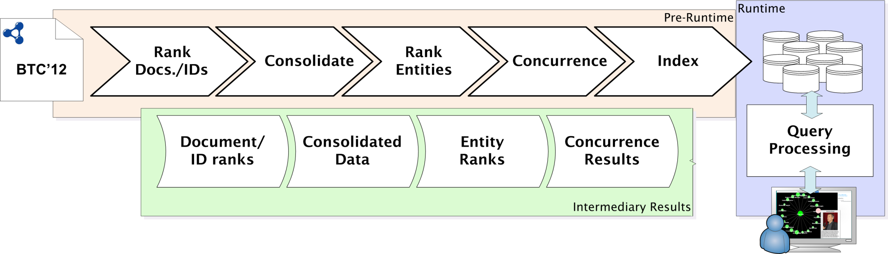
Index Build Phase …
PageRank over documents
Using
owl:sameAs
relations
Sum of document ranks
Based on overlapping
RDF info.
GENERIC RDF PROCESSING METHODS!

Slide 4
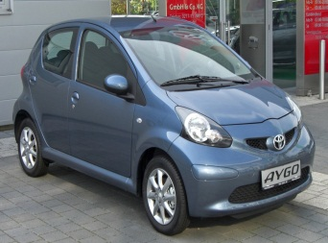
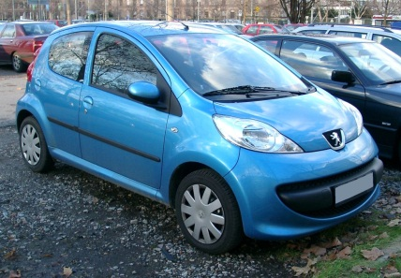
Concurrence …
(3)
dbpedia:Kolín
assembly
(10)
assembly
2340.0
wheelbase
wheelbase
…
dbpedia:Toyota_Aygo
dbpedia:Peugeot_107
related
(2)
related
dbpedia:Citroen_C1
(2)
(3)
(10)
0
1
= 0.5
= 0.66
= 0.73

Slide 5
BTC Criteria …
Uses all of BTC ’12!
End-user application!
Applies for various domains!
Generic RDF processing!
Scalable processing techniques!
Robust … works for diverse Web data!
Merges data from multiple domains!
(“owl:sameAs ≠ the end of the world” —Aidan)
No support for inserts yet.
Noisy data still rears its ugly head … missing labels, grr.
Keyword search still needs tweaking.
http://lodpeas.org

