Slide 1







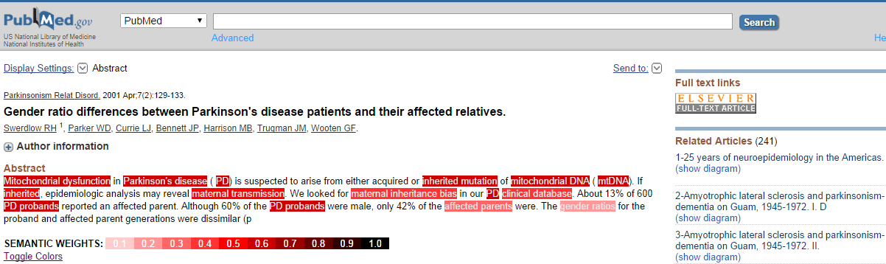
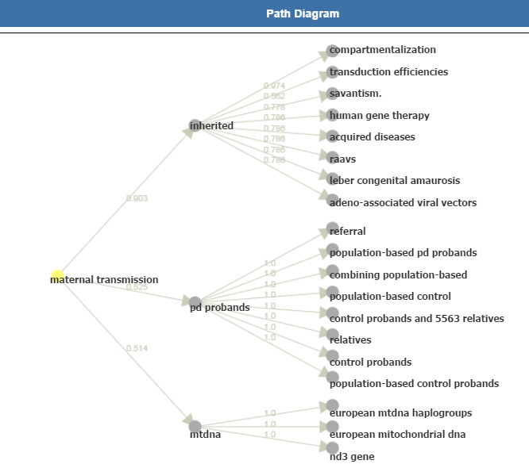

SemanTex: Semantic Text Exploration Using
document Links Implied by Conceptual Networks
Suad Aldarra(FI^{*1}), Emir Muñoz(FI^{*1}), Pierre-Yves Vandenbussche (FI^{*1}), Vít Nováček (Insight^{*2})
Summary
- Automatic method for computing semantic links between documents
- Provide the conceptual paths (explanation) between two documents
- Allow topical navigation within and through documents
- Application to biomedical literature (PubMed) Parkinson Disease article
Method
1. Noun-Phrase extraction
(Using Biomedical Named Entity recognition)
2. Co-occurrence Relationship computation
(Using Point wise Mutual Information)
3. Cosine similarity computation
Conceptual Network
Extraction
r
x
u
t
y
Conceptual Network
v
4. Extraction of paths between all nodes
and between all documents
(Using path length and product
of the edges weight threshold)
5. Multi-objective optimization
-Complexity
-Coherence
-Entropy
r
t
x
(B,C)
(D)
y
(A,B)
u
v
(D)
Paths Extraction
and Selection
(C,D)
(C)
Most relevant Paths from x
x
u
v
y
x
r
t
Most relevant Paths between documents A and D
Implementation and Evaluation
- Experimentation on 4722 abstracts from PubMed Parkinson disease related articles that led to the extraction of 43,362 concepts and xxx most relevant paths (among xxx paths possible)
- Possible Evaluation?
Application to PubMed abstracts
Most relevant paths from
“maternal transmission” concept
(*1) Fujitsu Ireland Limited
(*2) Insight @ NUI Galway

