Slide 1
SRS

Slide 2
What is SRS?
An SRS is basically an organization’s understanding (in writing) of a customer or potential client’s system requirements and dependencies at a particular point in time (usually) prior to any actual design or development work. It’s a two-way insurance policy that assures that both the client and the organization understand the other’s requirements from that perspective at a given point in time.

Slide 3
A well-designed, well-written SRS accomplishes four major goals:
It provides feedback to the customer. An SRS is the customer’s assurance that the development organization understands the issues or problems to be solved and the software behavior necessary to address those problems. Therefore, the SRS should be written in natural language (versus a formal language, explained later in this article), in an unambiguous manner that may also include charts, tables, data flow diagrams, decision tables, and so on.
It decomposes the problem into component parts. The simple act of writing down software requirements in a well-designed format organizes information, places borders around the problem, solidifies ideas, and helps break down the problem into its component parts in an orderly fashion.
It serves as an input to the design specification. As mentioned previously, the SRS serves as the parent document to subsequent documents, such as the software design specification and statement of work. Therefore, the SRS must contain sufficient detail in the functional system requirements so that a design solution can be devised. It serves as a product validation check. The SRS also
It serves as the parent document for testing and validation strategies that will be applied to the requirements for verification.

Slide 4
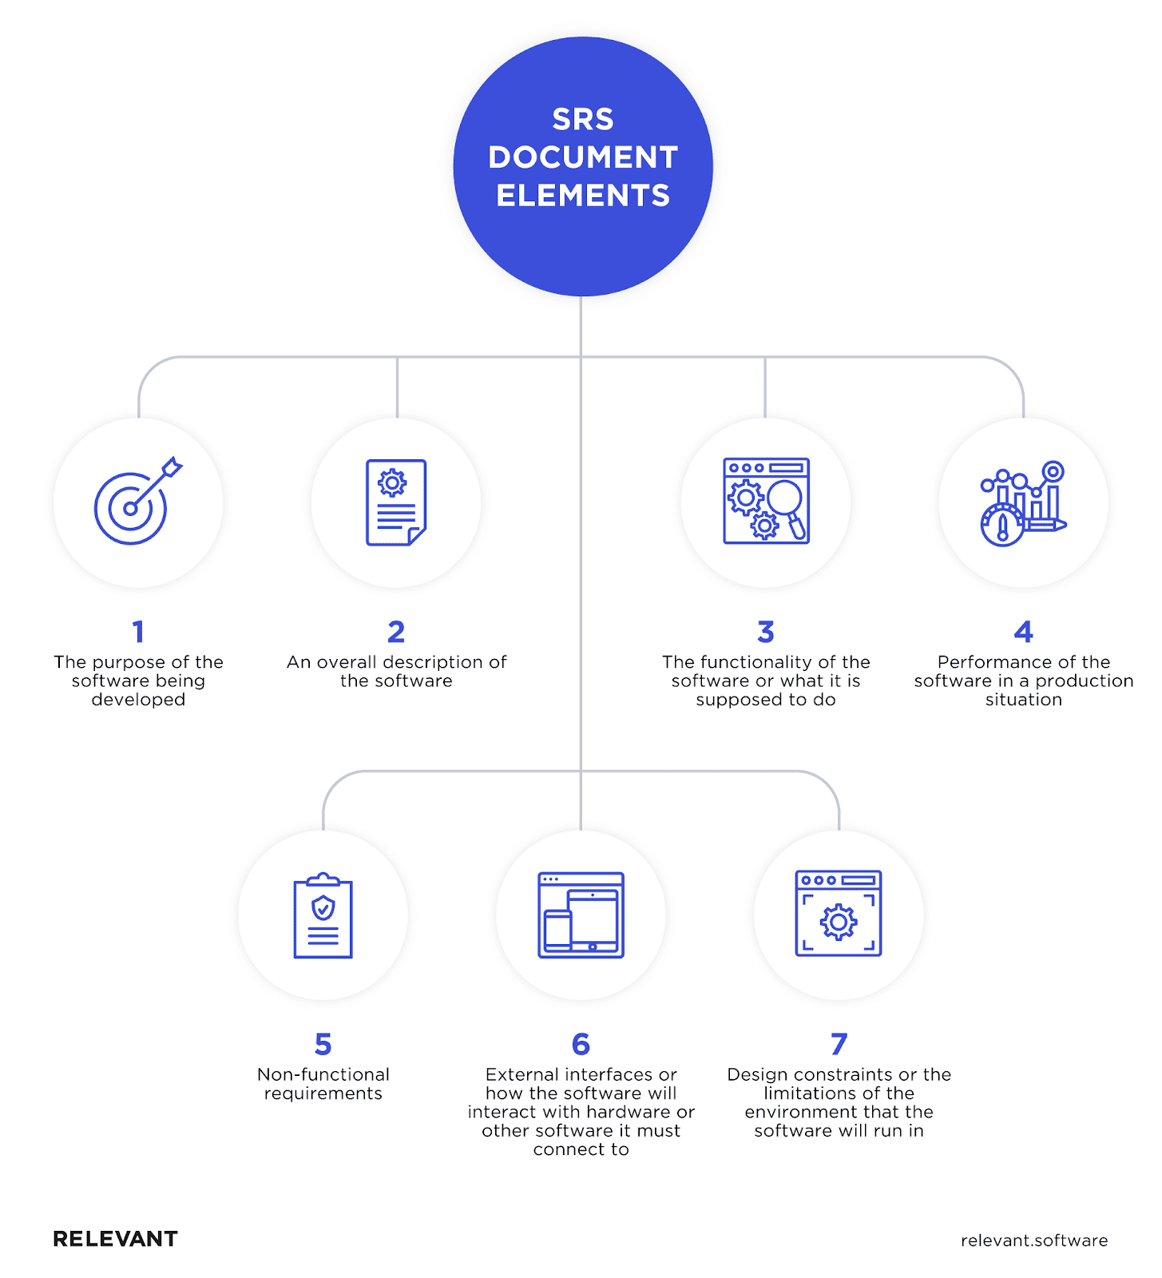

Slide 5
SRS Quality Characteristic | What It Means
Complete | SRS defines precisely all the go-live situations that will be encountered and the system’s capability to successfully address them.
Consistent | SRS capability functions and performance levels are compatible, and the required quality features (security, reliability, etc.) do not negate those capability functions. For example, the only electric hedge trimmer that is safe is one that is stored in a box and not connected to any electrical cords or outlets.
Accurate | SRS precisely defines the system’s capability in a real-world environment, as well as how it interfaces and interacts with it. This aspect of requirements is a significant problem area for many SRSs.
Modifiable | The logical, hierarchical structure of the SRS should facilitate any necessary modifications (grouping related issues together and separating them from unrelated issues makes the SRS easier to modify).
Ranked | Individual requirements of an SRS are hierarchically arranged according to stability, security, perceived ease/difficulty of implementation, or other parameter that helps in the design of that and subsequent documents.
Testable | An SRS must be stated in such a manner that unambiguous assessment criteria (pass/fail or some quantitative measure) can be derived from the SRS itself.
Traceable | Each requirement in an SRS must be uniquely identified to a source (use case, government requirement, industry standard, etc.)
Unambiguous | SRS must contain requirements statements that can be interpreted in one way only. This is another area that creates significant problems for SRS development because of the use of natural language.
Valid | A valid SRS is one in which all parties and project participants can understand, analyze, accept, or approve it. This is one of the main reasons SRSs are written using natural language.
Verifiable | A verifiable SRS is consistent from one level of abstraction to another. Most attributes of a specification are subjective and a conclusive assessment of quality requires a technical review by domain experts. Using indicators of strength and weakness provide some evidence that preferred attributes are or are not present.

Slide 6
Outline
1. Introduction
1.1 Purpose
1.2 Scope
1.3 Definitions, Acronyms, and Abbreviations
1.4 References
1.5 Overview
2. General Description
2.1 Product Perspective
2.2 Product Functions
2.3 User Characteristics
2.4 General Constraints
2.5 Assumptions and Dependencies
3. Specific Requirements
3.1.External Interface Requirements
3.1.1 User interfaces
Wireframes will be added here. 3.1.2 Hardware interfaces 3.1.3. Software interfaces 3.1.4. Communication interfaces
3.2.Functional Requirements
Use-case diagram will be added here.
Data Model will be added here
3.2.1. Feature 1
3.2.1.1 Description and Priority
Related Activity Diagram will be added here
3.2.1.2 Stimulus/Response Sequences
3.2.1.3 Functional Requirements for Feature1
3.2.2. Feature n
3.2.2.1 Description and Priority
Related Activity Diagram will be added here
3.2.2.2 Stimulus/Response Sequences
3.2.2.3 Functional Requirements for Feature n
4. Other Non-functional Requirements
4.1 Performance Requirements
4.2 Security Requirements
4.3 Software Quality Attributes

Slide 7
1. Introduction
The Software Requirement Specification(SRS) document provides an overview of the entire SRS.
Purpose:
Identify the purpose of SRS and its intended audience.
Scope:
Identify the software products to be produced by name.
Explain what the software products will, and, if necessary, will not do.
Describe the application of the software being specified, including relevant benefits, objective and goals
Be consistent with similar statement in higher level specification if the exist.

Slide 8
Introduction CONTD……………….
Definition, Acronyms, and Abbreviations:
Provide definition of all terms, acronyms, and abbreviations required to properly interpret the SRS.
This information may be provided by reference to an appendix.
References:
Provide complete list of all documents referenced elsewhere in the SRS.
Identified each document by title, report number, date, and publishing organization.
Specify the sources from which the reference can be obtained.

Slide 9
Introduction CONTD……………….
Overview:
Describe what the rest of the SRS contains.
Explain how the SRS is organised.

Slide 10
2. The general description
Describe the general factors that affects the product and its requirements.
Product Perspective:
Put the product into perspective with other related products.
If the product is independent and totally self-contained, it should be so stated here.
If the SRS defines a product that is a component of a larger system, as frequently occurs, then it relates the requirements of the larger system to functionality of the software and identifies interfaces between that system and the software.

Slide 11
Product function
Provide a summary of the major functions that the software will perform.
The function should be organised in a way that makes the list of functions understandable to the customer or to any one else reading the document for the first time.
Textual or graphic methods can be used to show the different function and their relationship.

Slide 12
User characteristics
Describe those general characteristic of the intended users of the product including educational level, experience, and technical expertise

Slide 13
constraints
Provide a general description of any other items that will limit the developer’s options. These can include:
Regulatory Policies
Hardware Limitation
Interface to other Application
Parallel Operation
Audit Function
Control Function
Higher Order Language Requirements
Signal Handshake Protocols
Reliability Requirements
Criticality of the Application
Safety and Security Considerations

Slide 14
Assumption and dependencies
List each of the factors that affects the requirements stated in SRS
These factors are not designed constraints on the software but, any change to them may that can affect requirements in SRS.

Slide 15
Apportioning of requirements
Identify requirements that may be delayed until future version of the system.

Slide 16
Specific Requirements - External interface
This contains a detailed description of all the input into and output from the software system.
It contains both content and format as follow:
Name of item
Description of purpose
Source of input or destination of output
Valid range, accuracy and tolerance
Units of measure
Timing
Relationship to other Input/Outputs
Screen formats
Window formats
Data formats
Command formats
End message

Slide 17
Specific Requirements - External Interface Requirements
The following subsection describe how the software operates inside various constraints:
System Interface:
List each system interface and identify the functionality of the software to accomplish the system requirement.
And the interface description to match the system.

Slide 18
Specific Requirements - External Interface Requirements
User Interfaces:
This should specify:
(1) The characteristics that the software must support for each human interface to the software product. For example, if the user of the system operates through a display terminal, the following should be specified:
(a) Required screen formats
(b) Page layout and content of any reports
(c) Relative timing of inputs and outputs (d) Availability of some form of programmable function keys
(2) All the aspects of optimizing the interface with the person who must use the system. This may simply comprise a list of do’s and don’ts on how the system will appear to the user. One example might be a requirement for the option of long or short error messages. Like all others, these requirements should be verifiable.

Slide 19
Specific Requirements - External Interface Requirements
Hardware Interfaces:
This should specify the logical characteristics of each interface between the software product and the hardware components of the system. It also covers such matters as what devices are to be supported, how they are to be supported, and protocols. For example, terminal support might specify full screen support as opposed to line by line.

Slide 20
Specific Requirements - External Interface Requirements
Software interfaces:
This should specify the use of other required software products (for example, a data management system, an operating system, or a mathematical package), and interfaces with other application systems (for example, the linkage between an accounts receivable system and a general ledger system).
For each required software product, the following should be provided:
(1) Name
(2) Mnemonic
(3) Specification number
(4) Version number
(5) Source For each interface,
this part should:
Discuss the purpose of the interfacing software as related to this software product.
(2) Define the interface in terms of message content and format. It is not necessary to detail any well documented interface, but a reference to the document defining the interface is required.

Slide 21
Specific Requirements - External Interface Requirements
Communication Interfaces:
Specify the various interfaces to communications such as local network protocols, etc.
Memory constraints:
Specify any applicable characteristics and limits on primary and secondary memory.

Slide 22
Specific Requirements - External Interface Requirements
Operations:
Specify the normal and special operations required by the users such as:
The various mode of operation in the user organization.
Periods of interactive operations and periods of unattended operations.
Data processing support functions
Backup and recovery operations

Slide 23
Specific Requirements - External Interface Requirements
Site Adaption Requirements:
Define the requirement for any data or initialization sequences that are specific to a given site, mission, operational mode.
Specify the site or mission related feature that should be modified to adapt the software to a particular installation.

Slide 24
Specific Requirements – Functional
Specific requirements should be stated with all the characteristics of the good SRS.
Correct
Unambiguous
Complete
Consistent
Ranked for importance and stability
Verifiable
Modifiable
Traceable
Specific requirement should be cross-referenced to earlier documents that relate.
All requirements should uniquely identifiable.
Careful attention should be given to organising the requirement to maximize readability.

Slide 25
Specific Requirements – Functional
Functional requirements defines the fundamental action that must take place in software in accepting and processing the inputs and in processing and generating the outputs. These includes:
Validity checks on the inputs
Exact sequence of operations
Response to abnormal situation, including
Overflow
Communication facilities
Error handling and recovery
Effects of parameters
Relationship of output to inputs, including
Input/output Sequences
Formulas for input to output conversion.

Slide 26
NonFunctional - Performance Requirements
This subsection specifies both the static and the dynamic numerical requirements placed on the software.
Static numerical requirements may include:
The number of terminals to be supported.
The number of simultaneous users to be supported.
Amount and types of information to be handled.
Dynamic numerical requirements may include:
Number of transactions and tasks and the amount of data to be processed within certain time periods for both normal and peak workload conditions.

Slide 27
NonFunctional – Quality attributes
There are a number of quality attribute of software that can serve as requirements.
Reliability:
Specify the factor required to establish the required reliability of the software system at time of delivery.
Availability:
Specify the factors required to guarantee a defined availability level for the entire system such as check point, recovery and restart.

Slide 28
NonFunctional – Quality attributes contd……
Security:
Specify the factor that would protect the software form accidental or malicious access, use, modification, destruction. This may include need to:
Utilizing certain cryptographic techniques
Keep specific lo or history data sets
Assign certain functions to different modules
Restrict communication between some areas of the program
Check data integrity for critical variable

Slide 29
NonFunctional – Quality attributes contd……
Maintainability:
Specify attribute of software that relate to the ease of maintenance of software itself.
There may be some requirement for certain modularity, interface, complexity, etc.
Portability:
Specify attributes of software that relates to the ease of parting the software to other host machine and operating systems. This may include:
Percentage of component with host dependent code
Percentage of code that is host dependent
Use of a proven portable language
Use of a particular compiler
Use of a particular operating system.

Slide 30
Organising the specific requirements contd…
Feature:
A feature is an externally desired service by the system that may require a sequence of inputs to effect the desired result.
Each feature is described as sequence of stimulus-response pairs.
Stimulus:
Some system can be best organised by describing their functions in terms of stimuli.
Response:
Some system can be best organised by describing their function in support of the generation of the response.

Slide 31
Change Management Process:
Specify the change management process to be used to identify, log, evaluate, and update the SRS to reflect changes in project scope and requirement.

Slide 32
Document approval
Identify the approvers of the SRS documents. Approver’s name, signature, and date should be used.

Slide 33
Supporting information
The supporting information makes the SRS easier to use. It includes:
Table of contents
Index
Appendices

