Slide 1
Software Project Management
Dr. Sevgi Koyuncu Tunç

Slide 2
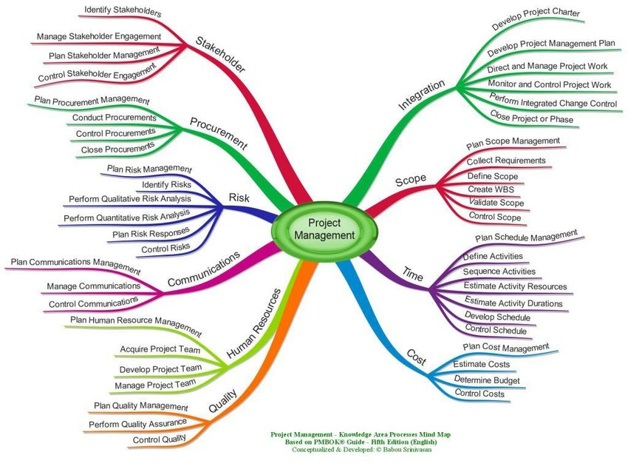

Slide 3
What is a Project? “A temporary endeavor undertaken to create a unique product, service or result.”
Goals
What are you trying to achieve?
Timeline
When are you trying to achieve it by?
G
T
Who are the players?
Stakeholders
How much will it cost to achieve it?
Budget
S
B
Notes:
Benzersiz bir ürün, hizmet veya sonuç yaratmak için gösterilen geçici çaba.
Kurumsal
Ürün bazlı

Slide 4
Project
A project is set up to achieve a specific objective
A project is something that does not last forever
A project would have a specific start date
A project may have a specific end date or a delivery deadline
A project generally consists of completing a number of tasks
A project generally involves a budget
A project will have people involved - in the form of teams

Slide 5
Non-projects
Running the daily operations of your company
Doing regular maintenance work on a product
Daily backup of the database
Billing clients

Slide 6
What is Project Management?
Project management is the practice of applying knowledge, skills, tools, and techniques to complete a project according to specific requirements.
It includes identifying the problem, creating a plan to solve the problem, and then executing on that plan until the problem has been solved.
Notes:
The roots of project management can be traced as far back as the building of the Pyramids in Giza and the Great Wall of China. However, the modern development of project management began in the 19th century when railway companies purchased tons of raw material and employed thousands of people to work on the transcontinental railroad.
By the early 20th century, Frederick Taylor applied concepts of project management to the work day, developing strategies for working smarter and improving inefficiencies, rather than demanding laborers work harder and longer. Henry Gantt, an associate of Taylor’s, took those concepts and used bars and charts to graph when certain tasks, or a series of tasks were completed, creating a new way to visualize project management.
During World War II, military and industrial leaders were employing even more detailed management strategies, eventually leading to more standardized processes like the critical path method.
These practices grew in popularity across industries, and in 1965 and 1969, the International Project Management Association and Project Management Institute were founded, respectively. In 2001, Agile project management methodologies were codified by the creation of the Agile Manifesto.

Slide 7
Project Constraints
TIME
(fast)
COST
(cheap)
SCOPE
(complete)
QUALITY
(good)

Slide 8
21%
X28
80%
of companies have standardized project management systems like waterfall and agile in place.
2.5%
of companies successfully complete 100% of their projects.
Companies that develop project management practices save 28 times more money than those that do not
of employees spend half of their workweek on “rework” caused by poor communication
(sources: Gallup, Wellingtone, PMP Gartner, PMI, UM Saint Louis)

Slide 9
Program Management
Portfolio Management
-Business Goal & Value Alignment
-Program Selection
-Portfolio Optimization
Program Management
-Multiple Projects
-Align Projects with overall Program Benefit
-Compliance with PM Standards
Project Management
-Delivery of product/Service
-Scope/Cost/Schedule
-Quality Deliverables

Slide 10
Brief History of Project Management
1917
Gannt Chart
1989
PRINCE Methodology
1968
Agile Methodology
1
3
5
2
4
6
1969
Project Management Institute
1957
Critical Path
Methodology
2006
Total Cost Management Framework
Notes:
The roots of project management can be traced as far back as the building of the Pyramids in Giza and the Great Wall of China.
However, the modern development of project management began in the 19th century when railway companies purchased tons of raw material and employed thousands of people to work on the transcontinental railroad.
By the early 20th century, Frederick Taylor applied concepts of project management to the work day, developing strategies for working smarter and improving inefficiencies, rather than demanding laborers work harder and longer. Henry Gantt, an associate of Taylor’s, took those concepts and used bars and charts to graph when certain tasks, or a series of tasks were completed, creating a new way to visualize project management.
During World War II, military and industrial leaders were employing even more detailed management strategies, eventually leading to more standardized processes like the critical path method.
These practices grew in popularity across industries, and in 1965 and 1969, the International Project Management Association and Project Management Institute were founded, respectively. In 2001, Agile project management methodologies were codified by the creation of the Agile Manifesto.
PRINCE2 stands for PRojects IN Controlled Environments. PRINCE2® is a globally recognised qualification, endorsed by the UK government, and best practice for project management. In fact, not only is it the number one benchmark of capability within the industry, it's also considered a key qualification for those looking to progress their project management careers.
Cost engineering is "the engineering practice devoted to the management of project cost, involving such activities as estimating, cost control, cost forecasting, investment appraisal and risk analysis."^{[1]} "Cost Engineers budget, plan and monitor investment projects. They seek the optimum balance between cost, quality and time requirements.

Slide 11
Project Management Phases & Activities
Initiation
Planning
Execution
Controlling & Monitoring
Project Closure
Define project scope constraints, goals, budget & deadlines
Identify stakeholders
Identify technical requirements(WBS)
Create a project plan/schedule (estimations,tasks,resources)
Create a communication plan
Setting up deliverables
Develop a resource plan
Define performance measures
Build out workflows
Anticipate risks
Monitor project performance
Risk management
Perform status
meetings and reports
Update project schedule
Modify project plans
Track the effort and cost
Kick-off meeting
Establish efficient workflows
Carefully monitor the progress of the team
Maintain effective collaboration
Handover Deliverables
Get Project approval
Document Project learnings

Slide 12
Project Management Methodologies
Software Delivery Life Cycle

Slide 13
Project Life Cycle Types - Predictive
Project scope, time and cost is determined in detail at the beginning of the project.
project is split up into phases which can be either sequential or overlapping.
Planning can be done for the entire project at a detailed level from the beginning of the project
Waterfall is a predictive method
Requirements
Design
Development
Testing
Deployment
Maintenance

Slide 14
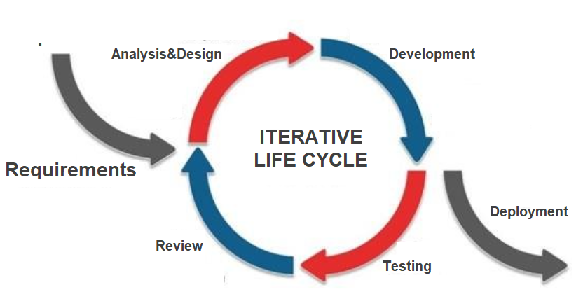
Project Life Cycle Types - Iterative
Requirements are dynamic & the scope is not fully determined, only for the first phase of the project.
Once that phase is completed, the detailed scope of the next phase is worked out.
Not necessarily releasing something but getting feedback on a regular basis, refining continuously on each iteration, usually every two to four weeks and still delivering one product at the end.
Iterative life cycles are essentially prototyping or proof-of-concept where each new prototype yields new stakeholder feedback and team insights.

Slide 15
Project Life Cycle Types - Adaptive
The detailed scope is only determined for the current iteration or phase of the project.
The phases or iterations are more rapid than in the iterative life cycle (2 or 4 weeks).
During the iteration, the scope is decomposed into a set of requirements (deliverables) and the work to be done to meet those requirements (often called the product backlog) is prioritized.
At the end of the iteration, the work on the product is reviewed by the customer, and the feedback from the customer is used to set the detailed scope of the next iteration.

Slide 16
Project Life Cycle Types - Adaptive
We know that things are going to change, and we’re prepared for adapting the changes.
Agile is an adaptive methodology
Develop
Test
Develop
Test
Develop
Test
Deploy
Deploy
Deploy
Sprint1
Review
Sprint 2
Review
Sprint n
Review
Design
Design
Design
Launch
Launch
Launch
Plan Sprint 1
Plan Sprint 2
Launch
Plan Sprint 3
Launch
Plan Sprint n+1
Launch

Slide 17
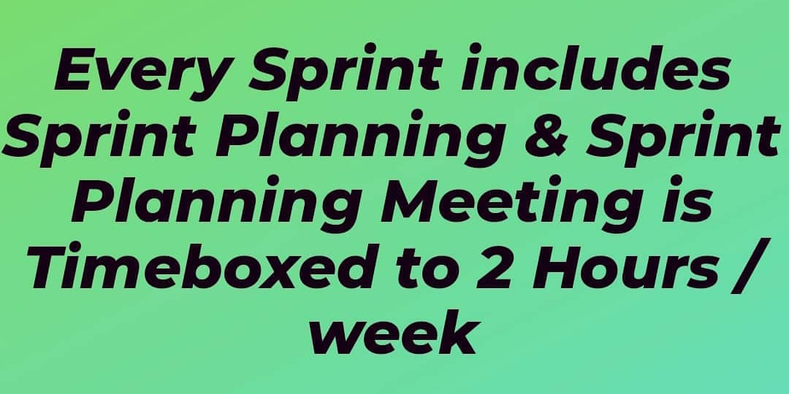
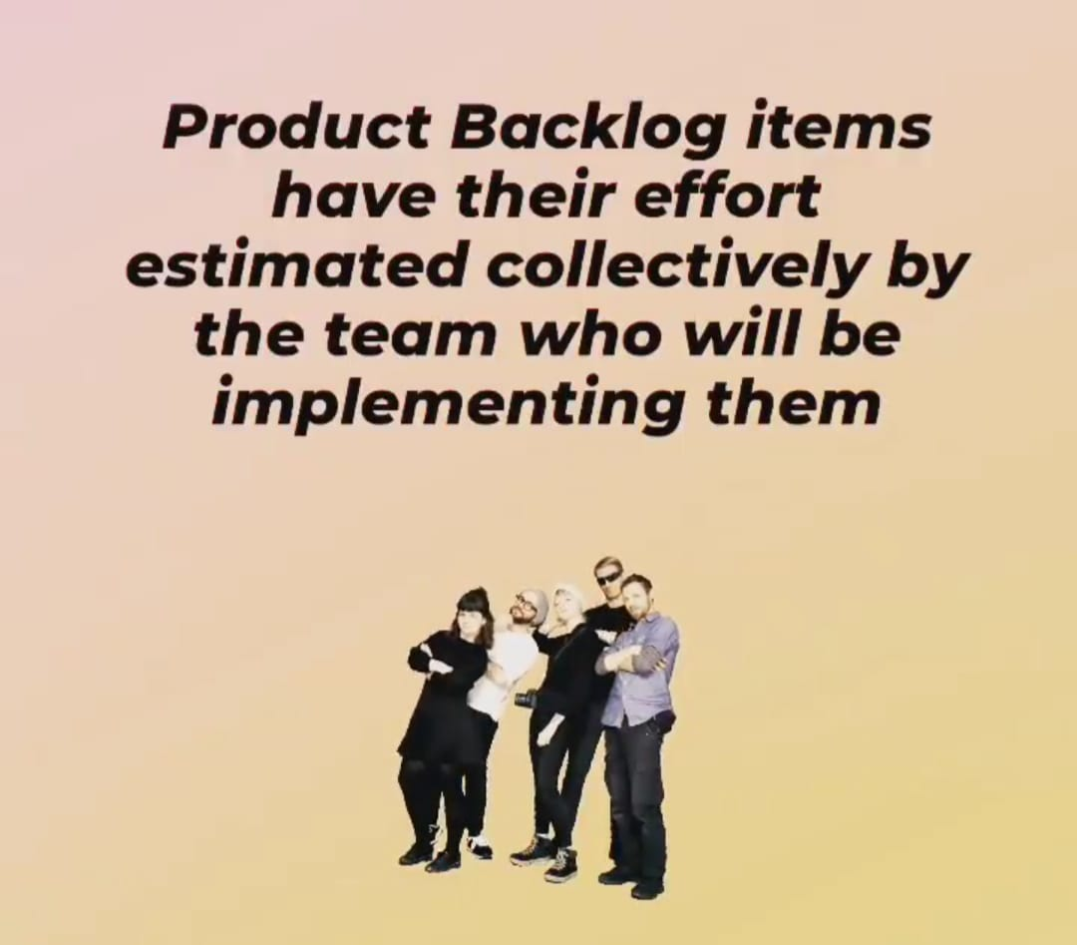
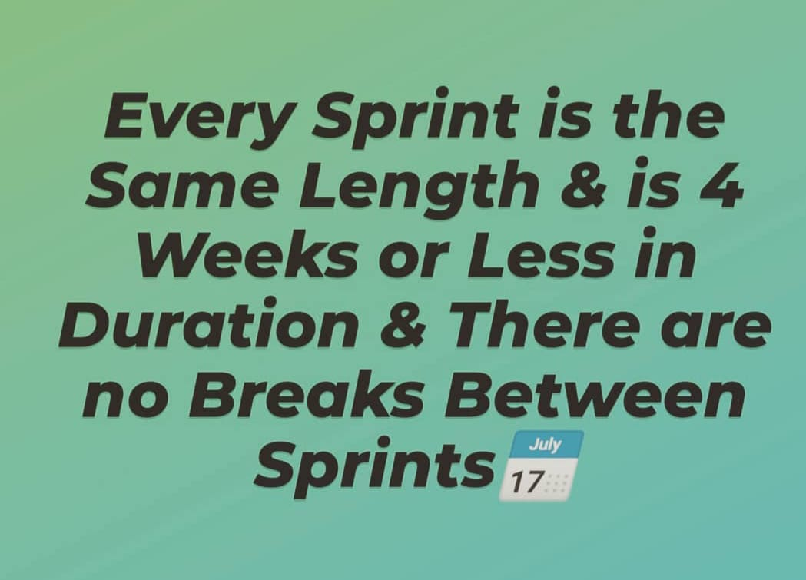
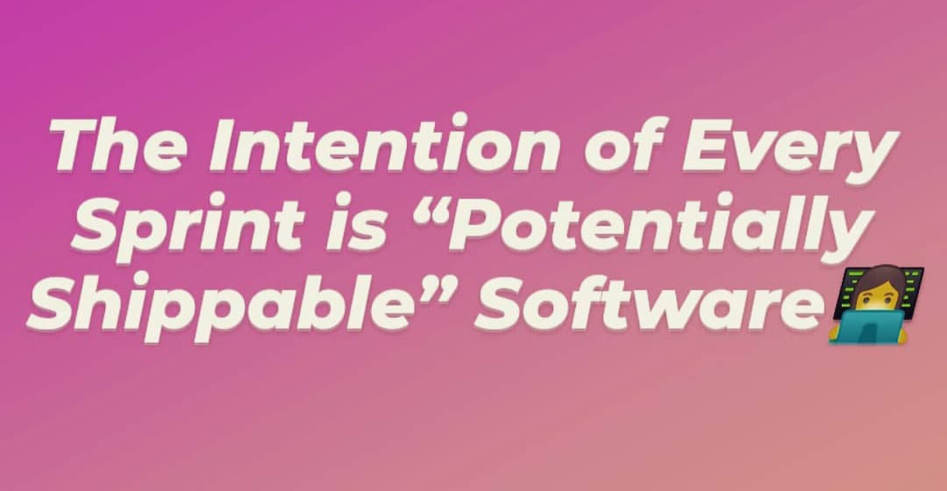
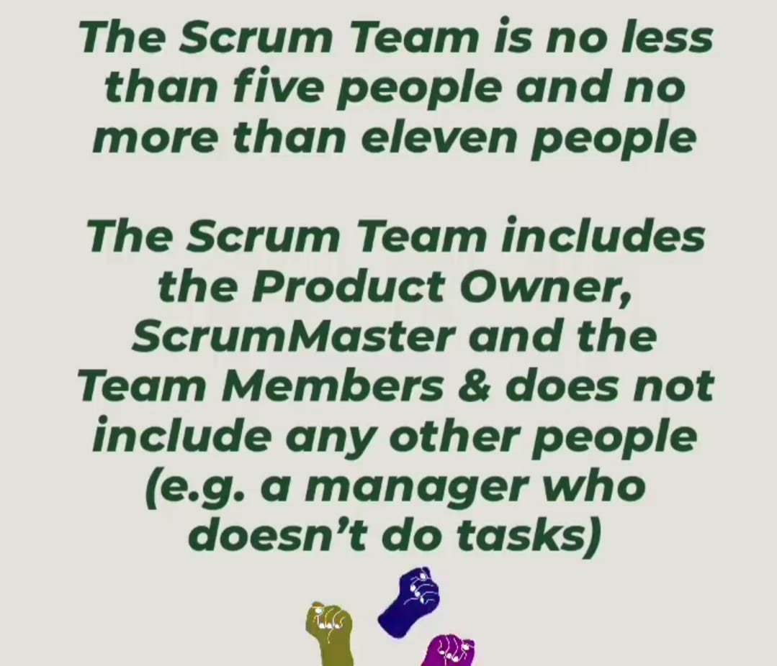
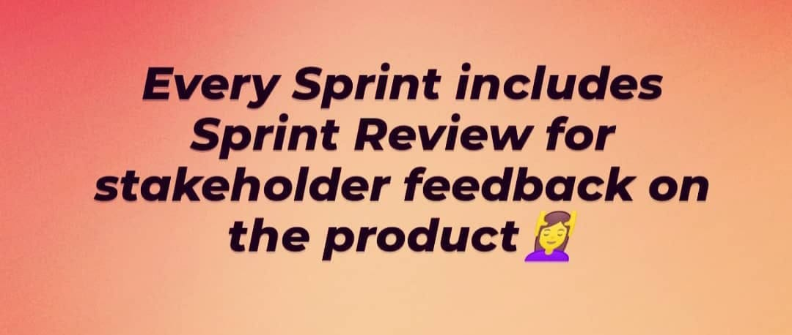
AGILE-SCRUM

Slide 18
Agile - SCRUM
Process:
Transparent
Auditable
Adaptive
Roles:
Product Owner: Define & Prioritise & Check Features
Scrum Master: Plan Sprints, Manage Process
Team: Groom & Estimate Goals, Develop&Test Code
Manifesto:
Small Teams & Interaction rather than tool&processes
A Running product rather than documentation
Collaboration with customer rather than contracts
Responsive to changes rather than sticking to the plans.

Slide 19
Project Scope Management
Scope Management

Slide 20
Objectives
Project Objectives are the goals that will be accomplished to achieve the vision.
Specific, Measurable, Achievable, Realistic, and Timebound
Managing Project scope is primarily concerned with defining and controlling what is and what is not included in the Project.

Slide 21
Activities
Create Software Requirement Specifications(SRS) document
Define the detailed description of the scope
Validate the scope with customer
Create work breakdown structure
Controll the scope and watch out for changes

Slide 22
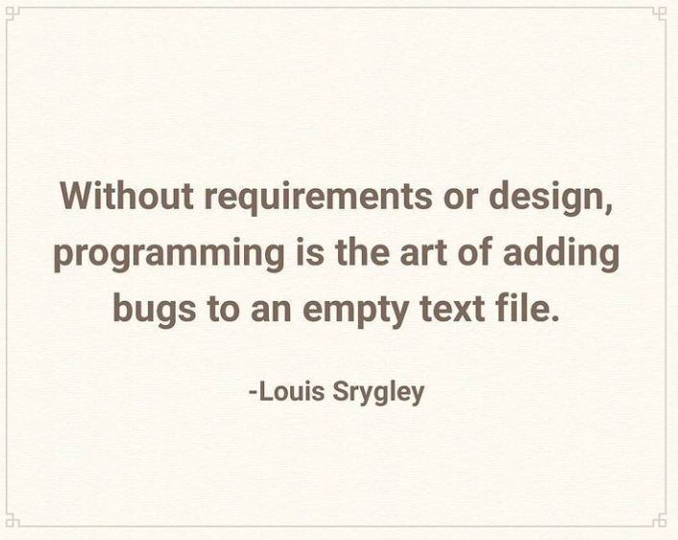
Don't start coding without proper Requirement Analysis and Software Design documents
which all the stakeholders have hand shaked on.

Slide 23
Inputs of Scope Management Phase
Project charter
A Project statement that provides high level project description and product characteristics
Enterprise environmental factors
How the company does business, org. culture
Organizational process assets
Process and procedures of the company

Slide 24
Tools & Techniques
Meetings
PM, TL, Client, Architect, UX designer, QA Lead
Expert judgement
Expertise provided by any group or individual with specialized knowledge
Consultants
PMO
Technical associations
Other units within organisation

Slide 25
Extracting Requirements/Specifications
The team reviews the project introduction post;
The PM schedules an internal kick off call with Sales
The PM contacts the client to introduce him/herself and to coordinate a kick off call.
The PM coordinates a team kick-off call;
The PM initiates the specification definition and/or review process;
The team works together with the PM and client to draft and/or review the specifications document and create the wireframes;
The first draft of the specifications document is sent to the specifications reviewer for feedback;
The team applies the specification reviewer’s feedback and sends it to the client for review;
The team continues feedback iterations on the specifications with the client,
Once a final draft of the specifications is ready the PM sends the document to the specifications reviewer for final feedback;
The team applies the specification reviewer’s final feedback;
Once done, the PM sends the document to the client for final confirmation

Slide 26
Project Kick-Off
Sales team should provide all project information for PM at the beginning of the Project.
It is the PM’s responsibility to manage the project documentation and assets from this point.
The entire team is responsible to review the project summary to confirm if there are any unclear details, prior to organizing a kick-off call with the client.
Client explains the objectives and the details of the Project in the kick-off meeting.
Team lead and project manager ask questions to clarify the requirements as much as possible.

Slide 27
Software Requirements Specification (SRS)
After a project has been kicked-off and the team reviews the project introduction, the team must consider whether the information provided is sufficient to proceed onto next steps or if a specifications document needs to be created.
The goal of the specifications document is to make sure that our understanding of the scope matches that of the client, and that it acts as an informative document for the development process – from a functional and technical standpoint.
Even if the client has provided us with a set of specifications, we need to use them as a basis to clarify additional details.

Slide 28
Software Requirements Specification (SRS)
The specifications process is a highly iterative, requiring constant communication between the PM and client and the PM and team.
The PM is primarily responsible to draft the specifications document, with the team’s help.
The TL and developers should provide input for the specifications from a technical perspective.
The designer and QA should provide input for the specifications from a workflow and user experience perspective.
The PM can create wireframes for smaller projects, but for more complex projects a designer should be assigned.

Slide 29
Software Requirements Specification (SRS)
SRS should include following outline which is also proposed by IEEE template (https://ieeexplore.ieee.org/stamp/stamp.jsp?arnumber=720574):
Introduction
Purpose
Product Scope
Product Functions
Users and Characteristics
Design and Implementation Constraints
Assumptions and Dependencies
User Interface Requirements
User Interfaces
Communications Interfaces
System Features (all the function, validations, interactions should be explained step by step for each UI)
Other Non-functional Requirements
Performance Requirements
Security Requirements
Software Quality Attributes

Slide 30
Validate Scope
Process of formalizing acceptance of completed Project deliverables.
Brings objectivity to acceptance testing process and increases chance of final product, service or result acceptance.
Stakeholders inspect the SRS and measures, examines and validate to determine whether work and deliverables meet the requirements and product acceptance criteria.
Outputs:
Accepted devliverables
Change requests

Slide 31
Change Requests
Can include preventive or corrective actions, defect repairs or enhancement requests.
Should be registered to some location that all the stakeholders have Access.
Change management will be discussed later in detail.

Slide 32
Final Estimate-Ready Specs (Final Specs Review)
The final estimate-ready draft of the specifications is when the team feels the document is sufficient to produce estimates and are ready to be sent to client for final confirmation, before the estimates can be accurately created.

Slide 33
Work Breakdown Structure (WBS)
WBS creation is a process of subdividing project deliverables and project work into smaller and more manageable components. It provides a structured vision of what has to be done and delivered throughout of the project.
100% rule:
WBS includes 100% of the work defined by the project scope
captures ALL deliverables—internal, external and interim—in terms of work to be completed, including project management.
WBS should not include any work that falls outside the actual scope of the Project. It cannot include more than 100% of the work.

Slide 34
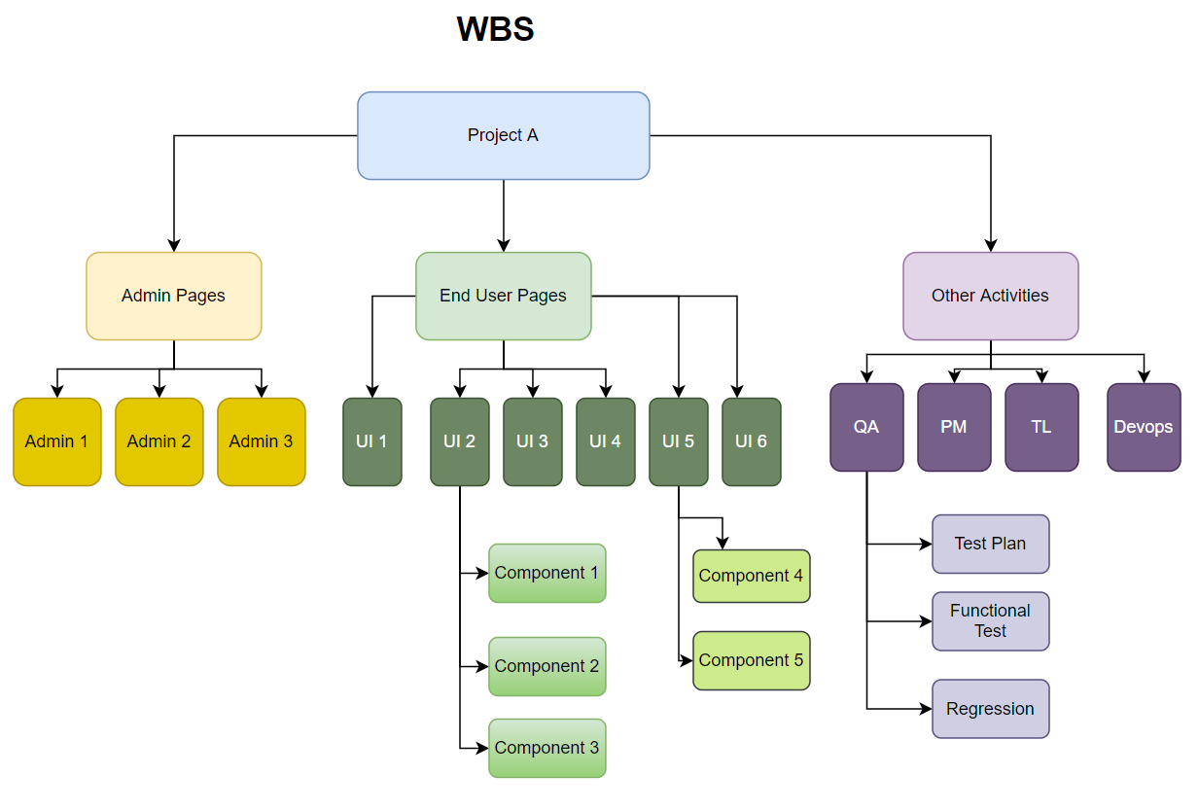

Slide 35
Tracibility Matrix
Requirements | Tasks | Status
R1 | T1 | Closed
R2 | T2 | In Progress
R3 | T3 | In Progress
R3 | T4 | Open

Slide 36
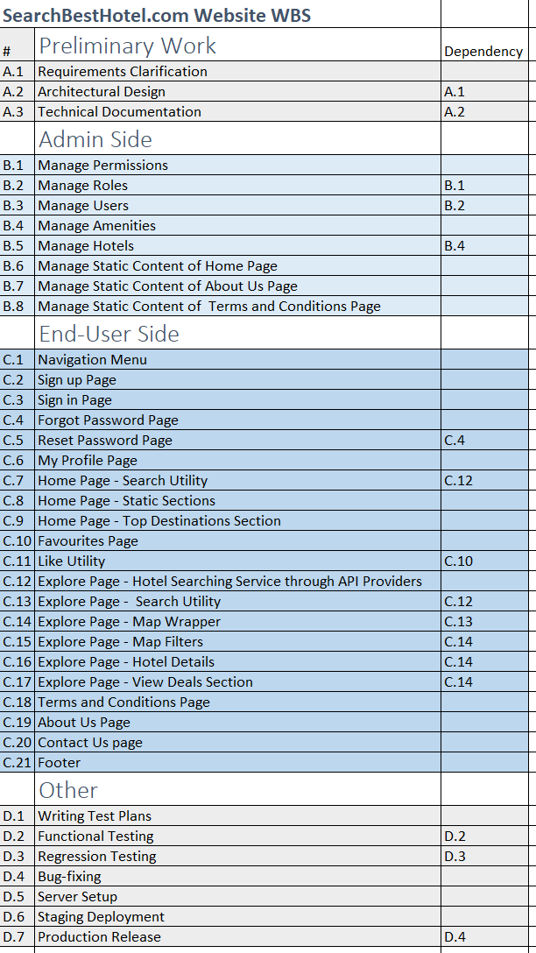
How can we extract milestones of this project?

