Slide 1
Project Cost Management
The better you are prepared with project estimates, the more likely you finish a project and save budget.

Slide 2
Cost Management
Complete the project within the approved budget by
Planning
Estimating
Budgeting
Financing
Funding
Managing
Controlling costs.
Consider requirements, resources and timeline for cost management.

Slide 3
Cost Estimation Methods
Expert Judgement
Parametric Estimating
Bottom-up Estimating
Three-point Estimating

Slide 4
Expert judgment
Expert judgment, guided by historical information, provides valuable insight about the environment and information from prior similar projects.
Estimates should be reviewed by an expert at the end of cost estimation activity.

Slide 5
Parametric estimating
Parametric estimating uses an algorithm or a statistical relationship between historical data to calculate resource quantities needed for an activity, based on historical data and project parameters.
Parametric estimating checks the relations between variables on a task to calculate time and cost estimates.
For example, If it takes 3 days to develop a listing page, how many days it will take to develop 10 listing pages of the similar structure?
The accuracy of parametric estimates is less but better than Analogous estimates.

Slide 6
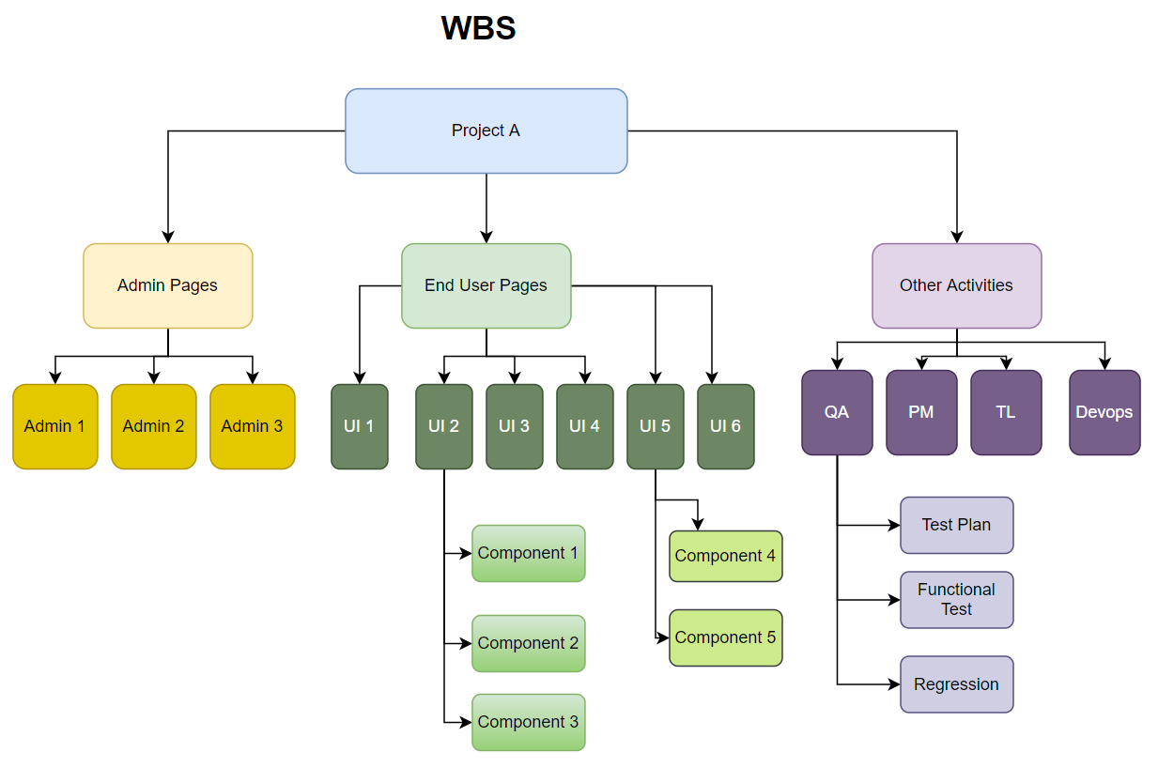
Bottom-up Estimating
Each item in the WBS is estimated first
Get the total of the each items estimate.
requires more time
gives the more accurate results.

Slide 7
Three-Point Estimating
“A technique used to estimate cost or duration by applying an average or weighted average of optimistic, pessimistic, and most likely(realistic) estimates when there is uncertainty with the individual activity estimates.”
Optimistic (O) –best-case scenario for the activity.
Pessimistic (P) – worst-case scenario for the activity.
Most Likely (M) –most realistic estimate based on the assigned resources, dependencies, possible problems etc.
It is more accurate than Analogous and Parametric estimating
it requires more time to provide three estimates for each task
Simple Average or Triangular Distribution:
E = ( P + M + O )/3
Weighted Average or Beta Distribution:
E = ( P +4 M + O )/6

Slide 8
Control Costs
Process of monitoring the status of the Project to update the Project costs and managing changes to the cost baseline.
It provides the means to recognize variance from the plan in order to take corrective action and to minimize risk.

Slide 9
EVM – Earned Value Management
EVM is a methodology that combines scope, schedule and resource measurements to assess project preformance and progress.
Integrates the scope baseline with the cost baseline along with the schedule baseline, to form the performance baseline.

Slide 10
Inputs
BAC | Budget at Completion | Total overall project budget (planned)
AC | Actual Cost | The actual cost of the task to date
PV | Planned Value | The value of the portion of the task that is supposed to have been completed | BAC x Planned % complete
EV | Earned Value | The value of the portion of the task that is actually completed | BAC x Actual % complete
Basic Outputs
SV | Schedule Variance | The amount that the task is ahead or behind schedule, expressed as a task value | SV = EV – PV | SV < 0 = behind schedule
 |  |  |  | SV > 0 = ahead of schedule
SPI | Schedule Performance Index | The amount that the task is ahead or behind schedule, expressed as a percentage of the task | SPI = EV/PV | SPI < 1 = behind schedule
 |  |  |  | SPI > 1 = ahead of schedule
CV | Cost Variance | The amount that the task is over or under budget, expressed as a task value | CV = EV – AC | CV < 0 = over budget
 |  |  |  | CV > 0 = under budget
CPI | Cost Performance Index | The amount that the task is ahead or behind schedule, expressed as a percentage of the task | CPI = EV/AC | CPI < 1 = over budget
 |  |  |  | CPI > 1 = under budget
Notes:
The first three are inputs obtained from project data. The rest are outputs calculated by the project manager which provide various information about the schedule and cost status of the project.
Planned Value (PV)
Also known as Budgeted Cost of Work Scheduled (BCWS), Planned Value is the amount of the task that is supposed to have been completed, in terms of the task budget. It is calculated from the project budget.
PV = Percent Complete (planned) x Task Budget
For example, if it’s Feb. 12 today, and the task is supposed to last from Feb. 10 to Feb. 20, it should be 20% complete. If the task budget is $10,000, PV = 20% x $10,000 = $2,000.
Earned Value (EV)
Also known as Budgeted Cost of Work Performed (BCWP), Earned Value is the amount of the task that is actually completed. It is also calculated from the project budget.
EV = Percent Complete (actual) x Task Budget
For example, if the actual percent complete is 25% and the task budget is $10,000, EV = 25% x $10,000 = $2,500.
Actual Cost (AC)
Also known as Actual Cost of Work Performed (ACWP), Actual Cost is the actual to-date cost of the task.
AC = Actual Cost of the Task
For example, if the actual cost is $3,500, AC = $3,500.
Schedule Variance (SV)
In this, the first output calculated in the earned value analysis, the project manager obtains a value which tells you the amount that the task is ahead or behind schedule.
SV = EV – PV
If SV is negative, the task is behind schedule.
If SV is zero, the task is on schedule
If SV is positive, the task is ahead of schedule.
In our example, SV = $2,500 – $2,000 = $500. This task is ahead of schedule.
Schedule Performance Index (SPI)
The SPI, similar to the SV, also indicates ahead or behind schedule but gives the project manager a sense of the relative amount of the variance. If you told me your project had a $500 schedule variance, this would mean drastically different things if your project was for building a backyard fence versus constructing a highrise building.
SPI = EV/PV
If SPI < 1, the task is behind schedule
If SPI = 1, the task is on schedule
If SPI > 1, the task is ahead of schedule
In our example, SPI = $2,500 / $2,000 = 1.25. Therefore, the task is 25% ahead of schedule.
Cost Variance (CV)
Similar to the schedule variance, the Cost Variance tells the project manager how far the task is over or under budget.
CV = EV – AC
If CV is negative, the task is over budget
If CV is zero, the project is on budget
If CV is positive, the project is under budget
In our example, CV = $2,500 – $3,500 = -$1,000. The task is over budget. Note that the task can be ahead of schedule but over budget. Too much money has been spent compared to the amount of work that is currently complete.
Cost Performance Index (CPI)
The CPI, similar to the CV, also indicates over or under budget but gives the project manager a sense of the relative amount of the variance.
CPI = EV/AC
If CPI < 1, the task is over budget
If CPI = 1, the task is on budget
If CPI > 1, the task is under budget
In our example, CPI = $2,500 / $3,500 = 0.71. Therefore, the task is 29% over budget.

Slide 11
Example 1 – PV, EV, AC
You are the PM of the ProjectX that is planned for 12 months with a budget (BAC) of 100,000 $. Calculate PV, EV and AC if the
scheduled work completed after three months is 25%,
the actual work completed after the three month is 15%
the actual amount spent is 20,000 $
PV | Planned Value | The value of the portion of the task that is supposed to have been completed | BAC x Planned %complete
EV | Earned Value | The value of the portion of the task that is actually completed | BAC x Actual %complete
AC | Actual Cost | The actual cost of the task to date
BAC | Budget at Completion | Total overall project budget (planned)

Slide 12
PV = BAC x Planned %complete
= 100000 x 25%
= 100000x(25/100)
= 25000 $
EV = BAC x Actual %complete
= 15% x $100,000
= (15/100) x 100,000
= 15.000 $
AC = 20,000 $

Slide 13
Calculate SV, SPI, CV, CPI
PV = 25.000 $
EV = 15.000 $
AC = 20.000 $
SV | Schedule Variance | The amount that the task is ahead or behind schedule, expressed as a task value | SV = EV – PV | SV < 0 = behind schedule
 |  |  |  | SV > 0 = ahead of schedule
SPI | Schedule Performance Index | The amount that the task is ahead or behind schedule, expressed as a percentage of the task | SPI = EV/PV | SPI < 1 = behind schedule
 |  |  |  | SPI > 1 = ahead of schedule
CV | Cost Variance | The amount that the task is over or under budget, expressed as a task value | CV = EV – AC | CV < 0 = over budget
 |  |  |  | CV > 0 = under budget
CPI | Cost Performance Index | The amount that the task is ahead or behind schedule, expressed as a percentage of the task | CPI = EV/AC | CPI < 1 = over budget
 |  |  |  | CPI > 1 = under budget

Slide 14
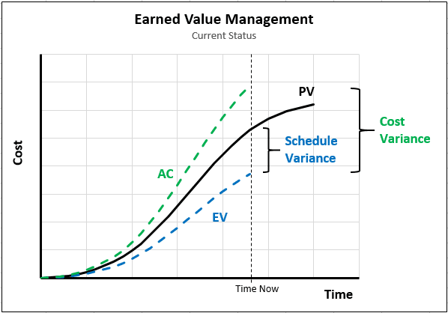
SV | Schedule Variance | The amount that the task is ahead or behind schedule, expressed as a task value | SV < 0 = behind schedule
 |  |  | SV > 0 = ahead of schedule
SPI | Schedule Performance Index | The amount that the task is ahead or behind schedule, expressed as a percentage of the task | SPI < 1 = behind schedule
 |  |  | SPI > 1 = ahead of schedule
CV | Cost Variance | The amount that the task is over or under budget, expressed as a task value | CV < 0 = over budget
 |  |  | CV > 0 = under budget
CPI | Cost Performance Index | The amount that the task is ahead or behind schedule, expressed as a percentage of the task | CPI < 1 = over budget
 |  |  | CPI > 1 = under budget
PV = 25.000 $
EV = 15.000 $
AC = 20.000 $
SV = EV – PV = 15.000 – 25.000 = -10.000
SPI = EV/PV = 15.000/25.000 = 0.6
CV = EV – AC = 15.000 – 20.000 = -5.000
CPI = EV/ AC = 15.000 / 20.000 = 0.75

Slide 15
Complex Outputs
EAC | Estimate at Completion | EAC = BAC/CPI | The estimated project budget at the end of the project, given current project budget status
 |  | EAC = AC + (BAC – EV)
 |  | EAC = AC + [(BAC – EV)/(SPI x CPI)]
 |  | EAC = AC + new estimate
ETC | Estimate to Complete | ETC = EAC – AC | The expected cost to finish the project
VAC | Variance at Completion | VAC = BAC – EAC | The expected cost variance at the end of the project, given current project status | VAC < 0 = over budget
 |  |  |  | VAC > 0 = under budget
TCPI | To Complete Performance Index | TCPI = (BAC – EV) / (BAC – AC) | The CPI required to complete the project on budget | TCPI < 1 = under budget
 |  | TCPI = (BAC – EV) / (EAC – AC) |  | TCPI > 1 = over budget
Notes:
Budget at Completion (BAC)
This one is easy. It is simply the total project budget, which is the aggregate of all of the task budgets.
BAC = Project Budget
In our example, if we assume the project has just that one task, BAC = $10,000.
Estimate at Completion (EAC)
This value tells the project manager what the overall project budget will be if everything else went according to plan. It is the extrapolation of the current project status to the end of the project. Because it is an extrapolation, it can be legitimately calculated in several ways. The project manager must make one of four assumptions:
The reason for the variance is likely to continue. The project will continue on its previous path.EAC = BAC/CPI
The reason for the variance is not likely to continue. The project performance is expected to return to planned levels.EAC = AC + (BAC – EV)
When you feel the project’s future cost performance is likely to be impacted by both the past schedule performance as well as cost, you can use a hybrid.EAC = AC + [(BAC – EV)/(SPI x CPI)]
When you need to change the estimate because the initial assumptions were wrong.EAC = AC + ETC
In our example, let’s say the reason for the negative cost variance is a snowstorm that delayed the project. It is not likely to affect the rest of the project, therefore EAC = $3,500 + ($10,000 – $2,500) = $11,000. This is the expected final budget.
Estimate to Complete (ETC)
This value tells the project manager how much money must be spent from this point forward to complete the project. Sometimes the project assumptions have changed and a new estimate must be produced instead of old performance metrics assumed.
The project is expected to continue with the same performance in the future as the past.ETC = EAC – AC
The past project performance cannot be expected to continue. A new estimate is required.ETC = new estimate
Variance at Completion (VAC)
This value tells the project manager the forecasted cost variance (CV) at the completion of the project. It is the extrapolation of the current project status, using the EAC method chosen.
VAC = BAC – EAC
If VAC is negative, you need that much more money to complete the project.
If VAC is positive, you will finish the project with that much of a surplus.
In our example, VAC = $10,000 – $11,000 = -$1,000. You will need an additional $1,000 to complete the project.
To Complete Performance Index (TCPI)
This value tells the project manager what CPI would be necessary to finish the project on budget. It gives an indication of how much efficiency needs to be found in the remainder of the project to make up for past negative variances.
If the project is required to finish within the original budget:
TCPI = (BAC – EV) / (BAC – AC)
If the project budget is flexible to accommodate the past variance:
TCPI = (BAC – EV) / (EAC – AC)
In our example, let’s assume there is no new money. The original budget is fixed and the project must make up the current negative cost variance. TCPI = ($10,000 – $2,500) / ($10,000 – $3,500) = 1.15. This means the project needs to find 15% efficiencies for the remainder to finish on budget.

Slide 16
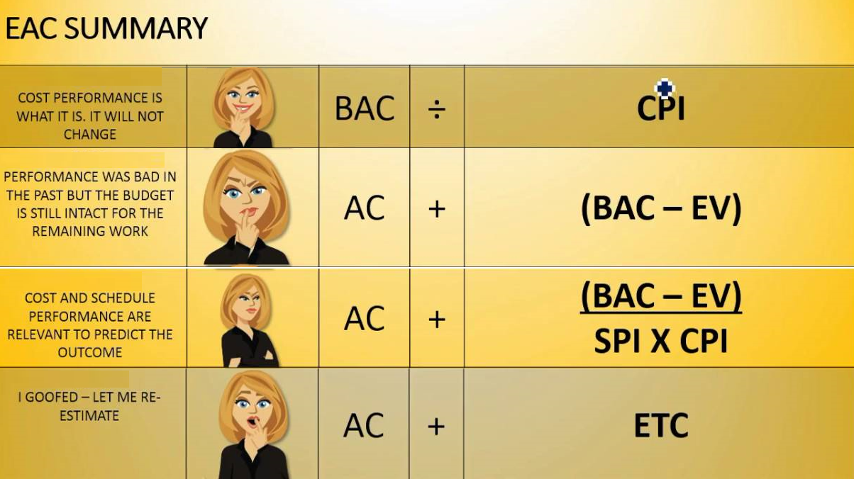
Notes:
EAC = BAC / CPI: This is the most recommended calculation when the project is in progress without interference. To check the EAC, divide the BAC by the Cost Performance Index (CPI).
EAC = AC + (BAC – EV) This formula is used when unforeseen events are overcome, and it’s believed that new interference will not occur until the end of the project.
EAC = AC + BAC – EV / CPI x SPI: This is the formula used when schedule delays and expenses increase. In this case, it’s necessary to add the Schedule Performance Index (SPI) and the Earned Value (EV) to the equation.
EAC = AC + ETC: This formula is the most generic and is often used when BAC is estimated from inaccurate or erroneous data. In this case, the EAC represents the sum of Actual Cost (AC) and Estimate to Completion (ETC).

Slide 17
Calculate EAC, ETC, VAC, TCPI
Complex Outputs
EAC | Estimate at Completion | EAC = BAC/CPI | The estimated project budget at the end of the project, given current project budget status
 |  | EAC = AC + (BAC – EV)
 |  | EAC = AC + [(BAC – EV)/(SPI x CPI)]
 |  | EAC = AC + new estimate
ETC | Estimate to Complete | ETC = EAC – AC | The expected cost to finish the project
VAC | Variance at Completion | VAC = BAC – EAC | The expected cost variance at the end of the project, given current project status | VAC < 0 = over budget
 |  |  |  | VAC > 0 = under budget
TCPI | To Complete Performance Index | TCPI = (BAC – EV) / (BAC – AC) | The CPI required to complete the project on budget | TCPI < 1 = under budget
 |  | TCPI = (BAC – EV) / (EAC – AC) |  | TCPI > 1 = over budget
PV = 25.000 $
EV = 15.000 $
AC = 20.000 $
SV = -10.000
SPI = 0.6
CV = -5.000
CPI = 0.75

Slide 18
PV = 25.000 $
EV = 15.000 $
AC = 20.000 $
SV = -10.000
SPI = 0.6
CV = -5.000
CPI = 0.75
EAC= BAC/CPI = 100.000/0.75
= 133.333,3
ETC = EAC-AC = 133.333,3 -20.000
= 113.333
VAC = BAC- EAC = 100.000 – 133.333,3
= -33.333
TCPI = (BAC-EV)/(BAC-AC) =
= (100.000 – 15.000)/(100.000-20.000)
= 85.000/80.000
= 1.06
Complex Outputs
EAC | Estimate at Completion | EAC = BAC/CPI | The estimated project budget at the end of the project, given current project budget status
 |  | EAC = AC + (BAC – EV)
 |  | EAC = AC + [(BAC – EV)/(SPI x CPI)]
 |  | EAC = AC + new estimate
ETC | Estimate to Complete | ETC = EAC – AC | The expected cost to finish the project
VAC | Variance at Completion | VAC = BAC – EAC | The expected cost variance at the end of the project, given current project status | VAC < 0 = over budget
 |  |  |  | VAC > 0 = under budget
TCPI | To Complete Performance Index | TCPI = (BAC – EV) / (BAC – AC) | The CPI required to complete the project on budget | TCPI < 1 = under budget
 |  | TCPI = (BAC – EV) / (EAC – AC) |  | TCPI > 1 = over budget

Slide 19
Parameters | Value | Conclusion
Actual Completeness | 0,15
Scheduled completeness | 0,25
BAC | 100.000
PV | 25000
EV | 15000
AC | 20.000
SV | -10000 | SV < 0 = behind schedule SV > 0 = ahead of schedule
SPI | 0,6 | SPI < 1 = behind schedule SPI > 1 = ahead of schedule
CV | -5.000 | CV < 0 = over budget CV > 0 = under budget
CPI | 0,75 | CPI < 1 = over budget CPI > 1 = under budget
EAC | 133333,3
ETC | 113.333
VAC | -33.333 | VAC < 0 = over budget VAC > 0 = under budget
TCPI | 1,06 | TCPI < 1 = under budget TCPI > 1 = over budget

Slide 20
Example 2
You have a Project that should be finished in 8 months with 60.000 $
You have a meeting with your manager who is asking for the current situation of the Project profitability in the 4th month of the project.
Scheduled work completed for the 4th month is 50%
The team lead notifies you that they have completed 55% of the Project.
Total spent Money so far is 40.000$
Calculate: PV, EV, AC, SV, SPI, CV, CPI, EAC, ETC, VAC, TCPI

Slide 21
Parameters | Value | Conclusion
Actual Completeness | 0,55
Scheduled Completeness | 0,5
Budget at Completion(BAC) | 60.000
Planned Value(PV) | 30000
Earned Value(EV) | 33000
Actual Cost(AC) | 40.000
Schedule Variance(SV) | 3000 | SV < 0 = behind schedule SV > 0 = ahead of schedule
Schedule Performance Index(SPI) | 1,1 | SPI < 1 = behind schedule SPI > 1 = ahead of schedule
Cost Variance(CV) | -7.000 | CV < 0 = over budget CV > 0 = under budget
Cost Performance Index(CPI) | 0,825 | CPI < 1 = over budget CPI > 1 = under budget
Estimate at Completion(EAC) | 72727,27
Estimate to Complete(ETC) | 32.727
Variance at Completion(VAC) | -12.727 | VAC < 0 = over budget VAC > 0 = under budget
To Complete Performance Index(TCIP) | 1,35 | TCPI < 1 = under budget TCPI > 1 = over budget

Slide 22
Earned Value Management

Slide 23
COST TYPES
Direct cost
Indirect cost
Fixed cost
Variable cost
Sunk cost

Slide 24
Direct Cost
Direct costs are those directly linked to doing the work of the project.
For example, this could include hiring specialised contractors or buying software licences.

Slide 25
Indirect cost
These costs are not specifically linked to your project but are the cost of doing business overall.
Examples are heating, lighting, office space rental (unless your project gets its own offices hired specially), stocking the communal coffee machine and so on.

Slide 26
Fixed cost
Fixed costs are everything that is a one-off charge.
These fees are not linked to how long your project goes on for.
So if you are paying for a day of Agile consultancy to help you start the project up the best way, this is fixed costs.

Slide 27
Variable cost
These are the opposite of fixed costs - charges that change with the length of your project.
It's more expensive to pay staff salaries over a 12 month project than a 6 month one.
Machine hire over 8 weeks is more than for 3 weeks.

Slide 28
Sunk Cost
Anything you've already spent on the project.
So if you've spent $20k on infrastructure and then are considering cancelling the project and you can't get the $20k back in anyway, that's a sunk cost.

Slide 29
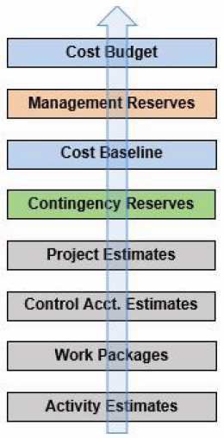
COST AGGREGATION
Contingency reserve and management reserve are options to respond to risks so that these risks do not compromise the project.
Management reserve is kept aside to cover “unknown unknowns,” or risks that occur but were not accounted for.
For the “known unknowns,” or risks that have been kept in the risk register, contingency reserve can be part of the overall risk response strategy.

Slide 30
Contingency Reserves
Contingency reserves are the finance for the project cost estimates by the project manager to deal with uncertain events/risks that may happen i.e known unknowns.
The contingency reserve is assigned for activities, work package, or a project.
The project manager has authority over the contingency reserve,

Slide 31
Contingency Calculation with EMV
Expected monetary value (EMV) = probability x impact
For example, a risk has a 60 percent probability of occurring and a cost impact of $10,000.
The EMV for this risk event is (0.6 * $10,000), or $6,000.
To compensate for this risk, the contingency reserve needs $6,000.
Totalling the EMV for each risk results in the total contingency reserve for the project.
For example, on a project, there are five risks with two having an EMV of $10,000 and three having an EMV of $11,000.
The sum of the risks is two times $10,000, or $20,000, plus three times $11,000, or $33,000.
Adding these gives the total contingency reserve of $53,000.

Slide 32
Management Reserves
The management reserve is defined as the cost or time reserve that is used to manage the unidentified risks or “unknown-unknown”.
The management reserve is a part of the project budget but not the cost baseline. It is not an estimated reserve; it is a figure that is fashioned according to the organization’s policies.
It can be 5% of the total project cost or duration of the project or it may be as high as 10%. The management reserve is usually estimated based on the uncertainty of the project.
The project manager does not control management reserve, the management does. The management reserve is for unidentified risks, not to cover the cost overrun.
Notes:
For example, if you are doing a project in which your organization has the expertise and experience, the management reserve will be less. In this case, there is less uncertainty.
However, if you are doing a kind of project new to your organization, the management reserve will be high, because, in this situation, the uncertainty is greater.

Slide 33
Q1
A manufacturing project has a Schedule Performance Index (SPI) of 0.89 and a Cost Performance Index (CPI) of 0.91. Generally, what is the best explanation for why this occurred?
Additional equipment needed to be purchased.
A critical path activity took longer and needed more labor hours to complete.
The scope was changed.
A supplier went out of business and a new one needed to be found.
Notes:
b

Slide 34
Q2
You provide a project cost estimate for the project to the project sponsor. He is unhappy with the estimate, because he thinks the price should be lower. He asks you to cut 15 percent off the project estimate. What should you do?
Inform the sponsor of the activities to be cut.
Add additional resources with low hourly rates
Tell all the team members to cut 15 percent from their estimates.
Start the project and constantly look for cost savings.
Notes:
a

Slide 35
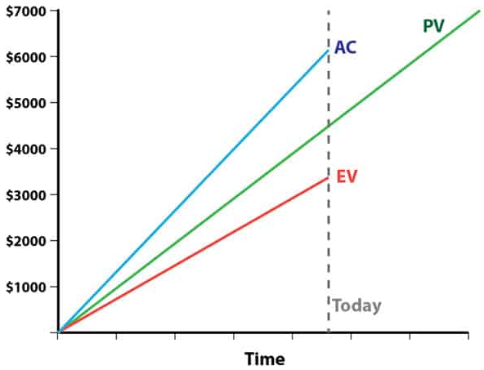
Q3
With reference to the diagram below, it can be inferred that the project is currently:
Behind schedule and under budget
Behind schedule and over budget
Ahead of schedule and under budget
Ahead of schedule and over budget
Notes:
b

