Slide 1
Road Trip Route Planner
North Texas highway connections as a graph
CSCE 2110.501 – Foundations of Data Structures
Yahya Baban and Emir Alakus
Team 6 – team project (2 members)
Created by: Yahya Baban and Emir Alakus | Presenter: Yahya
01
Notes:
Hi everyone, we are Yahya Baban and Emir Alakus, Team 6 in CSCE 2110.501. This is a team project completed by two people. Our project is a Road Trip Route Planner built on a graph of North Texas cities. We will explain the problem, the data structures, the algorithms, our tests and measurements, and what each of us did.

Slide 2
Introduction and project overview
Problem
• Find routes in a network of 15 North Texas cities and 19 two-way highway corridors.
• Shortest = fewest road connections (not miles or driving time).
Why it is useful
• Plan trips with a connection limit, required stops, a trip that visits every reachable city, or a meeting city for 3 travelers.
• Each result prints the city sequence and the highway used for every leg.
How data structures help
• Adjacency list stores sparse roads; hash map gives O(1) name → ID lookup.
• Queue (BFS) finds fewest-connection routes; parent array rebuilds the route.
Created by: Yahya Baban and Emir Alakus | Presenter: Yahya
02
Notes:
The problem: given a network of connected cities, answer route questions without checking every possible route by hand. It is useful for trip planning: fewest road connections, required stops, a trip that visits everything, and a fair meeting city for three travelers. Our main dataset has 15 cities and 19 two-way highway connections. Data structures matter here: the adjacency list stores the sparse network compactly, a hash map turns names into integer IDs, and a queue gives breadth-first order which finds the fewest connections. Shortest means fewest graph connections, not miles or time.

Slide 3
Development process and changes since the proposal
1. Defined cities, connections and expected results.
2. Read the text file and built the adjacency list.
3. Implemented BFS and reused it for the route operations.
4. Added a state-based search (city + visited set) for round trips.
5. Added highway labels, tested every option, packaged code, inputs and README.
Changes since the proposal
• Core idea unchanged: route planning on a city graph.
• Refined: road-label maps added; round trip uses a bitmask state search instead of plain BFS.
Created by: Yahya Baban and Emir Alakus | Presenter: Yahya
03
Notes:
We worked on every step together. We started with the graph idea, defined the input file, built the adjacency list and BFS, then reused BFS for the route features. Round trips needed a different search because the city alone is not enough; we added a bitmask of visited cities. Later we added highway labels so the output is easy to read. The core idea, planning routes on a city graph, did not change from the proposal; the changes were refinements of data structures and algorithms, which the guidelines allow.

Slide 4
Problem statement and input data
Input file (cities.txt) – created by us
Graph model
15 19
Dallas
Plano
Frisco
...
Dallas Richardson US 75 (Central Expressway)
Dallas Plano Dallas North Tollway (TOLL)
• Vertex = city; edge = highway corridor.
• Undirected (two-way) and unweighted (each edge = 1 connection).
• Local streets are abstracted away.
Required operations
• Shortest route; route with fewer than x connections.
• Route through two required cities; shortest round trip.
• Meeting city for three travelers.
• Line 1: number of cities, number of roads.
• Next lines: one city name each (underscore for spaces).
• Then: city 1, city 2, highway label per road.
Expected output
Route (city -> city), total connections, highway per leg – or “No route exists.”
Created by: Yahya Baban and Emir Alakus | Presenter: Yahya
04
Notes:
The required operations are: shortest route, route with fewer than x connections, route through two required cities in either order, shortest round trip visiting every reachable city, and a meeting city for three people. We created the input files ourselves. For the main file we used selected North Texas highway corridors, checked against the NTTA and TxDOT references in the README. It is a simplified city-level model, not a full road network. The graph is undirected and unweighted: every road works both ways and every connection costs one. Each output is a route, its connection count, and the highway for each leg.

Slide 5
Data structures and data types
Structure | Stores | Why we chose it
vector<vector<int>> neighbors | Neighbor IDs of each city | Sparse graph: O(V+E) space
unordered_map<string,int> ids | City name → integer ID | O(1) average lookup
vector<string> names | ID → city name | Print routes
vector<unordered_map<int,string>> | Highway label per road | Show road used on each leg
queue<int> + distance, parent vectors | BFS frontier, counts, route links | FIFO = fewest connections
parent array over (mask, city) states | Round-trip search states | Remember visited cities
Data types: int (IDs, distances, mask), string (names, highways), long long (sums), Graph class (groups data + operations).
Changed since proposal: added road-label maps and the visited-set bitmask for round trips.
Created by: Yahya Baban and Emir Alakus | Presenter: Yahya
05
Notes:
Graph class: vector of vectors for neighbor IDs, an unordered_map from city name to integer ID, a vector of names, and a vector of maps that holds the highway label for each neighbor. We chose an adjacency list because the network is sparse: it uses O(V+E) space instead of V squared for a matrix. The hash map gives constant-time lookup of the typed city name. BFS uses a FIFO queue because that order guarantees fewest connections; distance and parent vectors give the count and the route. Data types: int for IDs, distances and the mask, string for names and labels, long long for sums. Change from the proposal: we added the road-label maps and the bitmask state for round trips.

Slide 6
How the data is stored
Program output (menu option 1)
In memory (example)
Cities and direct road connections:
Dallas:
Richardson via US 75 (Central Expressway)
Plano via Dallas North Tollway (TOLL)
Lewisville via I-35E
Irving via SH 183
Arlington via I-30
Mesquite via US 80
Plano:
Richardson via US 75 (Central Expressway)
Allen via US 75 (Central Expressway)
Dallas via Dallas North Tollway (TOLL)
Frisco via Dallas North Tollway (TOLL)
...
names[0] = "Dallas" names[1] = "Plano" ...
ids["Dallas"] = 0
neighbors[0] (Dallas) = { Richardson, Plano,
Lewisville, Irving, Arlington, Mesquite }
roadNames[0][Plano] = "Dallas North Tollway (TOLL)"
roadNames[0][Lewisville] = "I-35E"
Menu option 1 prints every city with its direct roads. Neighbor order follows the road order in the input file.
Created by: Yahya Baban and Emir Alakus | Presenter: Yahya
06
Notes:
This screenshot is menu option 1, the adjacency list printed by the program. On the right is a small diagram of the same data in memory. Dallas has ID 0 and its neighbor list holds the IDs of Richardson, Plano, Lewisville, Irving, Arlington and Mesquite. Each neighbor also has a label such as US 75 or I-35E.

Slide 7
Algorithm: BFS shortest route
Pseudocode
Walkthrough: Allen → Denton
BFS(start):
distance[*] = -1; parent[*] = -1
distance[start] = 0; queue.push(start)
while queue not empty:
c = queue.pop_front()
for each n in neighbors[c]:
if distance[n] == -1:
distance[n] = distance[c] + 1
parent[n] = c
queue.push(n)
route(goal): follow parent[] from goal
back to start, then reverse
• Queue: Allen (0)
• Visit Plano (1), McKinney (1)
• From Plano: Richardson, Dallas, Frisco (2)
• From Frisco: Denton (3), parent = Frisco
• Back-trace: Denton ← Frisco ← Plano ← Allen
Choice: 2
Starting city: Allen
Destination: Denton
Route: Allen -> Plano -> Frisco -> Denton
Total connections: 3
Why BFS: all edges cost 1, so the first time a city is reached is by the fewest connections.
Created by: Yahya Baban and Emir Alakus | Presenter: Yahya
07
Notes:
Pseudocode on the left. Walkthrough for Allen to Denton: the queue starts with Allen at distance 0. Allen's neighbors Plano and McKinney get distance 1. Plano adds Richardson, Dallas and Frisco at distance 2. Frisco adds Denton at distance 3, with parent Frisco. We follow parent links back from Denton: Frisco, Plano, Allen, then reverse to print Allen, Plano, Frisco, Denton. Because every edge costs one, level-by-level exploration finds the fewest connections. Ties depend on the road order in the file.

Slide 8
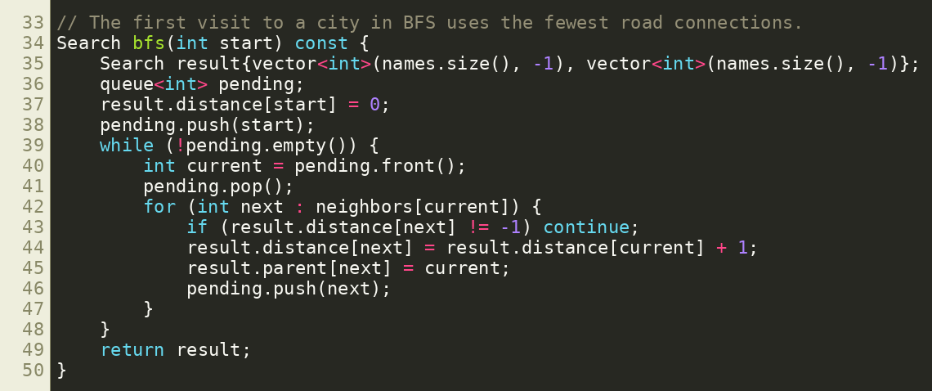
Code: BFS implementation (main.cpp)
Search bfs(int start): distance and parent vectors, FIFO queue; each city and edge handled once → O(V + E).
Created by: Yahya Baban and Emir Alakus | Presenter: Yahya
08
Notes:
This is the actual BFS function from main.cpp. distance is initialised to -1, which marks unvisited cities. The queue is FIFO, so cities are processed in order of distance. The first time we reach a city we set its distance and parent, which is exactly the fewest connections. pathTo then follows parent links back.

Slide 9
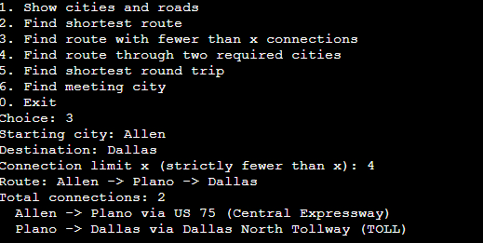
Connection limit (fewer than x)
2 < 4 → accepted
• Run BFS, take the shortest route.
• Accept only if connections < x.
• Equality is rejected.
Dallas -> Frisco, x = 2
No route has fewer than 2 connections.
Shortest available route requires 2.
Created by: Yahya Baban and Emir Alakus | Presenter: Yahya
09
Notes:
Option three finds the shortest route first, then compares its length with the limit. Allen to Dallas needs two connections through Plano, and the limit is four, so it is accepted. Because the requirement is strictly fewer than x, a limit of two rejects the same route. Using less-than-or-equal would give the wrong answer, so we tested the boundary: Dallas to Frisco with x = 2 is rejected, x = 3 is accepted.

Slide 10
Algorithm: two required stops
Pseudocode
Allen → Dallas via Frisco, Plano: 4
RouteVia(A, B, C, D):
BFS from A, B and C
if B, C or D unreachable: no route
t1 = d(A,B) + d(B,C) + d(C,D)
t2 = d(A,C) + d(C,B) + d(B,D)
choose the smaller order
join the three shortest paths
• Both stop orders compared.
• Result: Allen, Plano, Frisco, Plano, Dallas.
• Repeated cities are allowed.
• Cost: 3 BFS runs = O(V + E).
Choice: 4 (Allen -> Dallas via Frisco, Plano)
Route: Allen -> Plano -> Frisco -> Plano -> Dallas
Total connections: 4
Created by: Yahya Baban and Emir Alakus | Presenter: Emir
10
Notes:
For option four we run BFS from the start and from each required city. Then we add up the shortest legs for both stop orders and keep the smaller total, then join the three shortest paths. Example: start Allen, finish Dallas, required Frisco and Plano. The result is Allen, Plano, Frisco, Plano, Dallas with four connections. Plano appears twice because intermediate cities may repeat. Both orders tie here, so the first one is kept.

Slide 11
Algorithm: shortest round trip
RoundTrip(start):
K = cities reachable from start (BFS)
if K > 18: error (size limit)
state = (mask, city); initial = ({start}, start)
queue.push(initial)
while queue not empty and goal not found:
(mask, c) = queue.pop_front()
for each n in neighbors[c]:
if n == start and mask != FULL: skip
next = (mask | bit(n), n)
if next unseen:
parent[next] = (mask, c); push(next)
goal = (FULL, start): rebuild route from parent[]
else: no route
• State = current city + visited set.
• BFS by moves → first full return is optimal.
• Cities may repeat; it is not a Hamiltonian cycle.
• Dallas has no valid trip: it is an articulation point.
• Cap: 18 reachable cities (2¹⁸ masks).
Created by: Yahya Baban and Emir Alakus | Presenter: Emir
11
Notes:
A city alone is not enough, so each search state is a current city plus a bitmask of visited cities, one bit per city reachable from the start. A move along a road sets a bit. Returning to the start is blocked until every reachable city is visited, which matches the rule that once you return to A you do not leave again. BFS explores states by number of moves, so the first complete return is optimal. The number of masks is 2 to the K, so we cap exact search at 18 reachable cities.

Slide 12
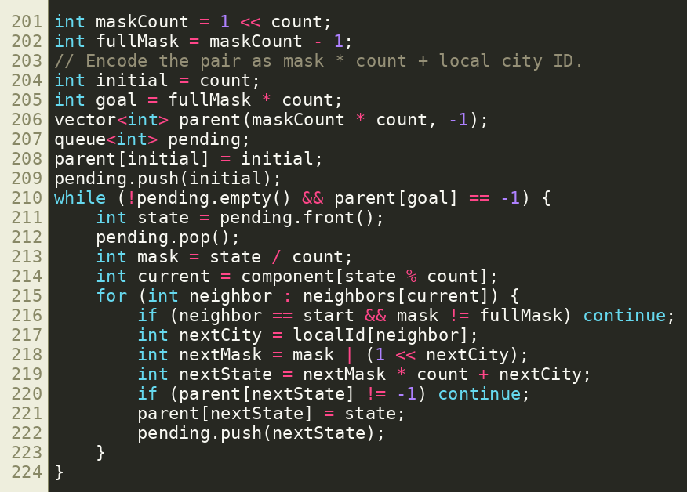
Code: round-trip state search (main.cpp)
State = (visited mask, current city). Line 216 blocks an early return to the start; parent[] rebuilds the route.
Created by: Yahya Baban and Emir Alakus | Presenter: Emir
12
Notes:
This is the round-trip loop. A state is encoded as mask times count plus the local city ID. The line that skips the start city unless the mask is full enforces the rule that once you return to the start you do not leave again. parent[] stores how each state was reached so the route can be rebuilt.

Slide 13
Round trip result (Allen)
Choice: 5
Starting city: Allen
Route: Allen -> Plano -> Richardson -> Dallas -> Lewisville -> Grapevine -> Irving -> Dallas -> Mesquite -> Garland -> Rockwall -> Garland -> Mesquite -> Dallas -> Arlington -> Fort_Worth -> Denton -> Frisco -> McKinney -> Allen
Total connections: 19
• All 15 cities visited; the trip ends the first time it returns to Allen.
• Dallas is a cut city and Rockwall is a dead end, so some cities repeat.
• Result: 19 connections; the same count is expected from Plano.
Created by: Yahya Baban and Emir Alakus | Presenter: Emir
13
Notes:
This is the real program output for menu option five starting in Allen. It visits all 15 cities and returns to Allen in 19 connections. Some cities appear twice, for example Dallas and Garland, because Dallas connects several branches and the Rockwall branch is a dead end that must be entered and left. We checked this result against an independent calculation and the same result is saved in round_trip_example_output.txt for Plano.

Slide 14
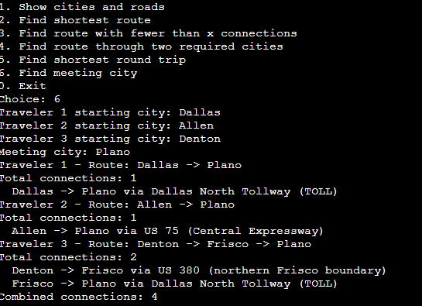
Algorithm: meeting city
Pseudocode
Meeting(A, B, C):
BFS from A, B, C
for each city X not in {A, B, C}:
if reachable from all three:
total = dA[X] + dB[X] + dC[X]
pick X with smallest total
rebuild 3 routes from parents
Dallas, Allen, Denton → Plano
1 + 1 + 2 = 4 connections
Cost: 3 BFS + 1 scan = O(V + E)
Created by: Yahya Baban and Emir Alakus | Presenter: Emir
14
Notes:
Option six runs BFS from each of the three starting cities, then scans every other city that all three can reach and adds the three distances. The smallest total wins; ties follow the city order in the file. Example: Dallas, Allen and Denton meet in Plano. Dallas needs one connection, Allen one, Denton two through Frisco, total four. The goal is the smallest combined number of connections, not equal travel for everyone. If the three starts are not all different, or no city is reachable by all three, the program says so.

Slide 15
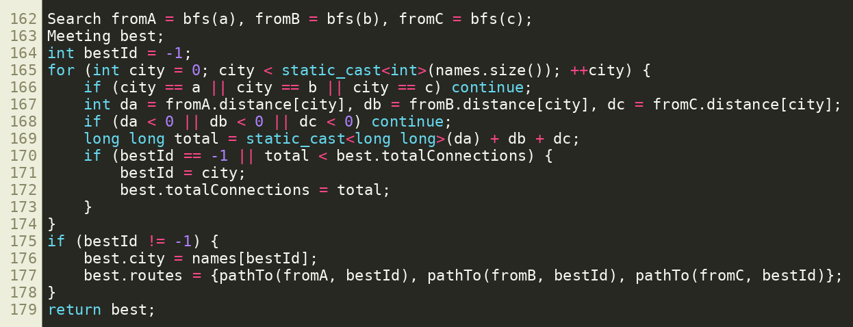
Code: meeting-city scoring (main.cpp)
Three BFS runs + one scan over all cities → O(V + E).
Created by: Yahya Baban and Emir Alakus | Presenter: Emir
15
Notes:
Meeting city: we run BFS from the three travelers, then scan every other city. A city counts only if all three can reach it. We add the three distances and keep the smallest total; ties keep the earlier city in the file.

Slide 16
Libraries, tools and feature status
Library / tool | Purpose
<fstream>, <iostream>, <sstream> | Read input file, menu I/O, parse numbers
<vector>, <unordered_map>, <queue> | Graph storage, name lookup, BFS
<algorithm>, <string> | reverse routes, city names
g++ -std=c++17 | Compiler (no other libraries)
Feature status
• Complete: all 6 menu options.
• Tested: normal and edge cases, 3 dataset sizes.
Known limitations
• Exact round trip: up to 18 reachable cities.
• Counts connections, not miles or time.
• Names are case-sensitive, one word.
• City-level model: no local streets.
Created by: Yahya Baban and Emir Alakus | Presenter: Emir
16
Notes:
Everything uses only the C++17 standard library. fstream reads the file, iostream handles the menu, queue is the BFS queue, vector and unordered_map hold the graph, algorithm gives reverse, string and sstream parse input. All six menu options are complete. The limits are listed on the right and in the README.

Slide 17
Complexity and scalability
V = number of cities, E = number of roads, K = cities in the start's component, M = roads in that component
Operation | Time | Extra space | Why
Options 2, 3, 4, 6 | O(V + E) | O(V) | constant number of BFS runs; each city/edge handled O(1) times
Graph storage | – | O(V + E) | one neighbor entry per edge end
Option 5 (round trip) | O(V + E + 2ᴷ(K + M)) | O(V + K·2ᴷ) | 2ᴷ·K states, each scans its roads
Loading the file | O(V + R·V) worst | O(V + E) | R road lines; duplicate check scans a neighbor list
• As the graph grows, BFS options grow linearly in V + E.
• The round trip doubles with every extra reachable city → exact search stops at K = 18.
Created by: Yahya Baban and Emir Alakus | Presenter: Emir
17
Notes:
V is the number of cities and E is the number of distinct roads. With an adjacency list, BFS touches each city and each neighbor entry a constant number of times, so it takes O of V plus E time. Options two, three, four and six use a constant number of BFS runs, so they have the same order. Storage is O of V plus E; a BFS adds O of V. For the round trip, K and M are the cities and roads in the start's component. There are 2 to the K masks times K cities as states, and each state scans its roads, giving the 2 to the K times K plus M term. That growth is why we cap at 18. As input grows, BFS grows linearly; the round trip grows exponentially in K.

Slide 18
Testing and results: normal cases
Option | Input (cities.txt) | Expected | Actual | Pass
2 route | Allen → Denton | 3 connections | Allen-Plano-Frisco-Denton, 3 | Yes
3 limit | Allen → Dallas, x = 4 | accept (2 < 4) | Allen-Plano-Dallas, 2 | Yes
3 limit | Dallas → Frisco, x = 3 | accept (2 < 3) | Dallas-Plano-Frisco, 2 | Yes
4 stops | Allen → Dallas via Frisco, Plano | 4 connections | Allen-Plano-Frisco-Plano-Dallas, 4 | Yes
4 stops | Dallas → Frisco via McKinney, Allen | 4 connections | Dallas-Plano-Allen-McKinney-Frisco, 4 | Yes
5 round trip | Allen | all 15 cities, 19 | returns to Allen, 19 | Yes
6 meeting | Dallas, Allen, Denton | Plano, total 4 | Plano, 1 + 1 + 2 = 4 | Yes
6 meeting | Dallas, Frisco, Allen | Plano, total 3 | Plano, 1 + 1 + 1 = 3 | Yes
Created by: Yahya Baban and Emir Alakus | Presenter: Yahya
18
Notes:
Each row is a real run of the program. All required operations are covered: shortest route, limit, required stops, round trip and meeting city. Expected results were worked out by hand on the small graph before running, and every row passed.

Slide 19
Testing and results: edge cases and correctness
Edge case | Input | Expected | Actual | Pass
Strict limit | opt 3, Dallas → Frisco, x = 2 | reject | No route has fewer than 2 | Yes
Unknown city | opt 2, Dallas → Fake_City | error message | Unknown city: Fake_City | Yes
No route | cities_disconnected: Dallas → Austin | no route | No route exists. | Yes
No meeting city | cities_disconnected: opt 6 | none | No eligible meeting city | Yes
Same city | opt 2, Dallas → Dallas | 0 connections | Dallas, 0 | Yes
No round trip | opt 5, Dallas | no route | No route exists. | Yes
Repeated start | opt 6, Dallas, Dallas, Denton | reject | Enter three different cities | Yes
Size limit | opt 5, 60-city file | size message | supports up to 18 cities | Yes
Correctness checks: hand-computed expectations; all 225 city pairs matched an independent all-pairs calculation; round-trip optimum 19 verified independently.
Created by: Yahya Baban and Emir Alakus | Presenter: Yahya
19
Notes:
Edge cases: strict limit exactly equal to the route length, unknown city, disconnected graph with no route, same start and end city, a start city that cannot have a round trip, repeated meeting cities, and the size limit on the 60-city graph. How we checked correctness: we compared every result with hand-computed answers on the small map, and during the final review we compared all 225 ordered city pairs against an independent all-pairs shortest-path calculation. We also confirmed the round trip optimum of 19 independently.

Slide 20
Testing with different input sizes (measured times)
Option 2 (BFS), E = 3V
Option 5 (round trip), E = 3K
Cities (V) | Roads (E) | Measured time
1,000 | 3,000 | 0.006 s
10,000 | 30,000 | 0.02 s
100,000 | 300,000 | 0.44 s
1,000,000 | 3,000,000 | 7.2 s
Cities (K) | Result | Measured time
10 / 12 / 14 | 10 / 12 / 14 | 0.006 – 0.007 s
16 | 16 | 0.013 s
18 | 18 | 0.06 s
• Measured (end to end, includes loading) – different from the theoretical O(V + E) and O(2ᴷ(K + M)).
• Loading the file takes about as long as the whole run, so it dominates on large inputs.
• Round trip: small up to K = 14, about 10× slower by K = 18, consistent with doubling states.
• Datasets in the zip: 6, 15 and 60 cities (cities_disconnected, cities, cities_large).
Created by: Yahya Baban and Emir Alakus | Presenter: Emir
20
Notes:
We generated random connected graphs with gen_graph.cpp and timed the program with bench.sh. These are measured wall-clock times, end to end, including starting the program and reading the file, on one Linux machine; they are not the Big O bounds. BFS runs on graphs from 1,000 to 1,000,000 cities. Time grows roughly with the input size, and file loading takes about as long as the whole run, so reading the input dominates. The round trip stays fast up to 14 cities and rises at 16 and 18, which fits the exponential state space. Datasets in the zip: 6, 15 and 60 cities.

Slide 21
Challenges, limitations and future work
Challenges and how we addressed them
Limitations and future work
• How detailed the map should be → city-level vertices keep the focus on algorithms.
• A city alone is not enough for round trips → (city, visited-set) states.
• Exponential memory → cap at 18 reachable cities.
• Tie routes → follow road order in the file.
• Counts connections, not miles or time.
• Exact round trip limited to 18 cities.
• Future: distance weights + Dijkstra.
• Future: finer junction model; approximate round trip for large graphs.
Created by: Yahya Baban and Emir Alakus | Presenter: Emir
21
Notes:
Challenge one was deciding how detailed the road network should be. We used cities as vertices so the project stays about graph algorithms; local streets and exact interchanges are left out. Challenge two was the round trip: a city alone does not describe the trip, so we added the visited-set bitmask and a size limit. Limitations: connection count is not miles, and the round trip is limited to 18 cities. Future work: distance or time weights with Dijkstra's algorithm, more detailed junctions, and an approximate round trip for larger graphs.

Slide 22
Project management and team contributions
Member | Completed tasks | Share
Yahya Baban | All tasks done together: graph design, code, datasets, testing, benchmarks, README, slides | 50%
Emir Alakus | All tasks done together: graph design, code, datasets, testing, benchmarks, README, slides | 50%
• We worked side by side on every part, so the work is split evenly.
• Work since the proposal: full implementation of all six options, highway labels, test files, README, timing tests.
• Total: 50% + 50% = 100%.
Created by: Yahya Baban and Emir Alakus | Presenter: Yahya and Emir
22
Notes:
This was a team of two. We did all the work together: designing the graph model, writing and reviewing the code, building the datasets, testing, measuring running times, writing the README and creating every slide. Because we worked side by side on all parts, we split the work evenly: 50 percent each.

Slide 23
References and acknowledgments
• CSCE 2110 final project guidelines and project ideas (course materials).
• NTTA (Dallas North Tollway, Plan Your Trip) and TxDOT toll road and corridor pages – highway labels.
• City of Richardson US 75 page; US 380 Prosper/Frisco project page – corridor information.
• Course lecture material: breadth-first search, queues, adjacency lists.
• cppreference.com – C++17 standard library documentation.
• Adapted code: none copied from other projects; BFS and bitmask search are standard techniques written by us.
• AI use: ChatGPT and Claude helped write/test code, README and slides; we reviewed and tested all of it. Disclosed here and in the README.
• Datasets: created by the team (full list of URLs in README).
GitHub repository: https://github.com/emiralks/road-trip-route-planner
Created by: Yahya Baban and Emir Alakus | Presenter: Emir
23
Notes:
Sources: the CSCE 2110 project guidelines and ideas; NTTA and TxDOT pages and the City of Richardson page for the highway labels; the course lecture material on BFS; and cppreference for the C++ library. No code was copied from other projects. We used AI tools, ChatGPT and Claude, to help write and test code, the README and these slides, and we reviewed and ran everything ourselves. Thank you. We are ready for questions.

