Slide 1
analyzing incident rate and patient’s transition state on leptospirosis in Malaysia
Amir Fadhli bin Abdul Razak
Nur Emira Aqilah bt Zulkefly
Zue Nadiy Farhan bt Zu Hazren

Slide 2
ISSUES OF PROBLEM
Calculating incident rate for Leptospirosis in Malaysia
Leptospirosis infections in flood-hit states (Idris, A.A., 2015)
The relationship between incident rate of leptospirosis with race, gender, and state.
Trends in Human Leptospirosis in Denmark, 1980 to 2012 (Holk, Nielsen, & Ronne, 2000)
Cases of Leptospirosis
A Review of Human Leptospirosis in Malaysia (El Jalii, I.M. and Bahaman, A. R., n.d.)
Case Study : Leptos)pirosis in Malaysia (J.K.Lim, V.M., 2011)
Review of Leptospirosis Notifications in Queensland and Australia: January 1998 – June 1999 Lee, S. Michael, D., Meegan, S.,Leonie, B.,Michael, M.,Dianne, B., et al. (2000)
Investigating accidents and incidents (Health and Safety Executive, 2004)

Slide 3
OBJETIVES | KEY ACTIVITIES | RESULTS & FINDINGS
To calculate the incidence rate of leptospirosis in Malaysia | Calculate Incident Rate | Increases every year. The highest is in the 4th Quarter of 2014. The lowest always occur in the 1st Quarter of every year. Incident has seasonal pattern.
To identify the relationship between the incidence rate of leptospirosis in Malaysia with race, gender, and state. | Identify relationships between variables race, gender, and state. | Overall, the highest for all three are – Malay, Male and those who are from West Coast.
To calculate the probability of patients on stages of leptospirosis by using Markov Chain approach | Use Markov Chain to calculate the probability of patients on stages of leptospirosis in Malaysia | 2011 – Stage 1 to Stage 2 2012 – Stage 1 to Stage 2 2013 – Stage 1 to Stage 2 2014 – Stage 1 to Stage 2

Slide 4
Incident rate
 | 1st Quarter | 2nd Quarter | 3rd Quarter | 4th Quarter
2011 | 0.11% | 0.31% | 0.30% | 0.51%
2012 | 0.16% | 0.31% | 0.34% | 0.46%
2013 | 0.15% | 0.21% | 0.30% | 0.53%
2014 | 0.19% | 0.20% | 0.31% | 0.56%
The Incident Rate of Leptospirosis in Malaysia 2011 – 2014 (Quarterly)

Slide 5
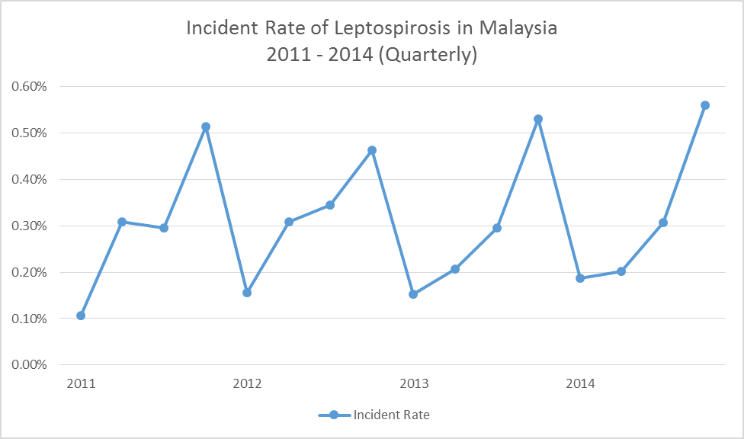
The graph of Incident Rate of Leptospirosis in Malaysia
2011 -2014 (Quarterly

Slide 6
Gender
 |  | Male | Female
2011 | 1ST QUARTER | 0.08% | 0.02%
 | 2ND QUARTER | 0.12% | 0.04%
 | 3RD QUARTER | 0.12% | 0.04%
 | 4TH QUARTER | 0.14% | 0.06%
2012 | 1st QUARTER | 0.21% | 0.09%
 | 2nd QUARTER | 0.22% | 0.09%
 | 3rd QUARTER | 0.16% | 0.05%
 | 4th QUARTER | 0.16% | 0.04%
 |  | Male | Female
2013 | 1st QUARTER | 0.23% | 0.06%
 | 2nd QUARTER | 0.25% | 0.09%
 | 3rd QUARTER | 0.21% | 0.09%
 | 4th QUARTER | 0.22% | 0.09%
2014 | 1st QUARTER | 0.33% | 0.17%
 | 2nd QUARTER | 0.31% | 0.15%
 | 3rd QUARTER | 0.34% | 0.18%
 | 4th QUARTER | 0.36% | 0.20%

Slide 7
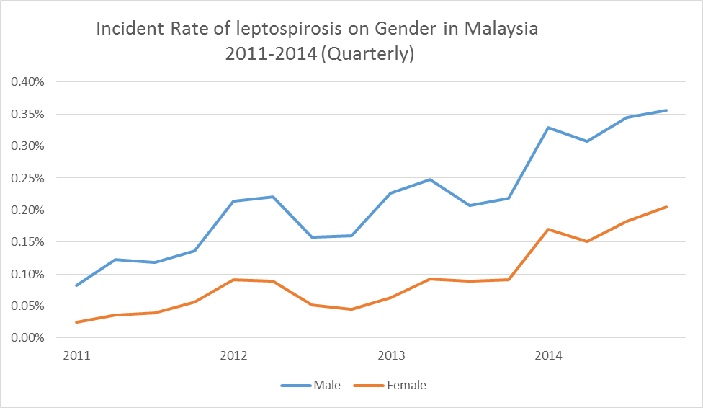
Graph of the Incident Rate of Leptospirosis on Gender in Malaysia
2011 – 2014 (Quarterly)

Slide 8
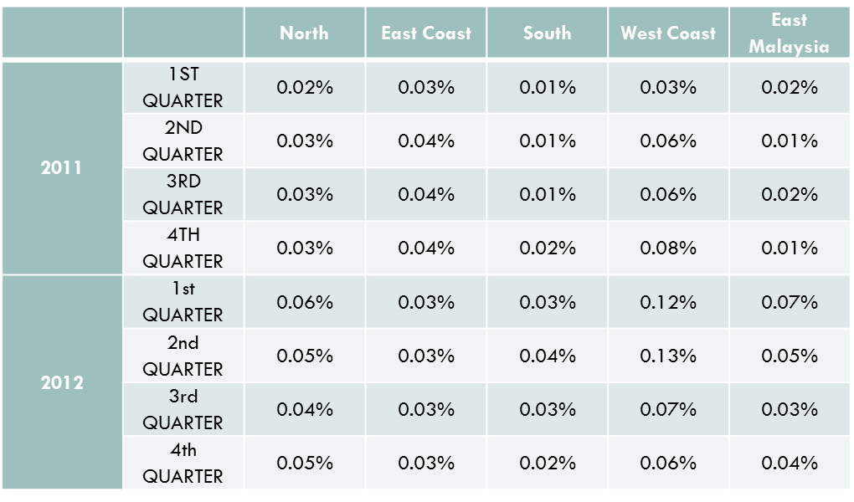
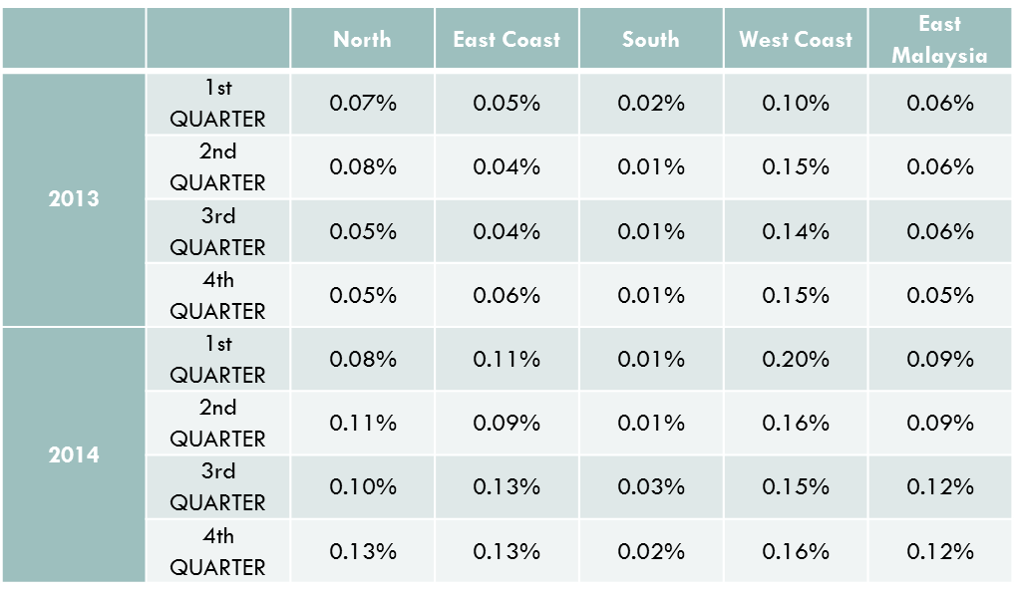
Region

Slide 9
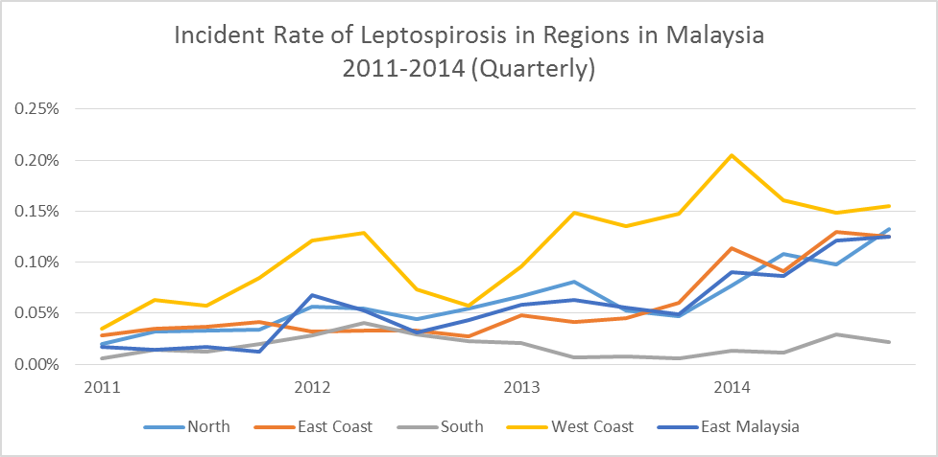
The Incident Rate of Leptospirosis in Regions in Malaysia
2011 – 2014 (Quarterly)

Slide 10
Race
 |  | Malay | Chinese | Indian | Others
2011 | 1st QUARTER | 0.0613% | 0.0048% | 0.0052% | 0.0350%
 | 2ND QUARTER | 0.0948% | 0.0072% | 0.0093% | 0.0466%
 | 3RD QUARTER | 0.0955% | 0.0082% | 0.0082% | 0.0446%
 | 4TH QUARTER | 0.1128% | 0.0106% | 0.0157% | 0.0533%
2012 | 1st QUARTER | 0.1669% | 0.0228% | 0.0225% | 0.0930%
 | 2nd QUARTER | 0.1679% | 0.0207% | 0.0217% | 0.0987%
 | 3rd QUARTER | 0.1243% | 0.0122% | 0.0115% | 0.0618%
 | 4th QUARTER | 0.1171% | 0.0131% | 0.0131% | 0.0612%
 |  | Malay | Chinese | Indian | Others
2013 | 1st QUARTER | 0.1551% | 0.0191% | 0.0181% | 0.0965%
 | 2nd QUARTER | 0.1946% | 0.0284% | 0.0184% | 0.0988%
 | 3rd QUARTER | 0.1512% | 0.0244% | 0.0200% | 0.0998%
 | 4th QUARTER | 0.1825% | 0.0194% | 0.0167% | 0.0908%
2014 | 1st QUARTER | 0.3018% | 0.0366% | 0.0243% | 0.1366%
 | 2nd QUARTER | 0.2757% | 0.0315% | 0.0252% | 0.1251%
 | 3rd QUARTER | 0.3223% | 0.0301% | 0.0252% | 0.1494%
 | 4th QUARTER | 0.3340% | 0.0291% | 0.0271% | 0.1700%

Slide 11
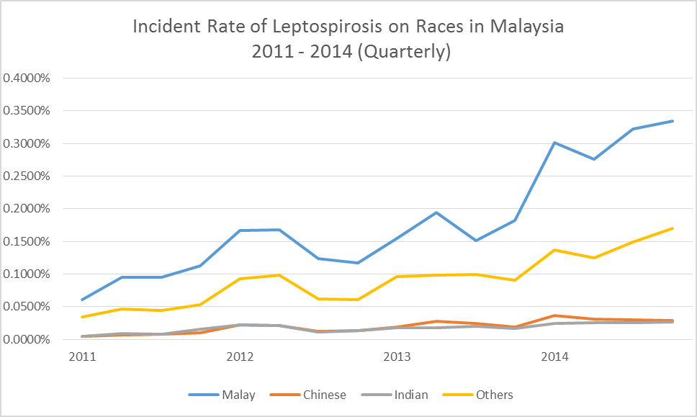
The Incident Rate of Leptospirosis on Races in Malaysia 2011 – 2014 (Quarterly)

Slide 12
Markov Chain – probability of patients on stages on leptospirosis
2011
2011 | EXIT STAGE |  |  | TOTAL
Current Stage | 1 | 2 | 3
1 | 89 | 1652 | 41 | 1782
2 | 0 | 2 | 0 | 2
3 | 0 | 0 | 0 | 0
TOTAL | 89 | 1654 | 41 | 1784

Slide 13

Transition probability for the year 2011

Slide 14
2012
2012 | EXIT STAGE |  |  | TOTAL
CURRENT STAGE | 1 | 2 | 3
1 | 116 | 2842 | 68 | 3026
2 | 0 | 9 | 0 | 9
3 | 0 | 0 | 0 | 0
TOTAL | 116 | 2851 | 68 | 3035

Slide 15

Transition probability for the year 2012

Slide 16
2013
2013 | EXIT STAGE |  |  | TOTAL
CURRENT STAGE | 1 | 2 | 3
1 | 1202 | 2420 | 63 | 3685
2 | 0 | 8 | 0 | 8
3 | 0 | 0 | 0 | 0
TOTAL | 1202 | 2428 | 63 | 3693

Slide 17

Transition probability for the year 2013

Slide 18
2014
2014 | EXIT STAGE |  |  | TOTAL
CURRENT STAGE | 1 | 2 | 3
1 | 2036 | 4009 | 83 | 6155
2 | 0 | 11 | 0 | 11
3 | 0 | 0 | 0 | 0
TOTAL | 2063 | 4020 | 83 | 6166

Slide 19

Transition probability for the year 2014

Slide 20
CONCLUSION
Calculate the incident rate of leptospirosis in Malaysia
The incident rate can be obtained from observing how many cases occurred during a period of time from a population at risk in the same period of time.
From the findings, we can see that the incident rate is high at 4th quarter (October – December) for each of the year.
It mainly caused by the flood happened during monsoon season.
But the highest case was in 4th quarter for the year 2014. it is because of last year flood was the worst in
Heavy seasonal rains and strong winds have affected most parts of Malaysia since mid-December 2014 and it continue until early January 2015.

Slide 21
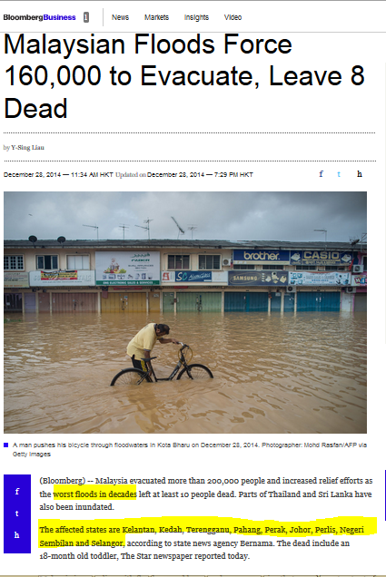
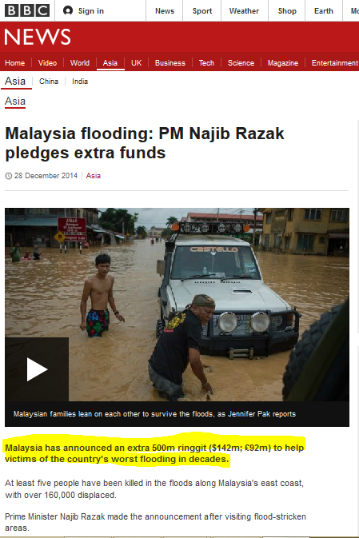
News on 2014 floods

Slide 22
CONCLUSION (cont.)
To Identify The Relationship Between The Incidence Rate of Leptospirosis In Malaysia With Gender, Race, And State
Incident rate vs gender
Sex refers to the biological and physiological factors that define males and females, while gender refers to socially constructed roles and attributes that a particular society considers appropriate for men and women.
The reason why men’s incident rate always above women because men always have high-risk behavior and occupations. Men do outdoor activities more frequent than women.
Even though both genders are exposed to occupational or recreational risk factors, males have higher rate of incident due to greater frequency and duration exposure
Notes:
The definition of seropositive is the results of a blood test that show the presence of a specific antibody in the blood serum.
-A blood test that shows you have a specific viral disease is an example of something that would be described as a seropositive test.

Slide 23
CONCLUSION (Cont.)
Incident rate vs state
From the analysis, West Coast’s incident rate is always above other regions. The main reason is over crowding. West coast state especially Selangor has high density population. Because of the high density population, sanitation is hardly to keep.
Other reason maybe because of medical accessibility. West coast has better medical accessibility compared to other regions. Since the lepto patients in West Coast region have better access for medical attention, it would affect directly to the surveillance data.

Slide 24
Conclusion (Cont.)
Incident rate vs race
From the analysis, we could see Malay have higher incident rate compare to others.
It maybe because of behavior exposure and recreational exposure. Most of Malays live in rural area.

Slide 25
CONCLUSION (Cont.)
To calculate the probability of patients on stages of leptospirosis by using Markov Chain approach
The results from the finding stated that from each year, many have survived leptospirosis.
With many survivors, there’s still hope that this disease can be prevented in the future.
In this research, it has proven that even though some are free from lepto, some still get infected again.

Slide 26
RECOMMENDATIONS
Usage of the incidence table can be applied in Malaysia for purposes of calculating government budget allocated for health expenses, relevant talk and prevention program.
Better understanding on factors leading to the development of leptospirosis can reduce the incidence of leptospirosis disease.
Society should be aware of the severity of this disease so that they’ll take precautions to prevent self from infected.
Further research on this disease need to be done. There is only a few research that had been done by the past researchers.

