Slide 1
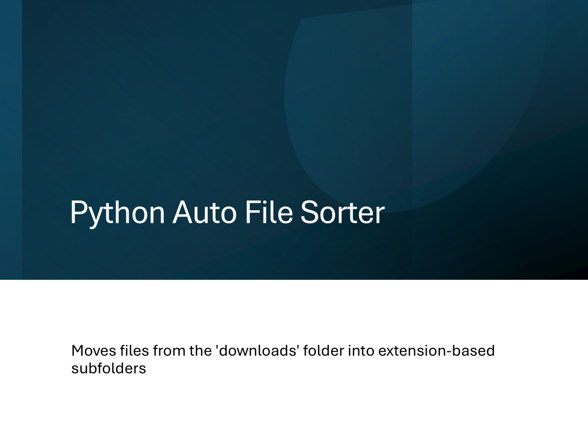

Slide 2
Aim & Scope
Aim: Organize the 'Downloads' folder in the same directory as the script/executable.
Scope: Move files into top-level folders according to their extensions.
Result: Files with extensions go into UPPERCASE folders; extensionless files go into 'Extensionless'.

Slide 3
How It Works (Step by Step)
1) Determine base_folder:
• If the app is frozen: use the directory of sys.executable.
• Otherwise: use the current script directory (os.path.abspath(__file__)).
2) Set source_folder = base_folder/'Downloads' and create if missing.
3) files = os.listdir(source_folder); if empty, return.
4) For each item: process only files (os.path.isfile).
5) Extract the extension from the right: if '.' exists, take the last part (lowercased); else empty.
6) Target folder name: ext.upper() or 'Extensionless'.
7) Create the target folder (exist_ok=True); move with shutil.move.
8) Print a message for each move; print a completion line at the end.

Slide 4
What We Used (From Code)
os: os.path.join, os.path.isfile, os.path.dirname, os.path.abspath, os.listdir, os.makedirs.
shutil: move files via shutil.move.
sys: getattr(sys, 'frozen', False) check and sys.executable.
Conditionals & loops: extension parsing and target folder selection flow.

Slide 5
Folder Layout (Before / After)
project/
├─ auto_sort.py (example)
└─ Downloads/ ← mixed files here
├─ report.pdf
├─ photo.jpg
└─ note
After running:
project/
├─ auto_sort.py
├─ PDF/ ← report.pdf
├─ JPG/ ← photo.jpg
└─ Extensionless/ ← note

Slide 6
Code Snippet — Setup
import os, shutil, sys
def auto_sort_files():
if getattr(sys, 'frozen', False):
base_folder = os.path.dirname(sys.executable)
else:
base_folder = os.path.dirname(os.path.abspath(__file__))
source_folder = os.path.join(base_folder, 'Downloads')
os.makedirs(source_folder, exist_ok=True)

Slide 7
Code Snippet — Loop & Move
files = os.listdir(source_folder)
if not files:
return
for file_name in files:
source_path = os.path.join(source_folder, file_name)
if os.path.isfile(source_path):
if '.' in file_name:
ext = file_name.split('.')[-1].lower()
else:
ext = ''
folder_name = 'Extensionless' if ext == '' else ext.upper()
destination_folder = os.path.join(base_folder, folder_name)
os.makedirs(destination_folder, exist_ok=True)
shutil.move(source_path, os.path.join(destination_folder, file_name))
print(f"{file_name} moved to {folder_name}.")
print('\nAll files are moved according to their extensions.')

Slide 8
How to Run?
Place the script in the project folder.
Keep a 'Downloads' folder in the same directory (the code creates it if missing).
Put files into 'Downloads'.
Run the script: auto_sort_files() is called automatically at the end.

Slide 9
Constraints (Current Code)
No name conflict handling (possible overwrite when files share the same name).
No try/except error handling; locked/inaccessible files will raise errors.
Processes only files; does not process subfolders.

Slide 10
Conclusion
auto_sort_files() moves files inside 'Downloads' into extension-based top-level folders.
Extensionless files are collected under 'Extensionless'
For each move, the console prints "<file> moved to <folder>."
If 'Downloads' is empty, the function exits without changes.
It is designed to operate on 'Downloads' next to the script/executable.

