Slide 1
Coach Attack Explorer
Goal build-up replay and tournament style comparison
Interactive Visualisation
StatsBomb Open Data
Emircan Bagcivan · FS26
IVI Final Pitch · Coach Attack Explorer · 1

Slide 2
Dataset and goal
Dataset
Project goal
StatsBomb open event data from major football tournaments
Raw actions include passes, carries, shots, locations and timestamps
Data was transformed into local CSV files for stable dashboard use
Inspect how goals were created before the final shot
Replay one concrete goal build-up on a pitch
Compare a selected team with the rest of the tournament
Support coaching discussion
Research question: How do teams create goals, and how does their attacking style compare within the tournament?
IVI Final Pitch · Coach Attack Explorer · 2

Slide 3
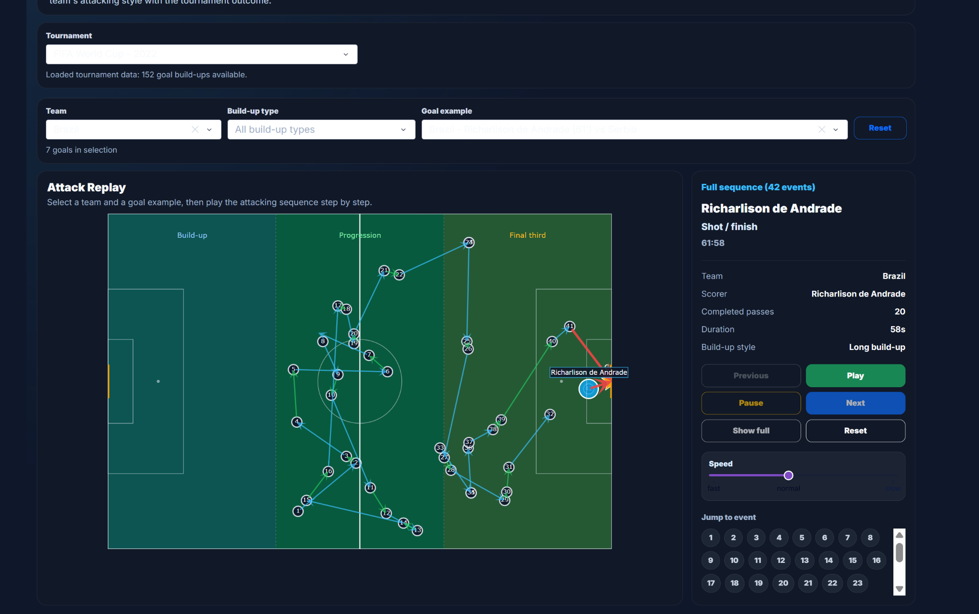
Goal replay workflow
The user moves from filters to one concrete attack sequence
What the user can do
Choose tournament, team and one goal example
Replay the attack with Play, Next and Jump to event
Read event details: player, action, scorer, passes and duration
Use the pitch zones to understand progression into the final third
Attack Replay view: selected Brazil goal build-up with step controls and event details.
IVI Final Pitch · Coach Attack Explorer · 3

Slide 4
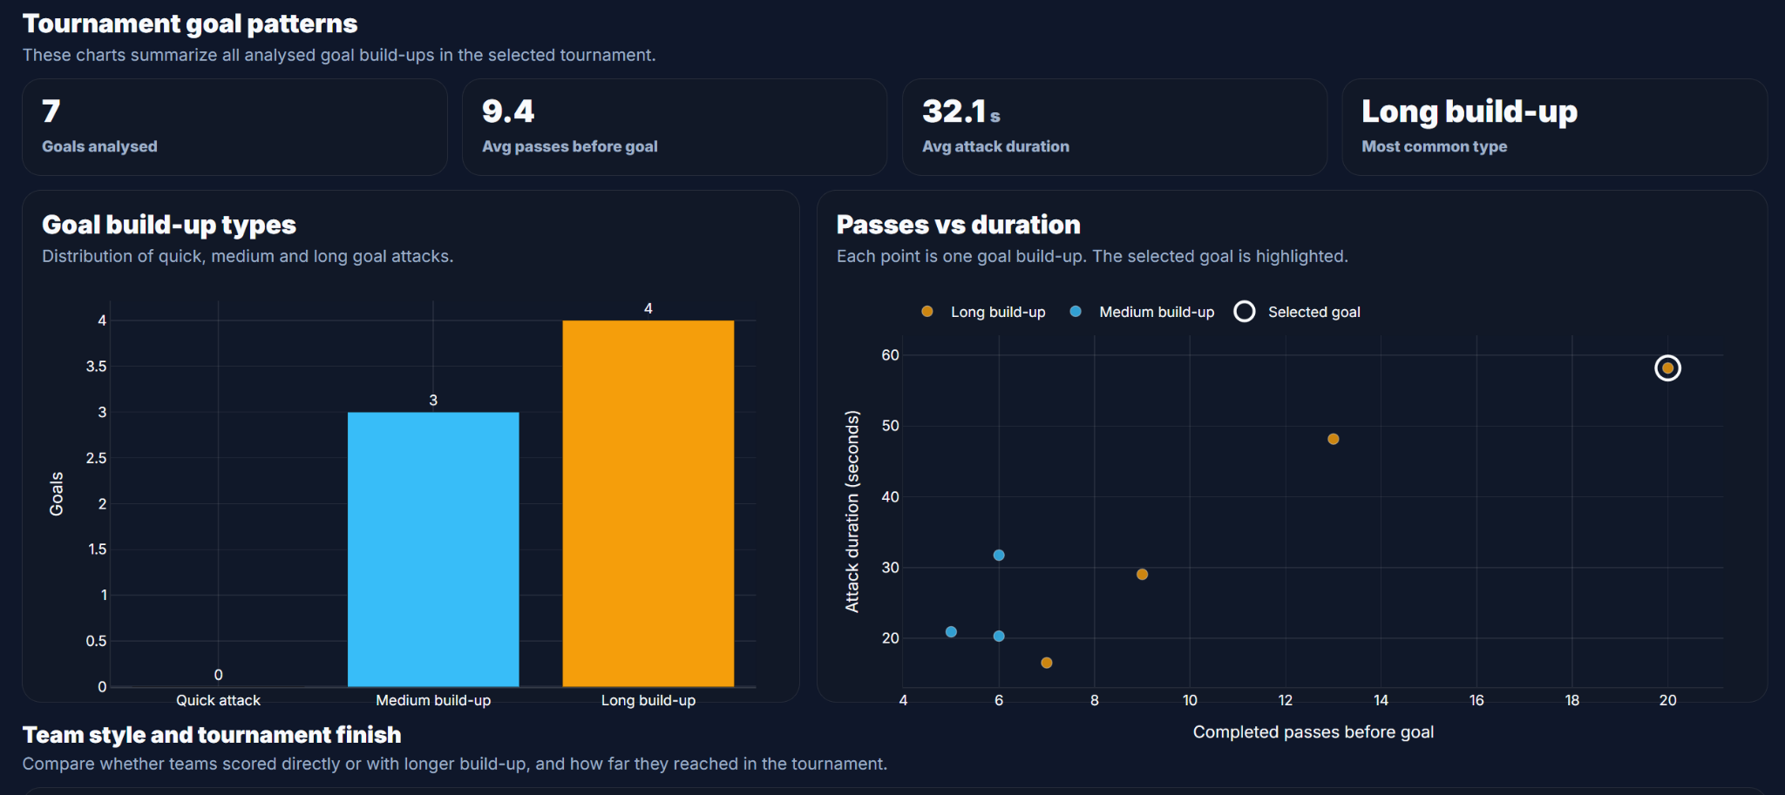
Tournament overview
The overview connects goal build-up type with passes and duration
Insight from the overview
KPI cards give a fast summary of the selected tournament or team
Build-up type chart separates quick, medium and long goal attacks
Scatterplot shows how completed passes relate to attack duration
Selected goal is highlighted so the user can compare example and pattern
Tournament goal patterns after selecting Brazil: KPIs, build-up type distribution and passes vs duration.
IVI Final Pitch · Coach Attack Explorer · 4

Slide 5
Key design choices and feedback
The final design choices were guided by IVI principles and user feedback
Design choices
Evaluation feedback
Overview first: tournament KPIs and charts before detailed comparison
Filtering: tournament, team, build-up type and goal example
Details on demand: step-by-step replay and event information
Linked views: filters update replay, charts and team comparison
3 football-interested participants tested the workflow
Replay was strongest because it uses a familiar football pitch
Directness Rank, scatterplot and build-up categories need short explanations
IVI Final Pitch · Coach Attack Explorer · 6

