Slide 1
© Philipp Arnoldt
Gamba – a distributed event organisation app
Emirhan, Eduard, Mikolaj | Scalable Software Systems | Programming Assignment| 13. July 2026

Slide 2
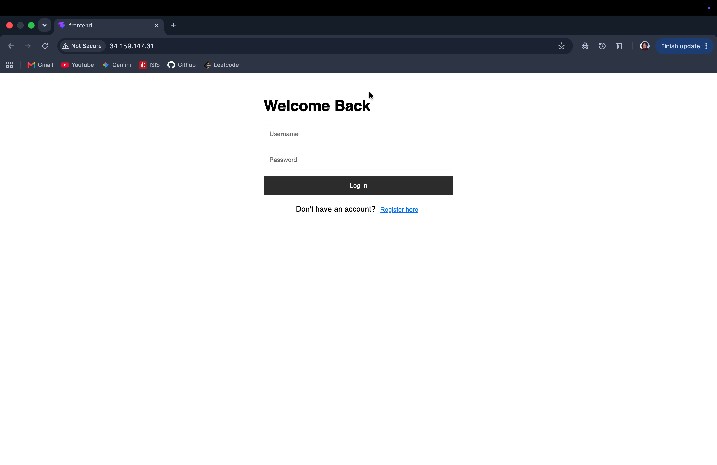
Gamba: Product DEMO

Slide 3





Application Architecture
Strategies to mitigate overloading:
Rate Limiter
Load Shedding
Caching
Rate Limiter: 60 req/s per IP (*backend nodes, potentially 300req/s/IP)
Load Shedding:
p95 latency
In-flight connections
Caching

Slide 4
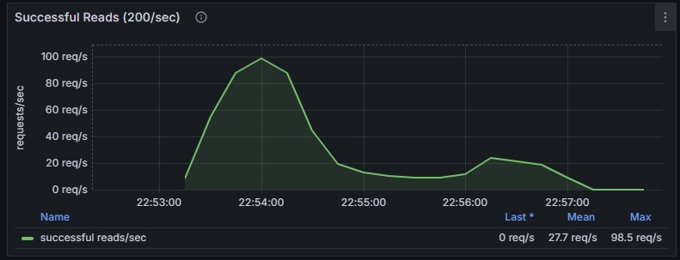
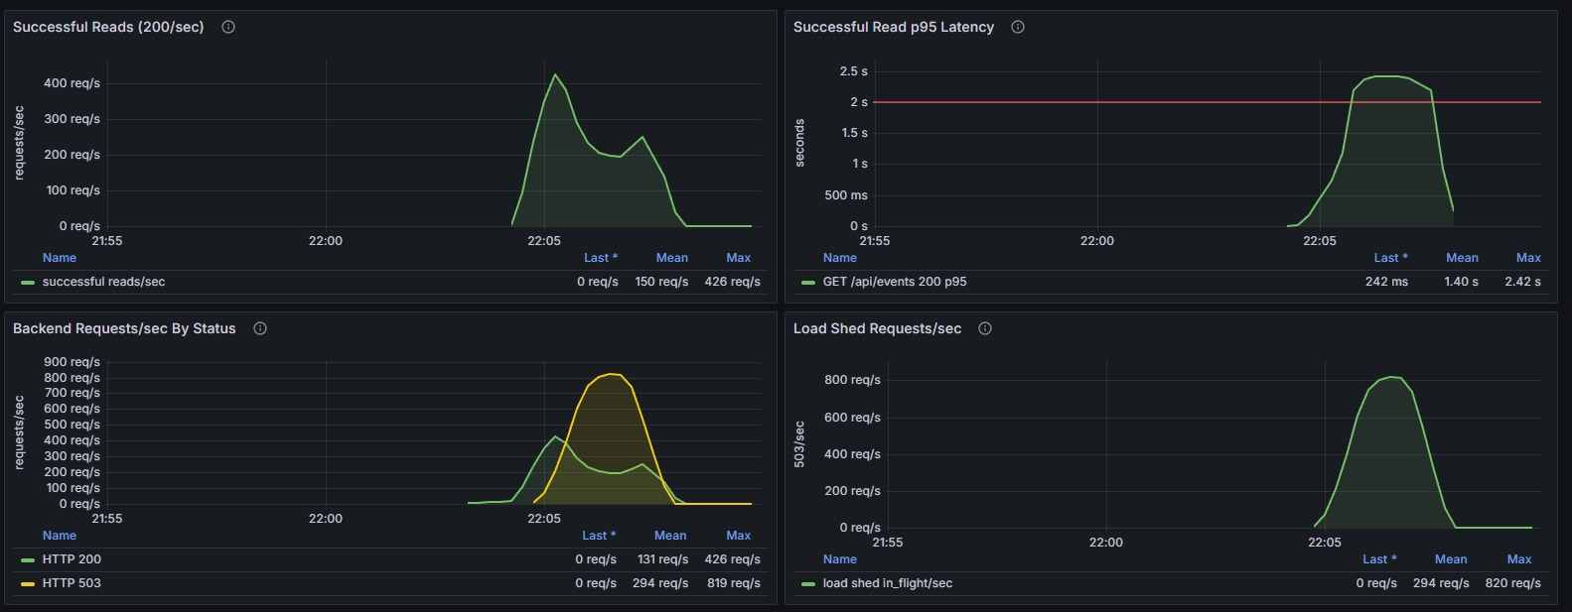
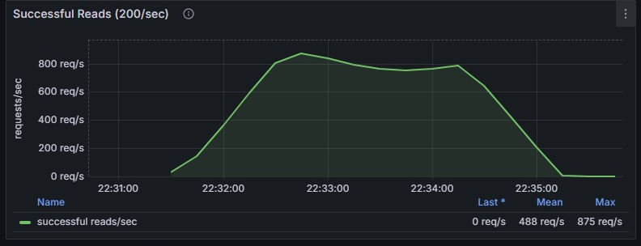
1 node cluster p95 = 3.64
Scaling out performance
Machine type: e2-standard-2
3 node cluster p95 = 1.4
5 node cluster p95 = 1.38

Slide 5
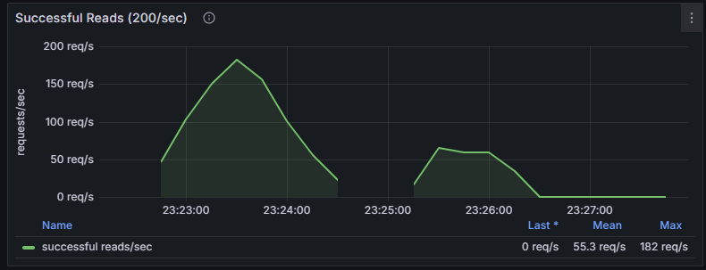
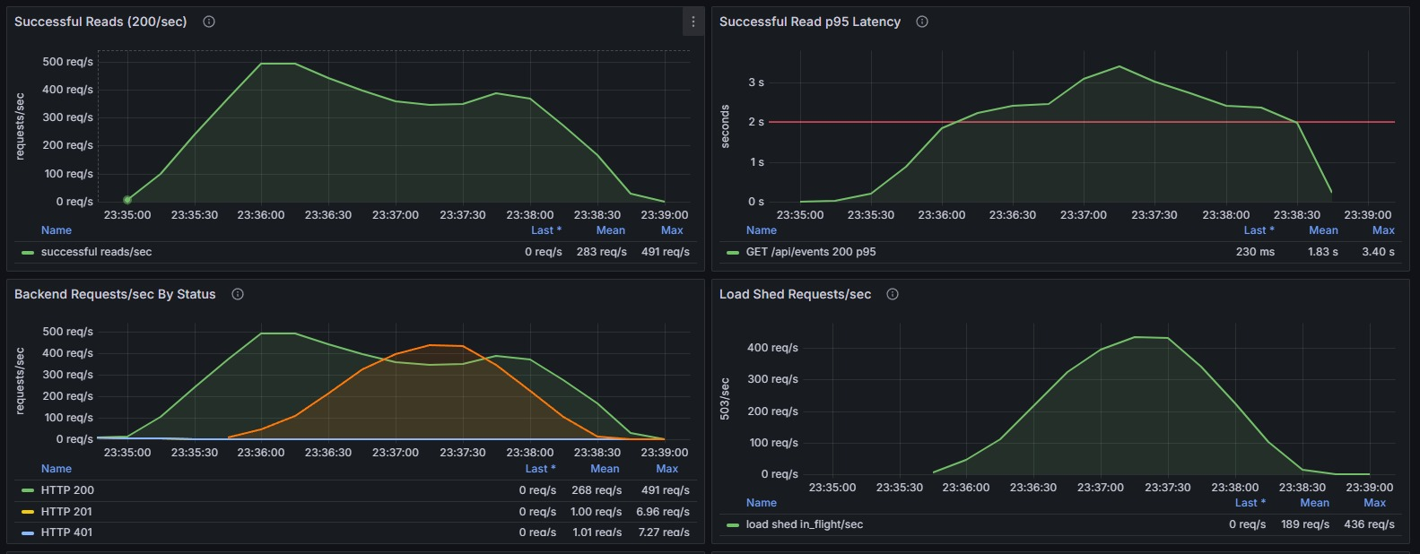
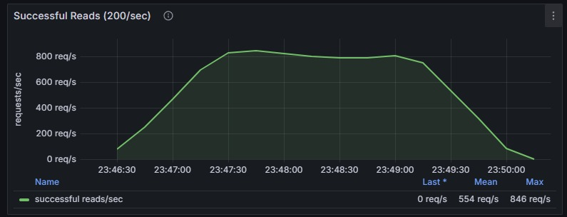
1 node cluster p95 = 5.7
Scaling out and up performance
Machine type: e2-standard-4
3 node cluster p95 = 1.8
5 node cluster p95 = 1.56

Slide 6
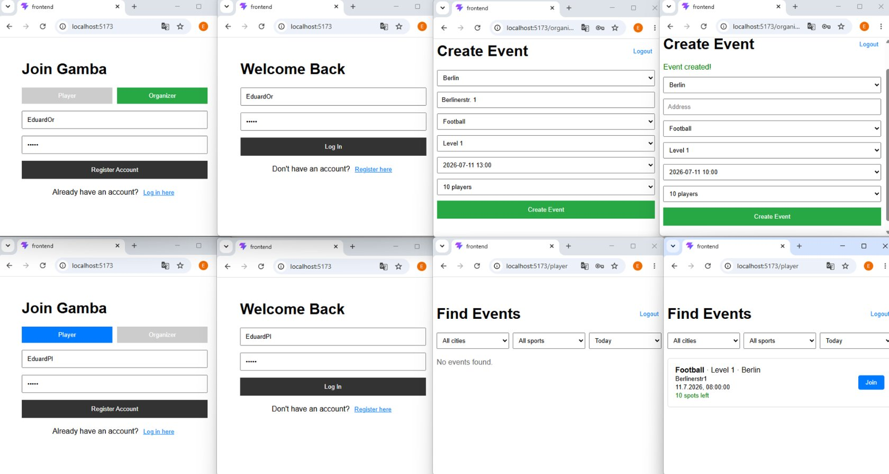
BACKUP: UI Showcase

