Slide 1
Numerical Analysis/ Scientific Computing
Feb – June 2023
Kelas A – T. Basaruddin

Slide 2
Course outline
Introduction: Motivation, Machine Precision, and Finite Precision Arithmetic
System of Linear Equations
Least Squares Problems
Nonlinear Equations
Optimizations
Interpolations
Numerical Integration
Initial Value Problems (tentative)

Slide 3
Motivation
Many real-world problems involves solving of mathematical problems using computers
New technologies requires good understanding on how computers handle arithmetic computation effectively and efficiently
Numerical Analysis: study of finding numerical solutions to mathematical problems (a branch of mathematic)
Scientific Computation: Design and analysis of algorithms for solving mathematical problems arising in science and engineering numerically (numerical analysis + computing)

Slide 4
Mathematical Problems & Solutions
Given mathematical relationship y = f (x); typical problems include
Evaluate a function: compute output y for given input x
Solve an equation: find input x that produces given output y
Optimize: find x that yields extreme value of y over given domain
Type of solutions
Analytical vs numerical solutions
Exact vs approximate solutions

Slide 5
Key questions
How to find the solution? → algorithms
design and construction of algorithms
Is the solution accurate? → effectiveness
error analysis (theoretical or empirical)
Is the algorithm efficient?
complexity analysis and optimization

Slide 6
Machine representation of numbers (review)
IEEE standards
Integer
Floating point systems
base β, precision p, range of exponent [L,U]

Slide 7
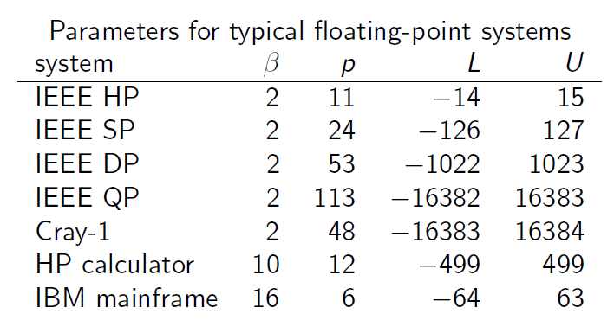
Implication of floating point system
Floating point systems is finite, discrete, and nonuniformly distributed
Total number of normalized fp ?
2( β -1) β^{p-1}(U - L + 1) + 1
smallest positive number (UFL)
normalized= β^{L}
maximum positive number (OFL)
β^{U+1}(1 – β^{1-p})
Machine epsilon/number
smallest number є such that (1 +є ) > 1
also known as unit round-off
characterizes the machine precision

Slide 8
Errors
Error = deviation from the true solution
Measuring error
absolute error = | approximation – true solution |
relative error = absolute error / |true solution|
Sources of error
data error → inexact input
computational error = truncation + rounding
truncation error:
Due to mathematical approximations such as truncating infinite series, discrete approximation of derivatives or integrals, or terminating iterative sequence before convergence
rounding error
Due to inexact representation of real numbers and arithmetic operations upon them
Total error = data error + computational error
Forward vs Backward error

Slide 9
Error Propagation
Amplification of error due to arithmetic operations

Slide 10
Loss of Significant Digits (cancelation)
It occurs when an operation on two numbers increases relative error substantially more than it increases absolute error

Slide 11
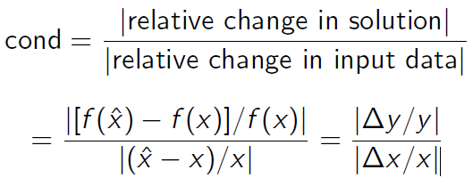
Sensitivity and Conditioning
Problem is insensitive, or well-conditioned, if relative change in input causes similar relative change in solution
Problem is sensitive, or ill-conditioned, if relative change in solution can be much larger than that in input data
Condition number :

