Slide 1
Least Squares Problems

Slide 2
Topics
Characterization of Least Squares Problems
Existence of solution and normal equations
Orthogonal transformation
Householder reflection
Givens rotations
Rank Deficient problems

Slide 3
Motivation
Data fitting to a model
more data is better
data is much more than the number of parameters in the model
We have an over-determined system of linear equations
in general, no solutions satisfies the problem exactly
Find the best-fit solution, the one with smallest deviation in Euclidean norm

Slide 4
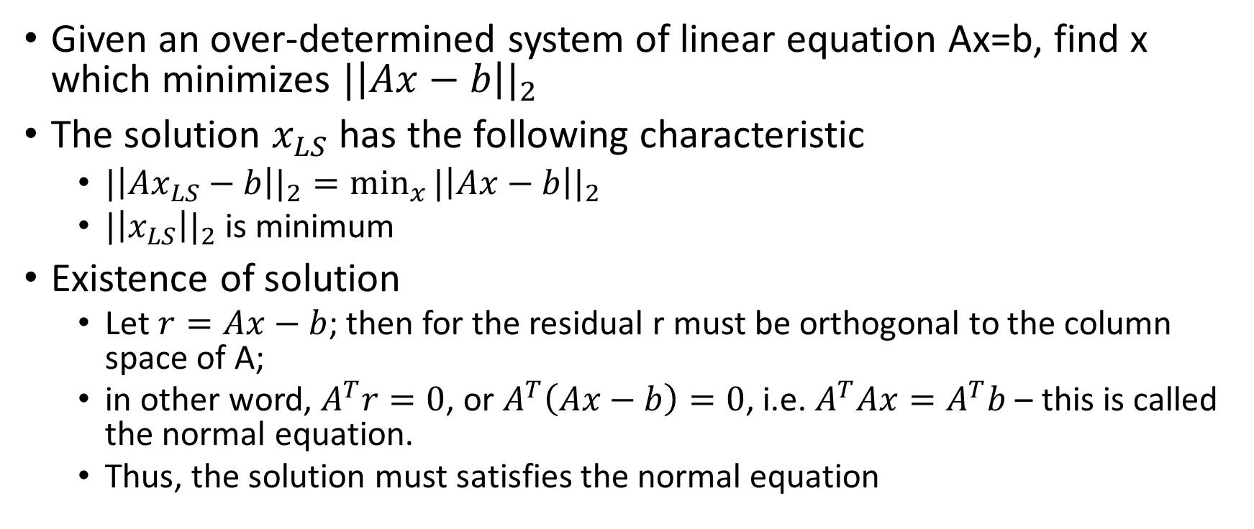
Least Square Problems & existence of solution
Given an over-determined system of linear equation Ax=b, find x which minimizes ${|\left|Ax−b\right||}_{2}$
The solution $x_{LS}$ has the following characteristic
${|\left|Ax_{LS}−b\right||}_{2}=\min_{x}{{|\left|Ax−b\right||}_{2}}$
${|\left|x_{LS}\right||}_{2}$ is minimum
Existence of solution
Let $r=Ax−b$; then for the residual r must be orthogonal to the column space of A;
in other word, $A^{T}r=0$, or $A^{T}\left(Ax−b\right)=0$, i.e. $A^{T}Ax=A^{T}b$ – this is called the normal equation.
Thus, the solution must satisfies the normal equation

Slide 5
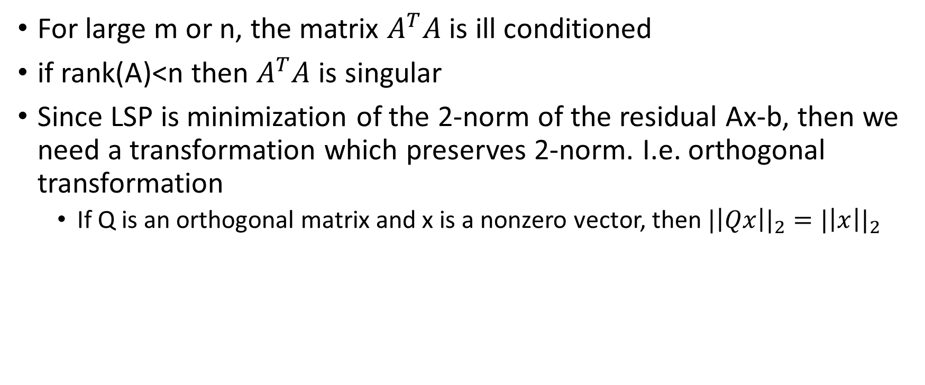

The problem with normal equation
For large m or n, the matrix $A^{T}A$ is ill conditioned
if rank(A)<n then $A^{T}A$ is singular
Since LSP is minimization of the 2-norm of the residual Ax-b, then we need a transformation which preserves 2-norm. I.e. orthogonal transformation
If Q is an orthogonal matrix and x is a nonzero vector, then ${|\left|Qx\right||}_{2}={|\left|x\right||}_{2}$

Slide 6
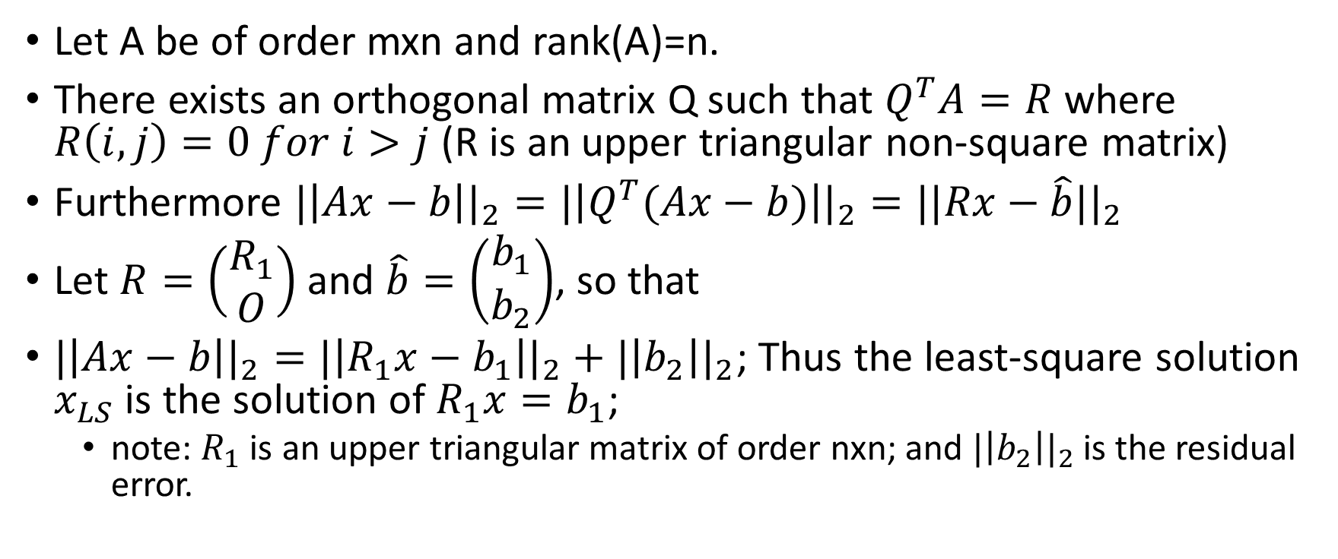
Orthogonal Transformation (QR) – full rank:
Let A be of order mxn and rank(A)=n.
There exists an orthogonal matrix Q such that $Q^{T}A=R$ where $R\left(i,j\right)=0 for i>j$ (R is an upper triangular non-square matrix)
Furthermore ${|\left|Ax−b\right||}_{2}={|\left|Q^{T}(Ax−b)\right||}_{2}={||Rx−\hat{b}||}_{2}$
Let $R=\left(\begin{aligned}R_{1} \\ O\end{aligned}\right)$ and $\hat{b}=\left(\begin{aligned}b_{1} \\ b_{2}\end{aligned}\right)$, so that
${|\left|Ax−b\right||}_{2}={|\left|R_{1}x−b_{1}\right||}_{2}+{|\left|b_{2}\right||}_{2}$; Thus the least-square solution $x_{LS}$ is the solution of $R_{1}x=b_{1}$;
note: $R_{1}$ is an upper triangular matrix of order nxn; and ${|\left|b_{2}\right||}_{2}$ is the residual error.

Slide 7

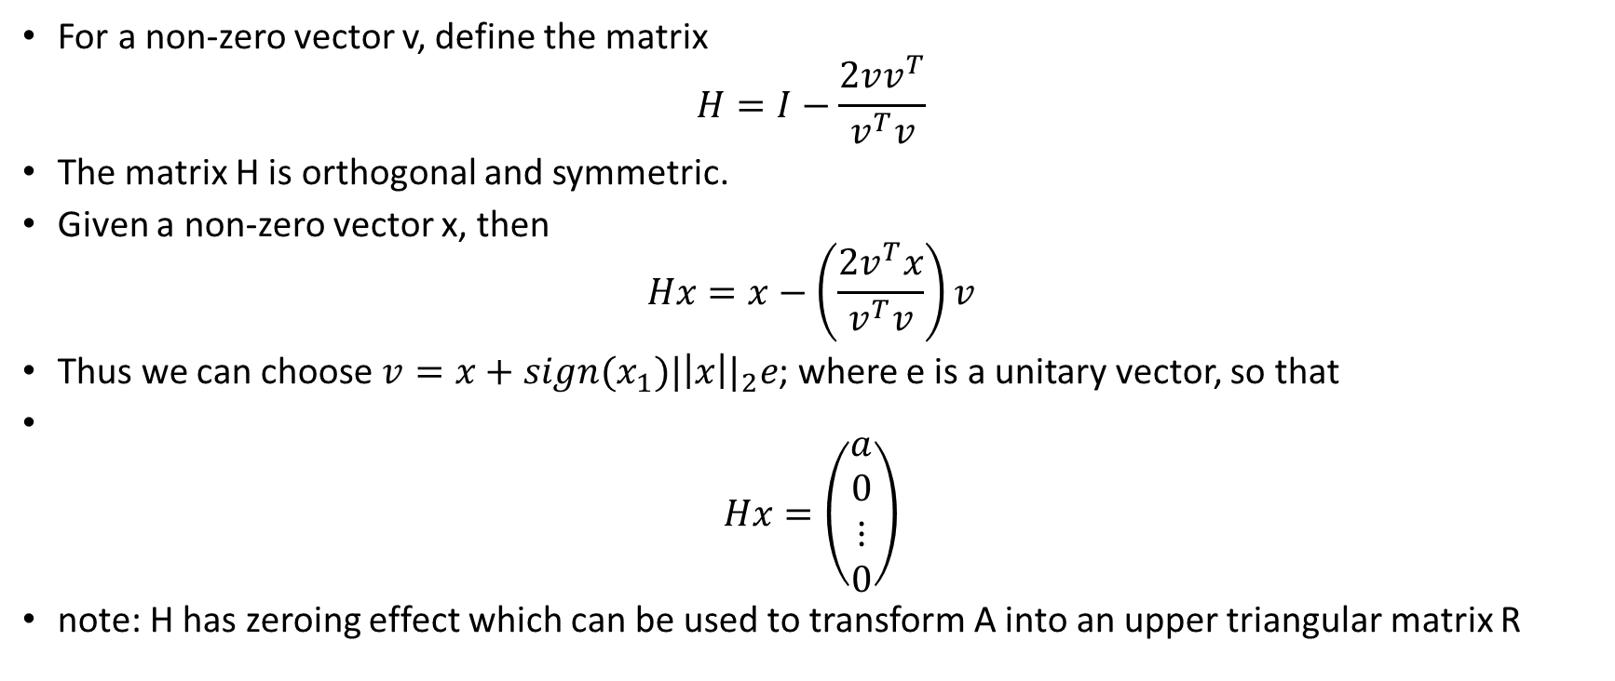

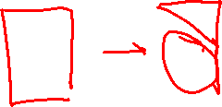
Householder Reflection
For a non-zero vector v, define the matrix
$$H=I−\frac{2vv^{T}}{v^{T}v}$$
The matrix H is orthogonal and symmetric.
Given a non-zero vector x, then
$$Hx=x−\left(\frac{2v^{T}x}{v^{T}v}\right)v$$
Thus we can choose $v=x+sign(x_{1}){|\left|x\right||}_{2}e$; where e is a unitary vector, so that
$$Hx=\left(\begin{aligned}a \\ 0 \\ ⋮ \\ 0\end{aligned}\right)$$
note: H has zeroing effect which can be used to transform A into an upper triangular matrix R

Slide 8
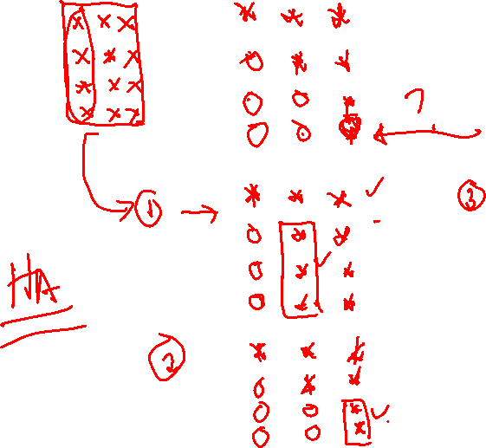
Illustration of Householder transformation processes

Slide 9
Householder Algorithm
Inputs: A and b; define A=[A b]
Outputs: R and bt
for k=1:n
v=A(k:m,k)+sign(A(k,k))*norm(A(k:m,k))*[1;zeros(m-k,1)];
alfa=2/(v’*v);
for j=k:n+1
alfa=alfa*v’*A(k:m,j);
A(k:m,j)=A(k:m,k)-alfa*v;
end
end
R=A(1:n,1:n); bt=A(1:m,n+1);

Slide 10
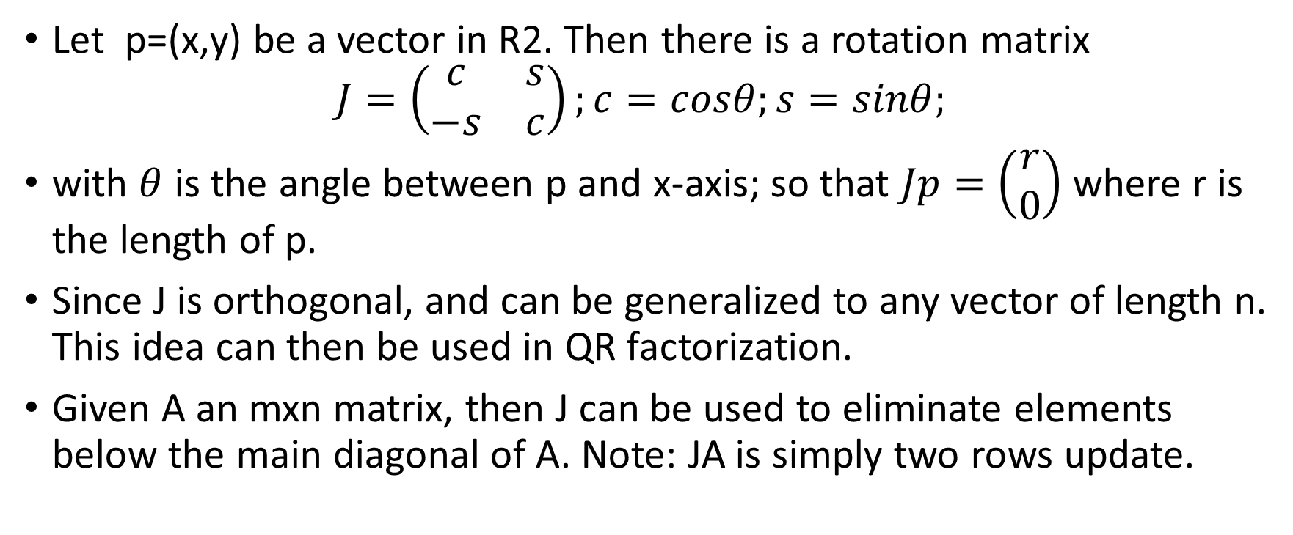
Givens Rotation
Let p=(x,y) be a vector in R2. Then there is a rotation matrix
$$J=\left(\begin{matrix}c & s \\ −s & c\end{matrix}\right);c=cosθ;s=sinθ;$$
with $θ$ is the angle between p and x-axis; so that $Jp=\left(\begin{aligned}r \\ 0\end{aligned}\right)$ where r is the length of p.
Since J is orthogonal, and can be generalized to any vector of length n. This idea can then be used in QR factorization.
Given A an mxn matrix, then J can be used to eliminate elements below the main diagonal of A. Note: JA is simply two rows update.

Slide 11
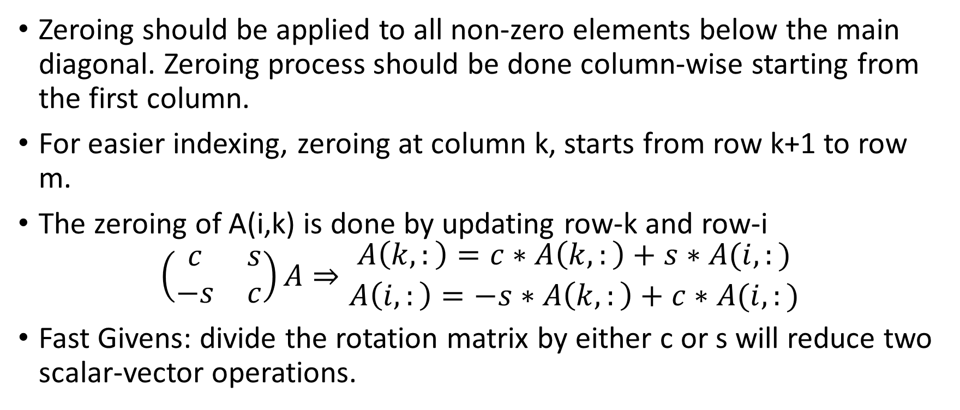
Illustration of Givens rotation processes
Zeroing should be applied to all non-zero elements below the main diagonal. Zeroing process should be done column-wise starting from the first column.
For easier indexing, zeroing at column k, starts from row k+1 to row m.
The zeroing of A(i,k) is done by updating row-k and row-i
$$\left(\begin{matrix}c & s \\ −s & c\end{matrix}\right)A⇒\begin{matrix}A\left(k,:\right)=c∗A\left(k,:\right)+s∗A(i,:) \\ A\left(i,:\right)=−s∗A\left(k,:\right)+c∗A(i,:)\end{matrix}$$
Fast Givens: divide the rotation matrix by either c or s will reduce two scalar-vector operations.

Slide 12
Givens Rotation Algorithm
Inputs: A, b
Outputs: R, bt
[m,n]=size(A); A=[A b];
for k=1:n
for i=k+1:m
r=sqrt(A(k,k)^2+A(k,i)^2); c=A(k,k)/r; s=A(k,i)/r;
tmp=c*A(k,k:n+1)+s*A(i,k:n+1);
A(i,k:n+1)=-s*A(k,k:n+1)+c*A(i,k:n+1);
A(k,k:n+1)=tmp;
end
end
R=C(:,1:n); bt=C(:,n+1)

Slide 13
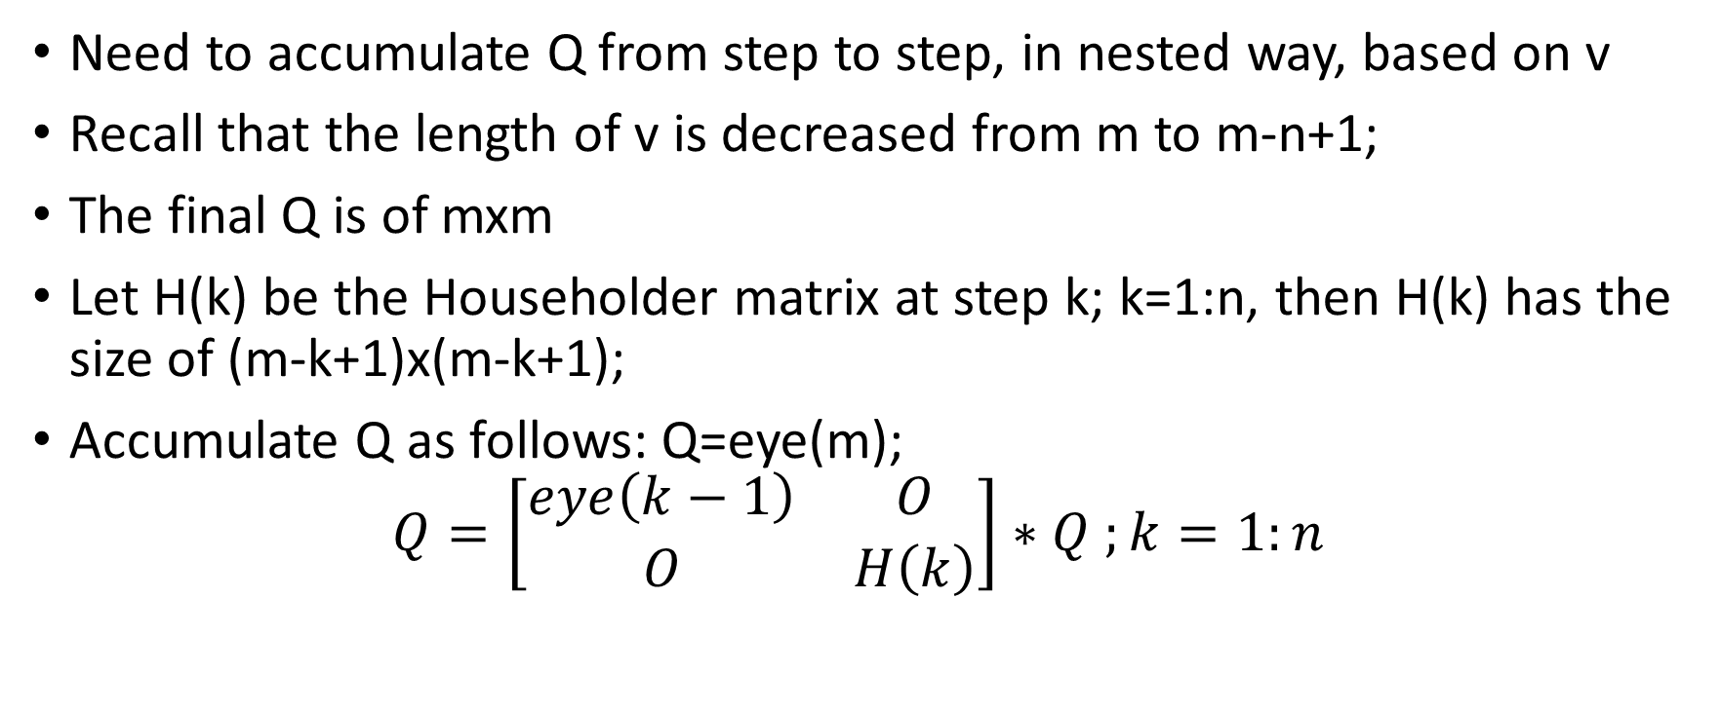
QR Algorithm where Q is stored
Need to accumulate Q from step to step, in nested way, based on v
Recall that the length of v is decreased from m to m-n+1;
The final Q is of mxm
Let H(k) be the Householder matrix at step k; k=1:n, then H(k) has the size of (m-k+1)x(m-k+1);
Accumulate Q as follows: Q=eye(m);
$$Q=\left[\begin{matrix}eye\left(k−1\right) & O \\ O & H\left(k\right)\end{matrix}\right]∗Q ;k=1:n$$

Slide 14
QR Factorization with Householder
function [Q,R]=MyQRHouse(A)
[m,n]=size(A);
Q=eye(m);
for j=1:n
v=A(j:m,j)+sign(A(j,j))*norm(A(j:m,j))*[1;zeros(m-j,1)];
a=2/(v'*v); H=eye(m-j+1)-a*v*v';
Q=[eye(j-1) zeros(j-1,m-j+1); zeros(m-j+1,j-1) H]*Q;
for i=j:n
A(j:m,i)=A(j:m,i)-a*v'*A(j:m,i)*v;
end
end
R=A;

Slide 15
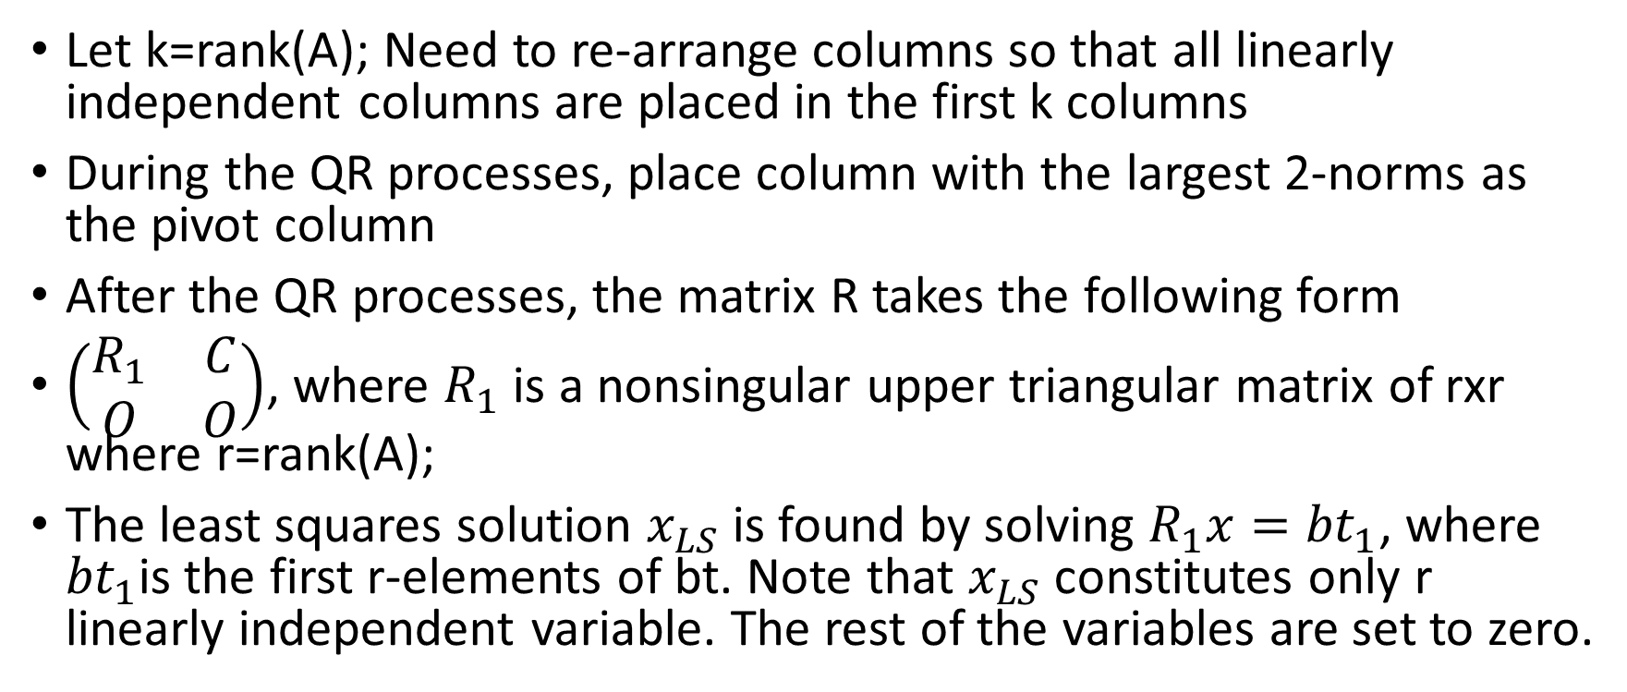
Rank(A)<n – rank deficient case
Let k=rank(A); Need to re-arrange columns so that all linearly independent columns are placed in the first k columns
During the QR processes, place column with the largest 2-norms as the pivot column
After the QR processes, the matrix R takes the following form
$\left(\begin{matrix}R_{1} & C \\ O & O\end{matrix}\right)$, where $R_{1}$ is a nonsingular upper triangular matrix of rxr where r=rank(A);
The least squares solution $x_{LS}$ is found by solving $R_{1}x={bt}_{1}$, where ${bt}_{1}$is the first r-elements of bt. Note that $x_{LS}$ constitutes only r linearly independent variable. The rest of the variables are set to zero.

Slide 16
QR with Column Pivoting
function [R,bt,p,r]=QRwithPivot(A,b)
[m,n]=size(A);
C=[A b];p=1:n;
for j=1:n
i=1; normcol=0;
for k=j:n
normcol(i)=norm(C(j:m,k)); i=i+1;
end
[x,k]=max(normcol);
if x < 10^-8,
r=j-1;
break;
end
k=k+j-1;
C(:,[j k])=C(:,[k j]);
p([j k])=p([k j]);
v=C(j:m,j)+sign(C(j,j))*norm(C(j:m,j))*[1;zeros(m-j,1)];
a=2/(v'*v);
for i=j:n+1
C(j:m,i)=C(j:m,i)-a*v'*C(j:m,i)*v;
end
end
R=C(1:m,1:n);bt=C(:,n+1);

