Slide 1
Special Linear Systems

Slide 2
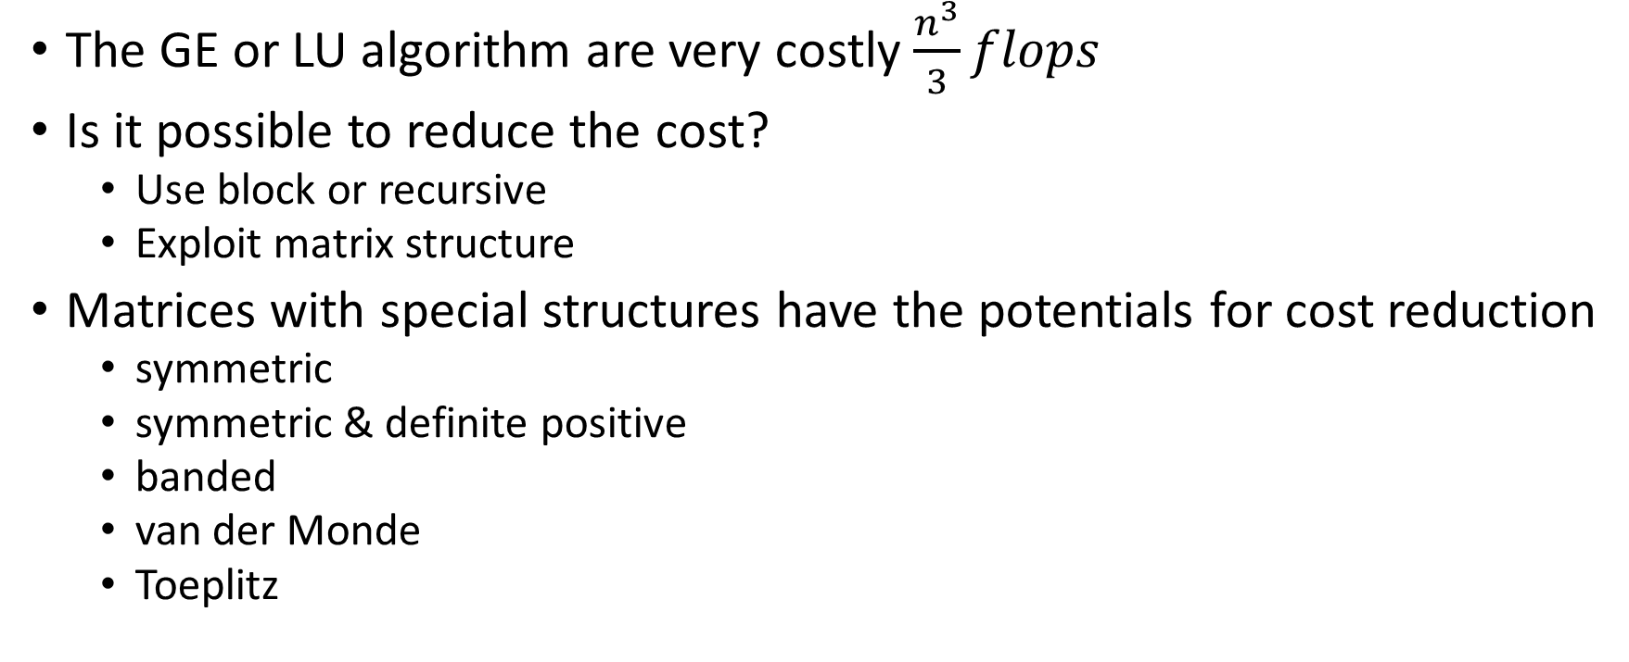
Motivation
The GE or LU algorithm are very costly $\frac{n^{3}}{3}flops$
Is it possible to reduce the cost?
Use block or recursive
Exploit matrix structure
Matrices with special structures have the potentials for cost reduction
symmetric
symmetric & definite positive
banded
van der Monde
Toeplitz

Slide 3
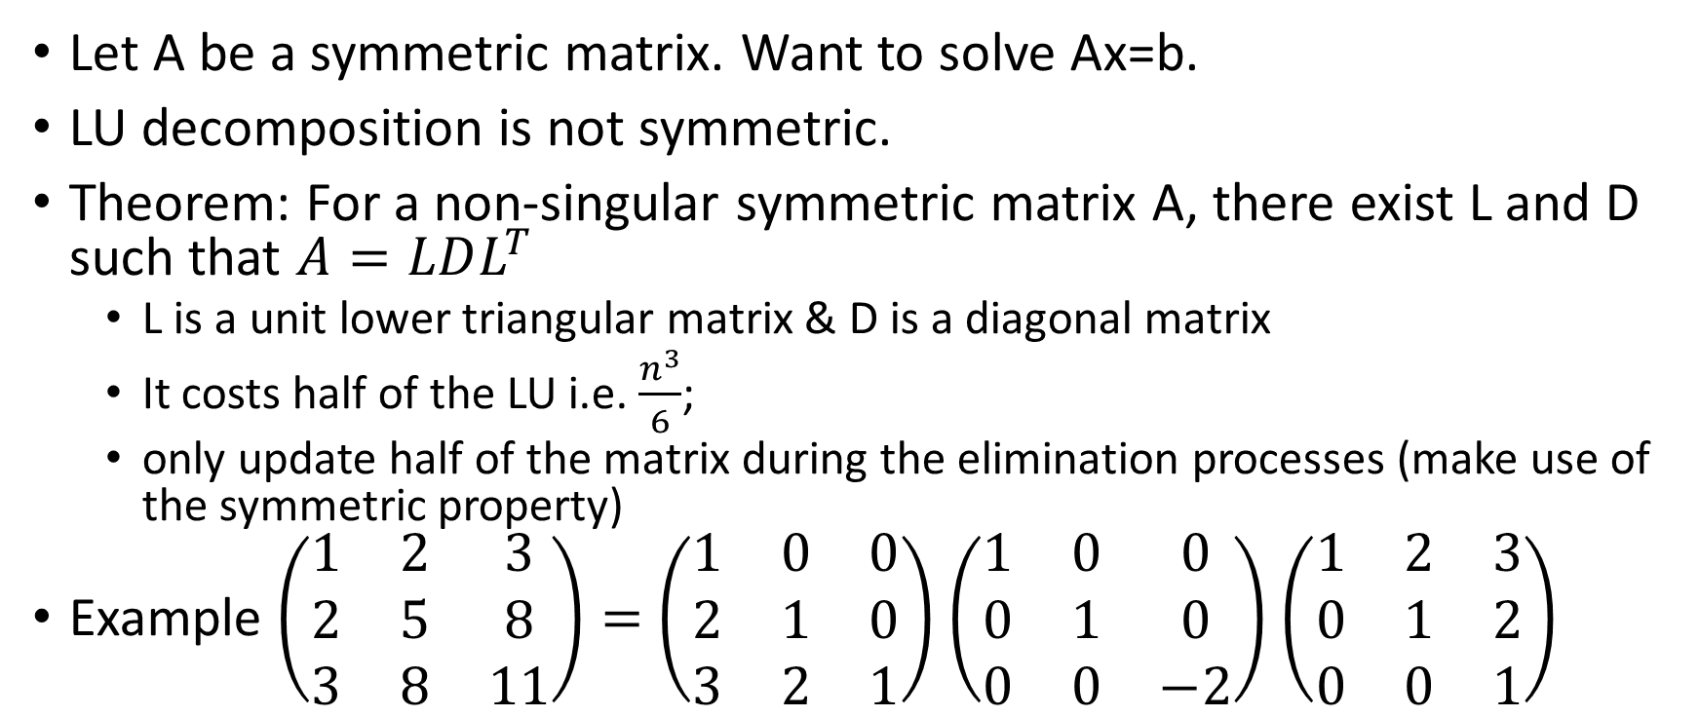
Symmetric indefinite matrices
Let A be a symmetric matrix. Want to solve Ax=b.
LU decomposition is not symmetric.
Theorem: For a non-singular symmetric matrix A, there exist L and D such that $A=LDL^{T}$
L is a unit lower triangular matrix & D is a diagonal matrix
It costs half of the LU i.e. $\frac{n^{3}}{6}$;
only update half of the matrix during the elimination processes (make use of the symmetric property)
Example $\left(\begin{matrix}1 & 2 & 3 \\ 2 & 5 & 8 \\ 3 & 8 & 11\end{matrix}\right)=$ $\left(\begin{matrix}1 & 0 & 0 \\ 2 & 1 & 0 \\ 3 & 2 & 1\end{matrix}\right)$ $\left(\begin{matrix}1 & 0 & 0 \\ 0 & 1 & 0 \\ 0 & 0 & −2\end{matrix}\right)$ $\left(\begin{matrix}1 & 2 & 3 \\ 0 & 1 & 2 \\ 0 & 0 & 1\end{matrix}\right)$

Slide 4
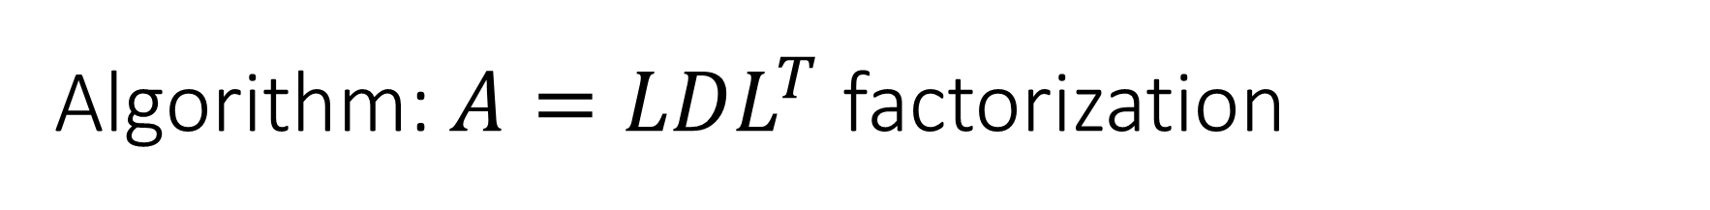
Algorithm: $A=LDL^{T}$ factorization
Input: A – a symmetric matrix
Outputs: a unit lower-triangular-matrix L and a diagonal matrix D.
L=I
for k=1:n-1
D(k)=A(k,k);
L(k+1:n,k)=A(k,k+1:n)’/D(k);
for i=k+1:n
A(i,k:n)=A(i,k:n)-L(i,k)*A(k,k:n);
end
end
D(n)=A(n,n);

Slide 5
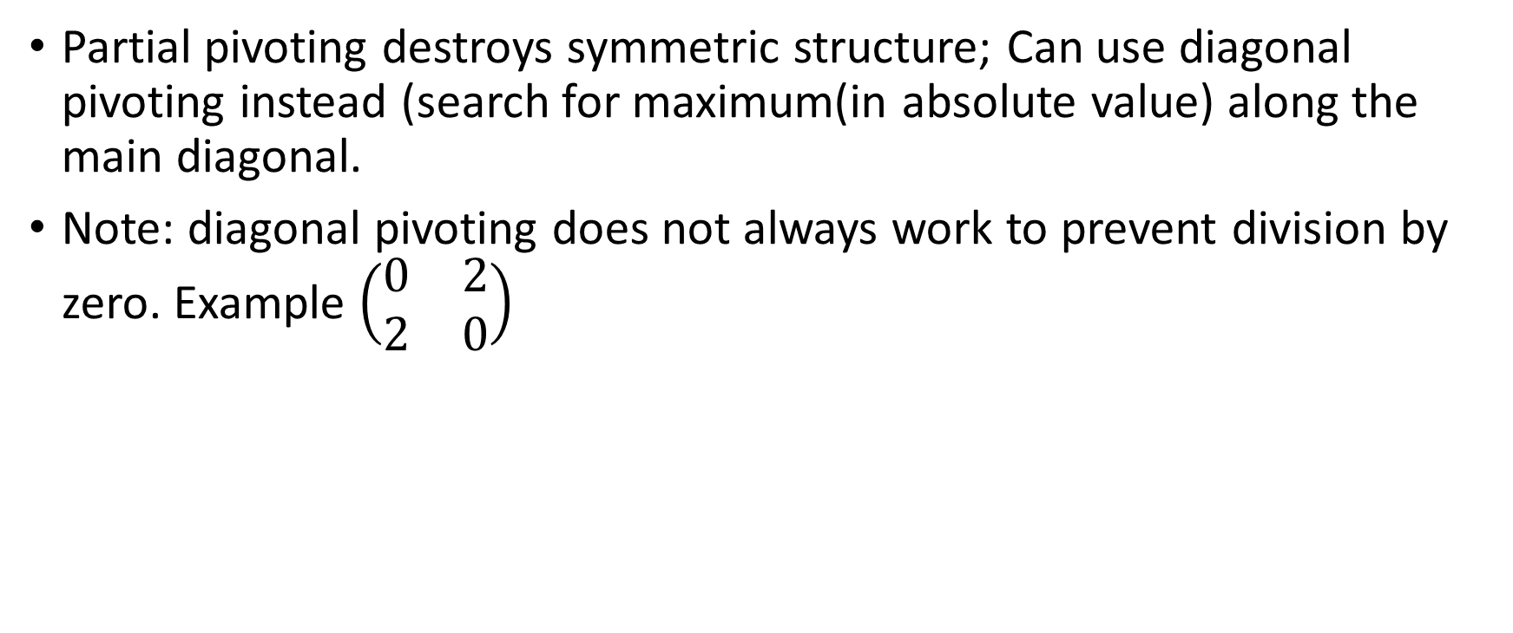
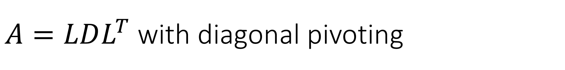
$A=LDL^{T}$ with diagonal pivoting
Partial pivoting destroys symmetric structure; Can use diagonal pivoting instead (search for maximum(in absolute value) along the main diagonal.
Note: diagonal pivoting does not always work to prevent division by zero. Example $\left(\begin{matrix}0 & 2 \\ 2 & 0\end{matrix}\right)$

Slide 6
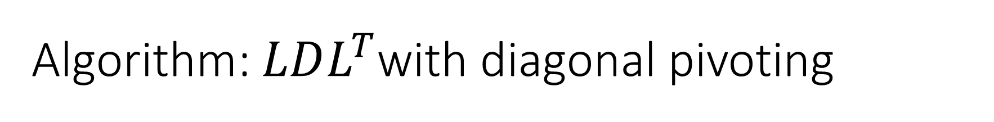
Algorithm: $LDL^{T}$with diagonal pivoting
Input: A – a symmetric matrix
Outputs: L,D,p
L=I; p=1:n
for k=1:n-1
[x,t]=max(abs(diag(A(k:n,k:n)));
t=t+k-1;
A([k t],:)=A([t k],:); A(:,[t k])=A(:,[k t]);
p([k t])=p([t k]);
L([k t],1:k-1)=L([t k],1:k-1);
D(k)=A(k,k);
L(k+1:n,k)=A(k,k+1:n)’/D(k);
for i=k+1:n
A(i,k:n)=A(i,k:n)-L(i,k)*A(k,k:n);
end
end
D(n)=A(n,n);
Solving Ax=b after LDLT with diagonal pivoting
Re-arrange b using p; b1=b([p]);
Solve Ly=b1
Solve Dv=y;
Solve Lw=v;
Set x=w([p]) % re-arrange w using p

Slide 7
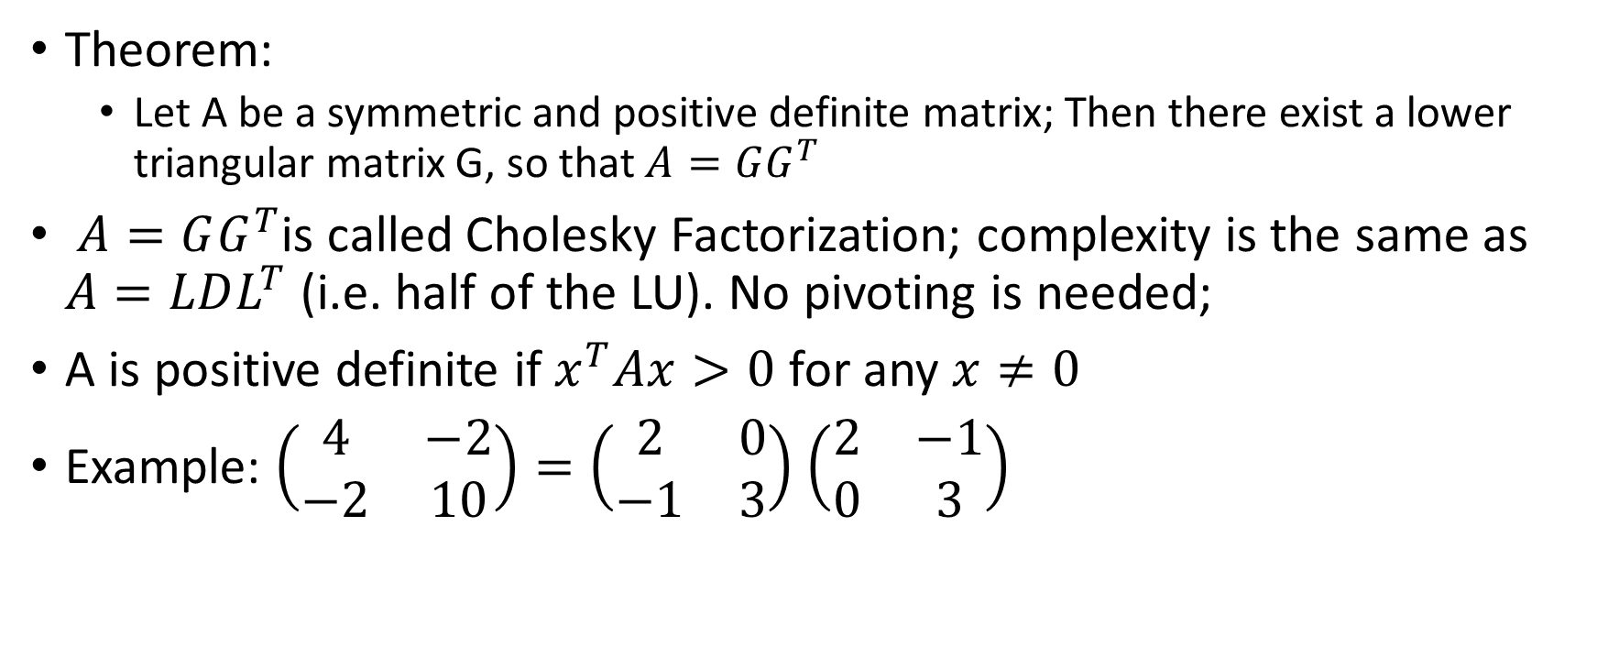
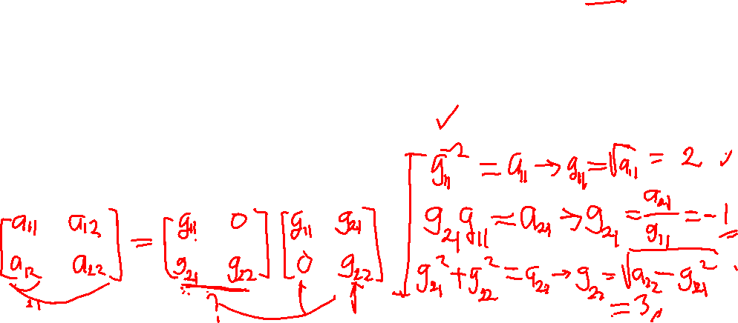
Symmetric Positive Definite Matrices
Theorem:
Let A be a symmetric and positive definite matrix; Then there exist a lower triangular matrix G, so that $A=GG^{T}$
$A=GG^{T}$is called Cholesky Factorization; complexity is the same as $A=LDL^{T}$ (i.e. half of the LU). No pivoting is needed;
A is positive definite if $x^{T}Ax>0$ for any $x≠0$
Example: $\left(\begin{matrix}4 & −2 \\ −2 & 10\end{matrix}\right)=\left(\begin{matrix}2 & 0 \\ −1 & 3\end{matrix}\right)$ $\left(\begin{matrix}2 & −1 \\ 0 & 3\end{matrix}\right)$

Slide 8

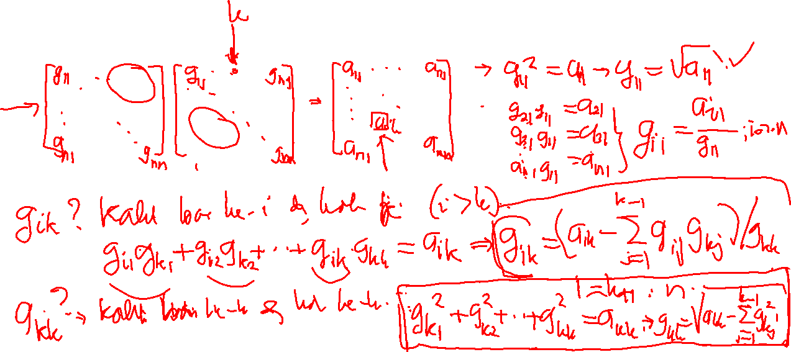
Cholesky Factorization – Computing G
Based on the equality $A=GG^{T}$; we can retrieve G column wise

Slide 9
Cholesky Algorithm
Input: A – symmetric & positive definite matrix
Ouput: G – a lower triangular matrix
G(1,1)=sqrt(A(1,1));
G(2:n,1)=A(2:n,1)/G(1,1);
for k=2:n-1
G(k,k)=sqrt(A(k,k)-G(k,1:k-1)*G(k,1:k-1)’);
for i=k+1:n
G(i,k)=(A(i,k)-G(i,1:k-1)*G(k,1:k-1)’)/G(k,k);
end
end
G(n,n)=sqrt(A(n,n)-G(n,1:n-1)*G(n,1:n-1)’);

Slide 10
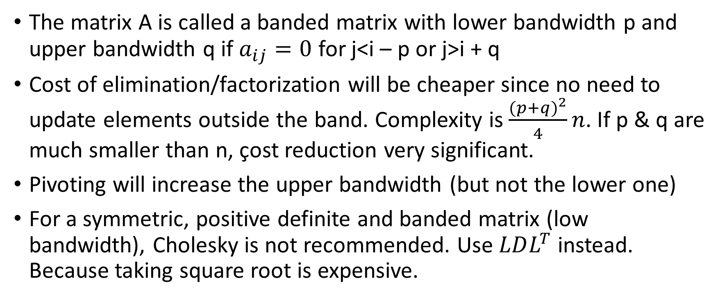
Banded Matrix
The matrix A is called a banded matrix with lower bandwidth p and upper bandwidth q if $a_{ij}=0$ for j<i – p or j>i + q
Cost of elimination/factorization will be cheaper since no need to update elements outside the band. Complexity is $\frac{{(p+q)}^{2}}{4}n$. If p & q are much smaller than n, çost reduction very significant.
Pivoting will increase the upper bandwidth (but not the lower one)
For a symmetric, positive definite and banded matrix (low bandwidth), Cholesky is not recommended. Use $LDL^{T}$ instead. Because taking square root is expensive.

Slide 11
Banded LU – with pivoting
function [L,U,v]=BandedLU(A,p,q)
[n,n]=size(A);
L=eye(n);v=1:n;
for j=1:n-1
k=min(j+p,n)
[x,m]=max(abs(A(j:k,j)));
m=m+j-1;
A([m j],:)=A([j m],:);
L([m j],1:j-1)=L([j m],1:j-1);
v([m j])=v([j m]);
for i=j+1:k
s=min(i+p+q,n);
L(i,j)=A(i,j)/A(j,j);
A(i,j:s)=A(i,j:s)-L(i,j)*A(j,j:s);
end
end
U=triu(A);

Slide 12
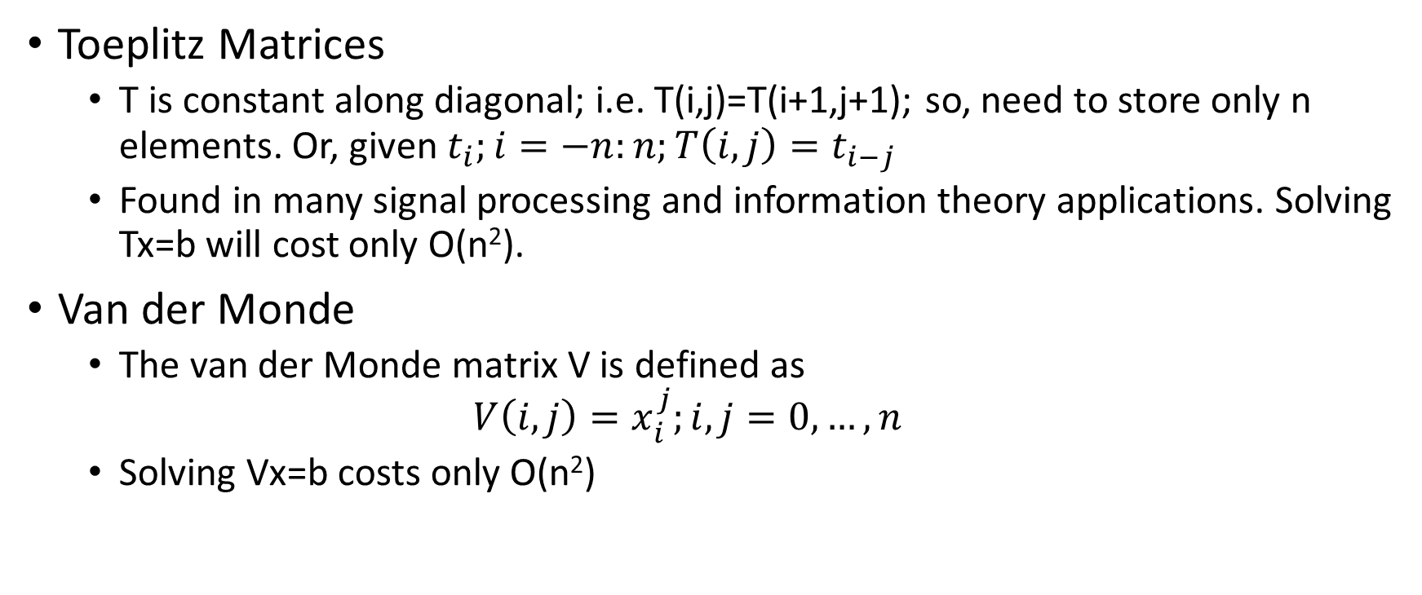
Other Special Matrices
Toeplitz Matrices
T is constant along diagonal; i.e. T(i,j)=T(i+1,j+1); so, need to store only n elements. Or, given $t_{i};i=−n:n;T\left(i,j\right)=t_{i−j}$
Found in many signal processing and information theory applications. Solving Tx=b will cost only O(n²).
Van der Monde
The van der Monde matrix V is defined as
$$V\left(i,j\right)=x_{i}^{j};i,j=0,…,n$$
Solving Vx=b costs only O(n²)

