Slide 1
High Availability on Cloud Environment

Slide 2
AVAILABILITY
Everyone expects their infrastructure to be available all the time
A 100% guaranteed availability of an infrastructure is impossible

Slide 3
Calculating availability
Availability can neither be calculated, nor guaranteed upfront
It can only be reported on afterwards, when a system has run for some years
Over the years, much knowledge and experience is gained on how to design high available systems
Failover
Redundancy
Structured programming
Avoiding Single Points of Failures (SPOFs)
Implementing systems management

Slide 4
Calculating availability
The availability of a system is usually expressed as a percentage of uptime in a given time period
Usually one year or one month
Example for downtime expressed as a percentage per year:

Slide 5
Calculating availability
Typical requirements used in service level agreements today are 99.8% or 99.9% availability per month for a full IT system
Amazon, Google, and Microsoft’s set their cloud SLAs at 99.9%
The availability of the infrastructure must be much higher
Typically in the range of 99.99% or higher
99.999% uptime is also known as carrier grade availability
For one component
Higher availability levels for a complete system are very uncommon, as they are almost impossible to reach

Slide 6
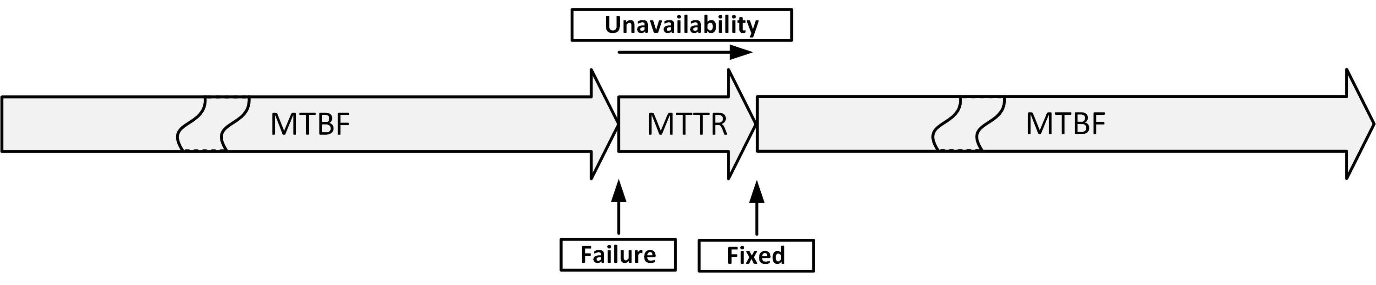
MTBF and MTTR
Mean Time Between Failures (MTBF)
The average time that passes between failures
Mean Time To Repair (MTTR)
The time it takes to recover from a failure

Slide 7

Calculation examples
$$Availability=\frac{MTBF}{\left(MTBF+MTTR\right)}×100\%$$

Slide 8
Sources of unavailability - human errors
80% of outages impacting mission-critical services is caused by people and process issues
Examples:
Performing a test in the production environment
Switching off the wrong component for repair
Swapping a good working disk in a RAID set instead of the defective one
Restoring the wrong backup tape to production
Accidentally removing files
Mail folders, configuration files
Accidentally removing database entries
Drop table x instead of drop table y

Slide 9
Sources of unavailability - software bugs
Because of the complexity of most software it is nearly impossible (and very costly) to create bug-free software
Application software bugs can stop an entire system
Operating systems are software too
Operating systems containing bugs can lead to corrupted file systems, network failures, or other sources of unavailability

Slide 10
Sources of unavailability - planned maintenance
Sometimes needed to perform systems management tasks:
Upgrading hardware or software
Implementing software changes
Migrating data
Creation of backups
Should only be performed on parts of the infrastructure where other parts keep serving clients
During planned maintenance the system is more vulnerable to downtime than under normal circumstances
A temporary SPOF could be introduced
Systems managers could make mistakes

Slide 11
Sources of unavailability - physical defects
Everything breaks down eventually
Mechanical parts are most likely to break first
Examples:
Fans for cooling equipment usually break because of dust in the bearings
Disk drives contain moving parts
Tapes are very vulnerable to defects as the tape is spun on and off the reels all the time
Tape drives contain very sensitive pieces of mechanics that can break easily

Slide 12
Sources of unavailability - environmental issues
Environmental issues can cause downtime:
Failing facilities
Power
Cooling
Disasters
Fire
Earthquakes
Flooding

Slide 13
Sources of unavailability - complexity of the infrastructure
Adding more components to an overall system design can undermine high availability
Even if the extra components are implemented to achieve high availability
Complex systems
Have more potential points of failure
Are more difficult to implement correctly
Are harder to manage
Sometimes it is better to just have an extra spare system in the closet than to use complex redundant systems

Slide 14
Redundancy
Redundancy is the duplication of critical components in a single system, to avoid a single point of failure (SPOF)
Examples:
A single component having two power supplies; if one fails, the other takes over
Dual networking interfaces
Redundant cabling

Slide 15
Failover
Failover is the (semi)automatic switch-over to a standby system or component
Examples:
Windows Server failover clustering
VMware High Availability
Oracle Real Application Cluster (RAC) database

Slide 16
Fallback
Fallback is the manual switchover to an identical standby computer system in a different location
Typically used for disaster recovery
Three basic forms of fallback solutions:
Hot site
Cold site
Warm site

Slide 17
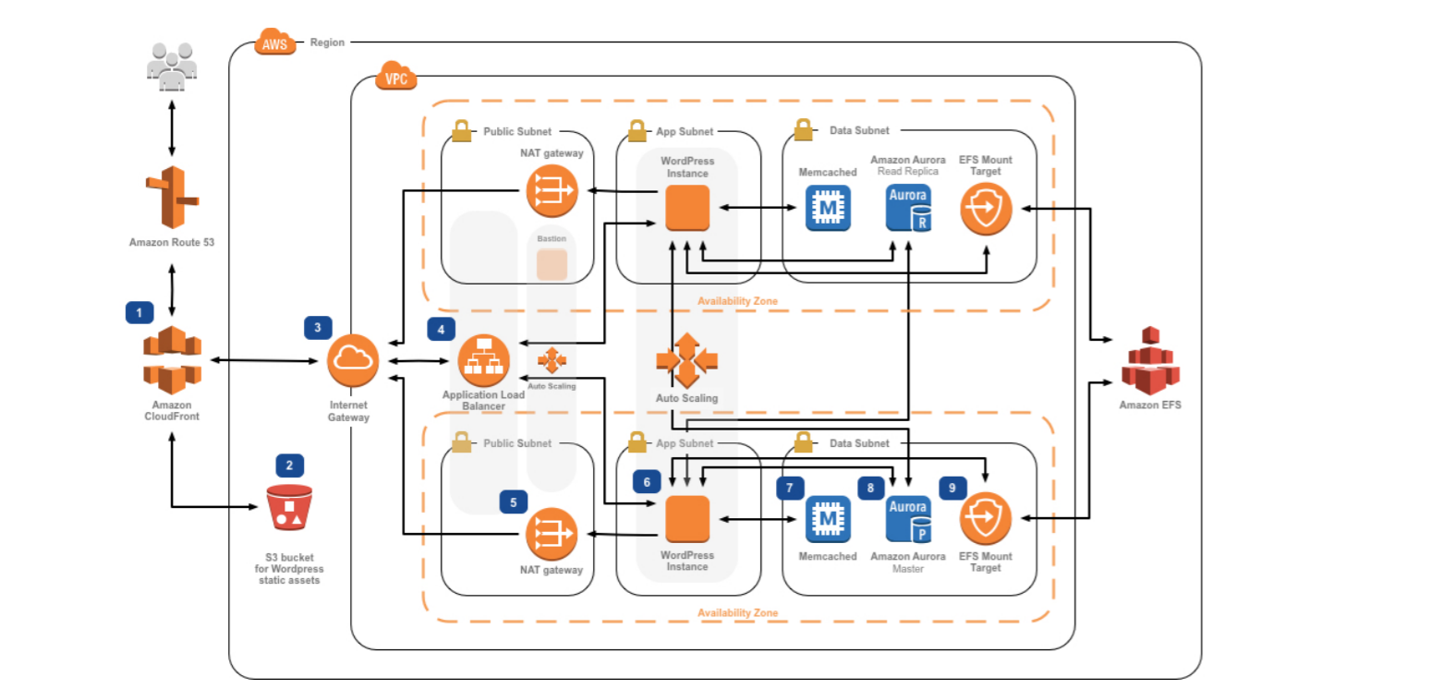
Example of High Availability Website

