Slide 1
Cloud Native

Slide 2
Cloud Native
Cloud-native architecture and technologies are an approach to designing, constructing, and operating workloads that are built in the cloud and take full advantage of the cloud computing model.
Cloud native is about speed and agility

Slide 3
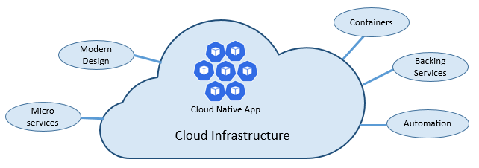
Pillars of Cloud Native

Slide 4
Cloud Native and The Cloud
Cloud-native systems take full advantage of the cloud service model
Extensive use of PaaS and managed service model
treat the underlying infrastructure as disposable - provisioned in minutes and resized, scaled, or destroyed on demand – via automation
Based on cattle service model
https://joachim8675309.medium.com/devops-concepts-pets-vs-cattle-2380b5aab313

Slide 5
The Twelve Factor
Methodology for constructing cloud-based application
I. Codebase
One codebase tracked in revision control, many deploys
II. Dependencies
Explicitly declare and isolate dependencies
III. Config
Store config in the environment
IV. Backing services
Treat backing services as attached resources
V. Build, release, run
Strictly separate build and run stages
VI. Processes
Execute the app as one or more stateless processes

Slide 6
The Twelve Factor
VII. Port binding
Export services via port binding
VIII. Concurrency
Scale out via the process model
IX. Disposability
Maximize robustness with fast startup and graceful shutdown
X. Dev/prod parity
Keep development, staging, and production as similar as possible
XI. Logs
Treat logs as event streams
XII. Admin processes
Run admin/management tasks as one-off processes

Slide 7
Beyond The Twelve Factor
XIII. API First
Make everything a service
XIV. Telemetry
Monitoring and collecting data
XV. Authentication/Authorization
Implement identity from start
The Twelve Factor: https://12factor.net/
Beyond The Twelve Factor: https://content.pivotal.io/blog/beyond-the-twelve-factor-app

Slide 8
Key Features of Cloud Native
Containerized
Microservices
Horizontal scaling
Service mesh
API driven
Service discovery
Delivery pipeline
Policy driven resource provisioning
Zero downtime deployment

Slide 9
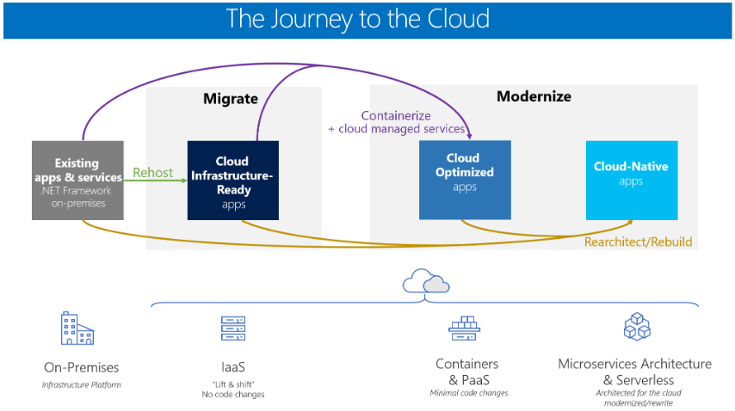

Slide 10
References
https://learn.microsoft.com/en-us/dotnet/architecture/cloud-native/definition
https://logz.io/blog/cloud-native-applications/

