Slide 1
Increasing Performance

Slide 2
Availability and Performance
Performance is a combination of response time and availability
From user’s perspective, high availability also mean high performance

Slide 3
Performance of a running system
‹#›

Slide 4
Managing bottlenecks
The performance of a system is based on:
The performance of all its components
The interoperability of various components
A component causing the system to reach some limit is referred to as the bottleneck of the system
Every system has at least one bottleneck that limits its performance
If the bottleneck does not negatively influence performance of the complete system under the highest expected load, it is OK
‹#›

Slide 5
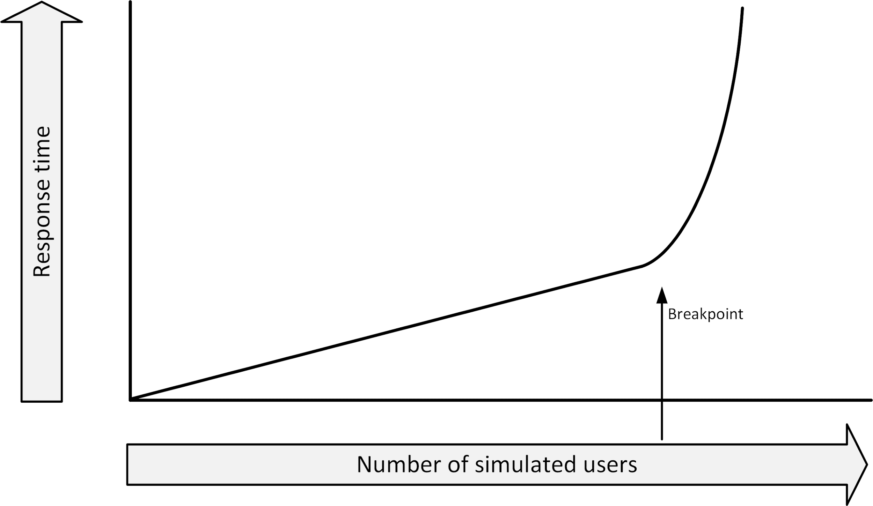
Performance testing - Breakpoint
Ramp up the load
Start with a small number of virtual users
Increase the number over a period of time
The test result shows how the performance varies with the load, given as number of users versus response time.
‹#›

Slide 6
Performance testing
Performance testing software typically uses:
One or more servers to act as injectors
Each emulating a number of users
Each running a sequence of interactions
A test conductor
Coordinating tasks
Gathering metrics from each of the injectors
Collecting performance data for reporting purposes
‹#›

Slide 7
Performance testing
Performance testing should be done in a production-like environment
Performance tests in a development environment usually lead to results that are highly unreliable
Even when underpowered test systems perform well enough to get good test results, the faster production system could show performance issues that did not occur in the tests
To reduce cost:
Use a temporary (hired) test environment
‹#›

Slide 8
Increasing performance on upper layers
80% of the performance issues are due to badly behaving applications
Application performance can benefit from:
Database and application tuning
Prioritizing tasks
Working from memory as much as possible (as opposed to working with data on disk)
Making good use of queues and schedulers
Typically more effective than adding compute power
‹#›

Slide 9
Caching
Caching can be implemented in:
Disks (CDN, proxy)
Operating system (files, data)
Database queries
Example in cloud:
Elasticache
Redis
Memcache
‹#›

Slide 10
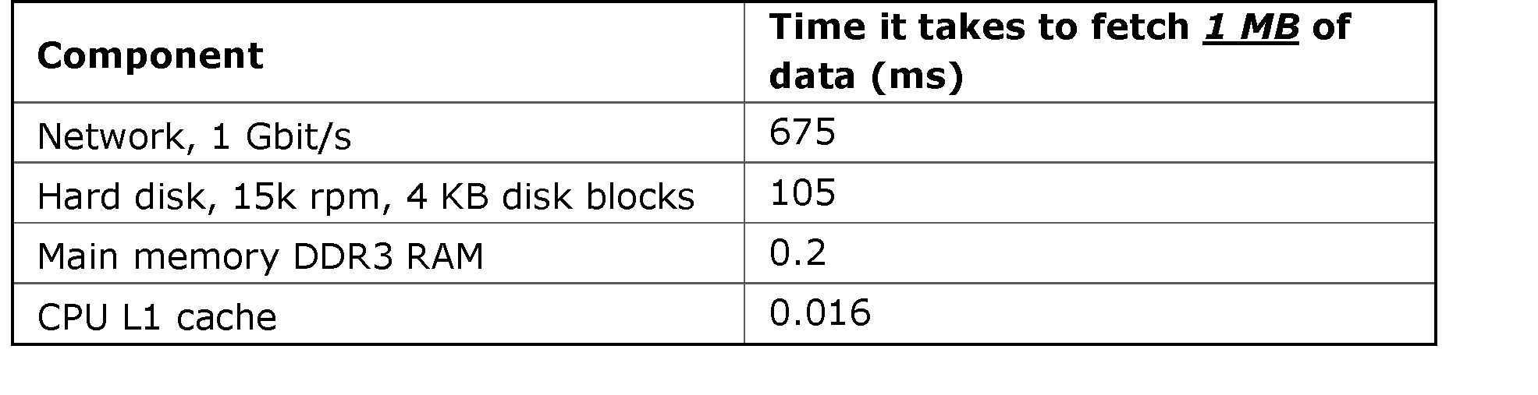
Caching
‹#›

Slide 11
Operational data store
An Operational Data Store (ODS) is a read-only replica of a part of a database, for a specific use
Frequently used information is retrieved from a small ODS database
The main database is used less for retrieving information
The performance of the main database is not degraded
Implementation in cloud:
- Read replica databases
‹#›

Slide 12
Front-end servers
Front-end servers serve data to end users
Typically web servers
To increase performance, store static data on the front-end servers
Pictures are a good candidate
Significantly lowers the amount of traffic to back-end systems
In addition, a reverse proxy can be used
Automatically cache most requested data
Examples in cloud:
Cloudflare
Cloudfront
Azure CDN
‹#›

Slide 13
In-memory databases
In special circumstances, entire databases can be run from memory instead of from disk
In-memory databases are used in situations where performance is crucial
Special arrangements must be made to ensure data is not lost when a power failure occurs
Examples:
Elasticache with Redis and memcache
AzureSQL in memory DB
MySQL in memory DB
‹#›

Slide 14
Scalability
Scalability indicates the ease in with which a system can be modified, or components can be added, to handle increasing load
Two ways to scale a system:
Vertical scaling (scale up) - adding resources to a single component
Horizontal scaling (scale out) - adding more components to the infrastructure
‹#›

Slide 15
Scalability – Vertical scaling
Adding more resources, for example:
Server: more memory, CPU’s
Network switch: adding more ports
Storage: Replace small disks by larger disks
Vertical scaling is easy to do
It quickly reaches a limit
The infrastructure component is “full”
‹#›

Slide 16
Scalability – Horizontal scaling
Adding more components to the infrastructure, for example:
Adding servers to a web server farm
Adding disk cabinets to a storage system
In theory, horizontal scaling scales much better
Be aware of bottlenecks
Doubling the number of components does not necessarily double the performance
Horizontal scaling is the basis for cloud computing
Applications must be aware of scaling infrastructure components
‹#›

Slide 17
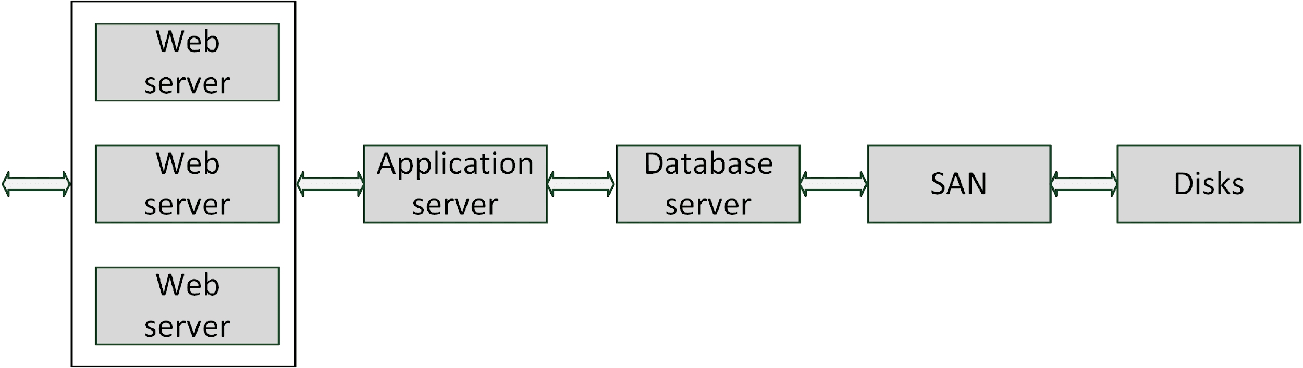
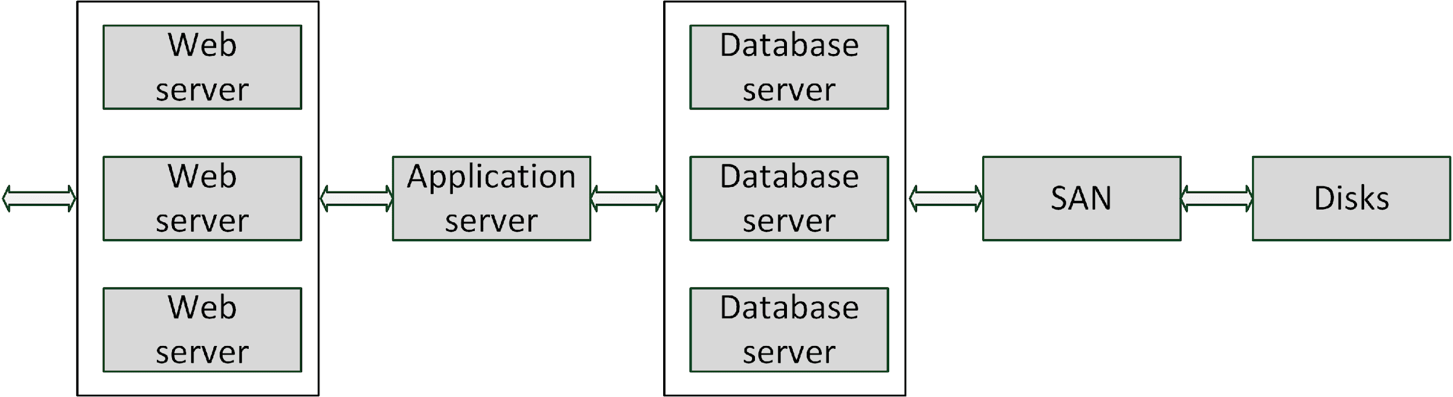
Scalability – Horizontal scaling
‹#›

Slide 18
Load balancing
Load balancing uses multiple servers that perform identical tasks
Examples:
Web server farm
Mail server farm
FTP (File Transfer Protocol) server farm
A load balancer spreads the load over the available machines
Checks the current load on each server in the farm
Sends incoming requests to the least busy server
‹#›

Slide 19
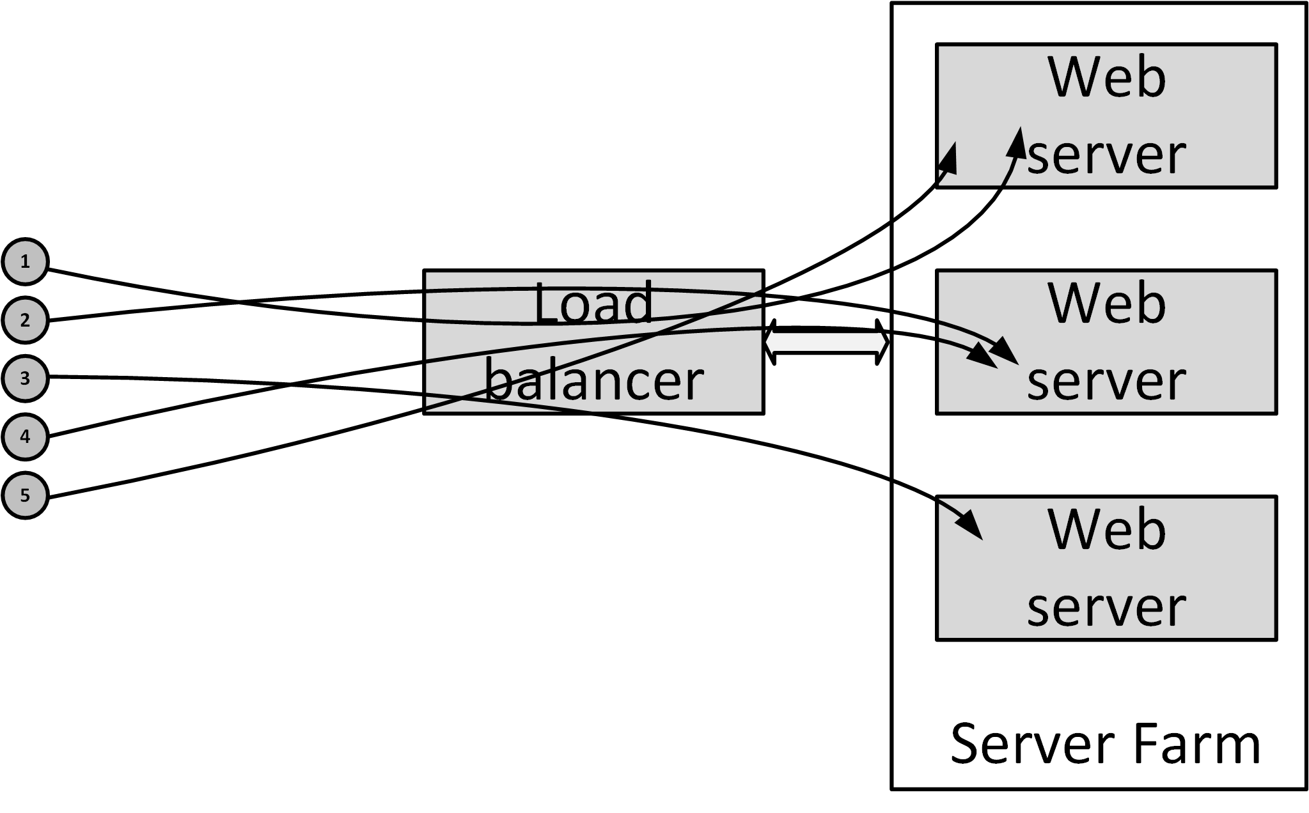
Load balancing
‹#›

Slide 20
Load balancing
A load balancer increases availability
When a server in the server farm is unavailable, the load balancer notices this and ensures no requests are sent to the unavailable server until it is back online again
The availability of the load balancer itself is very important
Load balancers are typically setup in a failover configuration
‹#›

