Slide 1
Cloud Security

Slide 2
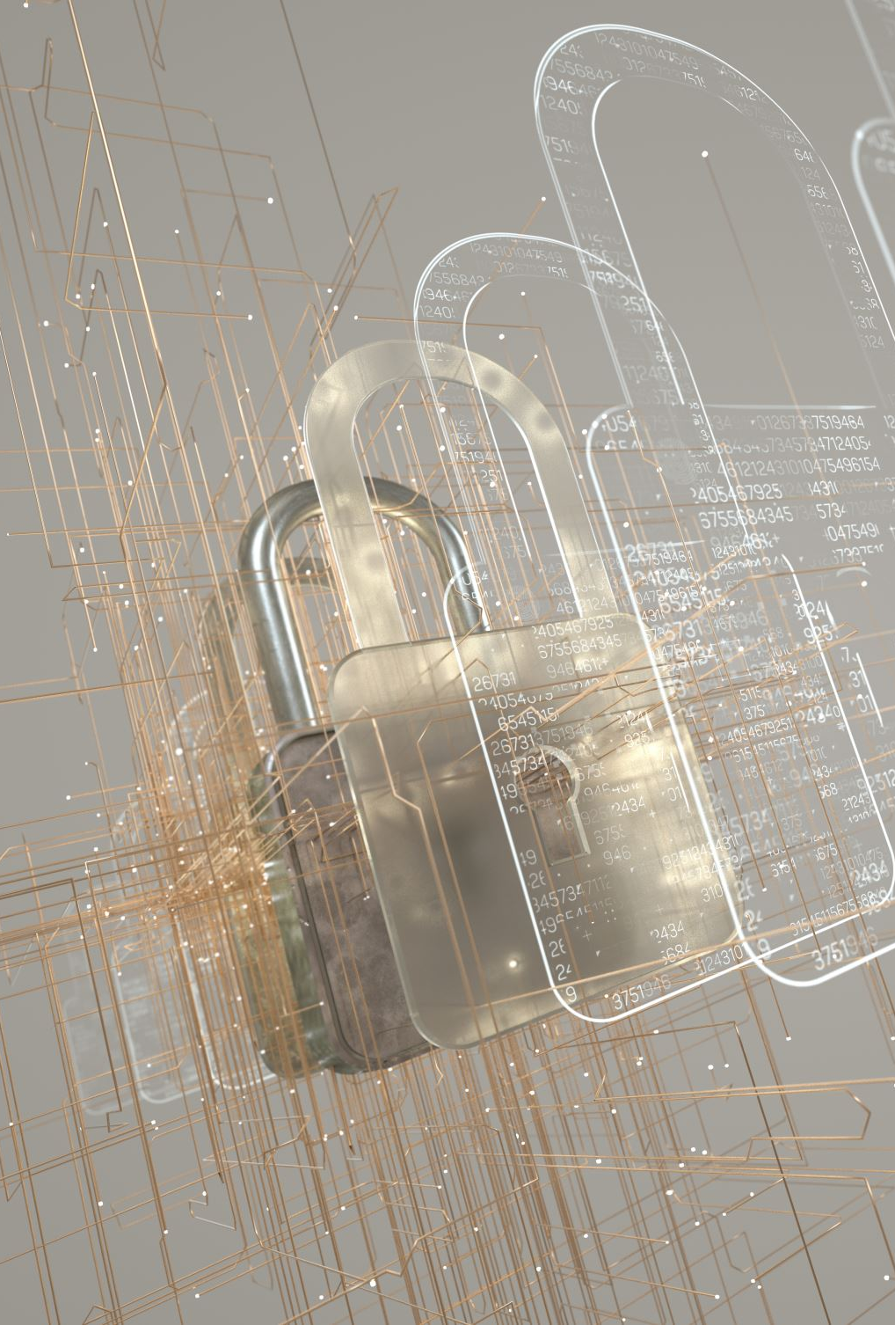
Security
A state of being secure and free from danger or harm; the actions taken to make someone or something secure.
The protection of information and its critical elements, including systems and hardware that use, store, and transmit that information
Includes information security management, data security, and network security

Slide 3
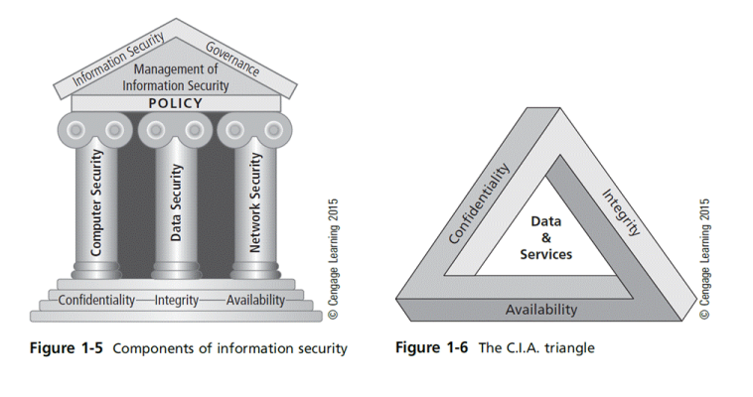
C.I.A Triangle

Slide 4
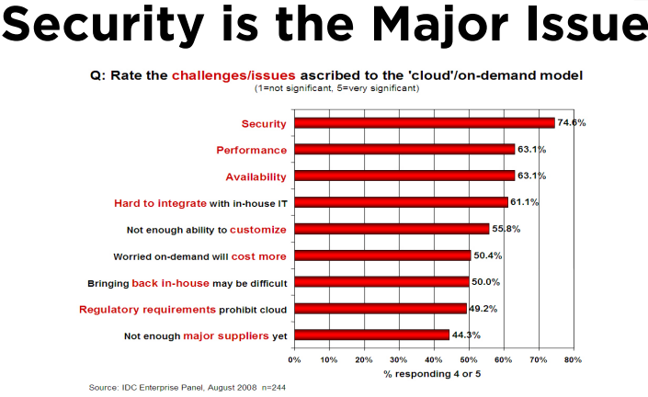

Slide 5
Top Security Threats
Abuse and nefarious use of cloud computing
Insecure interfaces & API’s
Unknown risk profile
Malicious insiders
Shared technology issues
Data loss or leakage
Account or service hijacking

Slide 6
Attack vectors
Malicious code
Applications that, when activated, can cause network and server overload, steal data and passwords, or erase data
Worms
Self-replicating programs that spread from one computer to another, leaving infections as they travel
Virus
Self-replicating program fragment that attaches itself to a program or file enabling it to spread from one computer to another, leaving infections as it travels
Trojan Horse
Appears to be useful software but will actually do damage once installed or run on your computer

Slide 7
Attack vectors (2)
Denial of service attack
An attempt to overload an infrastructure to cause disruption of a service
Can lead to downtime of a system, disabling an organization to do its business
In a Distributed Denial of Service (DDoS) attack the attacker uses many computers to overload the server
Groups of computers that are infected by malicious code, called botnets, perform an attack

Slide 8
Attack vectors (3)
Social engineering
Social skills are used to manipulate people to obtain information which can be used in an attack
Like passwords or other sensitive information
By nature, people want to help other people
Ransomware
Misleading Applications (shows defects that aren’t real)
Rogue/Fake Antivirus (shows fake infections) (2008)
Locker Ransomware (locks out browser/device) (2012)
Crypto-Ransomware (locks you out of your data) (2013)

Slide 9
Attack vectors (4)
Phishing
A technique of obtaining sensitive information
The phisher sends an e-mail that appears to come from a legitimate source, like a bank or credit card company, requesting "verification" of information
The e-mail usually contains a link to a fraudulent web page

Slide 10
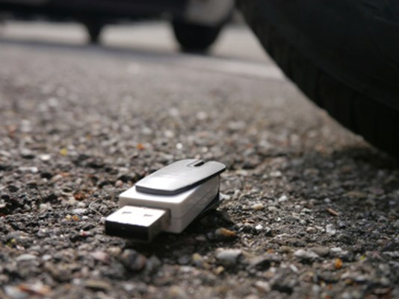
Attack vectors (5)
Baiting
Baiting uses physical media, like an USB flash drive, left to be found
It relies on the curiosity of people to find out what is on it
The attacker hopes some employee picks up the device and brings it inside the organization
When the device is put into an organization owned PC, malicious software is installed automatically

Slide 11
Security controls
Controls mitigate risks
Security controls must address at least one of the CIA
Information can be classified based on CIA levels
Controls can be designed and implemented based on the identified risk level for CIA

Slide 12
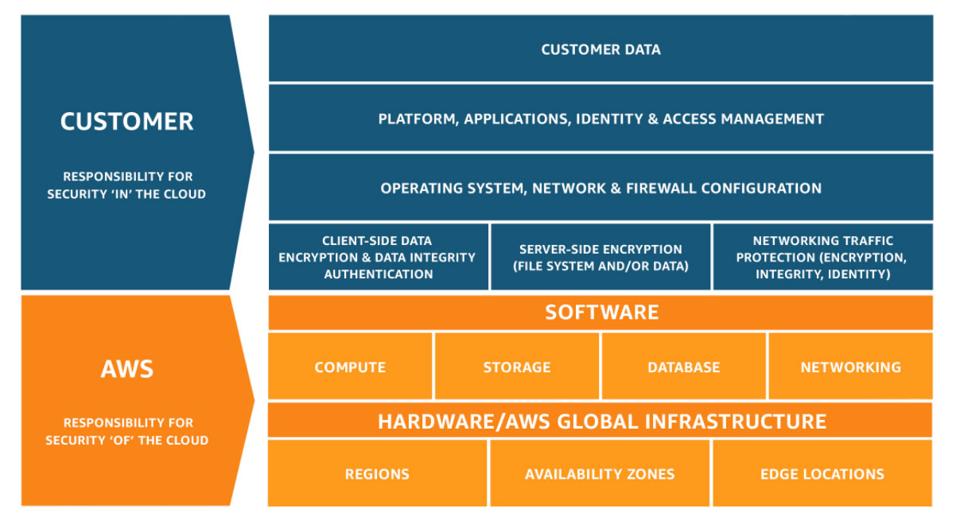
Shared Responsibility Model

Slide 13
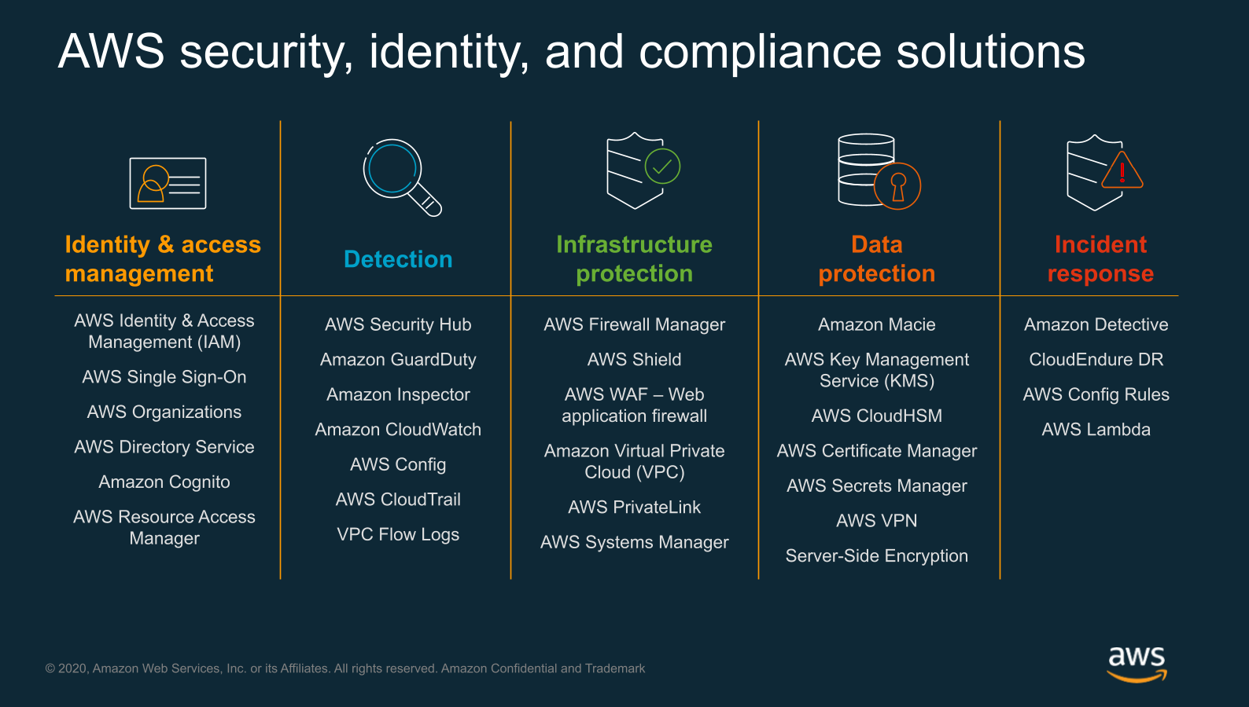

Slide 14
Identity and Access Management (IAM)
The process of managing the identity of people and systems, and their permissions
The IAM process follows three steps:
Users or systems claim who they are: identification
The claimed identity is checked: authentication
Permissions are granted related to the identity and the groups it belongs to: authorization

Slide 15
Hashed passwords
Operating systems should only store hashed passwords
When a user logs in, his/her password is hashed
The hashed password is compared to the stored hash
If the two are equal the login succeeds
There is no way to calculate or extract the original password from the hashed one
When weak passwords are used however, brute force of dictionary attacks can be used to find the passwords
The hashed passwords should therefore never be disclosed

Slide 16
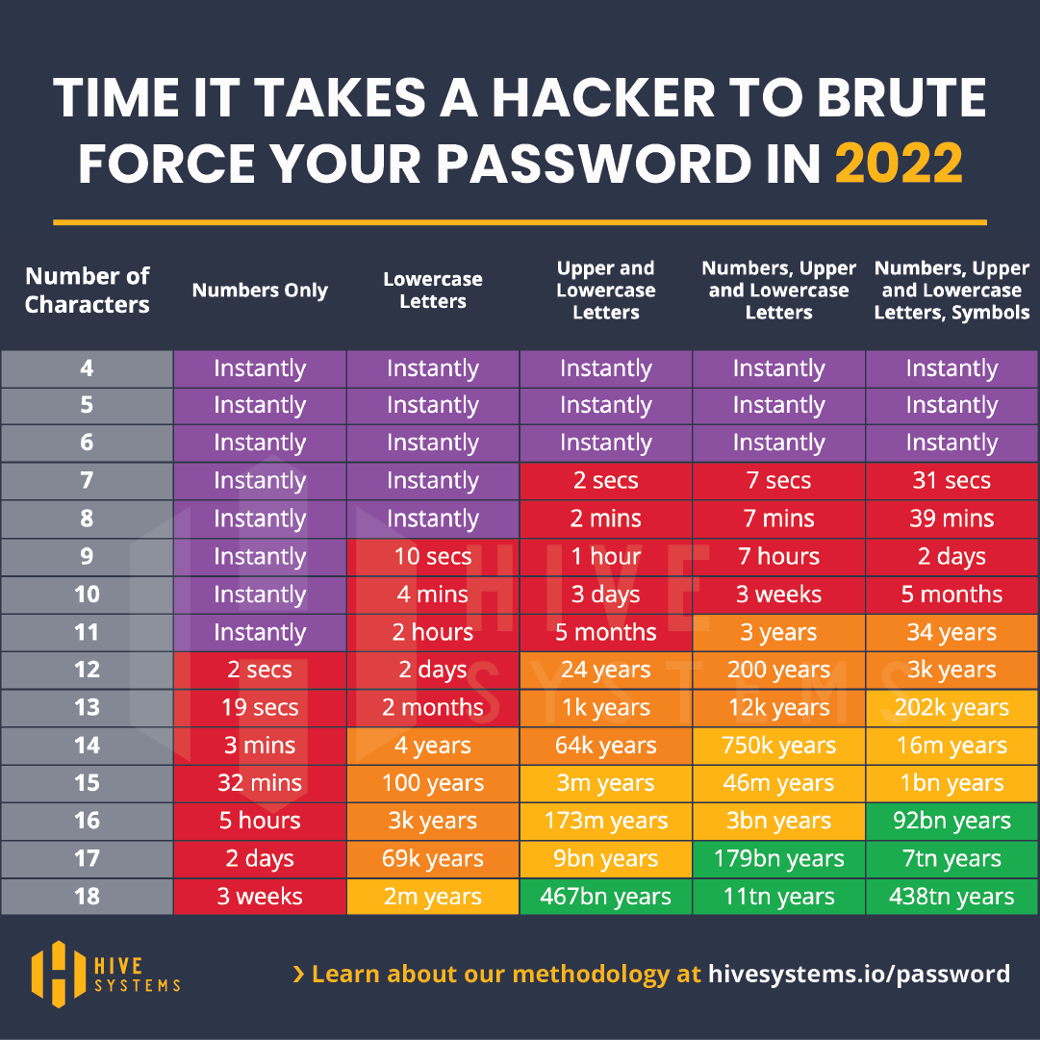
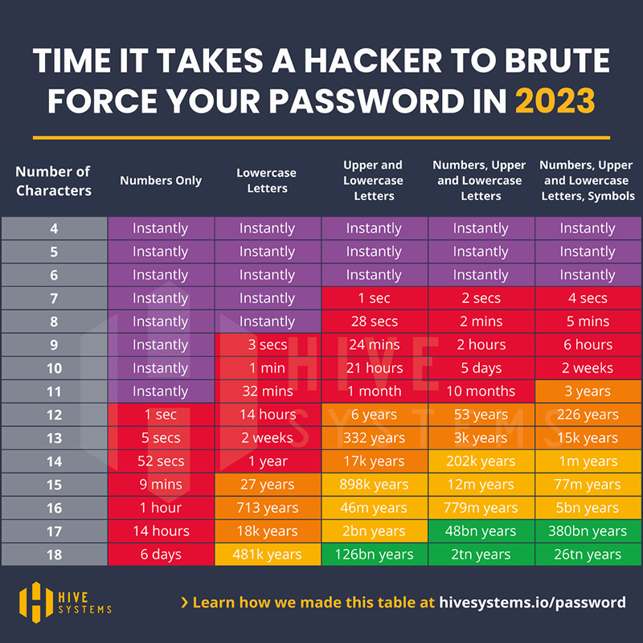

Slide 17
Patching
It is good practice to install all patches, hot-fixes, and service packs as soon as possible
They should be tested before deployed in production
They could introduce unwanted effects in the infrastructure
Patches hot-fixes, and service packs are usually provided with release notes describing what changes they make to the operating system
It is good practice to read release notes before installing the patch
When a patch or hot fix does not have impact on a specific deployment it can be discarded
The next service pack will include the patch anyway

Slide 18
Regulasi terkait
Undang-Undang (UU) No. 19 Tahun 2016 tentang Informasi dan Transaksi Elektronik
Undang-Undang (UU) No. 27 Tahun 2022 tentang Pelindungan Data Pribadi
Peraturan Pemerintah (PP) Nomor 71 Tahun 2019 tentang Penyelenggaraan Sistem dan Transaksi Elektronik
Peraturan Otoritas Jasa Keuangan (POJK) No.13/POJK.03/2020 tentang Penerapan Manajemen Risiko dalam Penggunaan Teknologi Informasi

