Slide 1
Cloud Storage

Slide 2
Cloud Storage
Multi purpose
Google drive, AWS S3, Azure Files
Block storage
AWS Elastic Block Storage, Azure Disks
Network File Sharing
Azure Files, AWS EFS
Database
Azure Tables, AWS RDS
Other types
Azure Blob (Data lake), AWS Glacier (Backup/Archive)

Slide 3
File systems
The operating system virtualizes the complexities of handling individual disk blocks or communication with a SAN or NAS by providing a file system to applications
File systems usually consist of directories (also known as folders) with files or other directories in them
The operating system hides the complexity of managing the files and the directory structure
It also manages the security of the files:
Permission to read, write, create, and delete files and directories

Slide 4
File systems
Most operating systems can handle multiple types of file systems on multiple disks at the same time
Some popular file systems are:
FAT (File Allocation Table), vFAT, and FAT32, used in MS-DOS, older versions of Windows, and removable storage devices like USB memory sticks
NTFS (New Technology File System) used in Windows
UFS (Universal File System) and VxFS (Veritas File System) used in most UNIX flavors
Ext (and Ext2, Ext3, Ext4) - used in Linux
Journaling file systems keep track of changes made to files in a journal log before committing them to the main file system
This allows for greater availability and fast recovery in case of a malfunction

Slide 5
File systems
File systems must be mounted before they can be used by the operating system
Mounting means that a disk and the file system on it are recognized by the operating system
After mounting, the file system is typically given:
A drive letter (Windows)
A drive name (OpenVMS)
A mount point in the global directory tree (UNIX and Linux)
Most operating systems provide file sharing functionality
File sharing enables files on one system to be accessed by (users on) other systems
Protocols like NFS (which originates from UNIX), and SMB/CIFS (originating from Windows), are used for file sharing

Slide 6
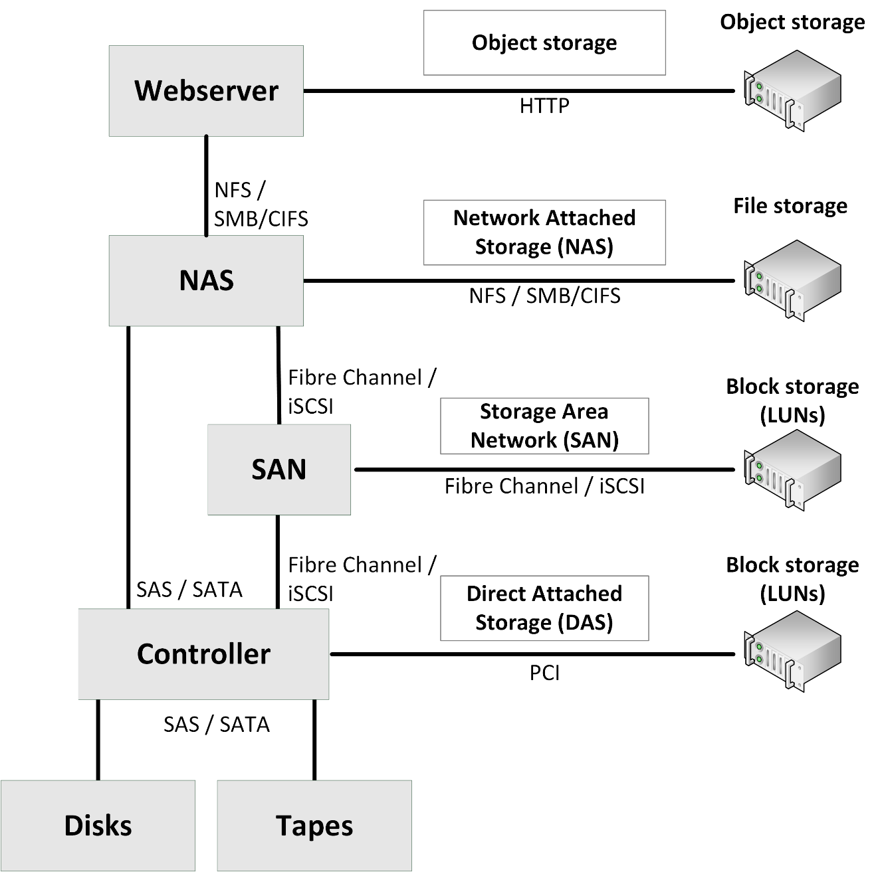
Storage model
Servers can use internal storage only, but most use external storage, sometimes combined with internal storage.
A model of storage building blocks is shown on the right

Slide 7
How Cloud Storage Works

Slide 8
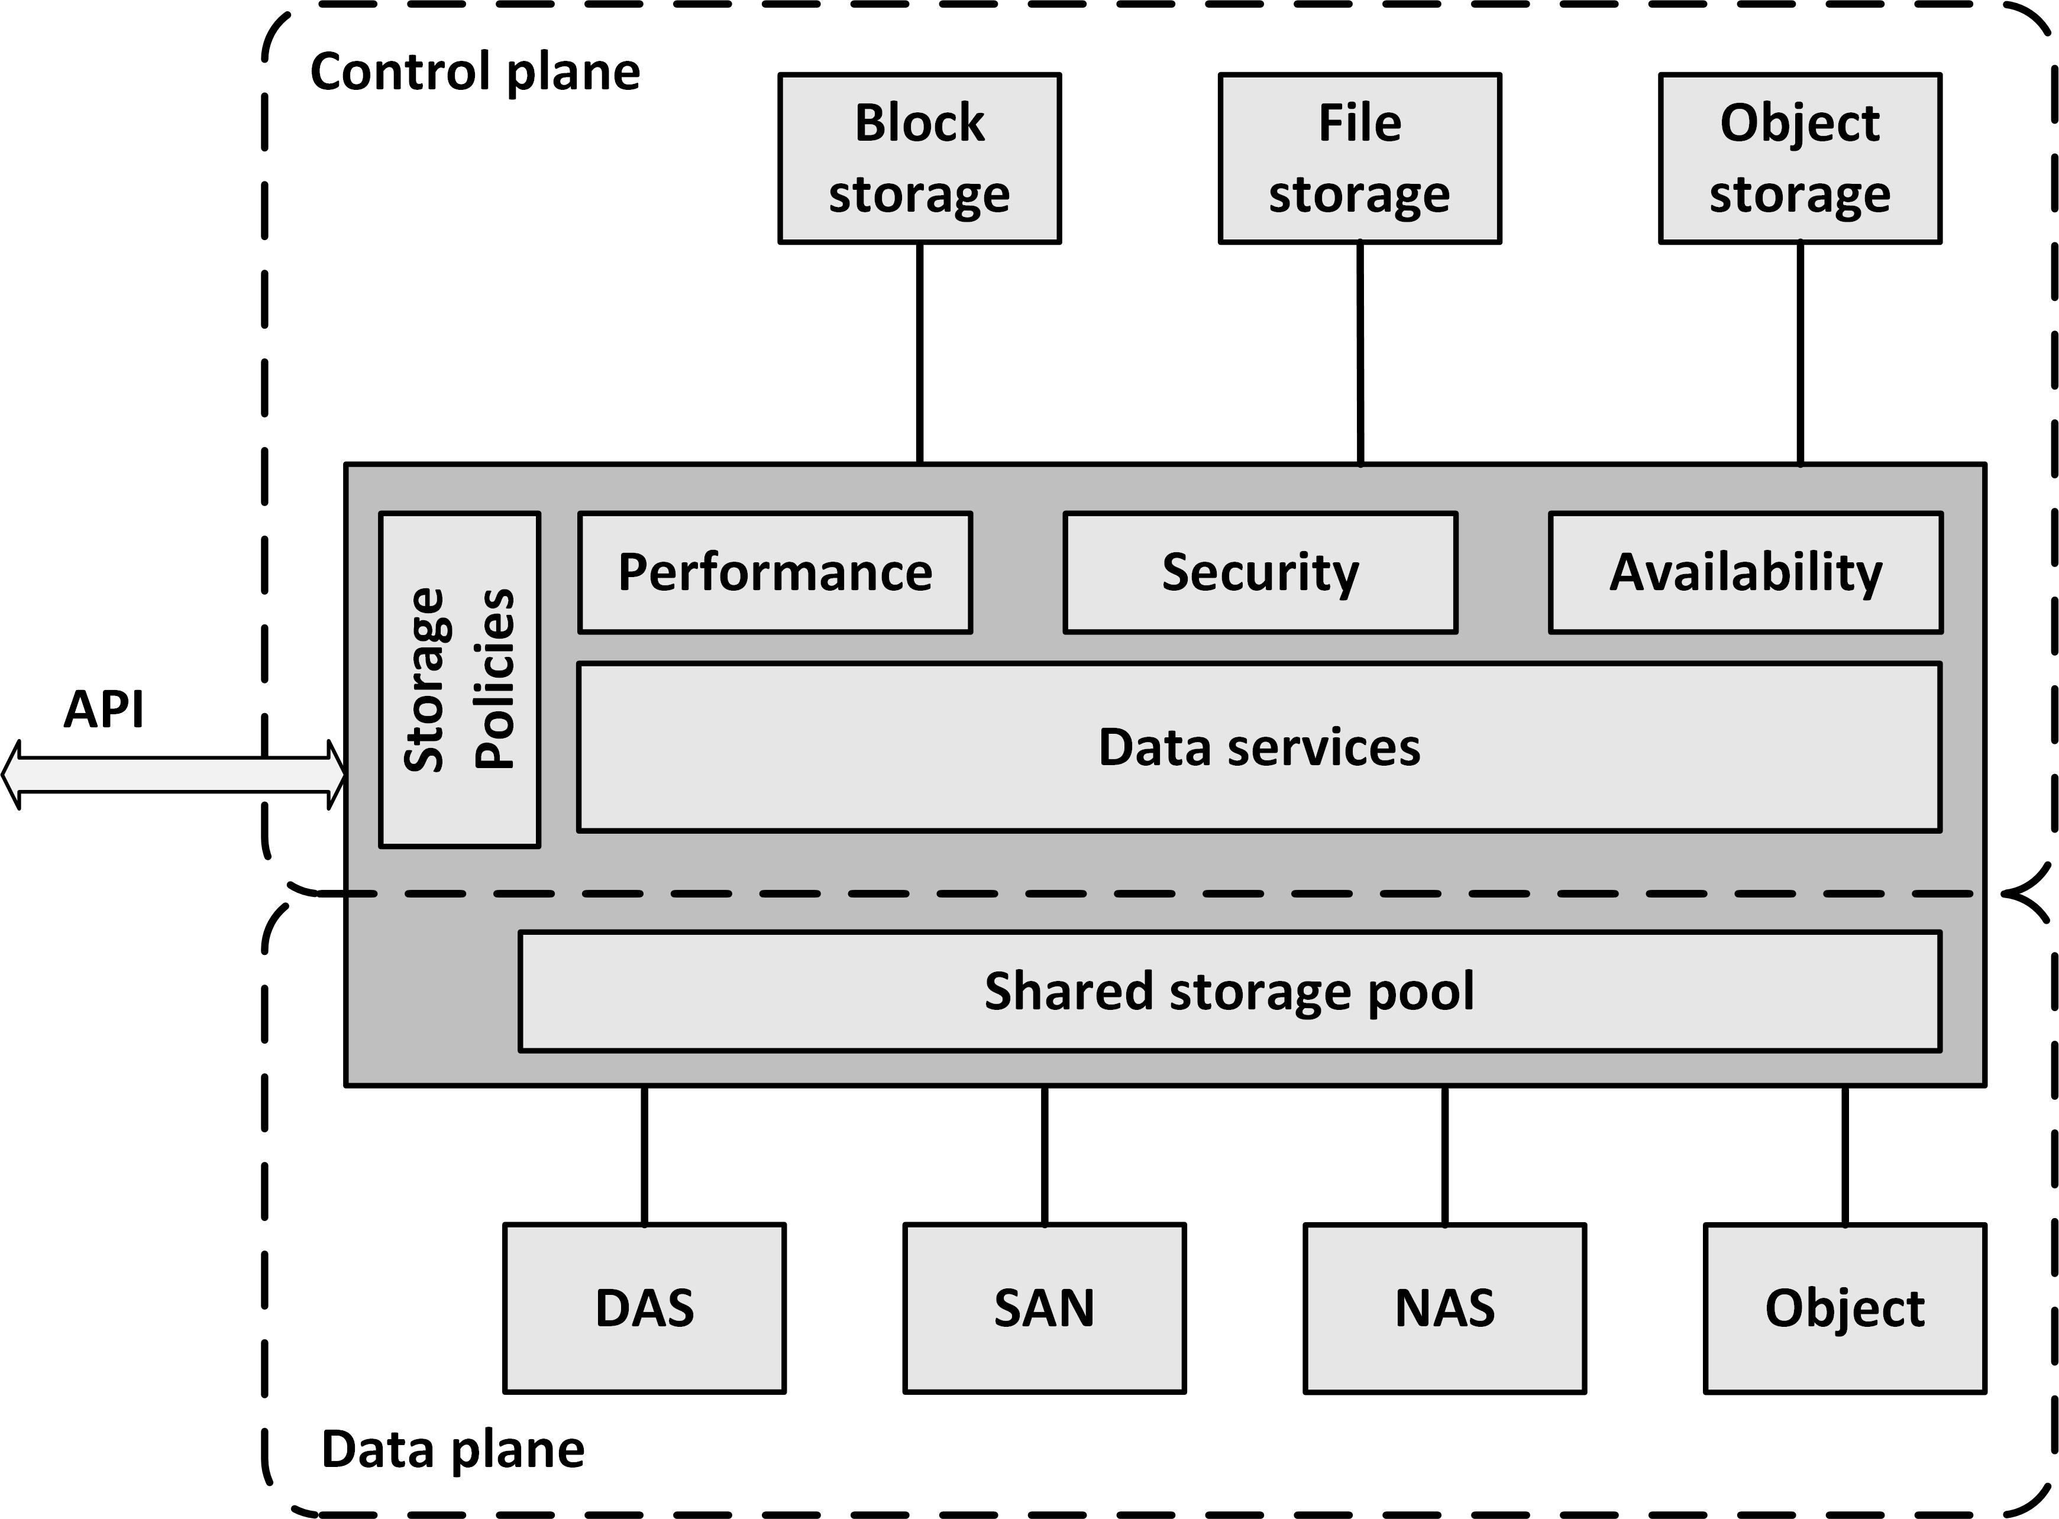
Software Defined Storage
Software Defined Storage (SDS) abstracts data and storage capabilities (also known as the control plane) from the underlying physical storage systems (the data plane)
This allows data to be stored in a variety of storage systems while being presented and managed as one storage pool to the servers consuming the storage

Slide 9
Software Defined Storage
SDS virtualizes all physical storage into one large shared storage pool
It enables the use of standard commodity hardware, where storage is implemented as software running on commodity x86-based servers with direct attached disks
Physical storage can also be a SAN, a NAS, or an Object storage system
From the shared storage pool, software provides data services like:
Deduplication
Compression
Caching
Snapshotting
Cloning
Replication
Tiering

Slide 10
Software Defined Storage
SDS provides servers with virtualized data storage pools with the required performance, availability and security, delivered as block, file, or object storage, based on policies
Example: a newly deployed database server can invoke an SDS policy that mounts storage configured to have its data striped across a number of disks, creates a daily snapshot, and has data stored on tier 1 disks
APIs can be used to provision storage pools and set the availability, security and performance levels of the virtualized storage
Using APIs, storage consumers can monitor and manage their own storage consumption

Slide 11
Distributed File System
Notes:
Objective of HDFS vs DFS
Instead of bringing data to machine to process, bring the code to the data machine. Only the result send it to the central machine

Slide 12
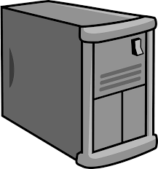
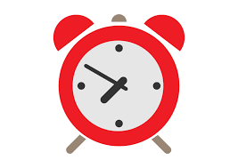
Single vs Distributed
1 Machine
4 I/O Channel
Each channel 100 MB/s
10 Machine
4 I/O Channel
Each channel 100 MB/s
43 minutes
4.3 minutes
Notes:
Is this costly???

Slide 13
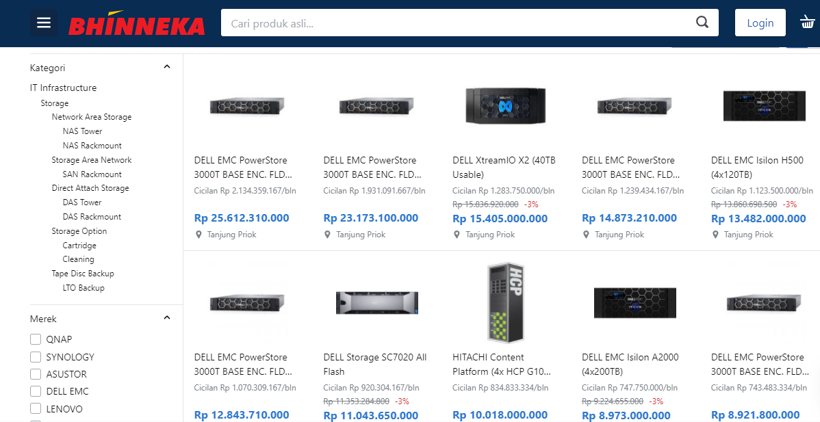
Single Storage

Slide 14
Distributed Storage
HDFS
Used in Big Data
MinIO
Object storage based on AWS S3 API

Slide 15
HDFS
Distributed file system for Big Data
Stores different type of dataset
Creates a level of abstraction over the resources

Slide 16
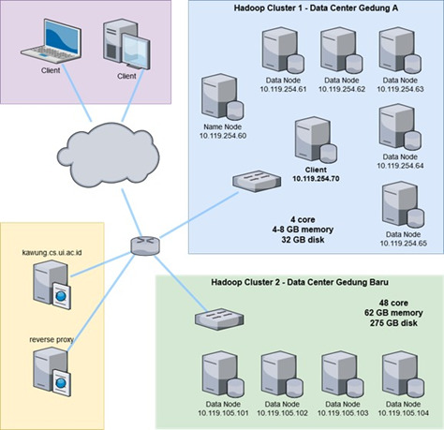
HDFS Architecture

Slide 17
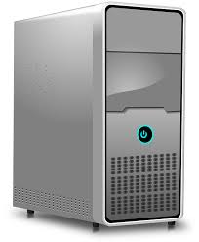
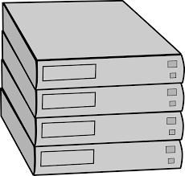
NameNode and DataNode
NameNode:
Master daemon
Maintain and manage DataNode
Records metadata
Receives heartbeat from DataNode
NameNode
DataNode:
Slave daemon
Stores the actual data
Serves read and write requests from clients
DataNodes
Notes:
NameNode has all the information metadata, which data is stored at which datanode.
DataNode regularly send heartbeat. Tells the namenode it still alive.

Slide 18
HDFS blocks
File is divided into HDFS blocks (128 MB by default) and duplicated into multiple places
2016-dec.log
513 MB
a
b
c
d
e
128 MB
128 MB
128 MB
128 MB
1
MB
Notes:
Dipecah2 , we can customize the block size

Slide 19
MinIO
High performance, software define, distributed object storage server
Compatible with AWS S3
Size of an object range from a few KB to maximum of 5TB

Slide 20
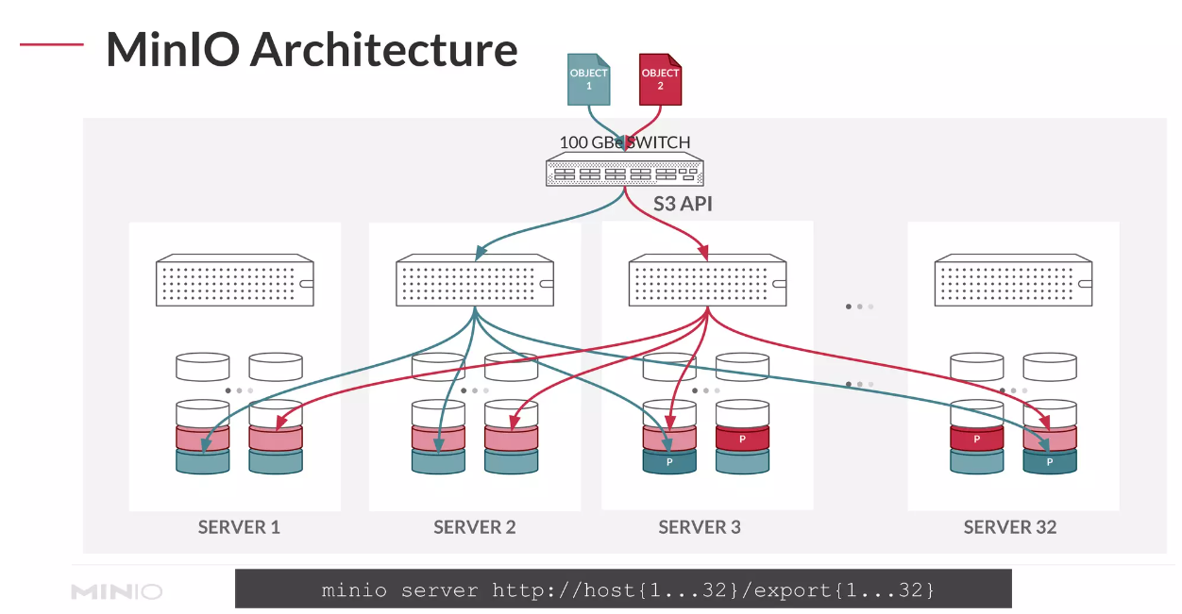

Slide 21
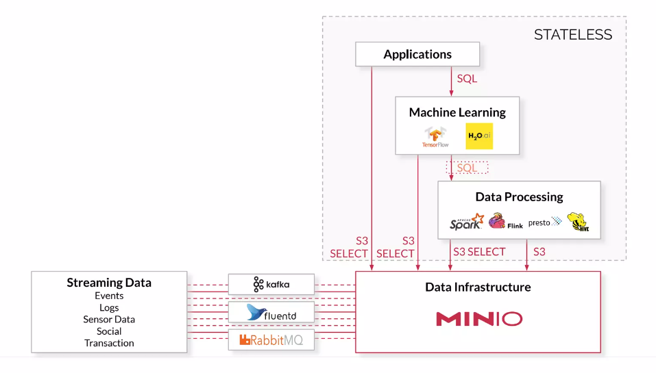

Slide 22
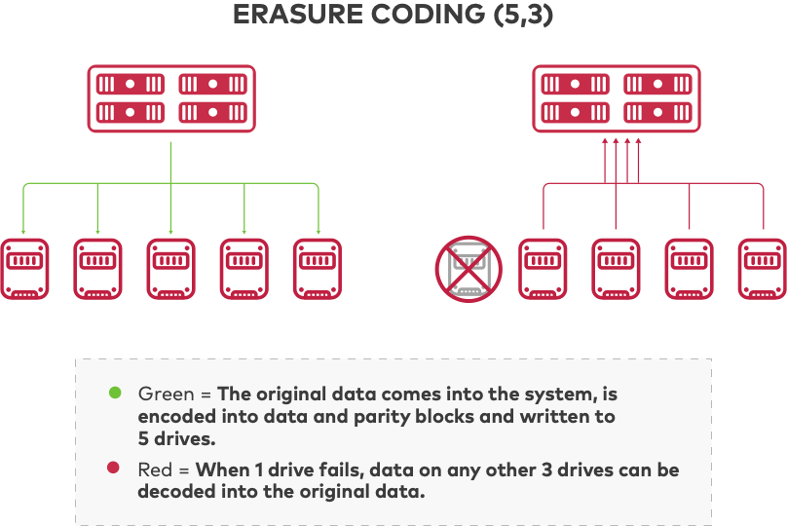
MinIO Erasure Coding

Slide 23
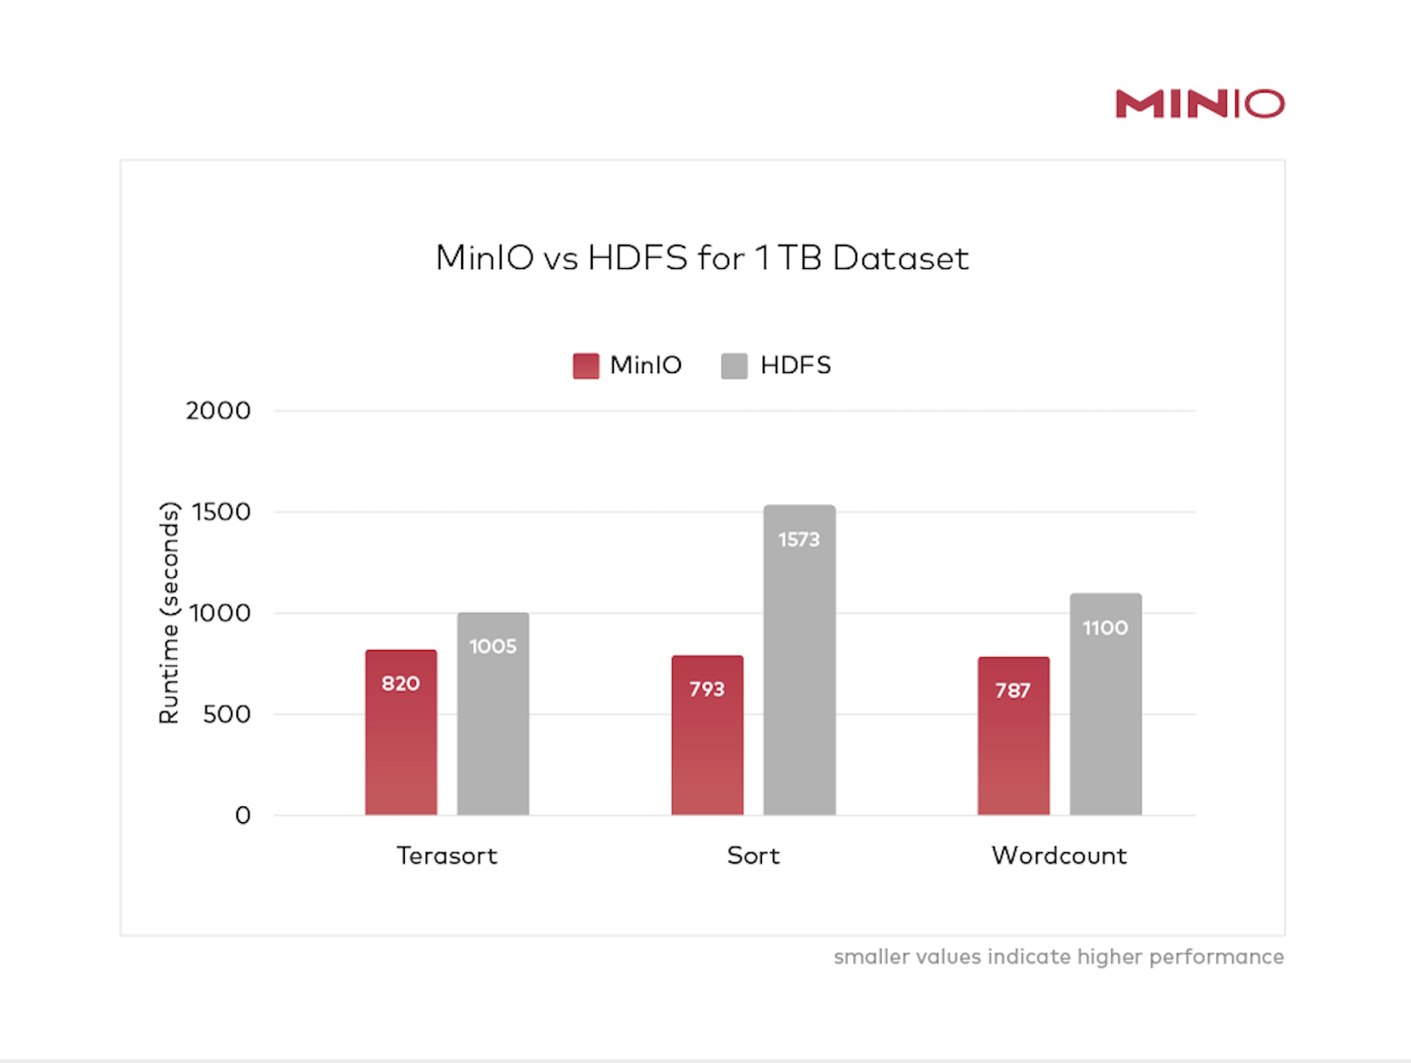

Slide 24
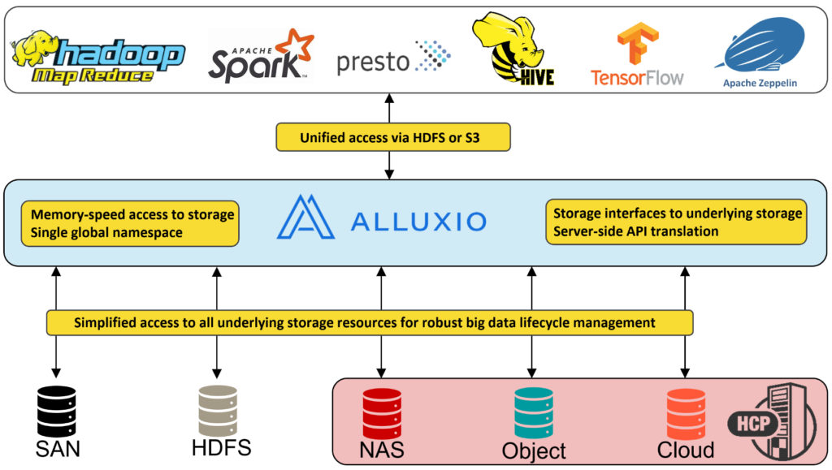
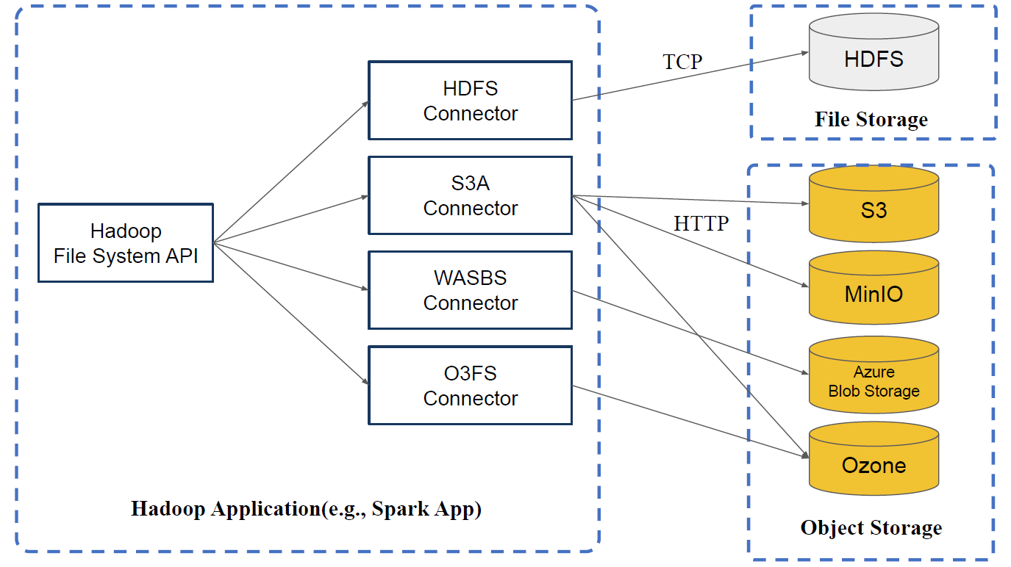
Unified Data Platform

