Slide 1

Migrating to Cloud

Slide 2
Some Considerations
Similarities and dissimilarities of design concept between on-premise environment with the one in the cloud provider
It is important to understand the existing infrastructure landscape and to identify equivalent component provided by cloud provider to ensure smooth migration
Including virtualization format for the VM being imported, e.g. VDI from Oracle, VMDK from VMware, VHD from Microsoft
Organizations typically prefer to use a hybrid cloud approach where part of the resources remain on-premise, and the architecture is designed to leverage resources in the cloud as well

Slide 3
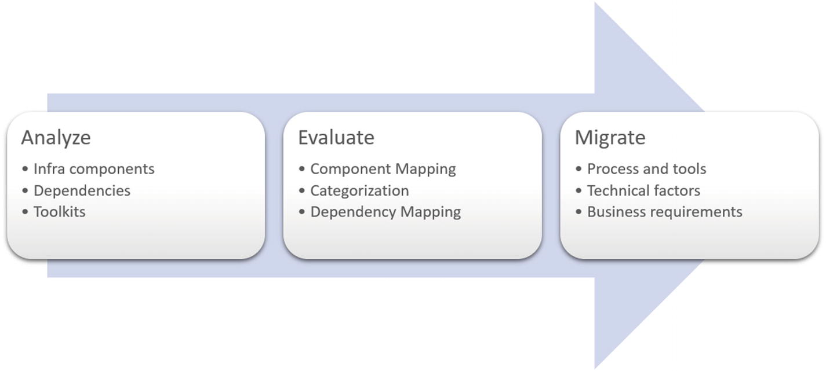
Migration Workflow

Slide 4
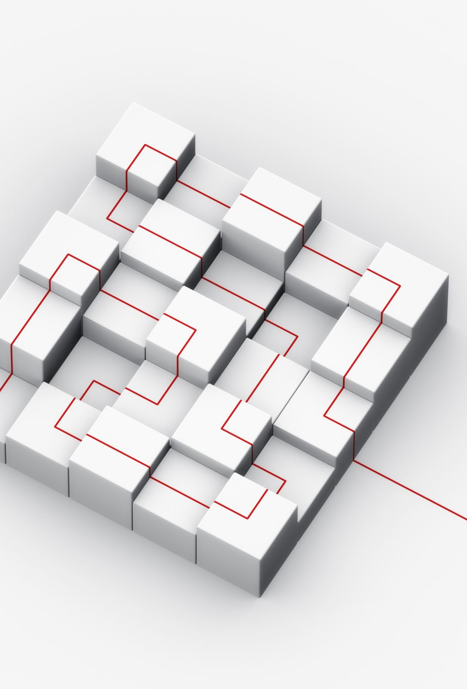
Analyze
A comprehensive document and an architecture diagram should be available to clearly understand the existing infrastructure layout.
The interdependencies of the components should be etched out for clarity.
For environments where this interrelationship is not documented—for example, legacy environments,
consider using options like the Microsoft Assessment and Planning (MAP) toolkit to generate a comprehensive report of existing environment.

Slide 5

Evaluate
List of the infrastructure components (and their dependencies) that need to be migrated should be evaluated and mapped against the equivalent services in cloud provider
Further subdivide the components into basic services;
For example, when migrating a server to Azure, you consume compute, storage, and network services
A mapping of the compute power to the available instance types in Azure should be done along with the mapping of storage.
Decide the kind of storage to be used:
Between premium vs. standard storage and managed vs. unmanaged disks

Slide 6

Migrate
After the assessment and evaluation phase, the primary decision involves the migration process and tools
This depends on technical factors such as infrastructure type (i.e., virtualized or not, type of virtualization used, OS versions, and etc.)
The business dependencies—such as consumption models, SLAs, acceptable downtimes, and so forth—should also be factored when selecting the migration method

Slide 7
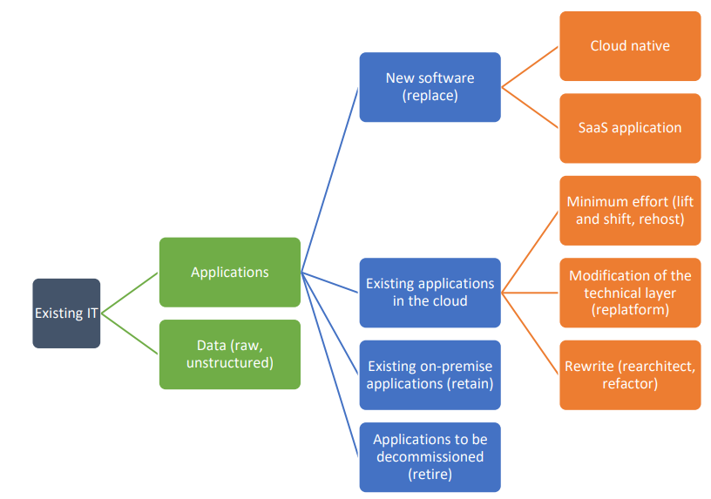
Cloud Migration Path
Source: Cigref WG

Slide 8
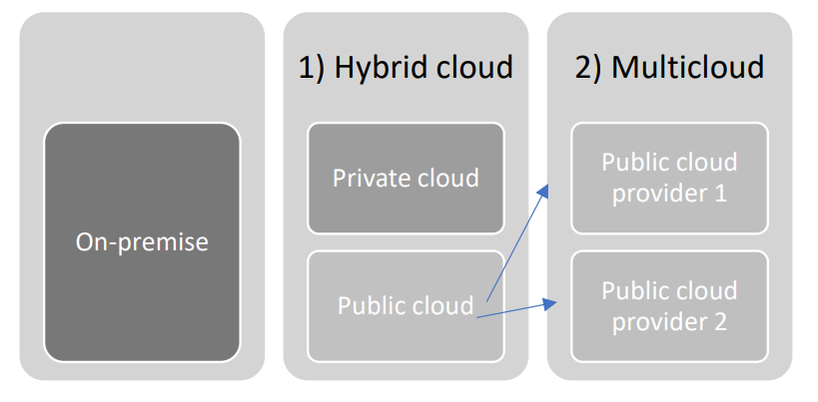
Hybrid vs Multi Cloud
Source: Cigref WG

Slide 9
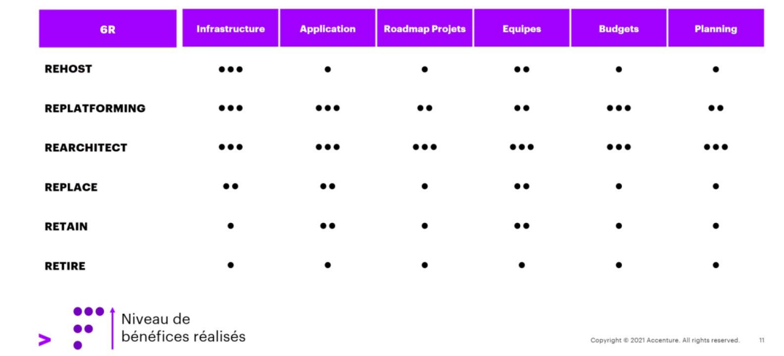
Level of Benefit

Slide 10
Types of Server Migration (Rehost)
Physical to virtual
Virtual to virtual
Virtual to physical
Storage data migration

Slide 11

Physical to Virtual (P2V)
Taking a server that is running an operating system and applications and then migrating it to a VM running on top of a hypervisor
May require reinstalling the operating system, application, and data files onto a new VM from scratch
Software utilities are offered by some companies, e.g. VMware vCenter Converter and Microsoft’s Virtual Machine Manager, that can perform the conversion
Several 3rd party software companies and cloud providers offer fully automated P2V utilities

Slide 12
Physical Server
Even though the majority of workloads nowadays use virtualization, some physical servers are still being used for special or specific use cases
For example, applications that need dedicated compute capacity without any processor sharing (GPUs ,etc)
Legacy applications may still run in original physical server due to ambiguity around design and dependencies
The end goal is to convert the source machine to a compatible format in the cloud provider (e.g. Azure)
Need to check equivalent components for special hardware requirements (e.g. GPU)
Azure N series virtual machines with NVIDIA GPUs can be an option when migrating to Microsoft Azure

Slide 13
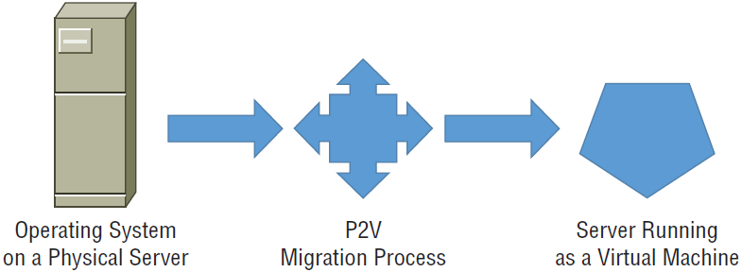
Physical to Virtual (P2V)

Slide 14
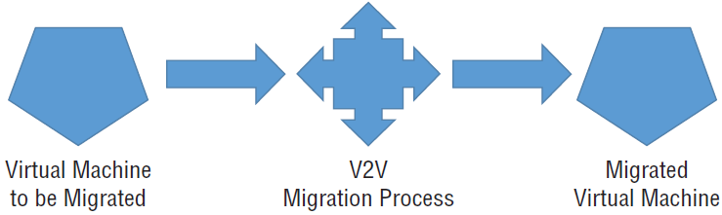
Virtual to Virtual (V2V)
It generally involves cloning the existing VM and installing that image at the cloud provider’s hosting center

Slide 15
Virtual to Physical (V2P)
While not as common, there is an option of converting from a virtual server to a physical server known as virtual-to-physical (V2P)
A use case would be if more processing power is needed and can be provided if the server is hosted on its own server hardware
Have lots of details that must be sorted through based on the hardware
May be that a fresh installation of the operating system and application will be required and virtualization software being used

Slide 16
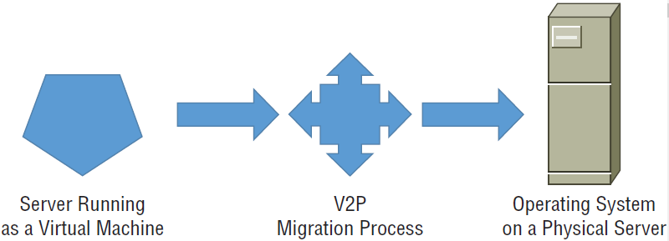
Virtual to Physical (V2P)

Slide 17

Storage Data Migration
A server’s data storage volumes can be migrated separately from or as part of a server migration
The transition to the cloud accompanied by a cloud service provider will vary based on the cloud provider’s storage offerings and infrastructure
Things to take into account:
the amount of bandwidth
how long it will take to upload the storage data from your internal data center to the cloud
However, with petabyte data in on-premise storage
Data transfer over the network could literally take years

Slide 18
Storage Data Migration
Workarounds have been developed for such issue
Including appliances that can be shipped to the private data center and directly connected to the storage network for a local transfer of stored data, then it is shipped to the cloud service provider and directly transfer the data to cloud storage
Some options are available to use these appliances
Including shipping-container-sized storage systems that are pulled by large semi-tractors

Slide 19
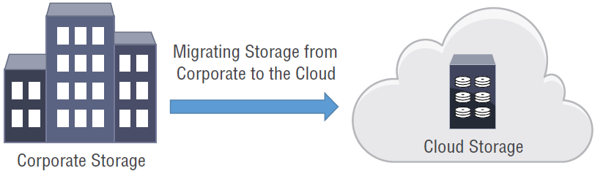
Storage Data Migration

Slide 20
Online vs Offline
 | Pros | Cons
Online migrations | No delay for transport times Less expensive | Bad if the available bandwidth (either in the existing server or cloud provider) is limited
Offline migrations | No problem with bandwidth limitations | More delay in shipping the storage media Also more costly

Slide 21
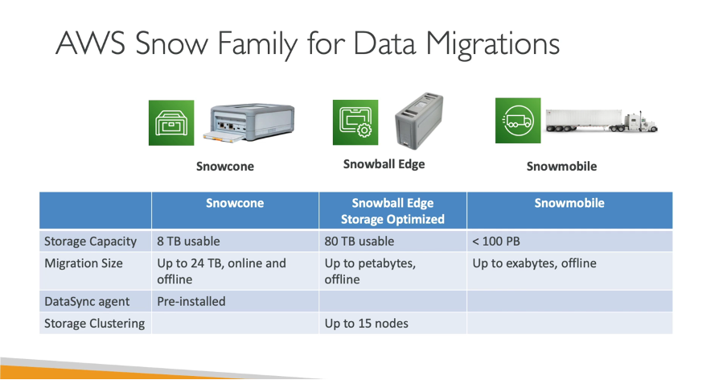

Slide 22
References
T. Montgomery, S. Olson, “CompTIA Cloud+ Study Guide,” John Willey & Sons, 2nd ed, 2018
S. A. Karthikeyan, “Practical Microsoft Azure IaaS: Migrating and Building Scalable and Secure Cloud Solutions,” Apres, 2018
Cigref, “Strategies for IT migrations to cloud computing”, November 2021

