Slide 1
Microservices

Slide 2
Monolithic
Built as a single unit
Often built in three main parts: a client-side user interface, a database and a server-side application.
The server-side application will handle HTTP requests, execute domain logic, retrieve and update data from the database, and select and populate HTML views to be sent to the browser. This server-side application is a monolith - a single logical executable
Any changes to the system involve building and deploying a new version of the server-side application.
Monolithic applications can be successful, but increasingly people are feeling frustrations with them - especially as more applications are being deployed to the cloud .
Change cycles are tied together - a change made to a small part of the application, requires the entire monolith to be rebuilt and deployed.
Over time it's often hard to keep a good modular structure, making it harder to keep changes that ought to only affect one module within that module.
Scaling requires scaling of the entire application rather than parts of it that require greater resource

Slide 3


Best Practice: Design Services, Not Servers
Leverage the breadth of AWS services; don't limit your infrastructure to servers.
Managed services and serverless architectures can provide greater reliability and efficiency in your environment.
Anti-pattern
Best practice
Simple applications run on persistent servers.
Applications communicate directly with one another.
Static web assets are stored locally on instances.
Back-end servers handle user authentication and user state storage.
Serverless solution is provisioned at time of need.
Message queues handle communication between applications.
Static web assets are stored externally, such as on Amazon S3.
User authentication and user state storage are handled by managed AWS services.

Slide 4
Microservices
Building applications as suites of services
Smaller, finer grain, independent processes within a service oriented style.
Each process is focused on doing one small task.
Processes communicate to each other using language-agnostic APIs that leverage JSON/REST.

Slide 5
Comparing Architectural Styles
Traditional SOA architectures are monolithic:[N-Tier]
Microservice-based architectures are loosely coupled:
Home
Home
Orders
Suggest
Suggest
Suggest
Stats
Cart
Orders
Cart
Stats
Orders
Orders
Inventory
Database
Inventory
Inventory

Slide 6
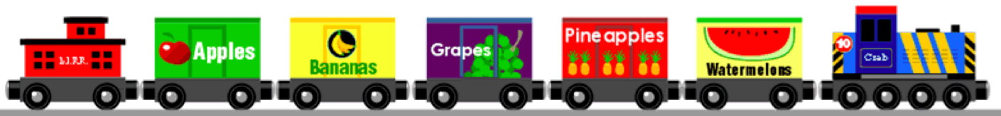
Monolithic App (Various Components linked together)
Comparing Monolithic to MicroServices

Slide 7
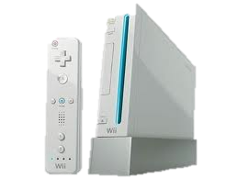








Monolithic Architecture
Load Balancer
Monolithic App
Account Component
Catalog
Component
Database
Recommendation
Component
Customer Service
Component

Slide 8
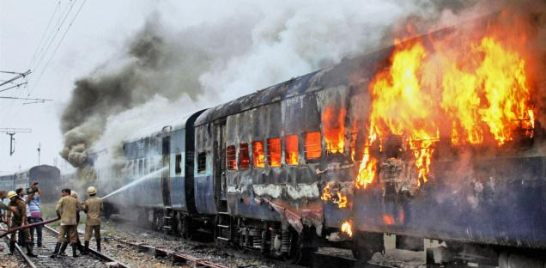
Monolithic Apps – Failure & Availability

Slide 9

MicroServices – separate single purpose services

Slide 10
Microservices Architecture
Load Balancer
API Gateway
Catalog DB
Account Service
Catalog
Service
Recommendation
Service
Customer Service
Service
Customer DB

Slide 11

Challenges
Can lead to chaos if not designed right …

Slide 12
Partitioning to microservices
Decompose by business capability and define services corresponding to business capabilities
Decompose by domain-driven design subdomain
Decompose by verb or use case and define services that are responsible for particular actions. e.g. a Shipping Service that’s responsible for shipping complete orders
Decompose by by nouns or resources by defining a service that is responsible for all operations on entities/resources of a given type. e.g. an Account Service that is responsible for managing user accounts

Slide 13
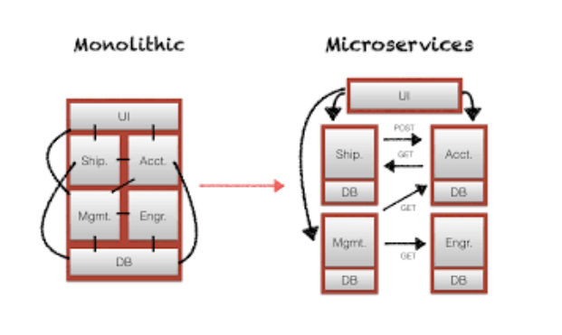
Communication between services

Slide 14
Advantages of Microservice
Support for scaling
Support for change
Support for reuse
Support for separate team development
Support for failure (fault tolerance)

Slide 15
Challenges using Microservice
Services may fail anytime
Bugs in service
Slow response
Failed hardware
More services deployed, increase the likelihood of failed services
Probable solution:
Monitoring
Design for Failure

Slide 16
Design for Failure
Design for idempotency
Should be able to retry requests without introducing bad data
Design APIs so that executing an action multiple times leads to same resulting state
Prefer state changes on existing entity rather than creating new entities
Design for data locality
Transactions across microservices are hard to manage
If datastore server fails or is slow, do not want entire site to go down
Decentralizes implementation decisions
Design for eventual consistency

Slide 17
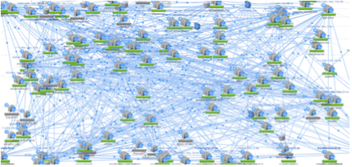
MicroServices at Netflix

