Slide 1
Platform as a Service

Slide 2
What Has IaaS Done
IaaS provides virtual machines and resources such that IaaS vendors can segment resources for each user
IaaS providers can also make users do not need to purchase the hardware
IaaS can make better use of resources

Slide 3
What IaaS Can Do
Traditional IT
IaaS

Slide 4
IaaS is Not Enough
IaaS provides many virtual or physical machines, but it cannot alter the quantity automatically
Consumers might
Require automatic make-decisions of dispatching jobs to available resources
Need a running environment or a development and testing platform to design their applications or services

Slide 5

More Requirements
Consumers require more and more…
Large-scale resource abstraction and management
Requirement of large-scale resources on demand
Running and hosting environment
Automatic and autonomous mechanism
Distribution and management of jobs
Access control and authentication
…

Slide 6
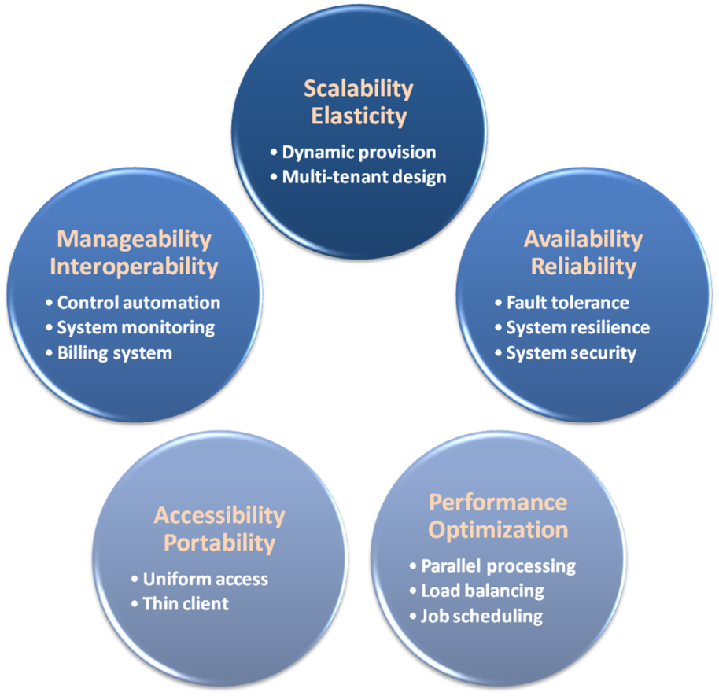
PaaS Buys It for You
PaaS provides a series of properties that can satisfy user’s requirements
PaaS guarantees the quality of resources, services and applications

Slide 7
From IaaS to PaaS
Traditional IT
IaaS
PaaS
Applications
Applications
Applications
You Manage
Data
Data
Data
Runtime
You Manage
Runtime
Runtime
Middleware
Middleware
Middleware
You Manage
OS
OS
OS
Virtualization
Virtualization
Virtualization
Provider Manage
Servers
Servers
Provider Manage
Servers
Storage
Storage
Storage
Networking
Networking
Networking

Slide 8
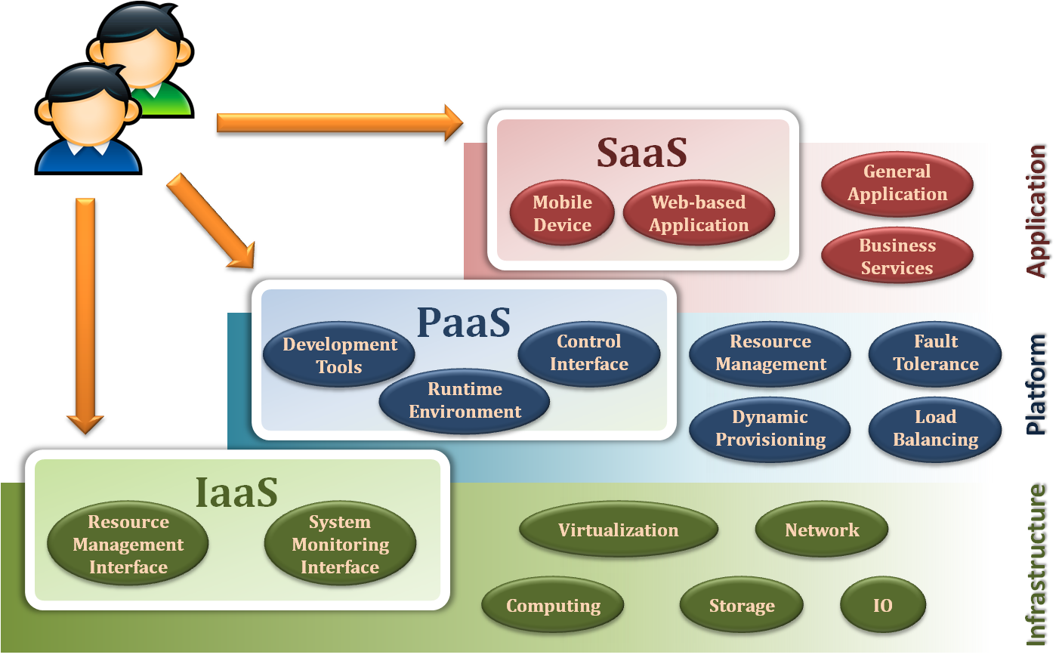
Platform as a Service
Platform as a Service (PaaS) is a computing platform that abstracts the infrastructure, OS, and middleware to drive developer productivity

Slide 9
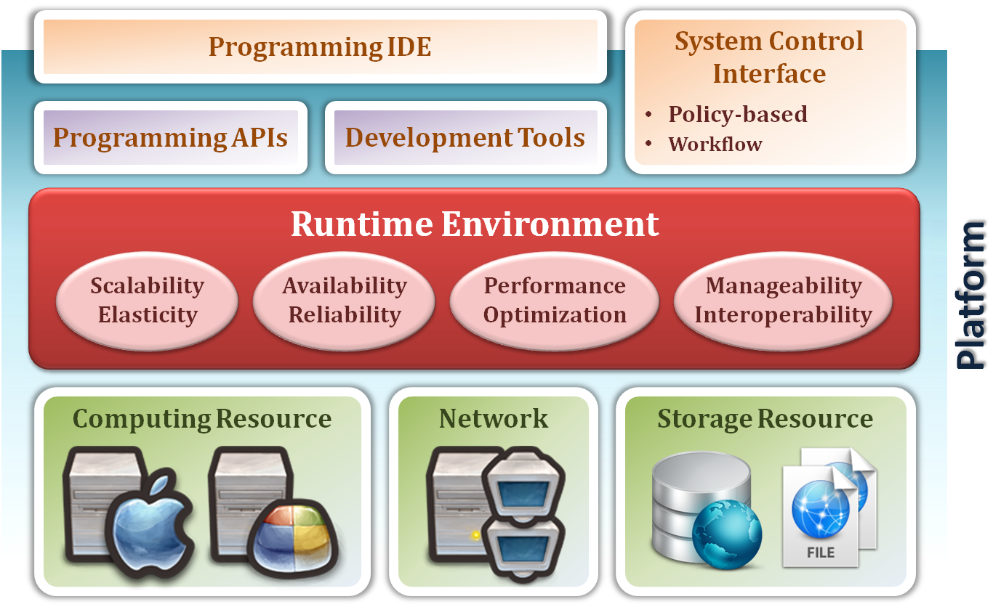
Platform as a Service
Deliver the computing platform as a service
Developing applications using programming languages and tools supported by the PaaS provider
Deploying consumer-created applications onto the cloud infrastructure
Enabling Services
provide
Core Platform
abstract
Resource Pool

Slide 10
Resource Pool
The capacities to abstract and control all the underlying resources
Resource Pool dynamically provides an abstraction and consolidation of large-scale resources
Consumers can acquire and return resources from the resource pool on demand
Enabling Services
provide
Core Platform
abstract
Resource Pool

Slide 11
Core Platform
PaaS providers can provide a runtime environment for the developer platform
Runtime environment is automatic control such that consumers can focus on their services
Dynamic provisioning
On-demand resource provisioning
Load balancing
Distribute workload evenly among resources
Fault tolerance
Continuously operating in the presence of failures
System monitoring
Monitor the system status and measure the usage of resources

Slide 12
Enabling Services
Enabling Services are the main focus of consumers
Consumers can make use of these sustaining services to develop their applications
Programming IDE
Integrate the full functionalities supported from the runtime environment
Provide some development tools, such as profiler, debugger and testing environment
System Control Interfaces
Make the decision according to some principles and requirements
Describe the flow of installation and configuration of resources

Slide 13

Platform as a Service
Guarantee some properties and characteristics
Scalability
Availability
Manageability
Performance
Accessibility

Slide 14

Scalability
PaaS needs to support dynamic provisioning that can increase or decrease resources on demand
PaaS provides the abstraction of cloud infrastructure and the automatic management

Slide 15

Availability
PaaS needs to support the fault tolerance ability such that system would not crash on failure
PaaS also needs to provide system resilience by duplicating applications or services

Slide 16
Manageability
PaaS provides automatic mechanisms to control the utilization of platform resources
Monitoring service provides the ability of management, analysis and operation for resources and jobs
Based on the system monitoring, PaaS can record and report the usage of resources
Consumers can pay for what they use

Slide 17

Billing
Consumers pay the bill according to how many units of resources and services they use
Input/output network bandwidth
Management report or warning
CPU time
Storage space
Data migration
…etc

Slide 18
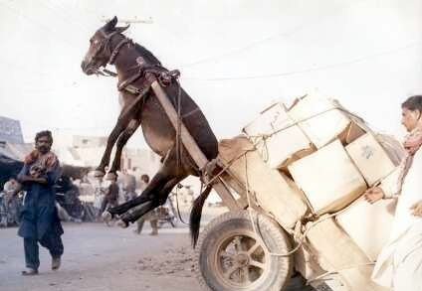
Performance
PaaS needs to support the capabilities
Distribute jobs to idle resources
Remove jobs from the overloading resources
PaaS also needs to distributes data to storage system with load balancing

Slide 19

Security
Security is an important characteristic in PaaS
PaaS needs to provide authentication and authorization to differentiate the access rights of different users

Slide 20
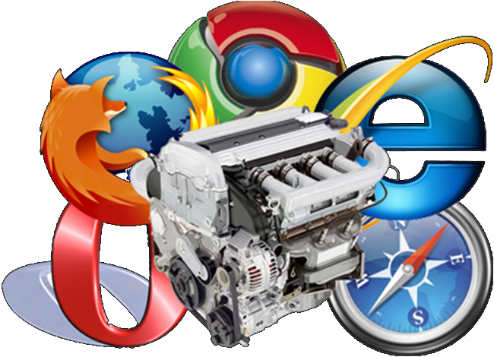
Accessibility
PaaS needs to provide an interactive interface for consumers to access cloud services or monitor the system status
Consumers could develop and test their applications via web browsers or other thin-clients

Slide 21
Example of PaaS
Deployment Platform on PaaS
Database as a Service
Docker Deployment on Cloud

Slide 22
Summary
PaaS is a magic box
Request anything on demand, and return the rent of resources dynamically
Automatically build an initial environment and support self-management with high quality of service and performance
Provide an ability of fault tolerance and disaster recovery that make services be more available and reliable
Support the security property to limit malicious behavior in cloud environments
More important
Do not care about how it works
Pay as you go

