Slide 1
Software as a Service

Slide 2
Software as a Service (SaaS)
Software as a service (SaaS) is a model of software delivery where the software company provides maintenance, daily technical operation, and support for the software provided to their client.
SaaS alleviates the burden of software maintenance/support
but users relinquish control over software versions and requirements.
It assumes the software is delivered over the internet.
Software delivered to home consumers, small business, medium and large business

Slide 3
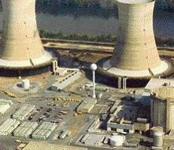
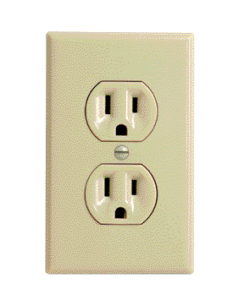
Software as a Service (SaaS)
Traditional Software
On-Demand Utility
Plug In, Subscribe Pay-per-Use
Build Your Own

Slide 4
Software as a Service (SaaS)
The web as a platform is the center point
Web-browser acting as a thin-client for accessing the software remotely across the internet.
Network-based access to, and management of, commercially available (i.e., not custom) software
Application delivery that typically is closer to a one-to-many model (single instance, multi-tenant architecture) than to a one-to-one model, including architecture, pricing, partnering, and management characteristics
Keyword: multitenancy

Slide 5
SaaS Architecture
Fueled by
Bandwidth technologies
The cost of a PC has been reduced significantly with more powerful computing but the cost of application software has not followed
Timely and expensive setup and maintenance costs
Licensing issues for business are contributing significantly to the use of illegal software and piracy.
Notes:
The bigger the hard drives the bigger the applications get
Cost of software has stayed the same or gotten higher
Even some small to medium companies are using pirated software cause they cannot afford it
I worked for a company that only installed products like huge Accounting packages as consultants. Made lots of cash due to long days to setup package

Slide 6
SaaS - Pros
Stay focused on business processes
Change software to an Operating Expense instead of a Capital Purchase, making better accounting and budgeting sense.
Create a consistent application environment for all users
No concerns for cross platform support
Easy Access
Reduced piracy of your software
Lower Cost
For an affordable monthly subscription
Implementation fees are significantly lower
Continuous Technology Enhancements
Notes:
Create a consistent application environment for all users through access to the same versions – compatibility –
Implementation fees are significantly lower than purchasing proprietary software and hardware.

Slide 7
SaaS - Cons
Initial time needed for licensing and agreements
Trust, or the lack thereof, is the number one factor blocking the adoption of software as a service (SaaS).
Centralized control
Possible erosion of customer privacy
Absence of disconnected use
Notes:
Another mitigating factor is need for disconnected use. Many users, such as traveling salespeople, need access to data while offline. Some apps have synchonization

Slide 8
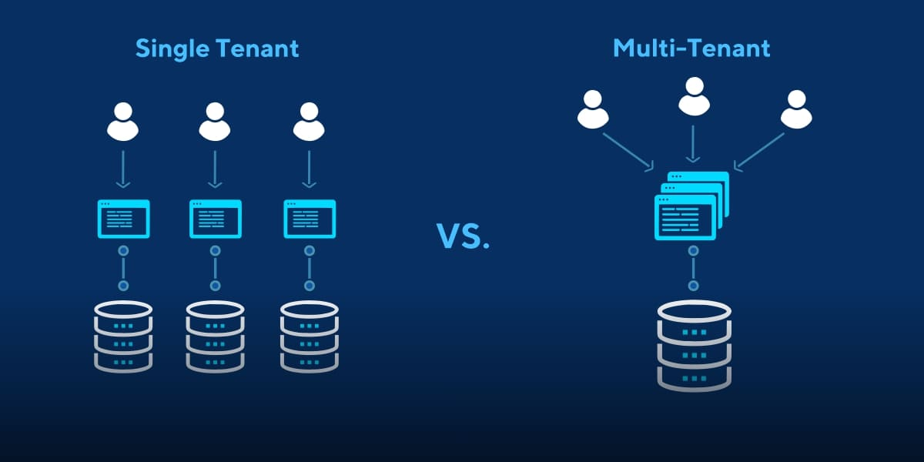
Multitenancy
Multitenancy is a reference to the mode of operation of software where multiple independent instances of one or multiple applications operate in a shared environment. The instances (tenants) are logically isolated, but physically integrated.

Slide 9
Multitenancy
Issues:
Security
Performance
Less powerful
Noisy neighbor
Interoperability
Monitoring
Capacity optimization

Slide 10
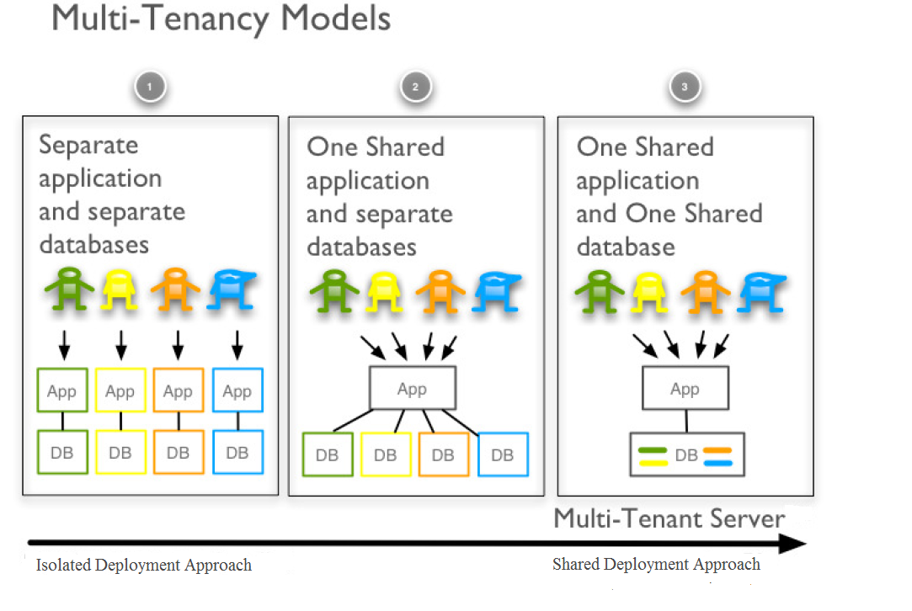
Multitenancy

Slide 11
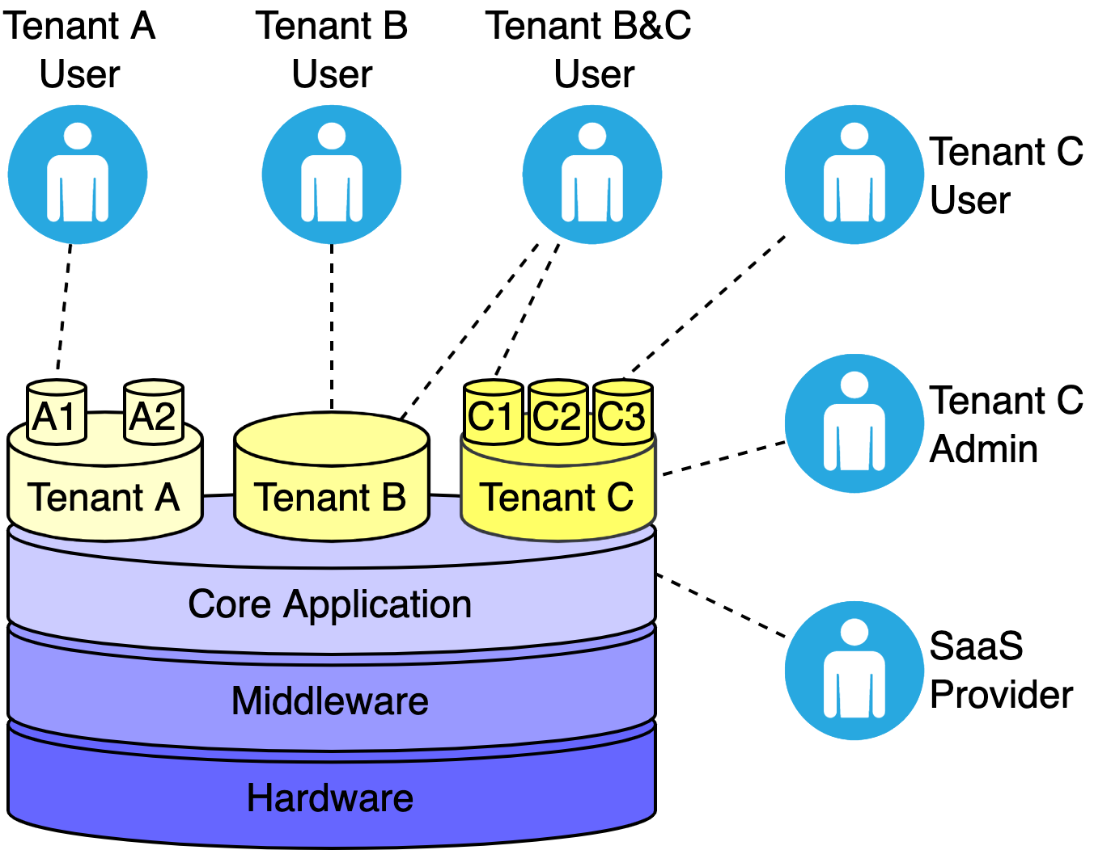

Slide 12
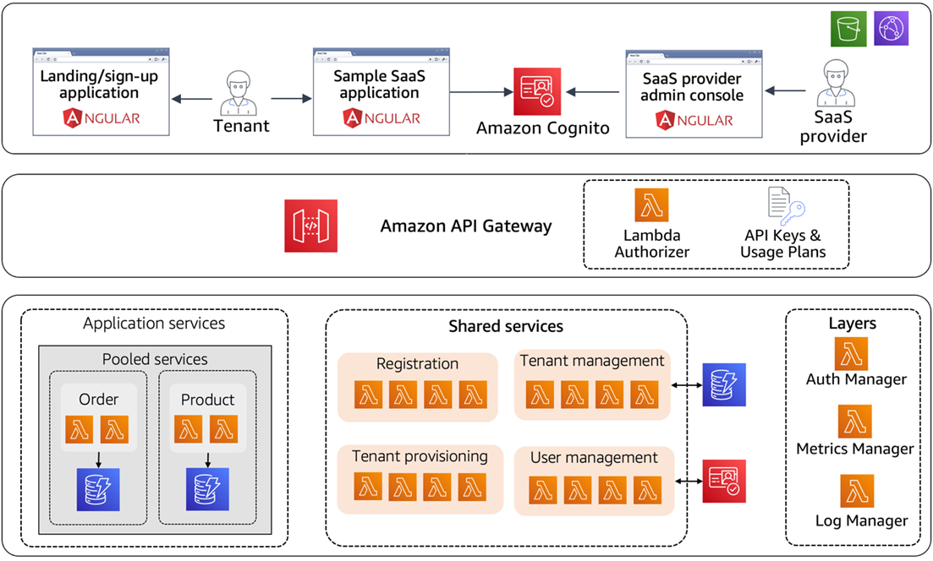

Slide 13
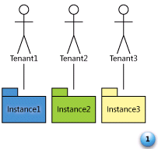
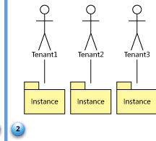
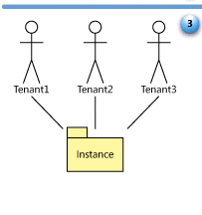
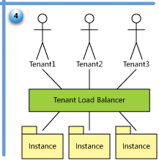
SaaS Maturity Model
Level 1: Ad-Hoc/Custom – One Instance per customer
Level 2: Configurable per customer
Level 3: configurable & Multi-Tenant-Efficient
Level 4: Scalable, Configurable & Multi-Tenant-Efficient
Source: Frederick Chong and Gianpaolo Carraro, “Architectures Strategies for Catching the Long Tail”

Slide 14
Developing Multitenancy Solution
Options:
Creating multitenancy from a ready to use product
Create from scratch
Combining different libraries and package
Using SaaS Boilerplate

Slide 15
SaaS Boilerplate
a.k.a SaaS starter kit
a pre-built foundation for a SaaS application
ready-to-use, customizable, and well-tested open-source tool kit, giving you all the essential parts to build a complete product.

Slide 16
SaaS Boilerplate
A typical SaaS boilerplate will have the following pieces:
A back end: including connecting to a database, data models for users, teams, and any other default functionality, APIs, business logic, integrations, and so on.
A front end: with pre-designed user interfaces, templates, dashboards, UI components, and so on.
Development support: tooling and infrastructure that help with development of code on top of the boilerplate.
Deployment support: the tools needed to push your app to production and host it on the cloud.

Slide 17
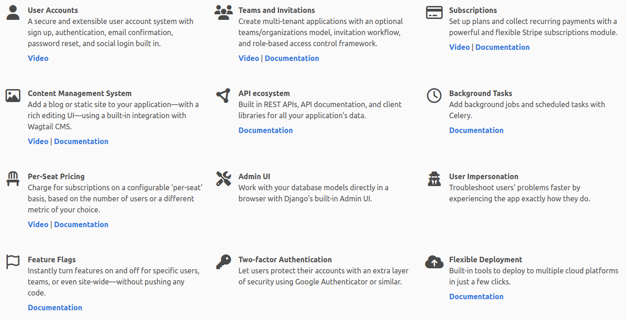

Slide 18
SaaS Boilerplate
Benefits:
Speed
Well tested
Create from best practice
Drawbacks:
Uncertainty
Inflexible
Add complexity

Slide 19
Developing Multitenancy Solution
SaaS Boilerplate by Apptension https://www.apptension.com/saas-boilerplate
Staart SaaS Stack https://staart.js.org/api/
Golang Startup Kit for SaaS https://saasstartupkit.com/
Ignite (Flask/Python) https://github.com/sumukh/ignite
Multitenancy for Laravel https://tenancyforlaravel.com/
Multitenancy for Moodle https://www.iomad.org/

