Slide 1
Serverless COMPUTING

Slide 2
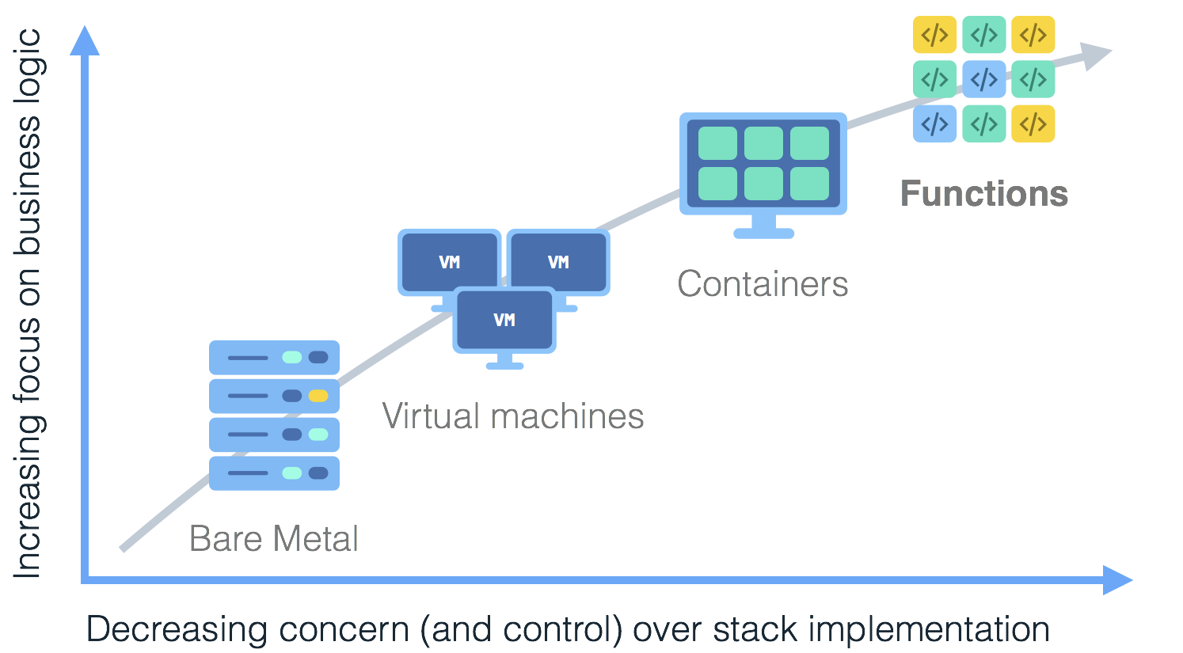
Notes:
Serverless is coming of age, developers want to focus on code instead of managing infrastructure.
Mention some of the companies.
Show the axis later.
Animate the arrow and boxes.

Slide 3
Evolution Of Serverless
PaaS
Container Orchestrators
IaaS
Bare Metal

Slide 4
Enter Serverless
Serverless
PaaS
Container Orchestrators
IaaS
Bare Metal

Slide 5
Monolithic Application
Break-down into microservices
Explosion in number of
containers / processes:
Make each micro service HA
Increase of infrastructure cost footprint
Protect against regional outages
Region A
Region B
Increase of operational
management cost and
complexity
Notes:
Managability
Load anticipation (models) and AutoScaling, Things can fail, load goes up and down.
So how about dividing your work into smaller pieces, but let the platform worry about manageability and autoscaling. Great Ideally, but its hard for the platform to scale and manage the services (So the suggestion is to make them stateless and smaller).

Slide 6
What is Serverless?
a cloud-native platform
for
short-running, stateless computation
and
event-driven applications
which
scales up and down instantly and automatically
and
charges for actual usage at a millisecond granularity

Slide 7
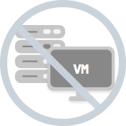
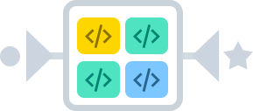
Server-less means no servers?
Or worry-less about servers?
Runs code only on-demand on a per-request basis
Serverless deployment & operations model
No servers
Just code
Notes:
What is Serverless
A cloud-native platform for
short-running, stateless computation
And event-driven applications
Which scales up and down instantly and automatically
And charges for actual usage at a millisecond granularity

Slide 8

What triggers code execution?
Runs code in response to events
Event-programming model
Notes:
What is Serverless

Slide 9
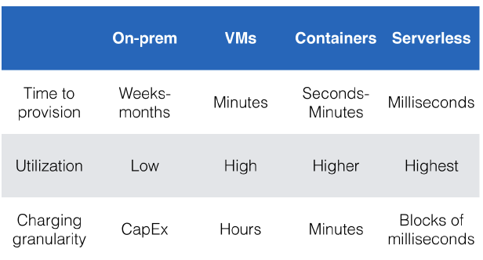
Why is Serverless attractive?
Making app development & ops dramatically faster, cheaper, easier
Drives infrastructure cost savings
Source: Jason McGee, IBM; Serverless Conference 2017.
Notes:
Another key reason for Serverless being attractive is the use of other provider services (logging, Data Analytics, Speech, Inferencing, etc….). Vendor Lock-in.

Slide 10
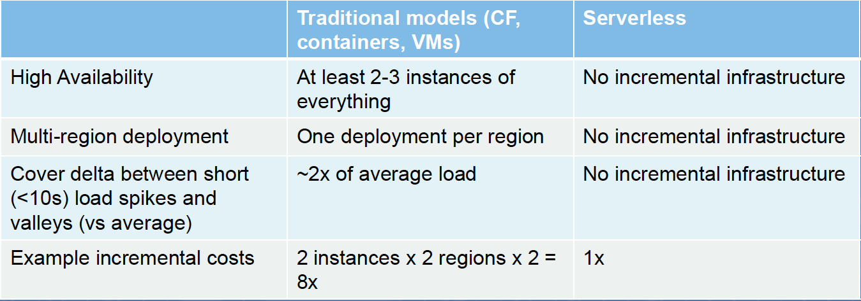
Key factors for infrastructure cost savings

Slide 11
Serverless Computing
Quick deployment
Seamless scalability
Greater cost-efficiency
Better user experience
Accurate resourcing

Slide 12
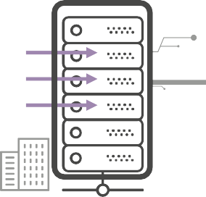
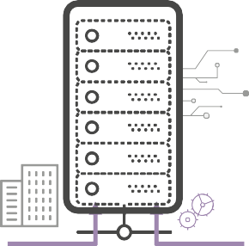
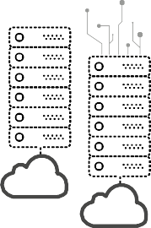


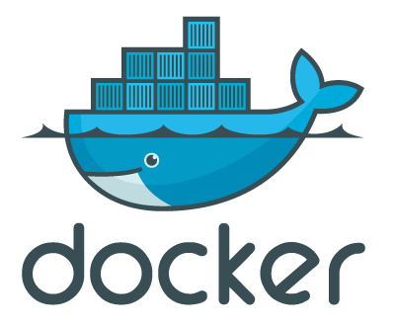
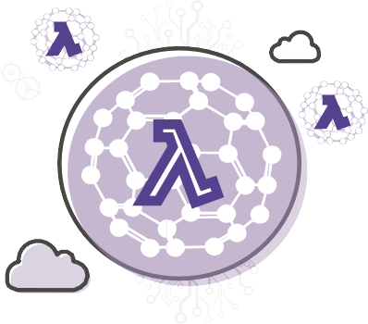

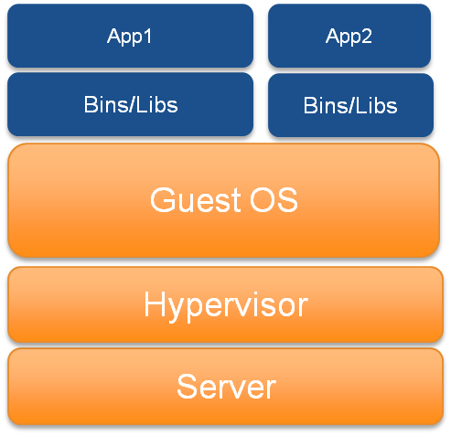


Evolving to Serverless
Physical Servers in Datacenters
Virtual Servers in Datacenters
Virtual Servers in the Cloud
Containers in the Cloud
Serverless with the Cloud
Notes:
Evolusi mekanisme komputasi dari : physical datacenter ke virtual

Slide 13




Important Benefits
No servers to provision or manage
Scales with usage
Never pay for idle
Availability and fault tolerance built in

Slide 14



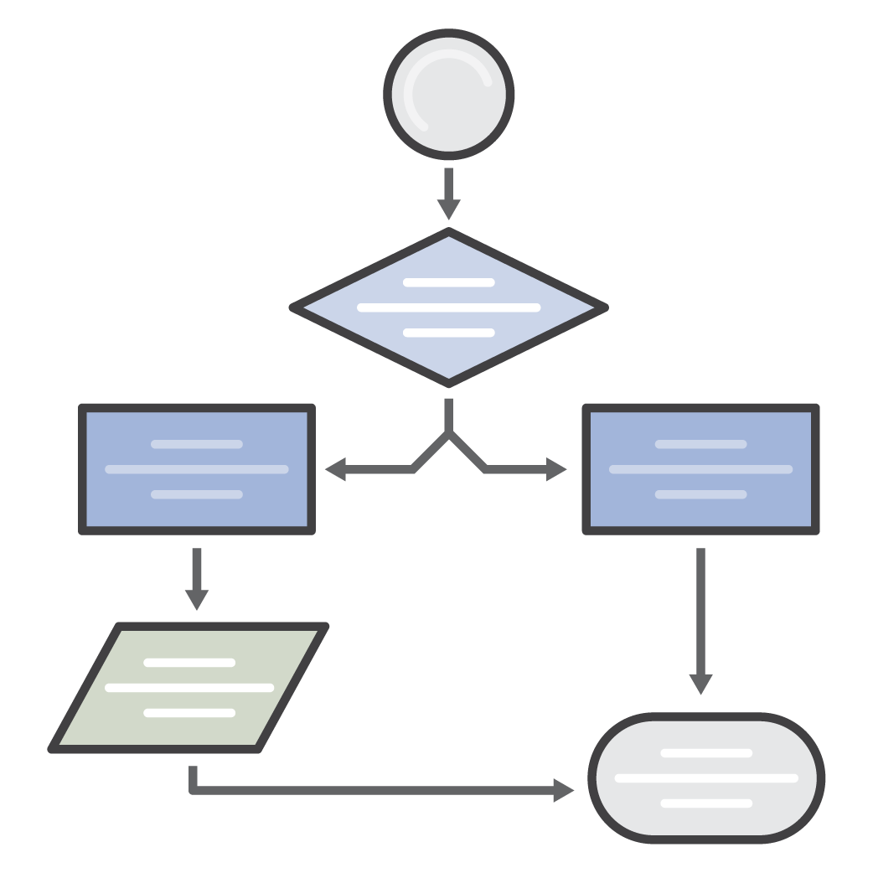

Common use cases for Serverless Applications
</>
Web Applications
Backends
Data Processing
Chatbots
Amazon Alexa
Autonomous IT
Static websites
Complex web apps
Packages for Flask and Express
Apps & services
Mobile
IoT
Real time
MapReduce
Batch
Powering chatbot logic
Powering voice-enabled apps
Alexa Skills Kit
Policy engines
Extending AWS services
Infrastructure management

Slide 15

Fundamentals of AWS Lambda
digitalent.kominfo.go.id

Slide 16
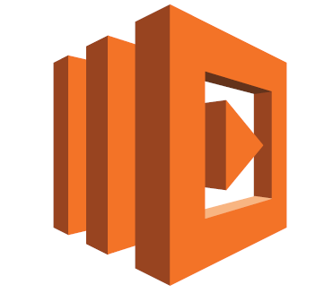
Let’s talk about Lambda!
Run code without thinking about server.
Serverless compute platform for stateless code execution in response to events.
AWS Lambda lets you run code without provisioning or managing servers.
digitalent.kominfo.go.id

Slide 17
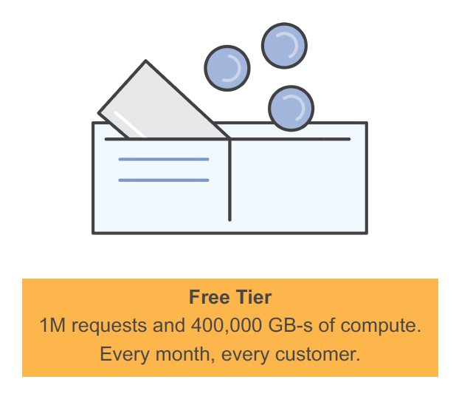
Pay per request
Buy compute time in 100ms increments
Low request charge
No hourly, daily, or monthly minimums
No per-device fees
Never pay for idle
digitalent.kominfo.go.id

Slide 18
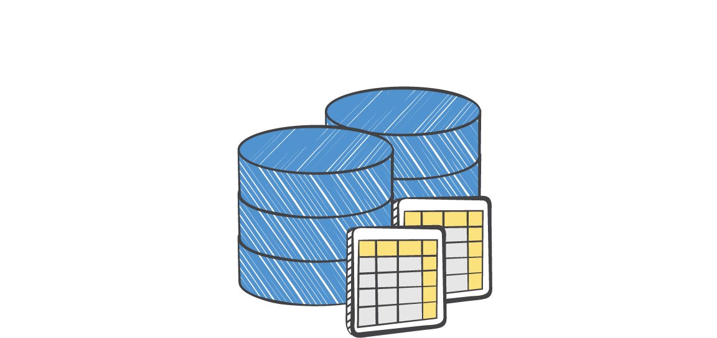



AWS Lambda Execution Flow
EVENT SOURCE
FUNCTION
SERVICES (ANYTHING)
Data Store
Changes in data state
Node Python Java C#
… more coming soon
Requests to endpoints
Action
Changes in resource state

Slide 19











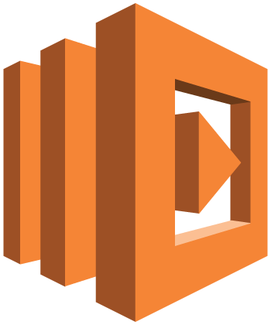

Lambda execution model
Synchronous (push)
Asynchronous (event)
Stream-based
Amazon API Gateway
Amazon SNS
Amazon DynamoDB
Amazon S3
Amazon Kinesis
/order
reqs
changes
AWS Lambda service
AWS Lambda function
AWS Lambda function
function

Slide 20











Event Sources that integrate with AWS Lambda
DATA STORES ENDPOINTS
Amazon S3 Amazon
DynamoDB
Amazon Kinesis
Amazon Cognito
Amazon RDS Aurora
Amazon Alexa
Amazon API Gateway
AWS IoT
REPOSITORIES
EVENT/MESSAGE SERVICES
ORCHESTRATION AND STATE MANAGEMENT
AWS AWS
CloudFormation CloudTrail
Amazon CloudWatch
Amazon SES
Amazon SNS
Cron events
AWS Step Functions
… and the list will continue to grow!

Slide 21


Working with Lambda
Bring your own code
Node.js, Java, Python, C#
Bring your own libraries (even native ones)
Simple resource model
Select power rating from 128MB to 1.5GB
CPU and network allocated proportionately
Metrics show usage

Slide 22


Working with Lambda
Flexible use
Call or send events
Integrated with other AWS services
Build serverless ecosystems
Flexible authorization
Securely grant access to resources, including VPCs
Fine-grained control over what can call your functions

Slide 23


Working with Lambda
Programming model
Built-in AWS SDK
Front end is Lambda
Use processes, threads, /tmp and sockets normally
Authoring functions
Author directly with WYSIWYG editor in console
Package code as .zip and upload to Lambda or S3
Plugins for Eclipse and Visual Studio
Command line tools

Slide 24


Working with Lambda
Stateless
Persist data using Amazon S3, RDS, Elasticache or non-relational database
No affinity to infrastructure (can’t login to host)
Monitoring and logging
Built in metrics for requests, latency, errors and throttles
Built in logging with CloudWatch

Slide 25
Authoring functions and AWS Lambda environment

Slide 26
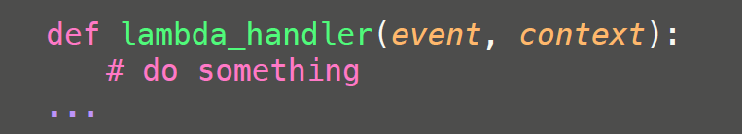
Anatomy of a Lambda function
Handler() function
Function to be executed upon invocation
Event object
Data sent during Lambda Function Invocation
Context object
Methods available to interact with runtime information (request ID, log group, etc.)

