Slide 1
XaaS: Anything as a Service

Slide 2
Cloud service offering
Serverless computing
AI and Machine learning
Content delivery
Disaster recovery
Migration
etc

Slide 3
Cloud service offering
Computing
Virtual private server
Container
GPU processing
Storage
File sharing
Database
Big data
Cloud Desktop

Slide 4

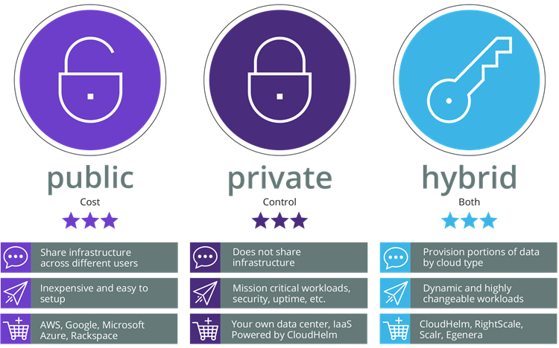


Cloud Deployment
Cloud Provider
Public External
Service & infrastructure provided publlicly for multiple client. Most economical solution, but security and compliance concerns.
The hosting infrastructure is provided exclusively for one customer (either locally or at en external provider). Most expensive solution for security requirements.
Customized combination of private and public cloud services. Most flexible system, but difficult to implement.
Hybrid
Share infrastructure accross different users
Does not share infrastructure
Data residence based on classificaiton
Inexpensive and easy to setup
Mission critical workload, security, uptime, etc
Dynamic and highly changeable workload
Private
(Service Provider)
Private On-premise (Customer)

Slide 5
Well-known Cloud service model
Infrastructure as a service (IaaS)
Platform as a service (PaaS)
Software as a service (SaaS)
Xaas: Anything as a service

Slide 6
Anything as a Service
Analytics as a Service (AaaS): Provides subscription-based data analytics software and procedures through the cloud. AaaS typically offers a fully customizable BI solution with end-toend capabilities, organizing, analyzing, and presenting data in a way that lets even non-IT professionals gain insight and take action.
AI as a Service (AIaaS): Refers to off-the-shelf AI tools that enable companies to implement and scale AI techniques at a fraction of the cost of a full, in-house AI.
Communication Platform as a Service (CPaaS): A cloud-based platform that enables developers to add real-time communications features to their own applications without needing to build backend infrastructure and interfaces
Disaster Recovery as a Service (DRaaS): A productized service offering in which the provider manages server image and production data replication to the cloud, disaster recovery run book creation, automated server recovery within the cloud, automated server failback from the cloud, and network element and functionality configuration, as needed.

Slide 7
Anything as a Service
Finance as a Service (FaaS): A future-focused service delivery model [that] combines best-in-class finance operations management practices with advanced technologies – such as cloud-based ERPs, artificial intelligence, and intelligent automation – to make finance more agile and forward-looking.
Function as a Service (FaaS) aka Serverless computing: FaaS/serverless computing enables customers to run server-side software in ephemeral, stateless containers without the need to manage the underlying servers.
Security as a Service (SecaaS): A set of services delivered by a security provider on a pay-as-you-go basis and typically without the installation of on-premises hardware. These security services often include authentication, anti-virus, anti-malware/spyware, intrusion detection, penetration testing, and security event management.
etc

Slide 8
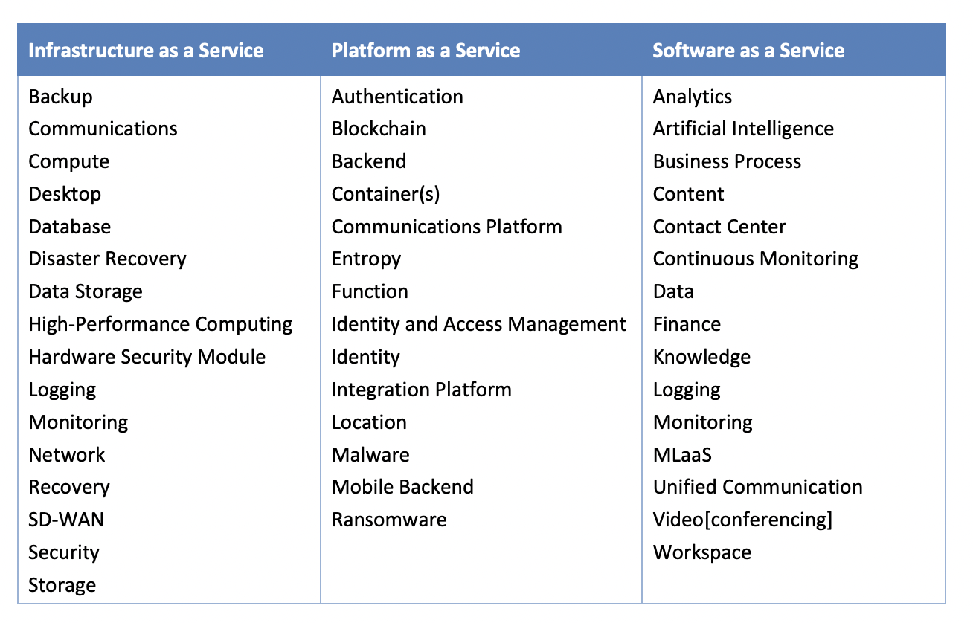
Mapping XaaS to Basic Service Model

