Slide 1
Infrastructure as a Service

Slide 2
Overview
Common problems in conventional IT infrastructure
Companies IT investment for peak capacity
Lack of agility for IT infrastructure
IT maintain cost for every company
Usually suffered from hardware failure risk
…etc

Slide 3
Overview
How to solve these problem ?
Let’s consider some kind of out-sourcing solution
Somebody will handle on demand capacity for me
Somebody will handle high available resource for me
Somebody will handle hardware management for me
Somebody will handle system performance for me
Somebody will …
Frankly, that would be a great solution IF there were “somebody”.
But who can be this “somebody”, and provide all these services ?

Slide 4
Overview
Infrastructure as a Service will be the salvation.
IaaS cloud provider takes care of all the IT infrastructure complexities.
IaaS cloud provider provides all the infrastructure functionalities.
IaaS cloud provider guarantees qualified infrastructure services.
IaaS cloud provider charges clients according to their resource usage.
Assume that you are going to be an IaaS cloud provider.
Then, what are the problems you are facing ?
Clients will request different operating systems.
Clients will request different storage sizes.
Clients will request different network bandwidths.
Clients will change their requests anytime.
Clients will …

Slide 5
Overview
Conventional strategies
Allocate a new physical machine for each incomer.
Prepare a pool of pre-installed machines for different requests.
IaaS strategies
User create a new virtual machine based on templates
How IaaS works?
Using virtualization
Computing
Storage
Network

Slide 6
Compute Virtualization

Slide 7
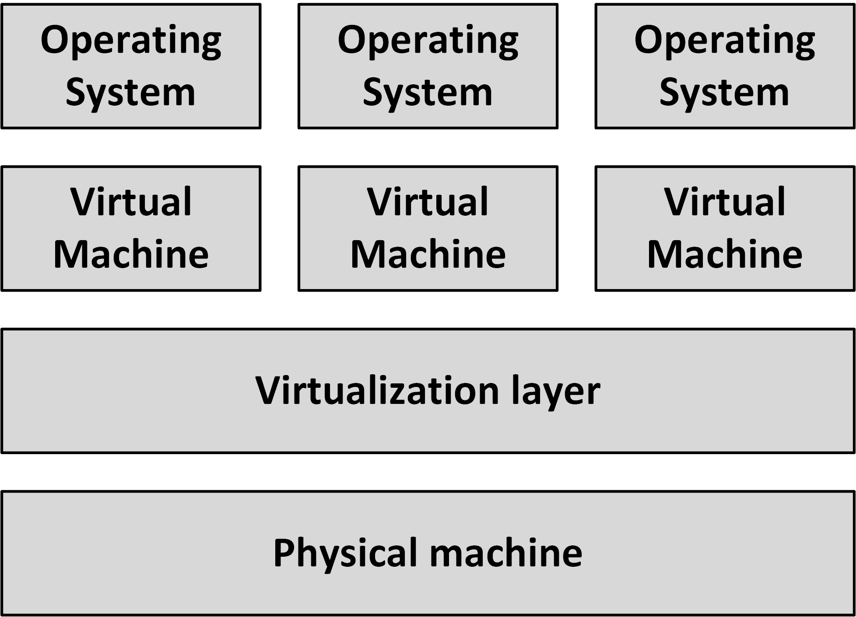
Compute virtualization
Compute virtualization, also known as server virtualization or Software Defined Compute, introduces an abstraction layer between physical computer hardware and the operating system using that hardware
Virtualization allows multiple operating systems to run on a single physical machine
Virtualization decouples and isolates virtual machines from the physical machine and from other virtual machines
A virtual machine is a logical representation of a physical computer in software

Slide 8
Compute virtualization
Virtualization allows for new virtual machines to be provisioned as needed, without the need for an upfront hardware purchase
With a few mouse clicks or using an API, new virtual machines for test or development can be installed in minutes
By consolidating many physical computers as virtual machines on fewer (bigger) physical machines, costs can be saved on hardware, power, and cooling
Because fewer physical machines are needed, the cost of maintenance contracts can be reduced and the risk of hardware failure is reduced

Slide 9
Software Defined Compute (SDC)
Virtual machines are typically managed using one redundant centralized virtual machine management system
This enables systems managers to manage more machines with the same number of staff and allows managing the virtual machines using APIs
Server virtualization can therefore be seen as Software Defined Compute
In an SDC architecture, all physical machines are running a hypervisor and all hypervisors are managed as one layer using management software

Slide 10
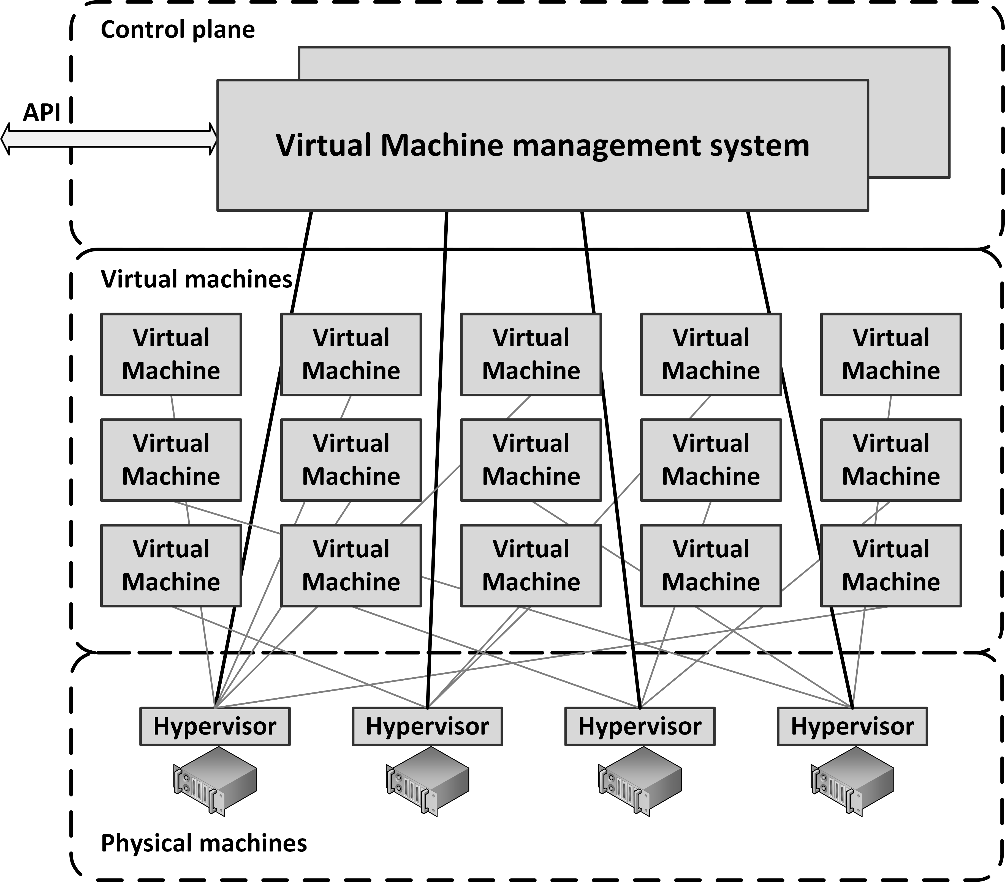
Software Defined Compute (SDC)

Slide 11
Software Defined Compute (SDC)
Some virtualization platforms allow running virtual machines to be moved automatically between physical machines
Some benefits:
When a physical machine fails, all virtual machines that ran on the failed physical machine can be restarted automatically on other physical machines
Virtual machines to be automatically moved to the least busy physical machines
Some physical machines can get fully loaded while other physical machines can be automatically switched off, saving power and cooling cost
Enables hardware maintenance without downtime. By moving all virtual machines from one physical machine to other physical machines, the physical machine can be switched off for maintenance without interruption of running virtual machines

Slide 12
Software Defined Compute (SDC)
Some virtualization platforms allow running virtual machines to be moved automatically between physical machines
Some benefits:
When a physical machine fails, all virtual machines that ran on the failed physical machine can be restarted automatically on other physical machines
Virtual machines to be automatically moved to the least busy physical machines
Some physical machines can get fully loaded while other physical machines can be automatically switched off, saving power and cooling cost
Enables hardware maintenance without downtime. By moving all virtual machines from one physical machine to other physical machines, the physical machine can be switched off for maintenance without interruption of running virtual machines

Slide 13
Disadvantages of computer virtualization
Because creating a new virtual machine is so easy, virtual machines tend to get created for all kinds of reasons. This effect is known as "virtual machine sprawl“
They must be managed, use resources of the physical machine, use power and cooling, must be back-upped and kept up to date by installing patches
Introduction of an extra layer in the infrastructure
License fees, systems managers training, and the installation and maintenance of additional tools
Virtualization cannot be used on all servers
Some servers require additional specialized hardware, like modem cards, USB tokens or some form of high speed I/O like in real-time SCADA systems
Virtualization is not supported by all application vendors
When the application experiences some problem, systems managers must reinstall the application on a physical machine before they get support

Slide 14
Virtualization technologies
Emulation
To run programs on a computer, other than the one they were originally intended for
Logical Partitions (LPARs)
Hardware based, used on mainframe and midrange systems
Hypervisors
Hypervisors control the physical computer's hardware and provide virtual machines with all the services of a physical system, including a virtual BIOS, virtual devices, and virtualized memory management

Slide 15
Virtualization Types
Virtualization Types :
Type 1 – Bare metal
VMMs run directly on the host's hardware as a hardware control and guest operating system monitor.
Type 2 – Hosted
VMMs are software applications running within a conventional operating system.

Slide 16
Virtualization Approaches
Virtualization Approaches :
Full-Virtualization
Hypervisor simulates enough hardware to allow an unmodified guest OS.
Para-Virtualization
Hypervisor does not necessarily simulate hardware, but instead offers a special API that can only be used by the modified guest OS.

Slide 17
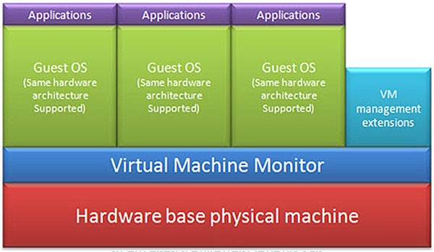
Virtualization Approaches
Full-Virtualization
Pros | Need not to modify guest OS
Cons | Significant performance hit

Slide 18
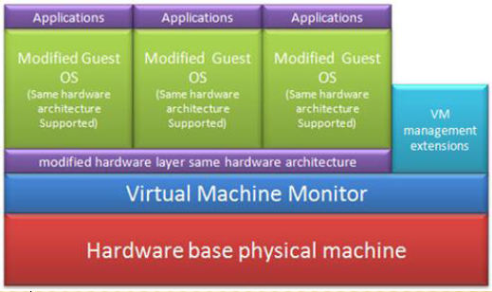
Virtualization Approaches
Para-Virtualization
Pros | Light weight and high performance
Cons | Require modification of guest OS

Slide 19
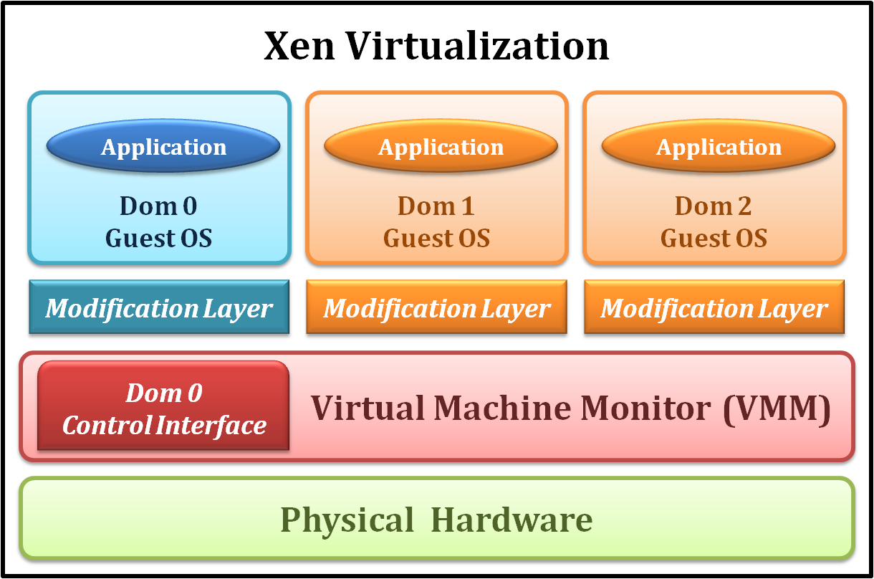
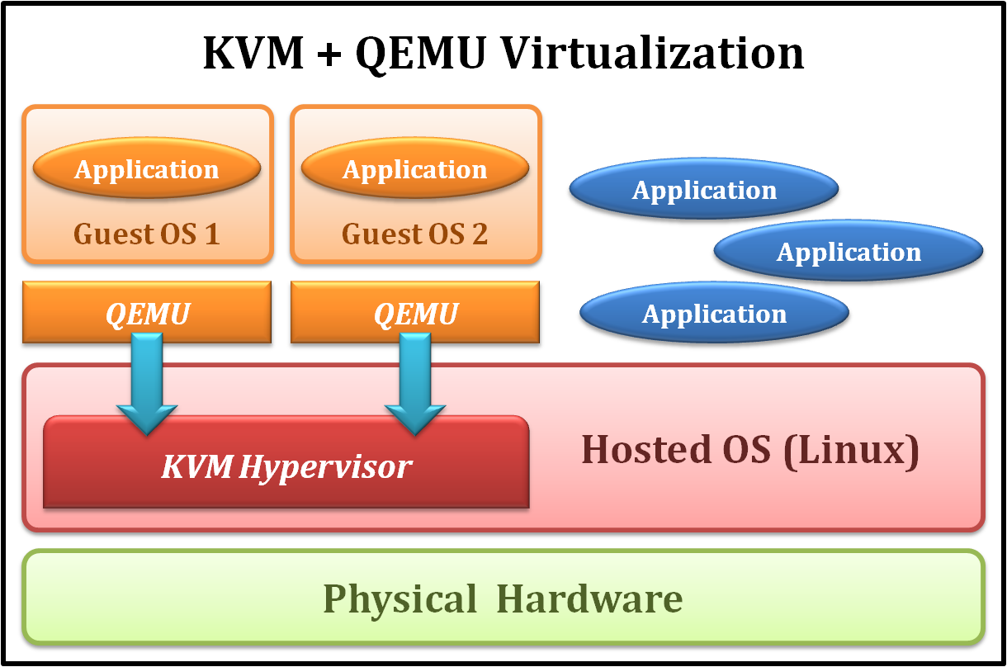
Examples
Xen
KVM
Type 1 Virtualization
Para-Virtualization
Type 2 Virtualization
Full-Virtualization

Slide 20
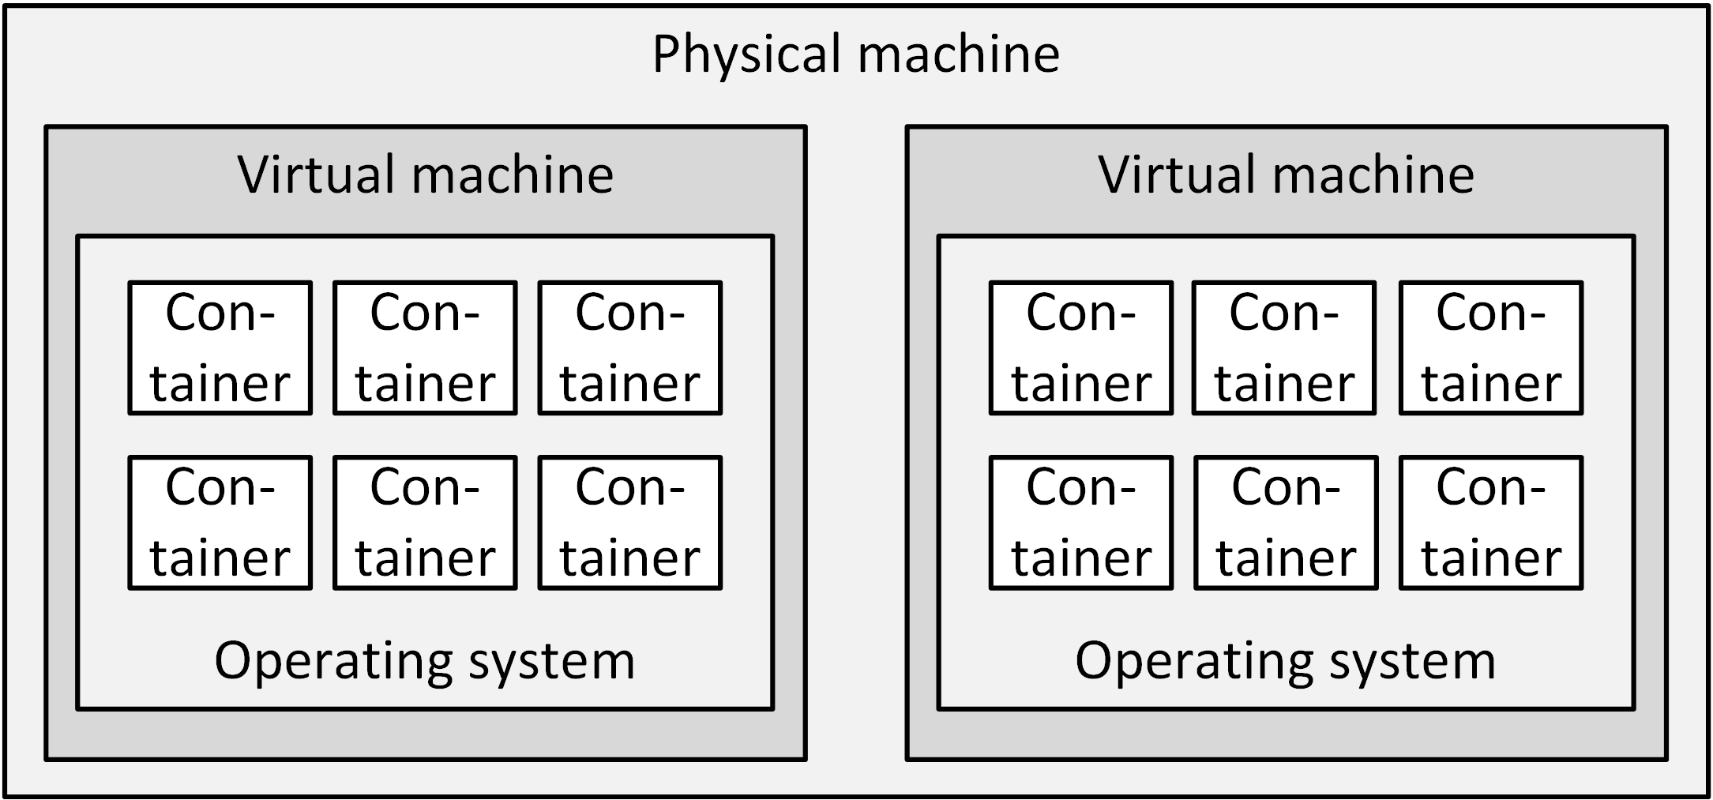
Container technology
Container technology is a server virtualization method in which the kernel of an operating system provides multiple isolated user-space instances, instead of just one
Containers look and feel like a real server from the point of view of its owners and users, but they share the same operating system kernel
Containers are part of the Linux kernel since 2008

Slide 21
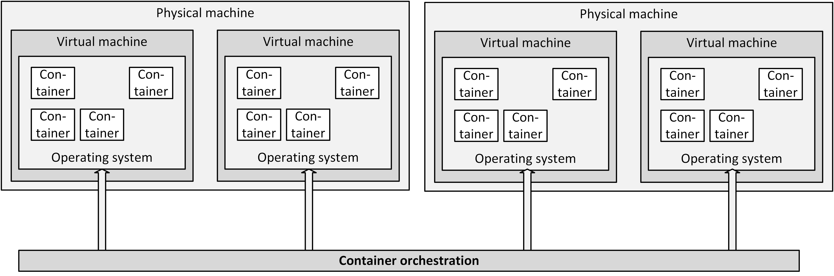
Container orchestration
Container orchestration, also known as a datacenter operating system, abstracts the resources of a cluster of machines and provides services to containers
A container orchestrator enables containers to be run anywhere on a cluster of machines. It schedules the containers to run on any machine that has resources available and it acts like a kernel for the combined resources of an entire datacenter instead of the resources of just a single computer

Slide 22
Storage Virtualization

Slide 23
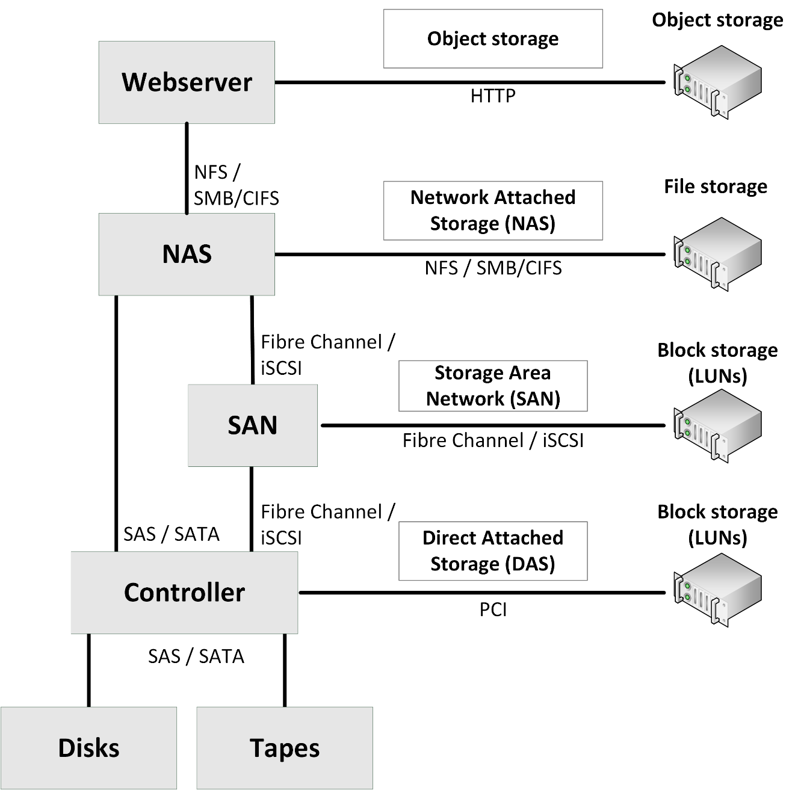
Storage model
Servers can use internal storage only, but most use external storage, sometimes combined with internal storage.
A model of storage building blocks is shown on the right

Slide 24
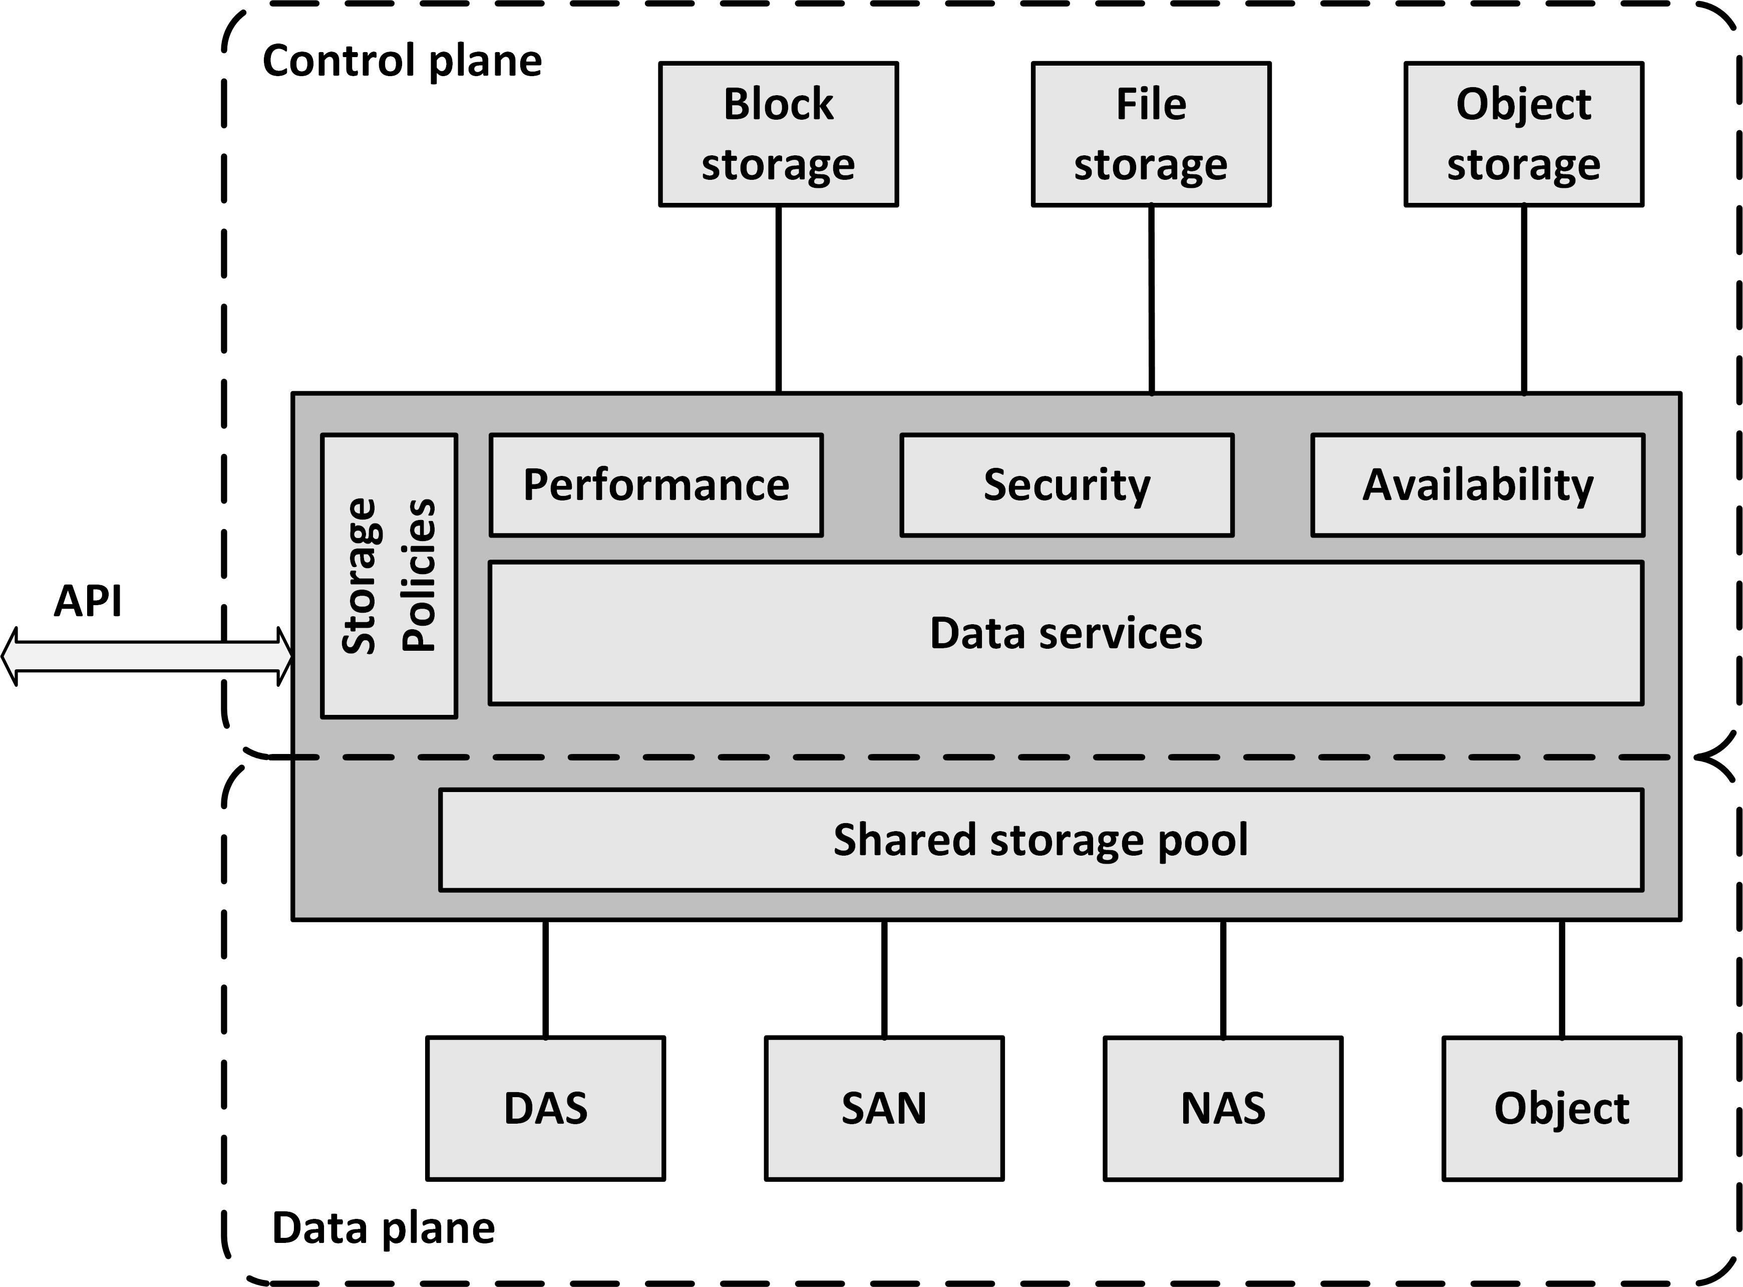
Software Defined Storage
Software Defined Storage (SDS) abstracts data and storage capabilities (also known as the control plane) from the underlying physical storage systems (the data plane)
This allows data to be stored in a variety of storage systems while being presented and managed as one storage pool to the servers consuming the storage

Slide 25
Software Defined Storage
SDS virtualizes all physical storage into one large shared storage pool
It enables the use of standard commodity hardware, where storage is implemented as software running on commodity x86-based servers with direct attached disks
Physical storage can also be a SAN, a NAS, or an Object storage system
From the shared storage pool, software provides data services like:
Deduplication
Compression
Caching
Snapshotting
Cloning
Replication
Tiering

Slide 26
Software Defined Storage
SDS provides servers with virtualized data storage pools with the required performance, availability and security, delivered as block, file, or object storage, based on policies
Example: a newly deployed database server can invoke an SDS policy that mounts storage configured to have its data striped across a number of disks, creates a daily snapshot, and has data stored on tier 1 disks
APIs can be used to provision storage pools and set the availability, security and performance levels of the virtualized storage
Using APIs, storage consumers can monitor and manage their own storage consumption

Slide 27
Network Virtualization

Slide 28
Virtual NICs
Virtual machines are only aware of virtual Network Interface Controllers (NICs) provided to them
Virtual machines running on physical machines share physical NICs
Communications between virtual machines on the same physical machine are routed directly in memory space by the hypervisor, without using the physical NIC
The hypervisor routes Ethernet packages from the virtual NIC on the virtual machine to the physical NIC on the physical machine

Slide 29
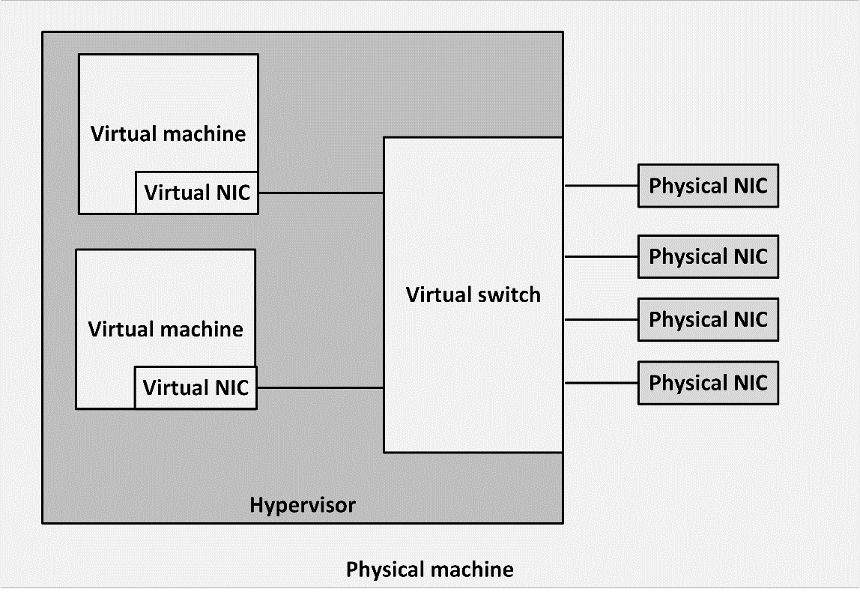
Virtual switch
Virtual NICs are connected to virtual switches
A virtual switch is an application running in the hypervisor, with most of the capabilities of a physical network switch.
A virtual switch is dynamically configured
Ports in the virtual switch are configured at runtime
The number of ports on the switch is in theory unlimited

Slide 30
Virtual switch
Availability:
No cable disconnects
No need for auto-detecting network speed
No network hubs, routers, adapters, or cables that could physically fail
Security:
No easy way to intercept network communications between virtual machines from outside of the physical machine

Slide 31
Software Defined Networking
Software Defined Networking (SDN) allows networks to be defined and controlled using software external to the physical networking devices
A relatively simple physical network can be programmed to act as a complex virtual network
A set of physical network switches can be programmed as a virtual network:
Hierarchical
Complex
Secured
Can easily be changed without touching the physical network components

Slide 32
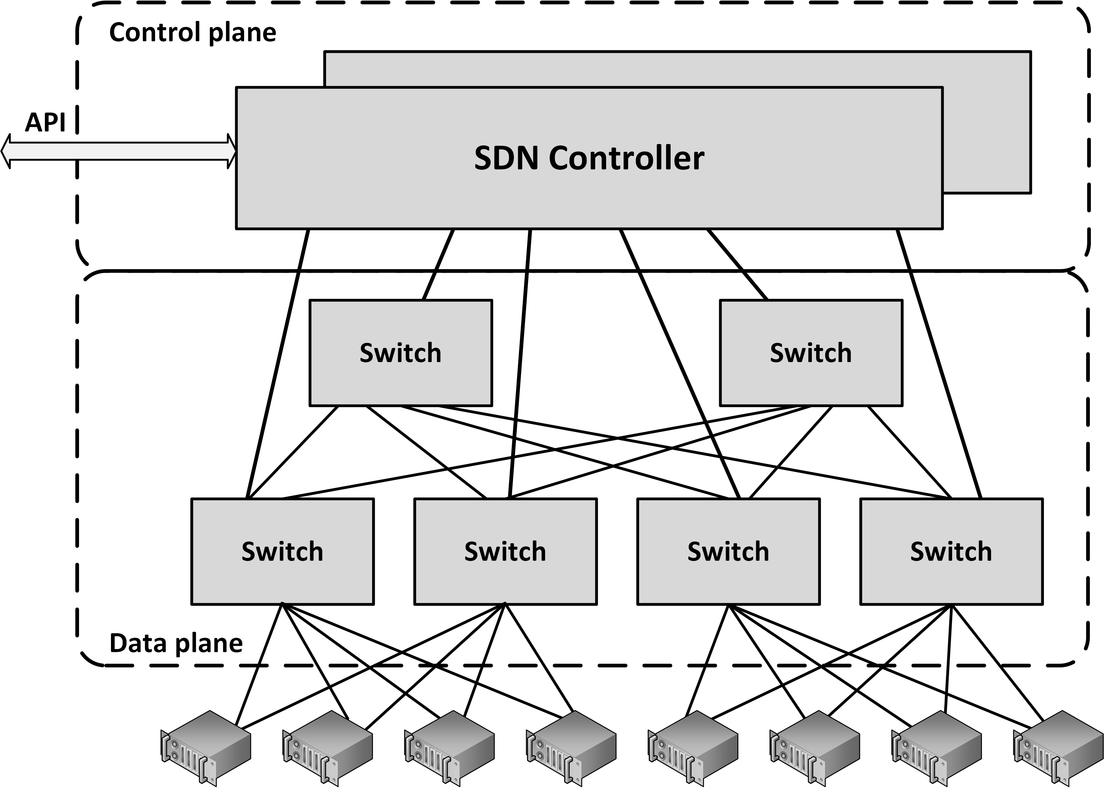
Software Defined Networking
SDN decouples:
Control plane resides centrally
Data plane (the physical switches) remain distributed

Slide 33
Software Defined Networking
A SDN can be controlled from a single management console
Provides open APIs that can be used to manage the network using third party software
In an SDN, the distributed data plane devices are only forwarding network packets based on ARP or routing rules that are preloaded into the devices by the SDN controller in the control plane
This allows the physical devices to be much simpler and more cost effective

Slide 34
Network Function Virtualization
Network Function Virtualization (NFV) is a way to virtualize networking devices like firewalls, VPN gateways and load balancers
Appliances are implemented in virtual machines running applications that perform the network functions
Using APIs, NFV virtual appliances can be created and configured dynamically and on-demand
Enables a flexible network configuration
It allows, for instance, deploying a new firewall as part of a script that creates a number of connected virtual machines in a cloud environment

Slide 35
Data Center

Slide 36
Datacenter location
Many variables should be considered to determine where a datacenter could be installed
Examples:
Environment of the datacenter
Visibility of the datacenter
Utilities available to the datacenter
Datacenters located in foreign countries

Slide 37
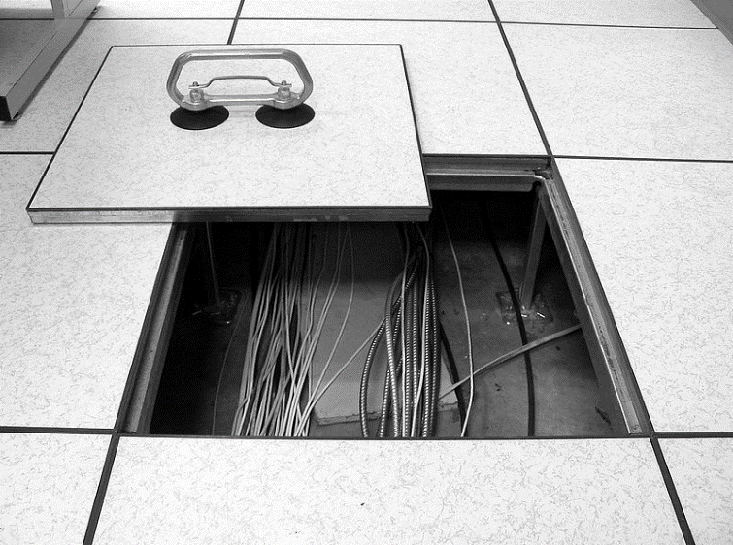
Physical structure
The physical structure of a datacenter includes components that need special attention:
Floors
Walls
Windows
Doors
Water and gas pipes

Slide 38
Power supply
Energy usage is a key issue for datacenters
Power drawn by datacenters ranges from a few kilowatts (kW) for one rack of servers in a small server room, to dozens of megawatts (MW) for large facilities
The amount of power available in a datacenter is typically expressed as the number of kilowatts per m²
A value of between 2 and 6 kW/m² is typical in a normal density datacentre
In a high-density datacenter, the power supply is between 10 and 20 kW/m². This allows racks to be filled with approximately 40 to 80 servers

Slide 39
Uninterruptable Power Supply (UPS)
Several types of power issues can occur in the utility power supply, possibly leading to downtime or damage to equipment in the datacenter
Blackout
Surge
Spike
Brownout
Waveform issues
An Uninterruptable Power Supply (UPS) provides high quality electrical power that is independent of the utility power supply

Slide 40
Cooling
More than 90% of all power used by IT infrastructure components is converted into heat, all of which has to be dissipated by a cooling system
Two types of cooling systems:
Computer Room Air Conditioners (CRAC) are refrigerant-based units connected to outside condensing units
Computer Room Air Handlers (CRAH) are chilled water based and connected to outside chillers. A chiller produces chilled water via a refrigeration process

Slide 41
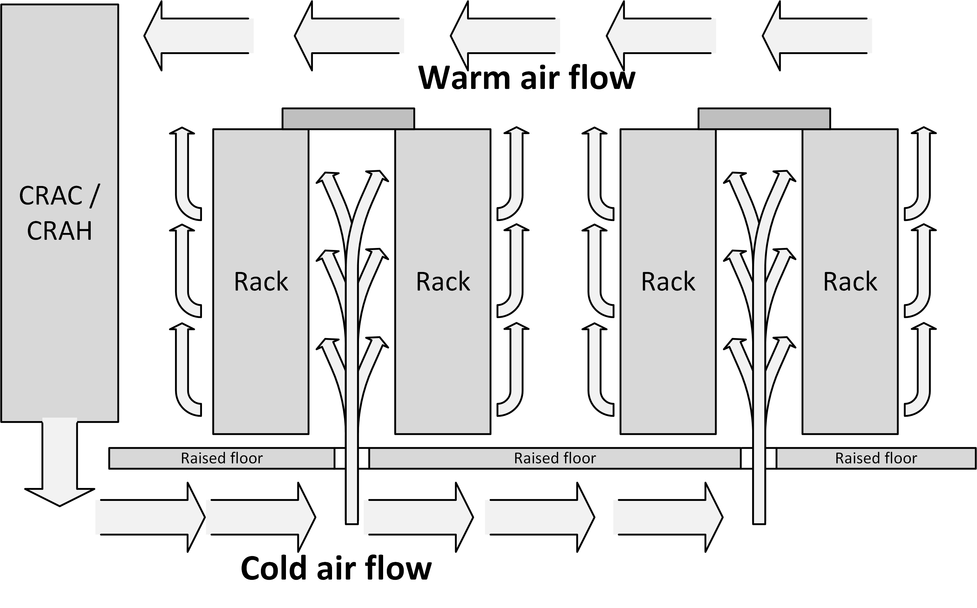
Airflow

Slide 42
Fire prevention, detection, and suppression
Fire is one of the main enemies of a datacenter
A short circuit in a cable, or a defect in the equipment can easily lead to fire
Because of the air flow in the datacenter and the frequent use of raised floors, fires can spread around very quickly
Even if a fire starts outside of the datacenter’s computer room, the smoke of such a fire could damage equipment in the datacenter

Slide 43
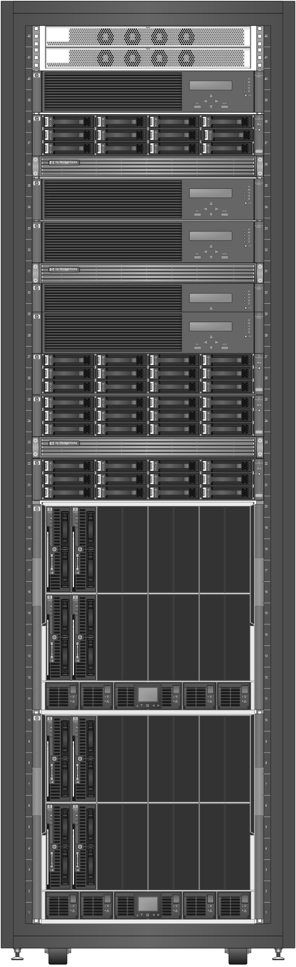
Equipment racks
A 19” rack is a standardized metal enclosure to house IT infrastructure components
The height of a rack is measured in rack unit or 'U', where one U is 44.5 mm
A typical rack is 42U high

