Slide 1
2048 AI Agent
Emir Baručija,
Faculty of Electrical Engineering, Sarajevo

Slide 2
01
What is 2048?

Slide 3
What is 2048?
  2048 is a single player sliding block puzzle game in which the objective of the game is to slide numbered tiles on a grid to combine them in order to generate a tile with the value of 2048, or even higher
  the game is played on a 4x4 grid with numbered tiles that slide in one of four directions where the tiles slide as far as possible in the chosen direction
  tiles slide until they are stopped by another tile or the edge, and if two of the same numbered tiles collide, they merge into a tile with double the value

Slide 4
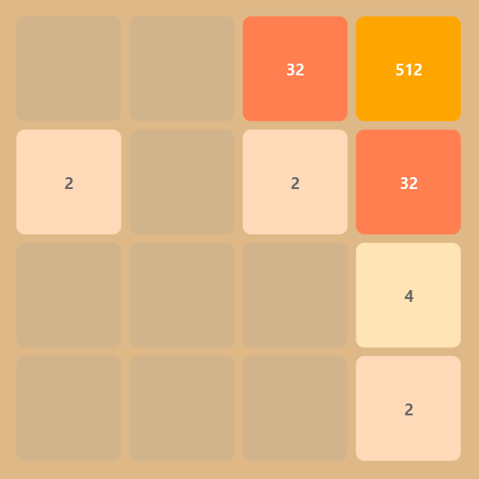
  the theoretical maximum tile is 2^17, giving 18 possible values per cell, meaning 2048 has ≈ 2.8 × 1020 possible states
  however, not all states are reachable
  researchers have estimated the number of actually reachable states to be on the order of ~10^15 to 10^16, though an exact count is computationally difficult to determine
example state in 2048 game

Slide 5
02
AI Agents

Slide 6
Who can play 2048?
I employed 5 agents to play 2048 game:
  Random - picks a random legal move, without lookahead or evaluation. Baseline for the others
  Priority - greedy, looks one move ahead with the heuristic and a preferred move order as tiebreaker. Plays like a human without a plan
  Expectimax - searches the game tree and accounts for randomness of tile spawns, hand-written heuristic at the leaves
  TD N-Tuple - learned value function, trained by self-play. Plays greedily one move deep, no search
  TD + Expectimax - the same learned values used to evaluate the leaves of the expectimax search

Slide 7
Expectimax - or how to win
03

Slide 8
Why expectimax?
  2048 is not a purely adversarial game, tiles spawn randomly, not strategically
  Minimax assumes a worst-case opponent, which is too pessimistic here
  Expectimax handles randomness by computing probability-weighted averages instead
  The game tree alternates between two node types:
  Max node (player's turn)
  Chance node (tile spawn)
  At the bottom of the tree, the heuristic function evaluates the board

Slide 9
Optimization improvements
  Transposition table - caches evaluated board states to avoid recomputing identical positions
  Probability pruning - cuts branches where cumulative probability drops below 0.0001
  Adaptive depth - 6 plies on an open board, up to 10 when two or fewer cells are empty
  Iterative deepening - searches depth 1, 2, 3... each pass warms the cache for the next
How much this optimizes algorithm depends on depth and number of empty cells. For comparison, at depth 4 with 4 empty cells, vanilla algorithm explores ~500K states, while my implementation explores ~30K–60K states

Slide 10
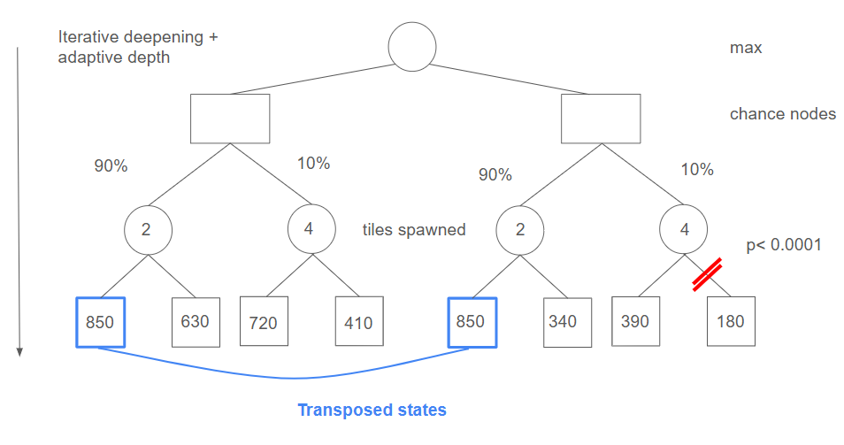

Slide 11
Heuristics - brain of the AI
04

Slide 12

Heuristics Overview
Empty cells
Available merges
Monotonicity (rank⁴)
Clutter penalty (rank^{3.5})

Slide 13
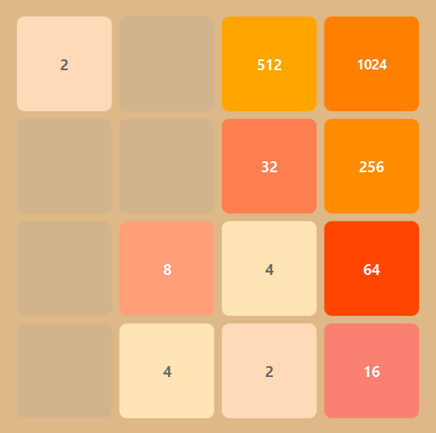
No corner bonus: monotonicity alone keeps the big tiles in a corner
More empty space = more room to maneuver
Tiles are monotonically increasing, mixed patterns are penalized
Clutter penalty: many small tiles spread around the board, each costs rank^{3.5}

Slide 14
TD N-Tuple - learning to play
05

Slide 15
N-tuple network
  An n-tuple is a fixed set of board cells; its table has 16^n entries, indexed by packing the 4-bit ranks of those cells together - a few shifts on the bitboard
  V(board) is a plain sum of lookups: 8 patterns of 5 cells, and all 8 symmetries of a pattern share one table, so every board trains 64 weights at once
  8 x 16^5 = 8.4M weights, 32 MB as float - evaluates in microseconds, trains on a CPU, cannot diverge like a neural network
  The agent plays greedily one move deep: the legal move with the highest reward + V(afterstate)
  TD + Expectimax: the same V replaces the hand-written heuristic at the leaves of the search

Slide 16
Training by self-play
  TD(0) on afterstates - the board after sliding, before the random tile appears
  V(s′) ← V(s′) + α [ r + V(s′ next) − V(s′) ], α = 0.1, the correction split evenly over the 64 weights the board touches
  Afterstates remove the spawn randomness from the target, which is why this converges much faster than learning the value of states
  Greedy the whole time - the random spawns give enough exploration, no epsilon needed
  Console trainer prints statistics and writes a checkpoint every K games, so a run can be stopped and resumed at any time

Slide 17
Results
Games | Mean score | 2048 | 4096 | 8192
20,000 | 27,446 | 50% | 10% | -
60,000 | 58,733 | 92% | 63% | 3%
100,000 | 67,354 | 95% | 77% | 7%
160,000 | 86,084 | 96% | 83% | 33%
200,000 | 93,131 | 96% | 85% | 43%
Self-play training with learning on: mean score and share of games reaching each tile, 200,000 games in 47 minutes on one CPU core
Measured afterwards on 300 games with learning off: mean 91,304, best game 173,236, 2048 in 95%, 4096 in 83%, 8192 in 44%
Szubert & Jaśkowski (2014), who introduced the method, report mean scores around 100,000

