Slide 1
Sparse LDL^{T} Factorization
Emir Baručija,
Faculty of Electrical Engineering, Sarajevo

Slide 2
What is LDL^{T}?
01

Slide 3
What is LDL^{T}?
  A = L D L^{T}, L unit lower triangular, D diagonal
  Cholesky without square roots, so D may go negative and indefinite matrices work
  Solve: permute, forward solve L, divide by D, backward solve L^{T}, permute back
  Ported from Davis' LDL. The ordering, the pivoting and the validation are mine

Slide 4
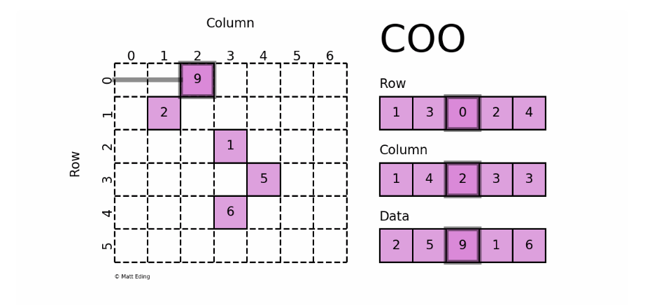
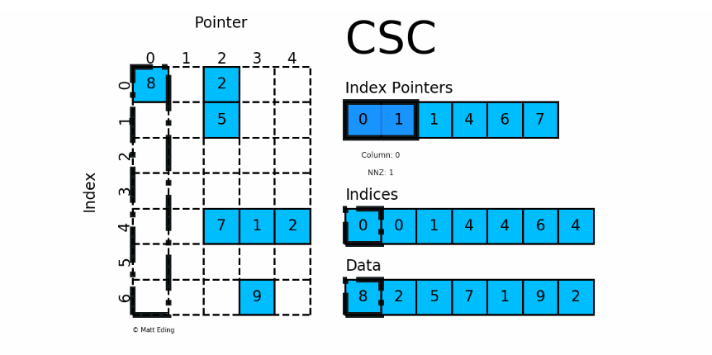
From COO to CSC
A file is read into a list of (row, column, value) triplets
The factorization reads CSC: values grouped by column, with a pointer array saying where each column starts
The conversion sorts each column and sums duplicates. Symmetric files store one triangle and are expanded on read.

Slide 5
The factorization
02

Slide 6
Symbolic analysis
  The pattern of L, computed from the pattern of A before any arithmetic
  Elimination tree, built with path compression
  Postorder, then column counts by row subtrees
  Gives nnz(L) and the flop count before a single value exists, so orderings are cheap to compare

Slide 7
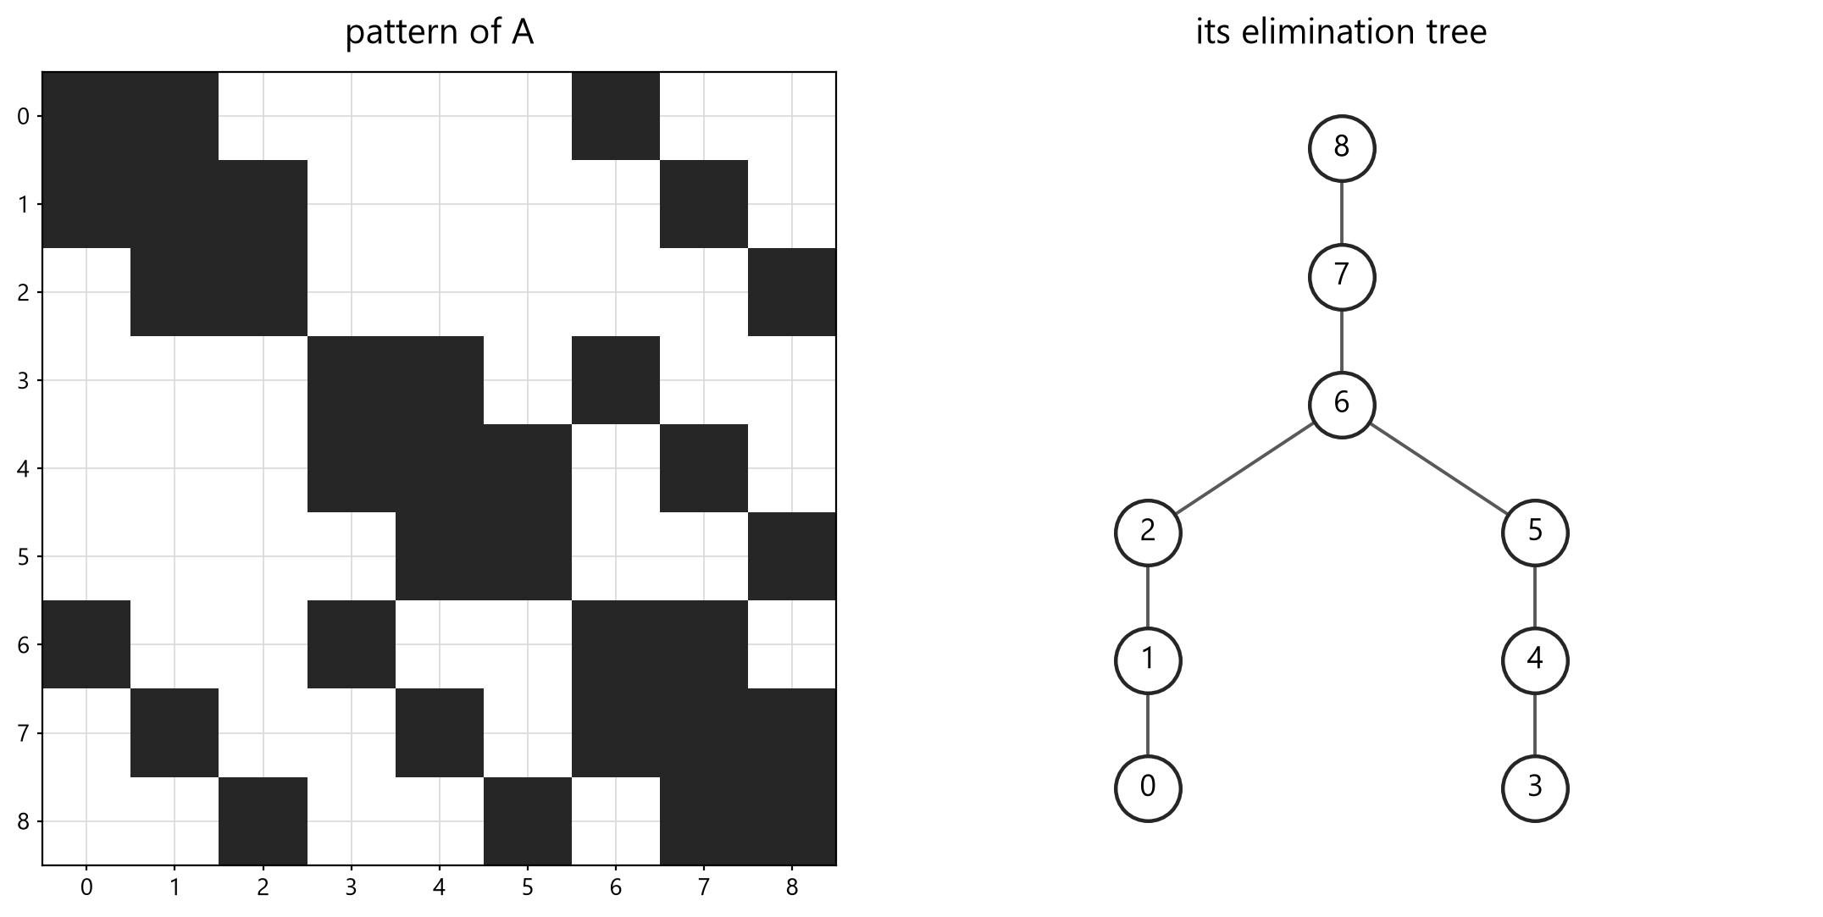
The elimination tree
A 3 by 3 grid, middle column eliminated last. The two halves stay independent until that separator, and the tree shows it.

Slide 8
Numeric factorization
  Up-looking: one row of L at a time
  Row k is a sparse triangular solve against the rows above it
  Its pattern comes first, from walking the elimination tree
  Reads the upper triangle of P A P^{T}. With a permutation both triangles must be stored, so the code rejects a one-sided matrix

Slide 9
Does it actually work?
  Residual check: solve for a known x, report the forward and backward error
  Factor check: form P A P^{T} - L D L^{T}, relative Frobenius norm. Small matrices only, but it tests the factor and not just the solve
  bcsstk01 with AMD: factor error 1.09e-16, backward error 9.49e-17

Slide 10
Fill-reducing orderings
03

Slide 11
Orderings
  Four implemented: natural, RCM, minimum degree, AMD
  RCM reduces bandwidth, not fill. A baseline
  Minimum degree: exact, too slow for large n. A reference
  AMD: elements instead of cliques, bounded degrees, supervariables. The one to use

Slide 12
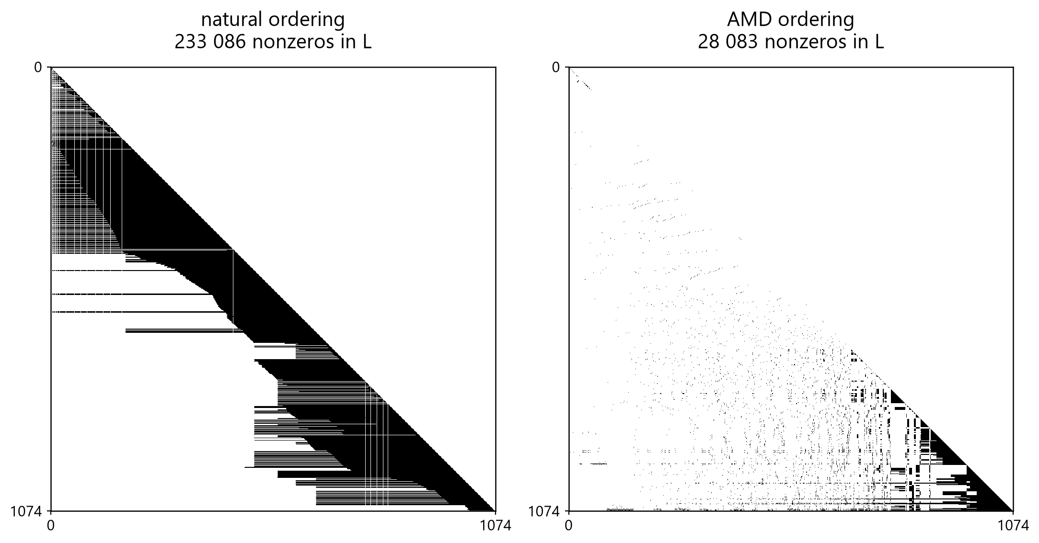
What the ordering buys
bcsstk08 factorized both ways. AMD leaves 8 times fewer nonzeros in L and cuts the flop count by a factor of 40.

Slide 13
Indefinite matrices
04

Slide 14
Static pivoting and refinement
  A pivot can sit near zero even when A is well conditioned, and destroy the factor
  Bunch-Kaufman needs 2x2 blocks; the up-looking kernel has no place for them
  Static pivoting instead: pivots below r times ||A|| are replaced by plus or minus that value
  The factor is then exact for a slightly perturbed matrix, so refinement against the original A restores the backward error
  r = 1e-12. The classic 1e-8 damaged badly scaled positive definite matrices

Slide 15
The ldlt tool
05

Slide 16
One run of LDLT CLI
ldlt (amd) > bcsstk08
matrix bcsstk08
n 1074
nnz(A) stored 12960
ordering amd
nnz(L) 28083
fill nnz(L+D)/nnz(triu A) 4.16
flops (numeric) 1.5081e+06
ordering 4.09 ms
symbolic 0.31 ms
numeric 1.01 ms
solve + refine 0.19 ms
status ok
pivots 1074 positive, 0 negative
min |d| / max |d| 3.977e+03 / 6.045e+10
static pivoting threshold 8.955e-02, 0 perturbed
backward error 9.589e-16
after refinement 9.589e-17 (1 step, converged)
forward error 1.476e-12
bcsstk08 with AMD. One refinement step takes the backward error to 9.6e-17.

