Slide 1
EMIT Initial Geolocation
Mike Smyth
August 19, 2022

Slide 2
Have 19 orbit from IOC, enough to take a initial look at geolocation
Geolocation accuracy:
Measured against the Landsat 7 ortho-base
Distance predicted location on the ground vs. actual determined by image matching
Error is “average error”, individual pixels will vary
Error is against reference dataset
Best estimate of absolute geolocation accuracy of Landsat orthobase is about 30 m (CE90) (~15 m 1 sigma)
Absolute geolocation should have have Landsat error included
Have accuracy estimate only where we performed image matching
Initial error – using raw ephemeris/attitude
Corrected error – after correcting ephemeris/attitude based on image matching
Varies along the orbit, so each scene/chunk has different values

Slide 3
Orbit | Initial Uncorrected Accuracy (m) Median (min – max) | Final Corrected Accuracy (m)
2220901 | 526.2 (526.2 - 526.2) | 34.1 (34.1 - 34.1)
2221501 | 420.7 (364.5 - 614.6) | 17.3 (10.3 - 34.2)
2221502 | 404.4 (373.6 - 410.1) | 17.8 (12.7 - 26.1)
2221601 | 585.9 (585.9 - 585.9) | 29.7 (29.7 - 29.7)
2221602 | 257.8 (234.4 - 281.2) | 31.7 (23.6 - 39.8)
2221603 | 297.5 (292.9 - 302.1) | 18.9 (15.0 - 22.8)
2221901 | 231.6 (210.9 - 252.1) | 11.9 (8.1 - 18.3)
2222203 | 348.9 (313.2 - 383.7) | 13.9 (10.2 - 21.2)
2222204 | 247.9 (191.3 - 448.9) | 26.0 (10.2 - 58.0)
2222205 | 470.3 (246.4 - 625.8) | 18.1 (10.6 - 53.0)
2222206 | 474.1 (269.8 - 774.2) | 20.4 (10.3 - 68.4)
2222207 | 627.9 (618.5 - 668.9) | 26.6 (19.5 - 50.4)
2222208 | 529.2 (478.5 - 2582.4) | 59.5 (16.0 - 2148.4)
2222211 | 245.9 (148.9 - 276.3) | 19.9 (9.8 - 26.8)
2222212 | 368.1 (346.4 - 385.3) | 16.2 (12.7 - 20.9)
2222215 | 712.9 (683.6 - 724.6) | 15.8 (14.0 - 28.5)
2222216 | 701.0 (700.5 - 701.6) | 27.4 (22.0 - 32.9)
2222302 | 278.6 (237.1 - 316.9) | 16.5 (10.0 - 30.6)
2222514 | 741.6 (668.4 - 776.3) | 17.4 (10.0 - 81.5)

Slide 4
Fit exterior orientation
We don’t know the orientation of the EMIT to the ISS exactly
Given how large the errors are in the BAD attitude, we can’t really nail this down even in orbit
But we assume that the “average” error is 0, even if it has a large variance
We can fit to minimize the initial uncorrected error
19 swaths is really pretty small number, but we can do an initial improvement
Select one “best” scene with the most tie-points for each swath, so we have a good distribution in time
Should fit this over time to get better estimate
Note that this corrects the average error, but a specific swath may actually have a worse initial error after adjusting the exterior orientation
Important point is that the fit is good enough to bootstrap AFIDS correction
Within 8 km requirement, even if we can’t correct the orbit
Initial quaternion – (1,0,0,0)
Fitted quaternion - (0.9999980693852834, 0.00029629615861164366, 0.0002727861861975373, 0.001923284167566613)
Euler angles - [0.0038467326241345533, 0.000544431622583616, 0.0005936405867353889]

Slide 5
Orbit | Initial Uncorrected Accuracy (m) Median (min – max) | After camera calibration Uncorrected Accuracy (m)
2220901 | 526.2 (526.2 - 526.2) | 518.5 (518.5 - 518.5)
2221501 | 420.7 (364.5 - 614.6) | 340.7 (219.3 - 362.5)
2221502 | 404.4 (373.6 - 410.1) | 361.6 (337.2 - 387.8)
2221601 | 585.9 (585.9 - 585.9) | 225.0 (225.0 - 225.0)
2221602 | 257.8 (234.4 - 281.2) | 129.9 (82.3 - 177.5)
2221603 | 297.5 (292.9 - 302.1) | 67.3 (64.1 - 70.6)
2221901 | 231.6 (210.9 - 252.1) | 513.8 (492.7 - 559.2)
2222203 | 348.9 (313.2 - 383.7) | 161.1 (127.8 - 174.3)
2222204 | 247.9 (191.3 - 448.9) | 143.4 (89.0 - 272.4)
2222205 | 470.3 (246.4 - 625.8) | 157.0 (47.9 - 291.4)
2222206 | 474.1 (269.8 - 774.2) | 170.4 (41.5 - 430.5)
2222207 | 627.9 (618.5 - 668.9) | 275.9 (234.6 - 287.3)
2222208 | 529.2 (478.5 - 2582.4) | 167.5 (143.7 - 2823.1)
2222211 | 245.9 (148.9 - 276.3) | 173.1 (152.4 - 183.1))
2222212 | 368.1 (346.4 - 385.3) | 27.5 (25.0 - 57.8)
2222215 | 712.9 (683.6 - 724.6) | 339.9 (313.9 - 351.1)
2222216 | 701.0 (700.5 - 701.6) | 331.5 (328.6 - 334.4)
2222302 | 278.6 (237.1 - 316.9) | 112.8 (70.7 - 140.7)
2222514 | 741.6 (668.4 - 776.3) | 770.7 (746.6 - 812.0)

Slide 6
Interior Orientation
We want to look at the interior orientation
Pixel to pixel registration
Best way to do this is lab measurements, which were done and included in our camera model
Want to verify this, and perhaps tweak this
Perform dense set of points image matching with our reference image
Do for very clean images
Cloud free, lots of good features for matching against
Matching is still a bit noisy, so we look at density plots of the predicted (by camera model) vs ”actual” (as determined by image matching)
A perfect camera, with perfect image matching and perfect data would be a line at a delta of “0”

Slide 7
Selected two scenes from orbit 22204
Large number of tiepoints collected
22,187 for first scene (was 2400 x 1242)
11,424 for second scene (was 1280 x 1242)
Looking for patterns in the predicted vs actual
Interested in one sample vs. another
i.e, how does pixel sample “i” compares to pixel sample “j”
Caveats
Our reference data isn’t perfect
Also, our DEM isn’t perfect
Looking for gross error (e.g, a smile pattern) – we don’t want to just fit to noise

Slide 8
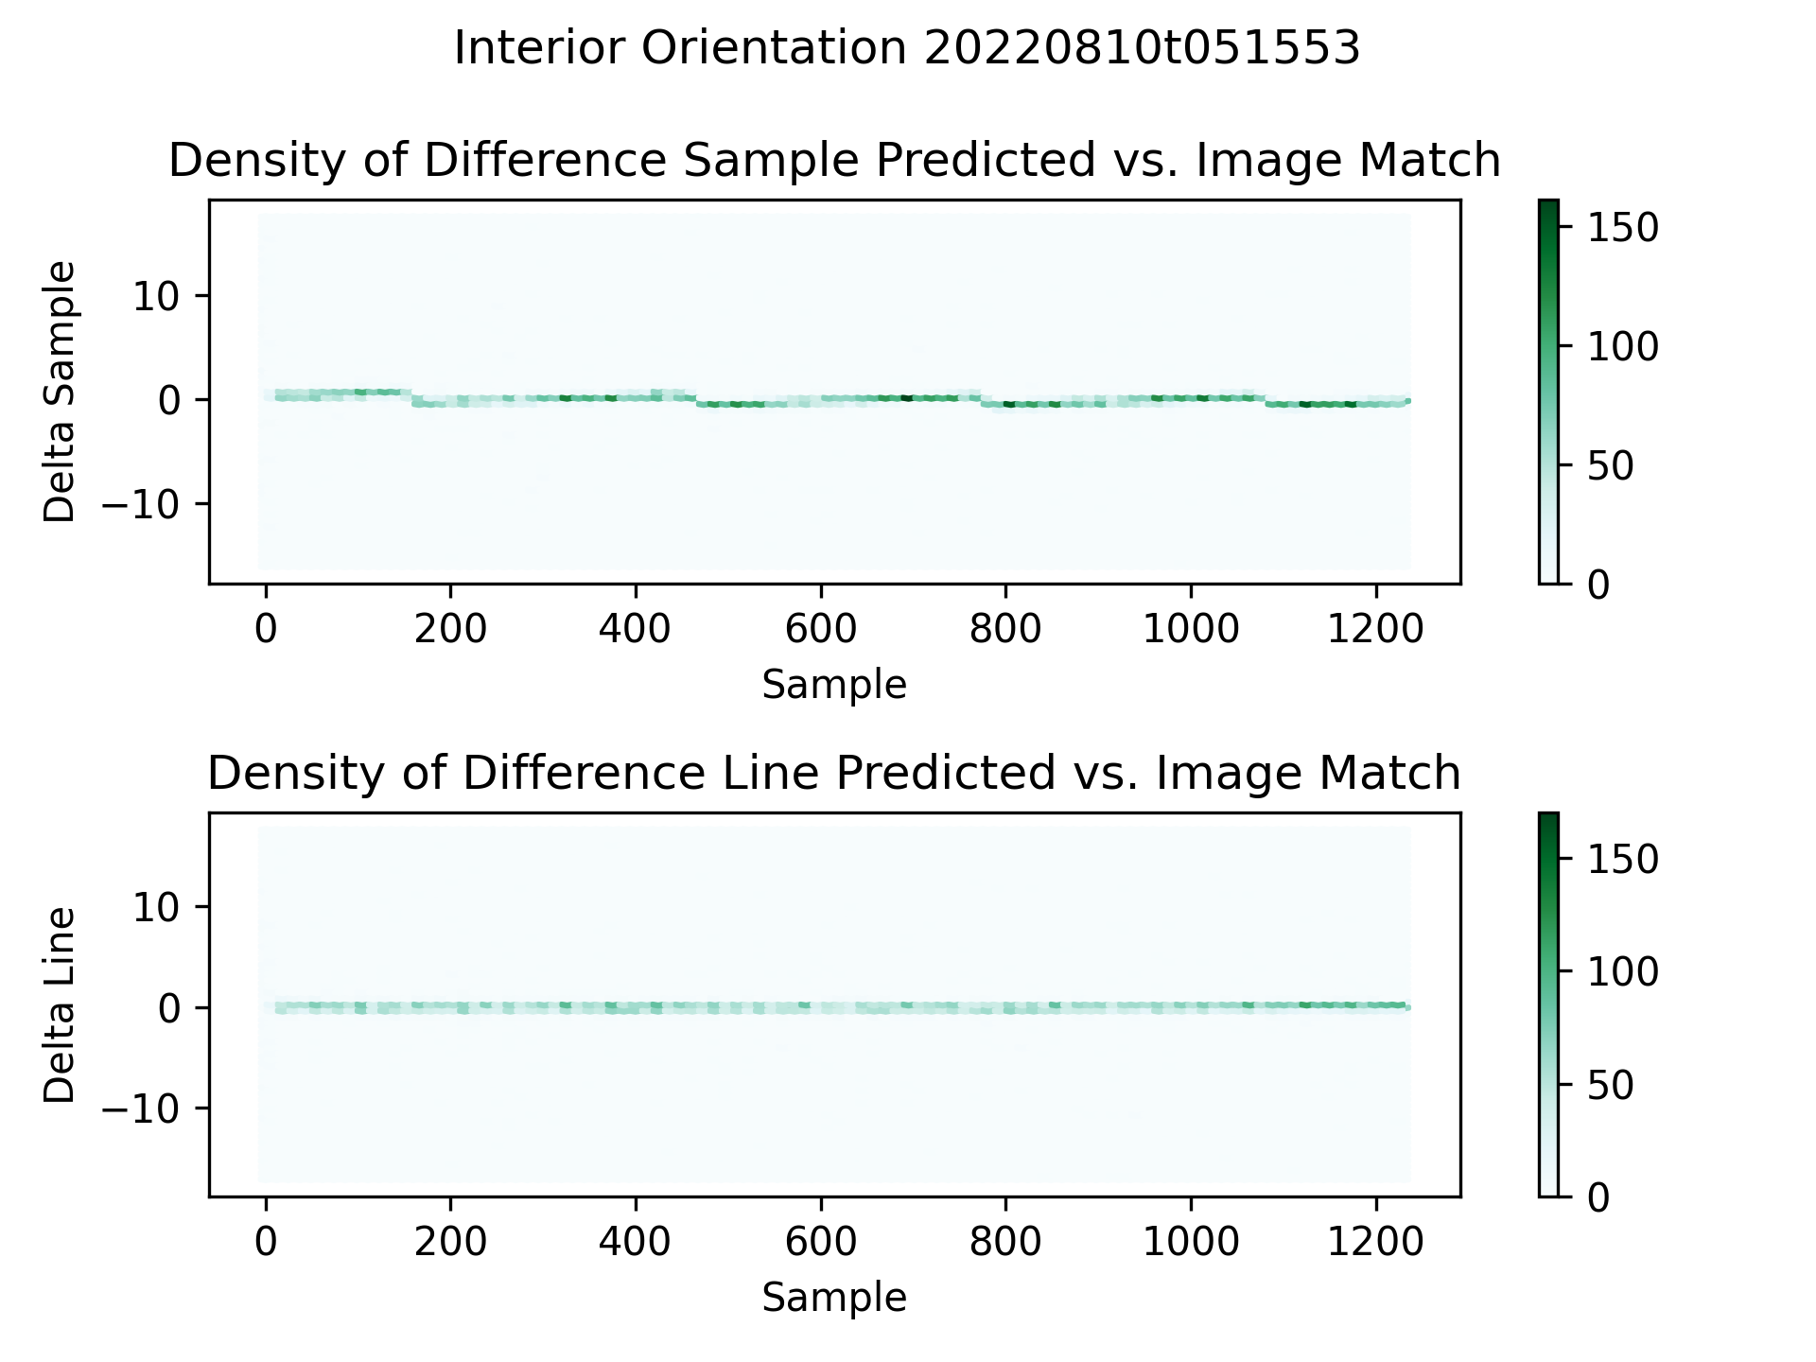

Slide 9
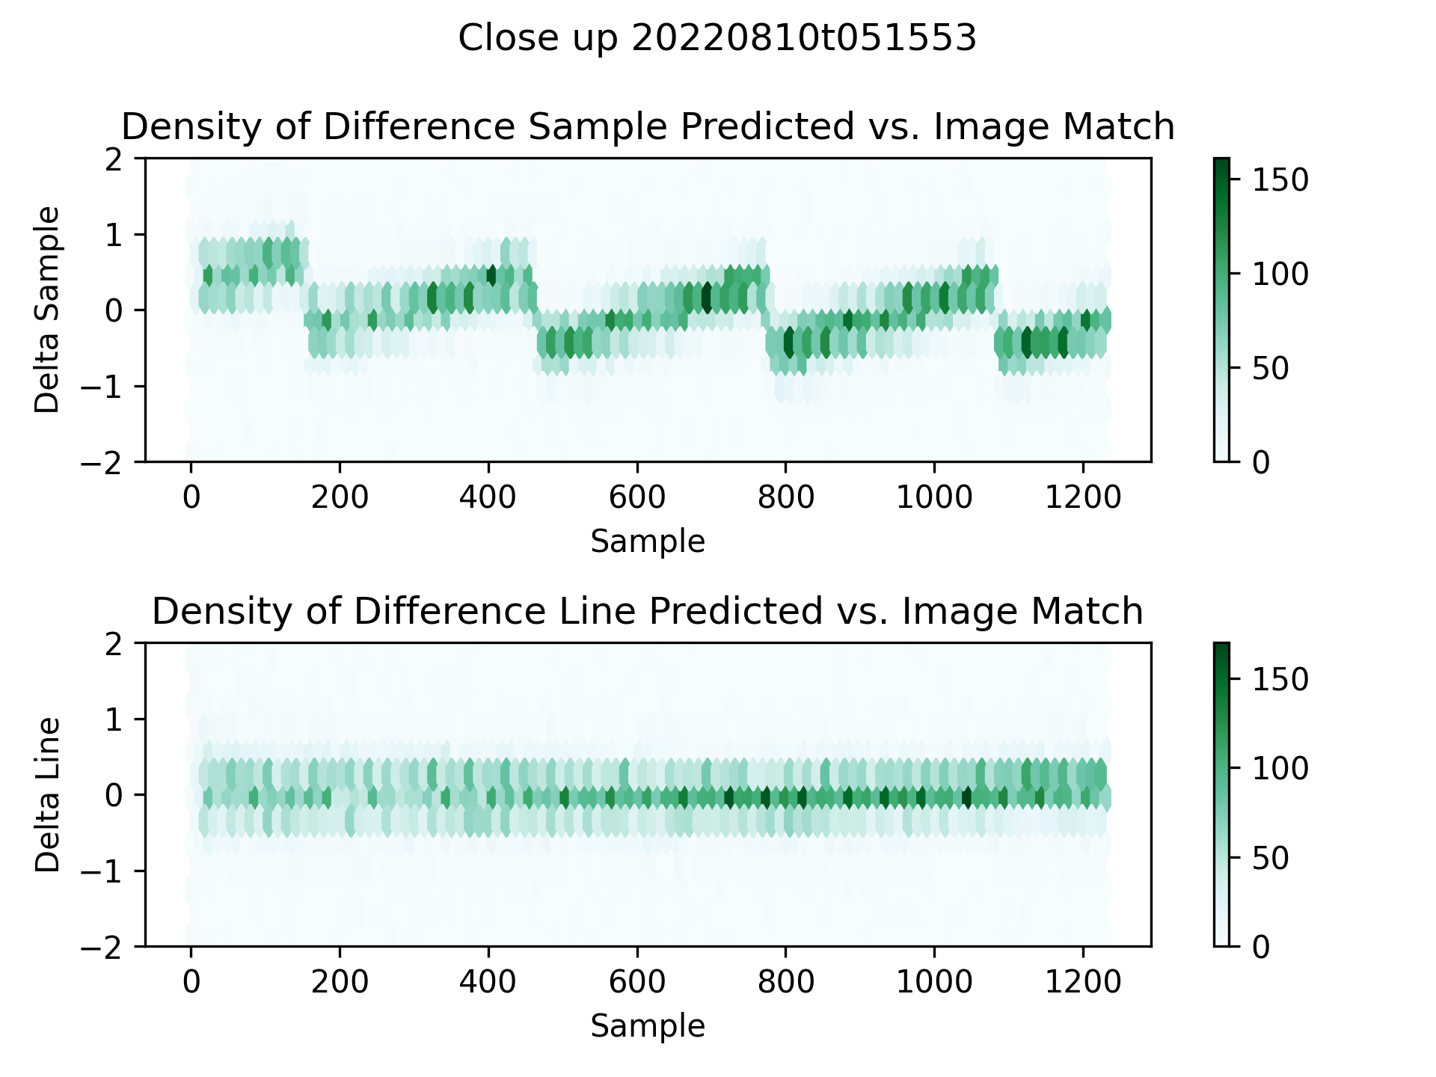

Slide 10
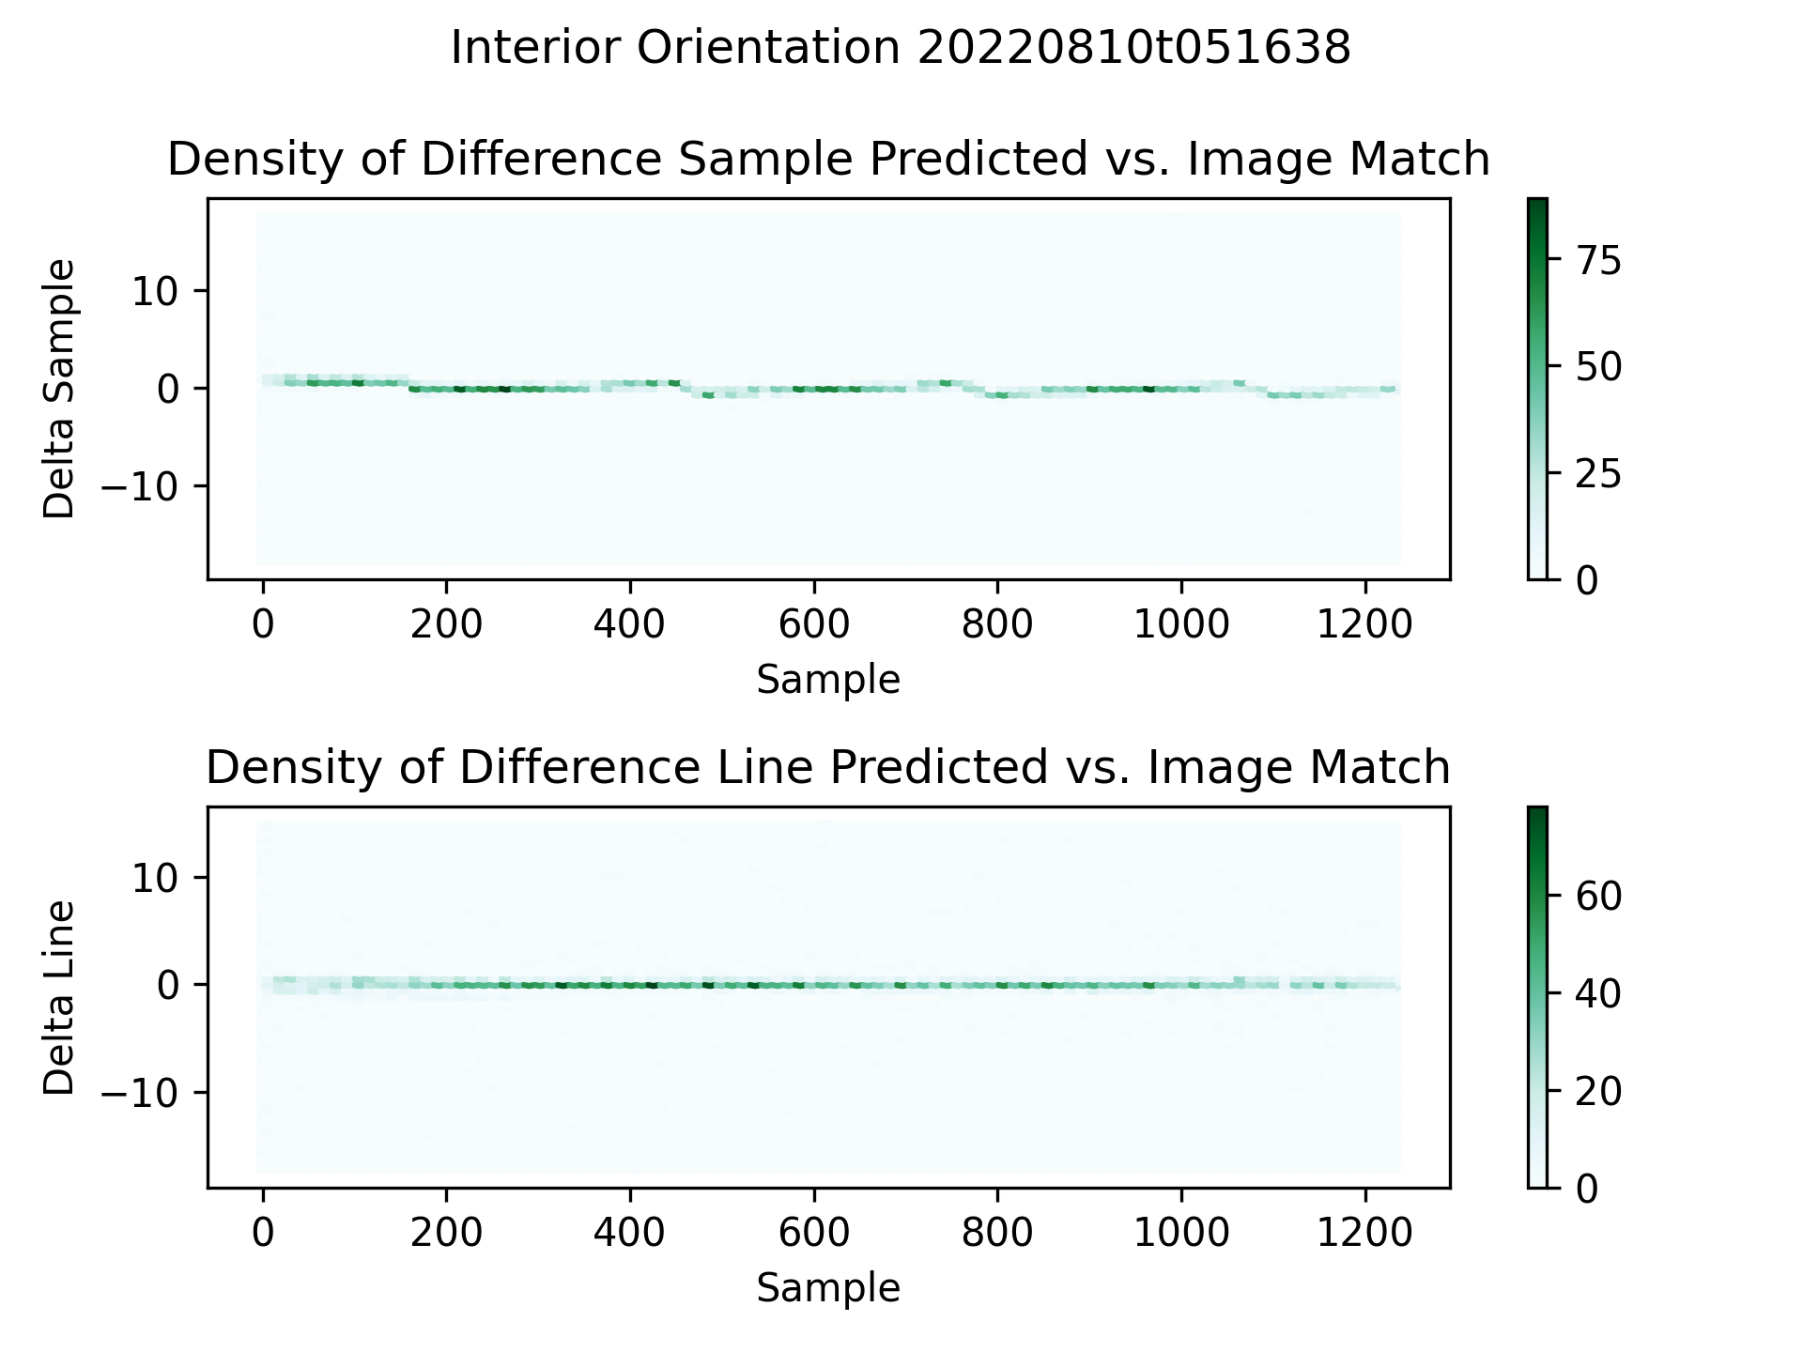

Slide 11
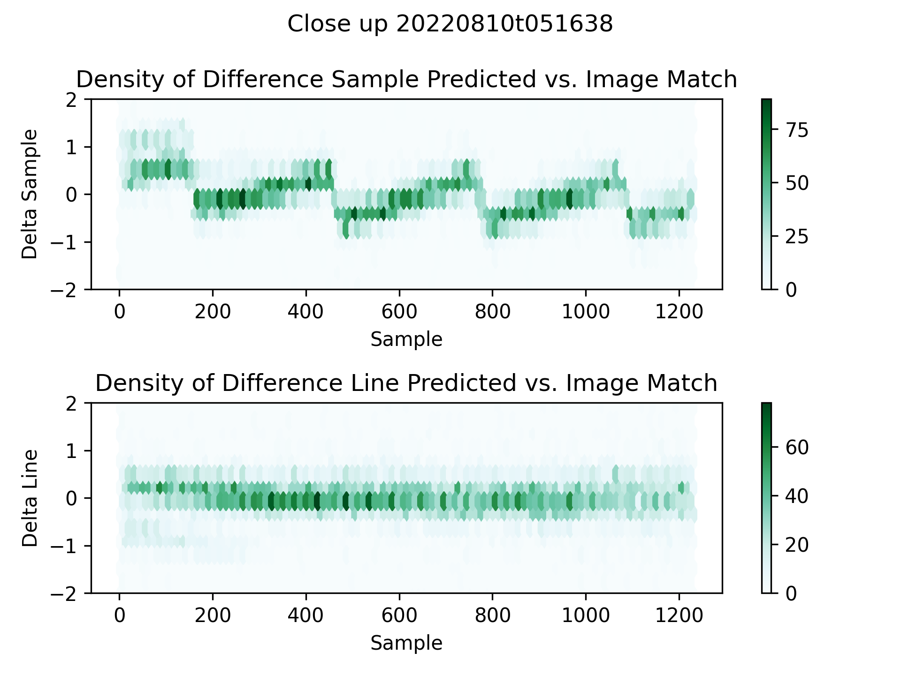

Slide 12
Interior orientation
No pattern in the predicted vs measured image line
Hint of a possible pattern in the sample direction
Subpixel, perhaps at the 0.5 pixel level
For IOC
Interior orientation looks good enough, certainly at the pixel level
Possibly a future correction can be made for a ~0.5 pixel error in the sample direction
This would be future work
Don’t want to make a change now, we’ll want look at a lot more data over a longer time period to make sure the pattern is really there and isn’t just an artifact of these particular scenes
Things are good enough for now

Slide 13
Conclusion
Even uncorrected, geolocation meets the 8 km requirement
Corrected data meets the 50 m geolocation goal
Possibly small corrections to the interior orientation can be made in the future, but data is good for IOC
Corrections, if they are done, will be at 0.5 pixel level or so
Passed the criteria for IOC

