Slide 1
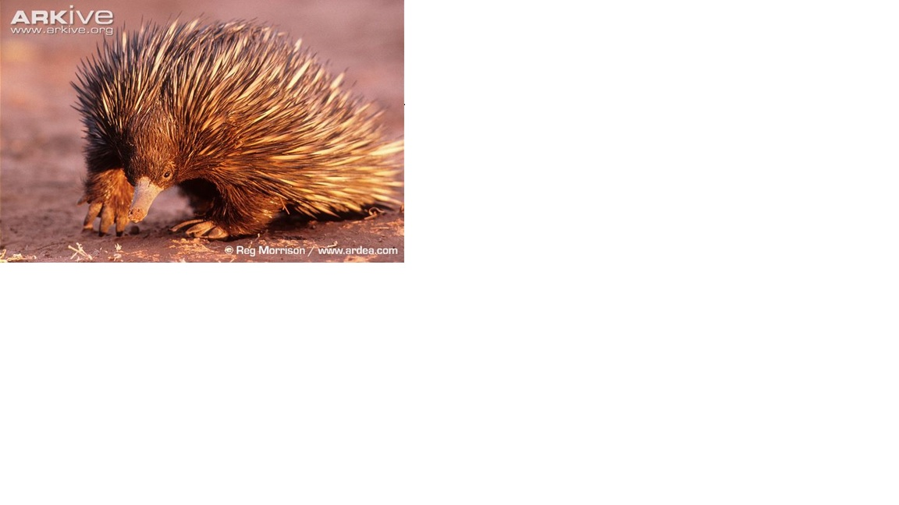

ASReml in Practice
Arthur R Gilmour
Australasian Applied Statistics Conference
Inverloch, 2022

Slide 2
Introduction
1949 – 1969 Boree Creek, YAHS, Sydney Uni
1970 -2008 Biometrician with NSW Agriculture
Sydney, Trangie, Palmerston North, Orange
1981 Robin Thompson in New Zealand
1996- ASReml
2018- Echidna

Slide 3
Average Information in Practice
Seminar honouring Dr Robin Thompson June 2018 published JABG 2019
Outlines the steps used in ASReml to fit Linear Mixed models and estimate the variance parameters.
Maximising sparsity
Factor Analytic models
Marker models
Wald F statistics

Slide 4
SUMMARY
Mixed Model
ASReml
Multivariate animal model
Testing model terms
(DHG)L(M)M
Large Genomic models

Slide 5
The MIXED model
The basic linear mixed model is y = Xβ + Zu + e
where y is the response variable, X is a design matrix for fixed effects β, Z is a design matrix for random effects u and e is a residual; var(u)=G, var(e)=R.
Widely used in many branches of biology because of the generality of the form of X, Z, G and R and extensions to hierarchal generalized models.
ASReml uses the mixed model equations to estimate the variance parameters in R and G, and the effects β, u and e.

Slide 6
ASReml update
ASReml 4.2 was deployed in 2022
It successfully accesses at least 125 Gb RAM workspace (on large systems)
More efficient computing means it runs up to 60 times faster (in large models)
Reorganised processing of most steps, using multiple threads, SLEEP
An updated version of asreml-R using the 4.2 core is planned for release in 2023 (Ask Darren for immediate access). Multiple threads?
Licencing
Echidna fits the commonly used ASReml models with similar efficiency, free for ASReml licencees and non-commercial use development platform for further development

Slide 7
Multivariate animal model
12 FT scores recorded on up to 22905 animals with a pedigree involving 49418 animals.
FT1 FT2 FT3 FT4 FT5 FT6 FT7 FT8 FT9 FT10 FT11 FT12 ~ Trait Tr.Geschlecht Tr.Stockmass Tr.leg(Alter,-2) Tr.Ort_Datum !r us(Trait).nrm(progeny) residual units.us(Trait) where Geschlecht has 2 classes, Stockmas is a covariate ranging 140:169, Ort_Datum has 1052 classes and Alter is a covariate ranging 925:1668.

Slide 8
Multivariate animal model
Client could not fit this model: fitted as xfa1(Trait),nrm(progeny) did 20 iterations in 85 hours using 95Gb RAM
Trimmed the pedigree Pedigree_FT_neu.txt !skip 1 !TRIM Phaenotypen_FT_neu.txt 2 !KEEP 4 which reduced the pedigree to 30972 individuals
Now model runs on 32GB PC (12 threads) xfa1(Trait),nrm(progeny) 22 iterations @ 11.3 min each converged us(Trait),nrm(progeny) 220 iterations @ 8.3 min each not converged (but Echidna converged in 50 iterations @ 12 min!)
Sometimes rrk().A +diag().A runs faster than xfak().A but in this example it takes nearly 3 times longer. The issue is mainly that of equation ordering (INFILL)

Slide 9
Model Comparison
Model | LogL | Param’s | ∆ LogL | ∆ Param’s | AIC
CS | -88176.7 | 78+2 |  |  | 176513.4
FA1 | -87760.3 | 78+24 | 416.4 | 22 | 175724.6
FA2 | -87609.5 | 78+35 | 150.8 | 11-2 | 175441.1
FA3 | -87481.3 | 78+45 | 128.2 | 10-3 | 175198.6
US | -87430 | 78+78 | 31.3 | 33 | 175177.7

Slide 10
Fixed or random
Fixed effects are independent and fitted to have maximum variance.
Best Linear Unbiased Estimates (BLUE) represent what happened (under the model)
Random effects have variance and often covariance, sharing information
Best Linear Unbiased Predictor (BLUP) indicating the expected outcome if the experiment is repeated.
Historically, variance components were estimated as functions of Mean Squares
Blocking terms fitted as random effects allow recovery of any inter block treatment information, and appropriate recognition of Denominator degrees of freedom of strata are involved.

Slide 11
Testing FIXED effects
The F statistic is commonly used for testing fixed effects.
However in a complex fixed model with multiple factors and unbalanced data, the F statistics depend on differences between nested models and they are many possible orders of fitting.
The usual rules are:
A test is not valid if it is a part of a higher order term which is significant: To say Variety is NS when Variety:SowTime is significant is illogical!
A test may depend on what other terms are present in the model: HT and DBH may each be significant alone, NS after the other when predicting YLD
A test may be affected by what random effects are fitted.

Slide 12
Dropping Fixed terms?
Consider a random regression model: the increase in EMD relative to WT of 11795 measurements on 1782 lambs from 4 to 16 months from 5 flocks over 2 lambings. emd ~ mu age year wt sex sex.wt flock tobr aod dob, year.dob year.flock sex.dob tobr.dob year.age year.tobr year.sex, !r at(year,1).spl(age,20) at(year,2).spl(age,20) , !{ animal animal.age us(2).nrm(animal) !}, !{ ide(animal) ide(animal).age us(2).ide(animal) !} residual units
Primary interest is to see how much of variation in trends is genetic
First identify and adjust for confounding sources of variation.
Initial tests: aod and all interactions

Slide 13
Source NumDF DenDF F-inc F-con M P-con
mu 1 57 140000 4917.12 . <.001
age 1 373 9456.68 166.65 A <.001
year 1 288 191.00 19.64 A <.001
wt 1 2322 8270.59 7596.01 A <.001
sex 1 1453 357.85 357.91 A <.001
sex.wt 1 1319 450.91 442.65 B <.001
flock 4 138 10.91 12.16 A <.001
tobr 2 1434 10.42 15.51 A <.001
aod 1 1368 13.15 15.92 B <.001
dob 1 735 0.40 0.08 A 0.774
year.dob 1 694 4.48 1.75 B 0.186
year.flock 4 247 3.21 2.73 B 0.030
sex.dob 1 1444 1.18 1.51 B 0.219
tobr.dob 2 1445 2.49 2.63 B 0.072
year.age 1 130 123.89 124.10 B <.001
year.tobr 2 1416 0.24 0.26 B 0.774
year.sex 1 1336 0.35 0.35 B 0.554
DenDF varies
F-inc tests variation added by the term after preceding terms
F-con tests variation explained by the term if added after all but its linked terms
F values based on appropriate stratum variance
M column:
A terms should be ignored unless the related B terms are not significant.
B terms are candidates for testing.
Last 2 terms can be dropped
Reorder other B terms for next run

Slide 14
Wald F statistics
Source NumDF DenDF F-inc F-con M P-con
mu 1 57 140000 4924.40 . <.001
age 1 375 9488.58 166.04 A <.001
year 1 289 191.20 19.52 A <.001
wt 1 2322 8272.03 7602.61 A <.001
sex 1 1455 358.65 358.42 A <.001
sex.wt 1 1315 450.99 443.97 B <.001
flock 4 140 10.93 12.23 A <.001
tobr 2 1435 10.44 15.55 A <.001
aod 1 1368 13.17 16.10 B <.001
year.age 1 130 125.82 124.12 B <.001
year.flock 4 252 3.37 2.81 B 0.026
dob 1 717 0.11 0.11 A 0.746
tobr.dob 2 1447 2.55 2.59 B 0.076
sex.dob 1 1445 1.57 1.37 B 0.242
year.dob 1 694 1.90 1.90 B 0.169
Now can drop the last 4 terms as not significant.
Need not rerun the model depending on the goal of the analysis
Here, the goal was to adjust for know fixed sources of variation when fitting the random regression model (random effects).

Slide 15
Dropping random terms?
Depends on the purpose of analysis.
To formally test whether a random term is significant using the Likelihood Ratio Test, you need the change in LogL from dropping the term.
If the term is small but represents an important experimental strata, you need to retain it, even allow it to be negative, to get the correct F statistic for fixed terms in that strata
Otherwise, if small, it is having little impact anyway.
An over-specified model may be hard to fit.
An inappropriate model may be hard to fit

Slide 16
SPline terms
LogL -10718.0 Term Gamma Sigma Z-Ratio year_1.spl(age,20) IDV_V 18 0.508163 0.848480 1.58 0 P year_2.spl(age,20) IDV_V 18 0.473663 0.790876 1.57 0 P year.age F statistic 1 10.4 0.29 0.29 B 0.604 (0.0411 ± 0.0766)
Pattern looked similar LogL -11219.0 Term Gamma Sigma Z-Ratio spl(age,20) IDV_V 18 0.393464 0.744762 1.57 0 P year.age F statistic 1 221.8 125.73 125.18 B <.001 (0.1232 ± 0.0110)

Slide 17
SPLINE TERM
This is emd adjusted for wt
There is an obvious seasonal pattern
The change in LogL is huge (501) but the spline (seasonal) effect is very similar
Keep year.age in model

Slide 18
Random Regression
us(2).animal 5858 effects 2 US_V 1 1 0.940874 1.57101 6.27 7 P 2 US_C 2 1 -0.458997E-01 -0.766401E-01 -4.10 -5 P 2 US_V 2 2 0.547421E-02 0.914047E-02 4.88 0 P animal NRM 2929
us(2).ide(animal) 5858 effects 2 US_V 1 1 0.832563E-01 0.139016 0.69 0 ? 2 US_C 2 1 0.556968E-03 0.929988E-03 0.06 0 ? 2 US_V 2 2 0.671096E-04 0.112055E-03 0.07 0 ?
Note Z-ratio for ide(animal) are small: Drop its slope component: LogL -10717.5 Drop both ide(animal) compinents: LogL -10717.7
Conclusion: there are genetic differences in rate of EMD change relative to weight.

Slide 19
Generalized linear models
Linear Models are a powerful tool When the data values have varying variances, we can weight them by the inverse variance
A special case is the exponential family, typified by Binomial and Poisson data where the variance is related to the mean.
For Binary data, a logit or probit transformation is often used to map the means from the 0,1 interval to the real line (although 0 becomes -∞, 1 becomes ∞), an underlying scale.
Iteratively reweighted least squares incorporates both weights and transformation Fit y* = Xβ + e where y* is a working variable predicted as X^β + (y- t(Xβ))/(dy/du) and the model is fitted using weights (dy/du)²/Var(y)

Slide 20
Generalized mixed linear models
GLMM are typically fitted by adding random terms to the model
In a genetic context, many genes as well as environment effects are assumed to generate an underlying Normal variable, but we just observe a binary outcome relative to whether the underlying variable exceeds a threshold.
However this doesn’t work for the ‘animal’ model because the animal effects pertain to data values (0, 1) which map to ±∞. We recommend having at least 10 progeny in a ‘sire’ model.
Often, the means do not vary greatly, hence the transformation and individual weights do not vary much and there is little gain from the GLMM approach.

Slide 21
Hierarchical Generalized linear models
This is a further extension where two models are fitted simultaneously (in ASReml, alternately in Genstat)
The mean model is a typical linear model, but fitted using weights predicted from the dispersion model.
The dispersion model is typically a GAMMA GLM fitted to squared random effects from the mean model.
Augment the data with records for random effects to be model Second trait is the random effect (called dev(y) for syntax reasons)

Slide 22
Hierarchical Generalized linear models
Cake example from Lee and Nelder:The trial measured 'breaking angle' of cakes made using 3 recipes baked at 6 temperatures. There were 15 replicates consisting of 3 batches (= recipes) a total of 270 measures.
Angle !GAMMA !LOG !DISP 1 ~ mu Recipe Temperature Rec.Temp !h Rep Rep.Batch . 270 data records + 15 Rep records + 45 Rep.Batch records
Simple case so just 3 variances to estimate (1 for each Section)

Slide 23
Hierarchical Generalized linear models
111 patients, 2 treatments, 2 centres, 2 sexes, 11-68 yo, 4 binary tests each
!HGLM HSection patient # adds 111 patient records for dispersion model !CONTRAST Main HS 1 0 # defines intercept for Mean model y !BIN !LOGIT !TOT TOT dev(y) ~ + at(Tr,1).(Main treatment+center+sex+age+baseline+past patient) at(Tr,2).( at(HS,1) at(HS,2) at(HS,2).PatAge ) residual units.id(2) .

Slide 24
DOUBLE Hierarchical Generalized linear models
Aim is to look at genetic variation in the variability and allow it to be genetically correlated with additive effects
!HGLM Hsection Yval dev(Yval) ~ Trait Trait.X !r us(Trait !init 1 -.5 0.8 !GH).Z !h residual units.id(Trait) .
This has just 1 section of data. dev(Yval) is the residual from the mean model which is modelled as a function of fixed and random effets.

Slide 25
LARGE GENOMIC models
ASReml became popular because it efficiently analysed large ‘animal’ models since the inverse A (Numerator Relationship Matrix) is sparse.
However, the Genomic relationship matrix G=MM’/s is dense
!CYCLE 2:63 $I ~ mu + Sex Age Region !r grm1(grmID) 0.003
ASReml can handle a C matrix with up to 2147 million non-zero cells, a G matrix for 66,000 genotypes in a simple univariate model.
Milagros and Mohammed have G matrixes for over 200000 subjects!
One is human data for which most covariances are effectively zero. Removing covariance < 0.005 ➔ 62,274899 non-zero cells; < 0.03 ➔ 876321 cells.

Slide 26
Restructure to block diagonal G
75% of subjects were unrelated (i.e. <0.03), or related to only one other
Blocks were defined as follows:
Find the highest remaining correlation to start a group.
Add in the individual with the next highest correlation recursively until no more linked subjects.
Result is an ordered set. Either
get the inverse for the block (half stored N(N-1)/2 cells)
get approximate inverse assuming an ANTEDEPENCE 1 structure (half stored 2N-1 cells)

Slide 27
Three RUNS
1. CLIENT supplied Sparse G: Identified genetic variance in 12 of 62 traits
Was not positive definite and looked implausible
II Second Sparse inverse from client identified genetic variance in 19 traits
Values more plausible but still not positive definite
III I built the sparse inverse as described above. I also transformed (SQRT) strongly skewed traits. Identified significant genetic variance in 32 traits.
Bivariate analysis among these traits took 1 minute per trait pair.

Slide 28
What next
VALIDATE inverse approximation by using full inverse of each block
Review blocking algorithm
Apply current approach to the second data set (Mohammed)
Review method of forming the inverse (ANTE 2 or ANTE 3 for larger blocks?)
Transform the model using SVD of blocked G
Implemented for whole GRM; could be extended to blocked GRM.

Slide 29
Conclusion
I like to see applications of mixed models
VSN have contracted me to support ASReml and its users
Echidna should be a better basis for future developments

Slide 30
acknowledgements
VSN for contracting me to support ASReml and ASReml users
Robin Thompson for ongoing critical review of my work
ASReml/Echidna users who keep finding issues for me to address
Past collaborators: NSW Dept Ag, University of Wollongong, Brian Cullis
Jesus Christ who
created this incredible world
Forgives my sin and failure
Gives me new things to do each day

Slide 31
references
Gilmour, A.R. (2021) Echidna Mixed Model Software www.EchidnaMMS.org
Gilmour, A.R. (2019) Average Information REML in practice J. Anim. Breed. Genet. 1–12 doi:10.1111/jbg.12398
ASReml: https://vsni.co.uk/software/asreml
Arthur: Arthur.Gilmour@cargovale.com.au

