Slide 1
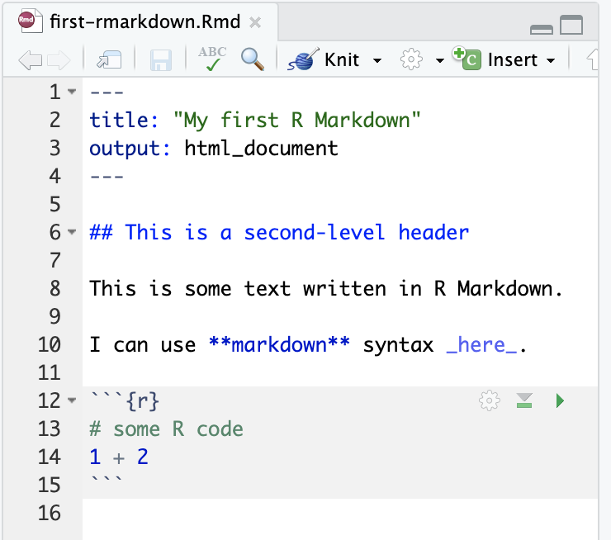
File extension is Rmd
YAML: meta data fenced by ---
Text can use markdown
Code chunk: fenced by ```

Slide 2
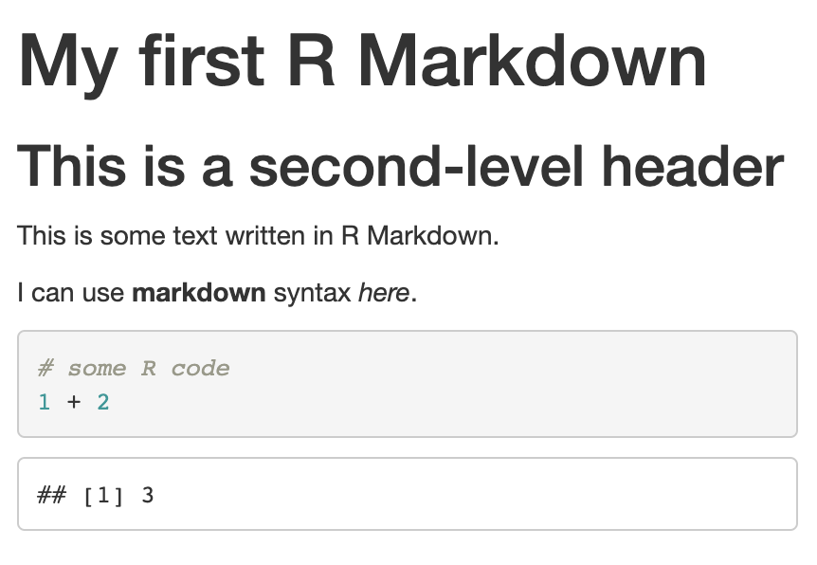
Output file name matches Rmd file name
first-rmarkdown.html

Slide 3
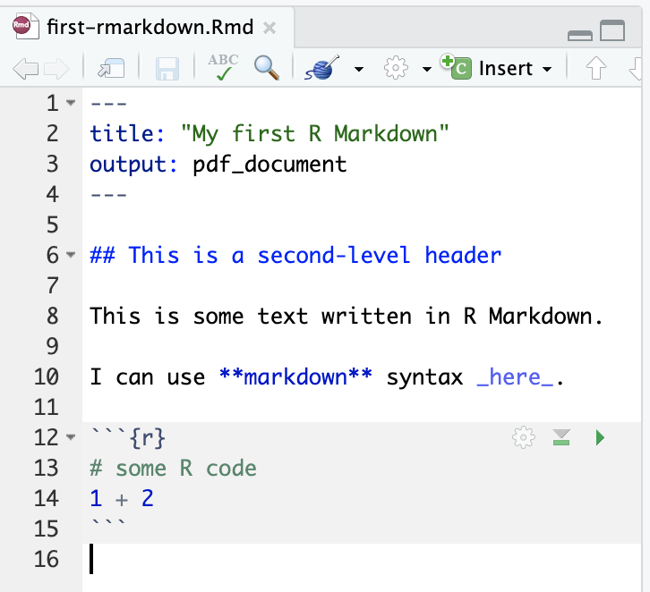
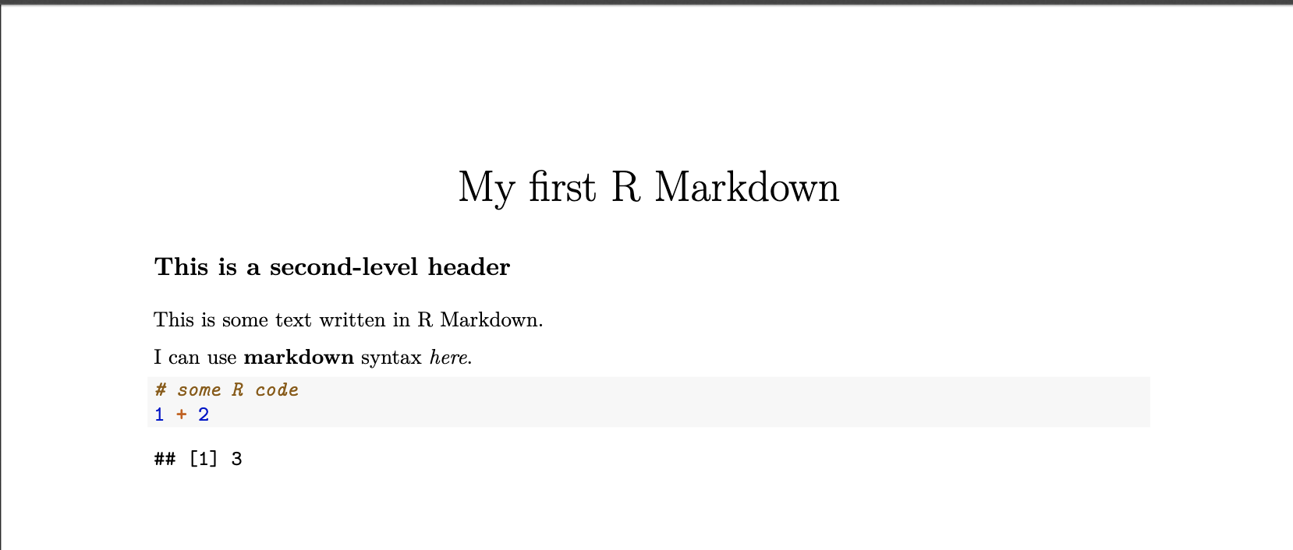
first-rmarkdown.pdf
pdf output

