Slide 1







Introduction to Statistics with R workshop : : CHEAT SHEET
Basics
Parametric distributions
Useful Elements
Logistics
BERNOULLI (p)
NUMERICAL SUMMARIES
An event with two possible outcomes.
The probability of outcome with “success” is p.
CODE
FONTS
Numerical variable
Where possible, use code that works when run.
Measure of central location
rbinom(1, 1, p)
ggplot(mpg, aes(hwy, cty)) +
geom_point(aes(size = fl)) +
geom_smooth(method ="lm")
mean(x)
median(x)
BINOMIAL (n, p)
Measure of variation
The number of successes out of n cases where each case is independent and has the same probability of success p.
Word balloons
can help explain
code
sd(x)
var(x)
IQR(x)
Empirical quantiles
quantile(x, 0.75)
The sum of n Bernoulli random variables with probability p.
quantile(x, 0.25)
max(x)
rbinom(1, n, p)
min(x)
These are just font awesome characters
Five number summaries
fivenum(x)
NORMAL / GAUSSIAN ($μ$, $σ$)
GRAPHICAL SUMMARIES
See ggplot2 cheatsheet
rnorm(1, mean, sd)
Histogram
Barplot
MOCK TABLES
KEYNOTE
Scatter plot
T (degrees of freedom)
Boxplot
Violin plot
rt(1, df)
Beeswarm plot
summary function
KEYNOTE TIPS
MOCK GRAPHS
TABLES
sub-option | description
citation_package | The LaTeX package to process citations, natbib, biblatex or none
code_folding | Let readers to toggle the display of R code, "none", "hide", or "show"
colortheme | Beamer color theme to use
CC BY SA Emi Tanaka • dr.emi.tanaka@gmail.com. • emitanaka.org • Learn more at webpage or vignette • Updated: 2025-02

Slide 2


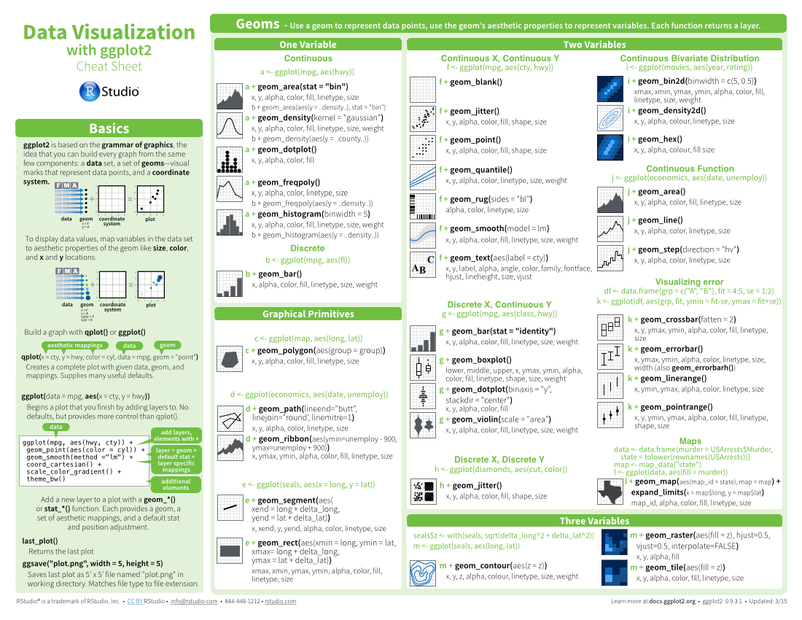
Three Column Layout: : CHEAT SHEET
Basics
Layout Suggestions
Manipulate Variables
Thank you for making a new cheatsheet for R! These cheatsheets have an important job:
Use headers, colors, and/or backgrounds to separate or group together sections.
Create a visual hierarchy. Help users navigate the page with titles, subtitles, and subsubtitles
Quickly identify content with a package hexsticker (if available)
Fit sections to content. Try several different layouts.
Use numbers or arrows to link sections if the order/flow is confusing.
Cheatsheets make it easy for R users
to look up useful information.
Section 1
Section 2
Section 3
Title
Remember that the best cheatsheets are visual—not written—documents. Whenever possible use visual elements to make it easier for readers to find the information they need.
SUBTITLE
SUBSUBTITLE
Use a layout that flows and makes it easy to zero in on specific topics.
Logistics
Useful Elements
FONTS
CODE
Where possible, use code that works when run.
Word balloons
This template uses several fonts: Helvetica Neue, Menlo, Source Sans pro, which you can acquire for free here, www.fontsquirrel.com/fonts/source-sans-pro, and Font Awesome, which you can acquire here, fortawesome.github.io/Font-Awesome/get-started/
ggplot(mpg, aes(hwy, cty)) +
geom_point(aes(color = cyl)) +
geom_smooth(method ="lm")
can help explain
code
Use visualizations to explain concepts quickly and concisely.
summary function
To use a font awesome icon, copy and paste one from here fortawesome.github.io/Font-Awesome/cheatsheet/. Then set the text font to font awesome.
ICONS
☞    
These are just font awesome characters
Use visual elements to make the sheet scannable.
i + geom_area() x, y, alpha, color, fill, linetype, size
i + geom_line() x, y, alpha, color, group, linetype, size
KEYNOTE
MOCK TABLES
I make my cheatsheets in Apple Keynote, and not latex or R Markdown, because presentation software makes it much easier to tweak the visual appearance of a document
Use visual emphasis (like color, size, and font weight) to make important information easy to find.
KEYNOTE TIPS
dplyr::lag() - Offset elements by 1
dplyr::lead() - Offset elements by -1
MOCK GRAPHS
COPYRIGHT
Select multiple elements by holding down shift and then selecting each. Click on a selected element before letting go of shift to unselect it.
To group elements together. Select them all , then click Arrange > Group
To evenly space multiple objects, select them all then Right Click > Align objects or Right Click > Distribute objects
Click on a table, then visit Format >Table > Row and Column Size to make even width rows/columns.
Each cheatsheet should be licensed under the creative commons license.
To license the sheet as creative commons, put CC'd by <your name> in the small print at the bottom of each page and link it to http://creativecommons.org/licenses/by/4.0/
TABLES
sub-option | description
citation_package | The LaTeX package to process citations, natbib, biblatex or none
code_folding | Let readers to toggle the display of R code, "none", "hide", or "show"
colortheme | Beamer color theme to use
YOUR LOGO
(optional)
RStudio® is a trademark of RStudio, Inc. • CC BY SA Your Name • your@email.com • 844-448-1212 • your.website.com • Learn more at webpage or vignette • package version 0.5.0 • Updated: 2017-01

