Slide 1





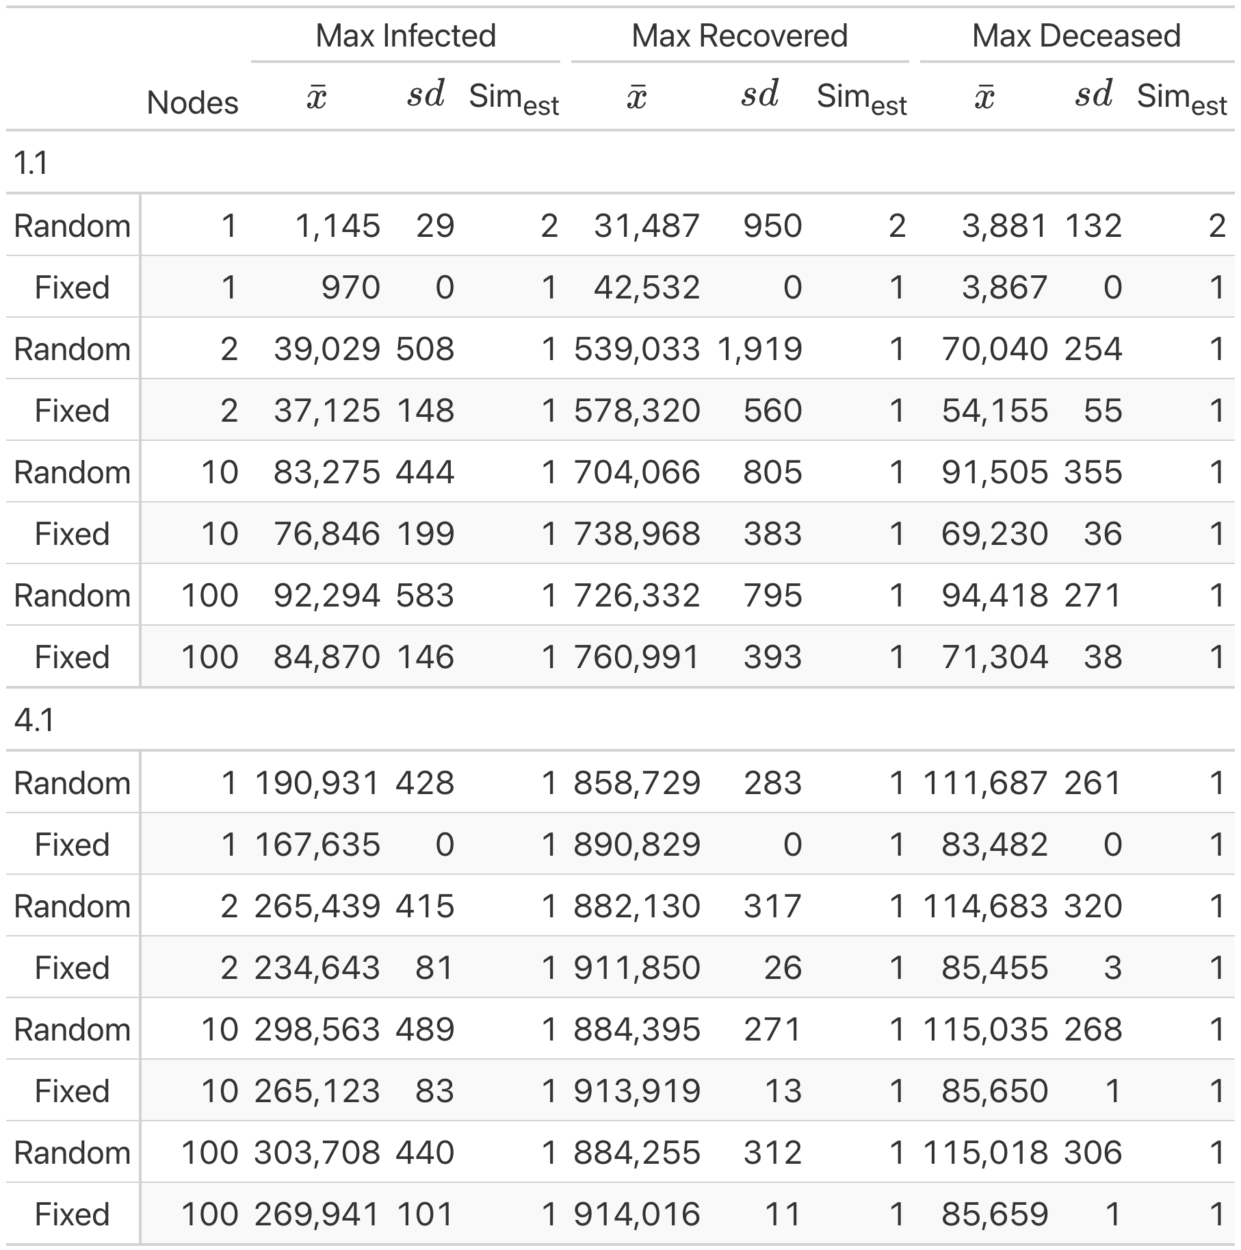
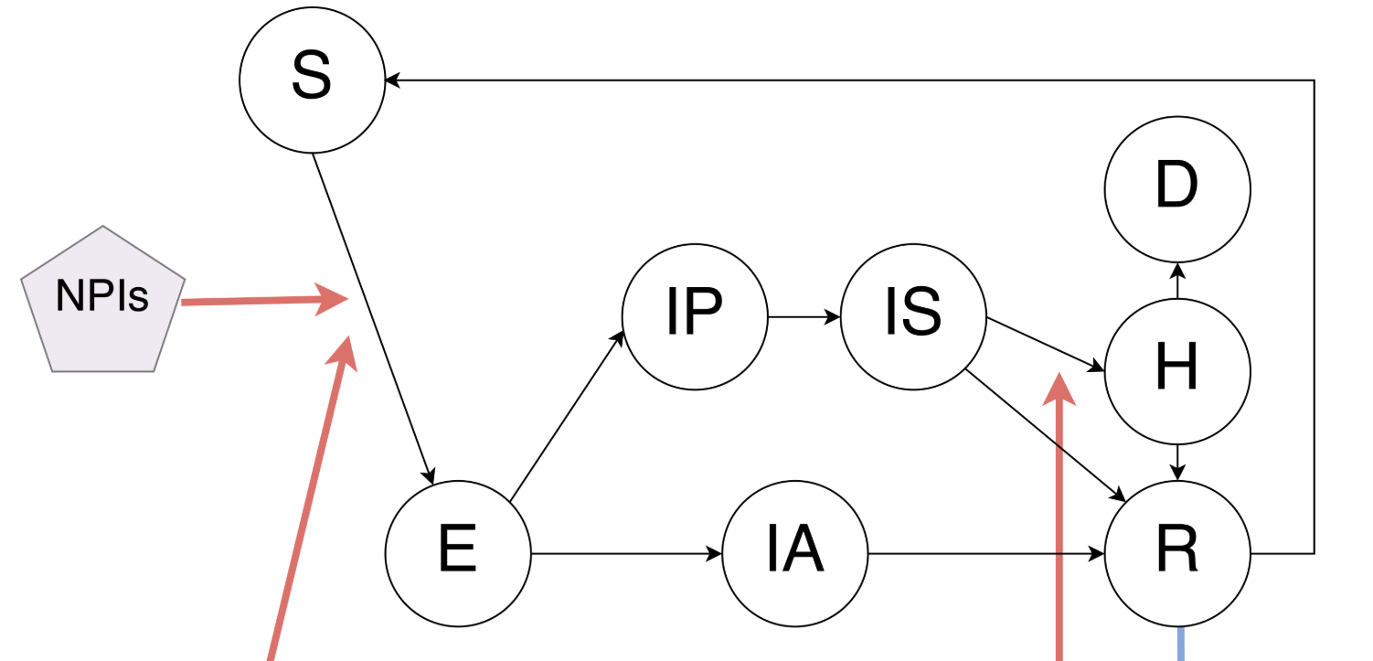

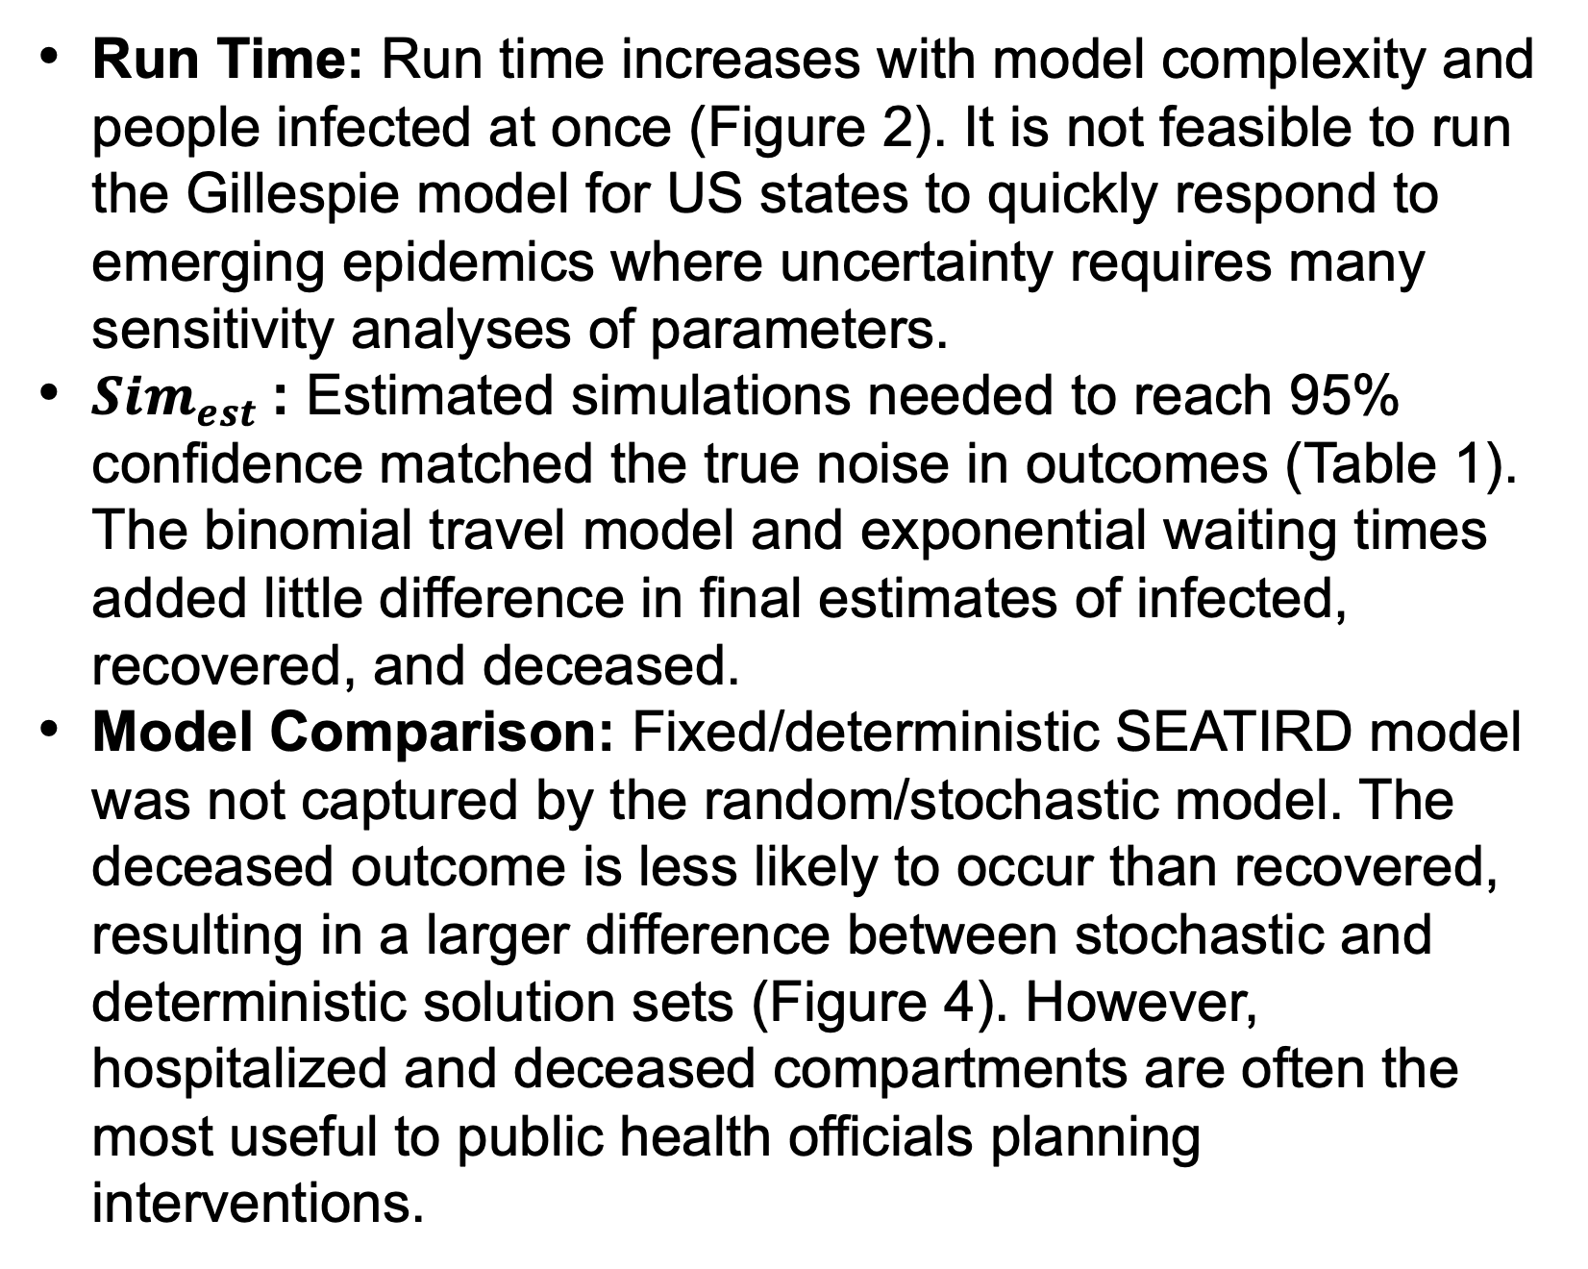
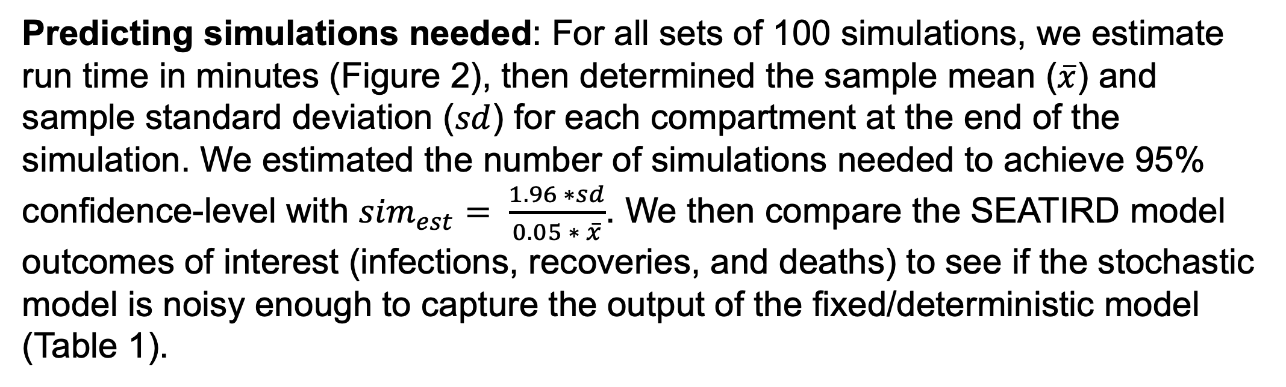
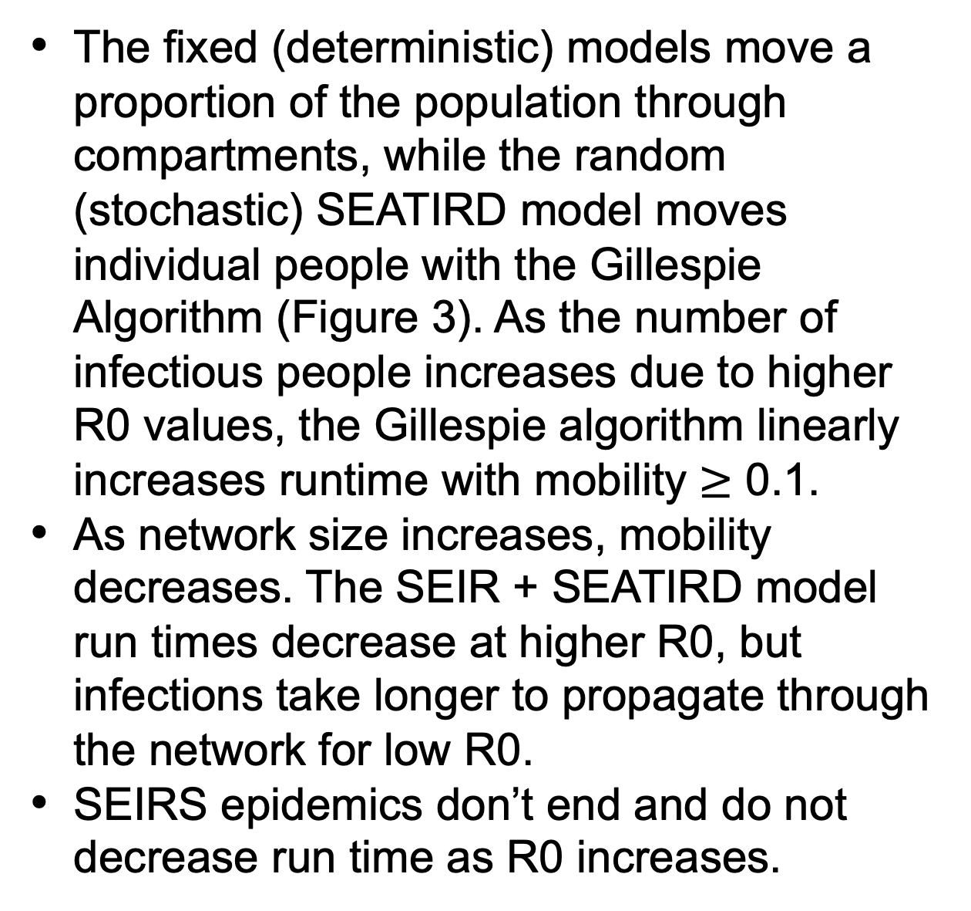
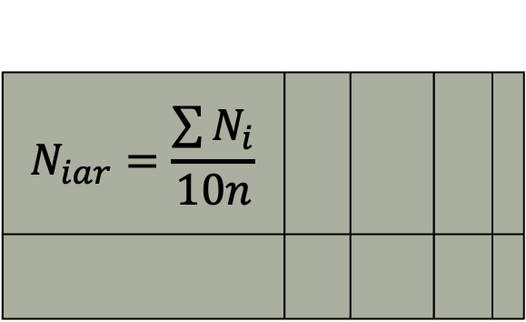
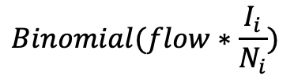
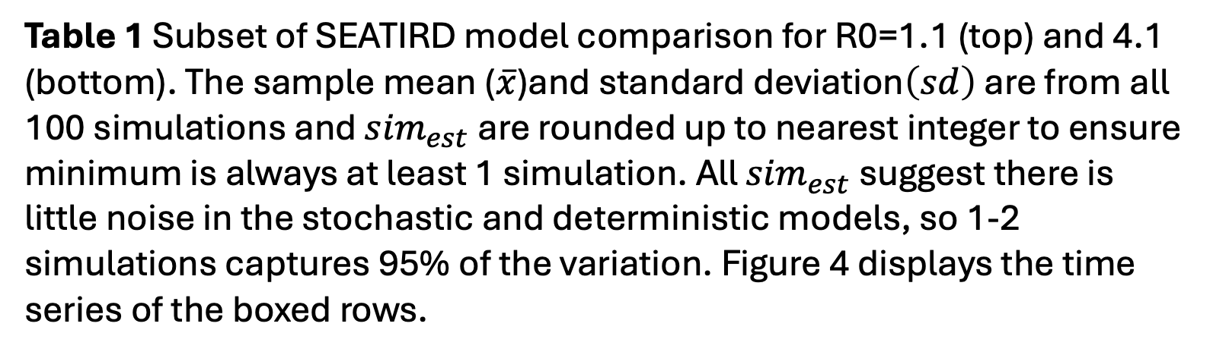
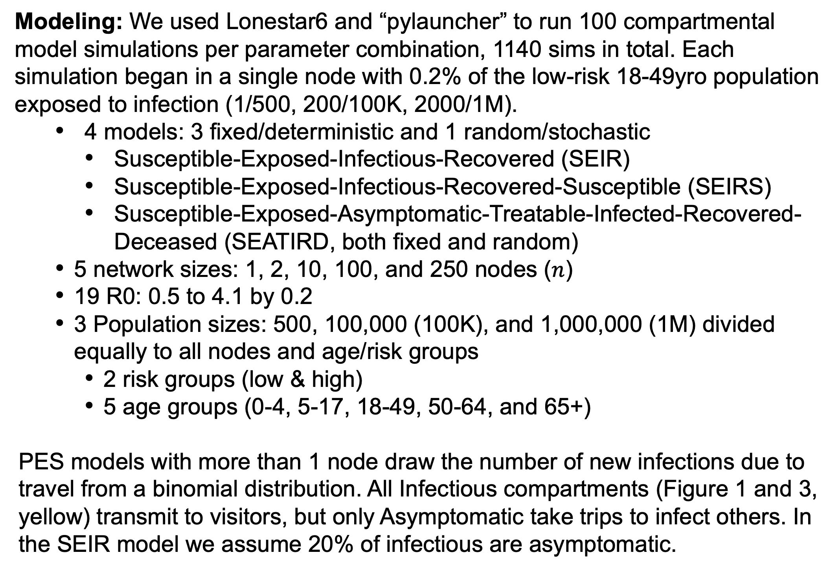

Balancing accuracy and urgency for real-time epidemic response:
How many stochastic simulations is enough?
Emily M. Javan¹, William J. Allen¹, Lena Duplechin Seymour¹, Shraddha Ramdas Bandekar², Remy F. Pasco³, Sarosha Prasla¹,
Gladys Chen¹, Vennela Gajjala¹, Maytal Dahan¹, Lauren Ancel Meyers² ¹Texas Advanced Computing Center, ²Department of Integrative Biology, The University of Texas at Austin,
³BioFrontiers Institute, University of Colorado at Boulder
Motivation
Results
Conclusions
The Pandemic Exercise Simulator (PES) is an epidemic modeling platform used to evaluate a range of intervention strategies under pandemic and epidemic scenarios. The simulator allows for user-defined age and risk groups, interconnected spatial regions (cities or counties), and multiple interventions, such as school closures, public health announcements, vaccination, and antiviral distribution. However, we lack clear guidelines for users on the minimum number of simulations to reach a confidence level while considering run time constraints. We investigated how simulation requirements scale with model complexity and epidemic dynamics.
Complexity
The fixed (deterministic) models move a proportion of the population through compartments, while the random (stochastic) SEATIRD model moves individual people with the Gillespie Algorithm (Figure 3). As the number of infectious people increases due to higher R0 values, the Gillespie algorithm linearly increases runtime with mobility $≥$ 0.1.
As network size increases, mobility decreases. The SEIR + SEATIRD model run times decrease at higher R0, but infections take longer to propagate through the network for low R0.
SEIRS epidemics don’t end and do not decrease run time as R0 increases.
Run Time: Run time increases with model complexity and people infected at once (Figure 2). It is not feasible to run the Gillespie model for US states to quickly respond to emerging epidemics where uncertainty requires many sensitivity analyses of parameters.
${Sim}_{est}$: Estimated simulations needed to reach 95% confidence matched the true noise in outcomes (Table 1). The binomial travel model and exponential waiting times added little difference in final estimates of infected, recovered, and deceased.
Model Comparison: Fixed/deterministic SEATIRD model was not captured by the random/stochastic model. The deceased outcome is less likely to occur than recovered, resulting in a larger difference between stochastic and deterministic solution sets (Figure 4). However, hospitalized and deceased compartments are often the most useful to public health officials planning interventions.
Run time not impacted by pop size
Mobility
0.5
Methods
Higher R0 a little faster
0.1
R0~1 epi ends slowly
0.01
Modeling: We used Lonestar6 and “pylauncher” to run 100 compartmental model simulations per parameter combination, 1140 sims in total. Each simulation began in a single node with 0.2% of the low-risk 18-49yro population exposed to infection (1/500, 200/100K, 2000/1M).
4 models: 3 fixed/deterministic and 1 random/stochastic
Susceptible-Exposed-Infectious-Recovered (SEIR)
Susceptible-Exposed-Infectious-Recovered-Susceptible (SEIRS)
Susceptible-Exposed-Asymptomatic-Treatable-Infected-Recovered-Deceased (SEATIRD, both fixed and random)
5 network sizes: 1, 2, 10, 100, and 250 nodes ($n$)
19 R0: 0.5 to 4.1 by 0.2
3 Population sizes: 500, 100,000 (100K), and 1,000,000 (1M) divided equally to all nodes and age/risk groups
2 risk groups (low & high)
5 age groups (0-4, 5-17, 18-49, 50-64, and 65+)
PES models with more than 1 node draw the number of new infections due to travel from a binomial distribution. All Infectious compartments (Figure 1 and 3, yellow) transmit to visitors, but only Asymptomatic take trips to infect others. In the SEIR model we assume 20% of infectious are asymptomatic.
Epidemic doesn’t end
0.004
R
Figure 2 Mean and standard deviation of simulation run times varying R0 (infectiousness), total population (500, 100K, and 1 million), and nodes in the network. All simulations start with 0.2% of population infected in a single node.
Future Work
S
E
A
T
I
Analyze Stochastic Distributions: The current stochastic model does not capture the key outcomes of the deterministic model. This may be due to the Gillespie Algorithm new infections coming from an exponential distribution instead of binomial like the travel flow. Negative binomial is classically used for super-spreading, so we will explore this behavior as well.
Proportional Stochastic Model: The Gillespie algorithm will not scale, so stochastic models moving proportions of the population are needed.
Vectorize matrices: With 10 subgroups per node, even the deterministic models are significantly slowed down by nested for-loops.
Modern Models: The SEATIRD model comes from pre-COVID-19 pandemic understanding of influenza spread. Including hospitalized (H), pre-symptomatic (IP), and asymptomatic (IA) compartments can be critical to effective public health planning and realistic model parameterization. The model below from Bi & Bandekar (2023).
Every US State: With improved performance we will test the models for every US state at county level and Washington D.C. Texas alone has 254 counties with over 31M people, so significant model improvements will be needed for effective real-time response.
D
Figure 3 The SEATIRD model has multiple terminal compartments (burnt orange) that every infectious (yellow) compartment can transition to equally. Random model draws every rate (black arrow) from an exponential distribution .
Node 1
Node 2
$$Binomial(flow∗\frac{I_{i}}{N_{i}})$$
S
E
I
R
$$flow= \frac{1}{nodes}$$
5 Age Groups
Node 3
2 Risk Grp
$$N_{iar}=\frac{\sum{N_{i}}}{10n}$$
Figure 1 Inside each node a SEIR(S) or SEATIRD compartmental model simulates disease spread. Each compartment is subdivided into 5 age and 2 risk groups (10 groups). In the SEIRS model immunity wanes and Recovered return to Susceptible. Infections to other nodes are drawn from the binomial distribution based on the current infectious and flow rate between nodes.
Vaccination against infection
Vaccination against hospitalization
Predicting simulations needed: For all sets of 100 simulations, we estimate run time in minutes (Figure 2), then determined the sample mean ($\overline{x}$) and sample standard deviation ($sd$) for each compartment at the end of the simulation. We estimated the number of simulations needed to achieve 95% confidence-level with ${sim}_{est}= \frac{1.96 ∗sd}{0.05 ∗ \overline{x}}$. We then compare the SEATIRD model outcomes of interest (infections, recoveries, and deaths) to see if the stochastic model is noisy enough to capture the output of the fixed/deterministic model (Table 1).
Table 1 Subset of SEATIRD model comparison for R0=1.1 (top) and 4.1 (bottom). The sample mean ($\overline{x}$)and standard deviation$\left(sd\right)$ are from all 100 simulations and ${sim}_{est}$are rounded up to nearest integer to ensure minimum is always at least 1 simulation. All ${sim}_{est}$suggest there is little noise in the stochastic and deterministic models, so 1-2 simulations captures 95% of the variation. Figure 4 displays the time series of the boxed rows.
Figure 4 100 simulations from each model of 100 node network, R0=1.1 (top) and 4.1 (bottom) for 1M people. The susceptible (S) and exposed time series are closely aligned, but the stochastic model fails to capture the recovered (R) and deceased (D) deterministic final values.
GitHub Repository

