Slide 1
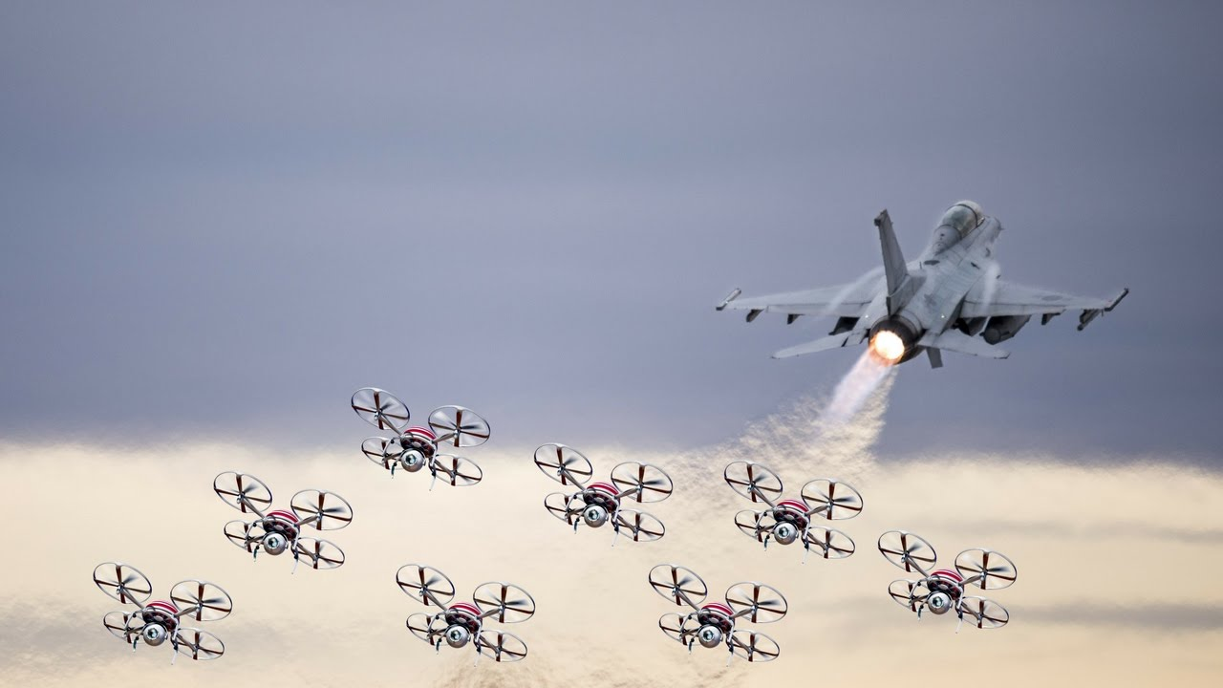


Eagle-I
Srinidhi Emkay

Slide 2
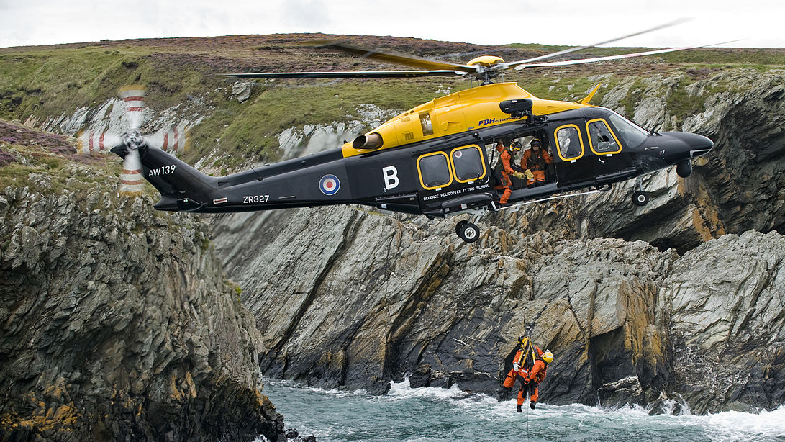
Search and Rescue missions
Swarm Drones can be cheaply dispersed to clear the area.
The National Park Service spends nearly $5 million annually, where it’s $1,600 per hour

Slide 3
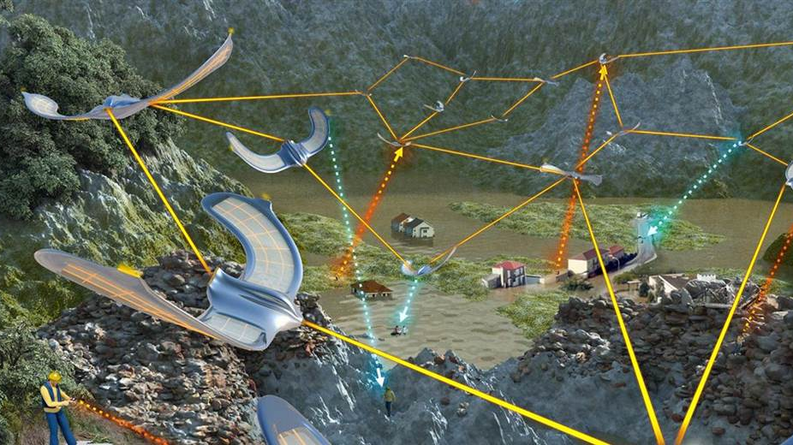
Drone Swarm
Can quickly be quickly assembled, and dispersed cost per area of vastly smaller
Can locate people faster using Computer Vison.

Slide 4
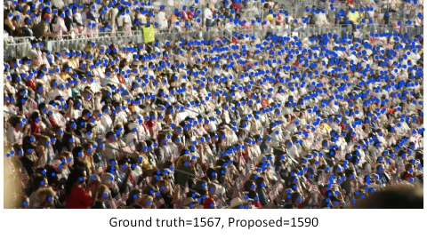
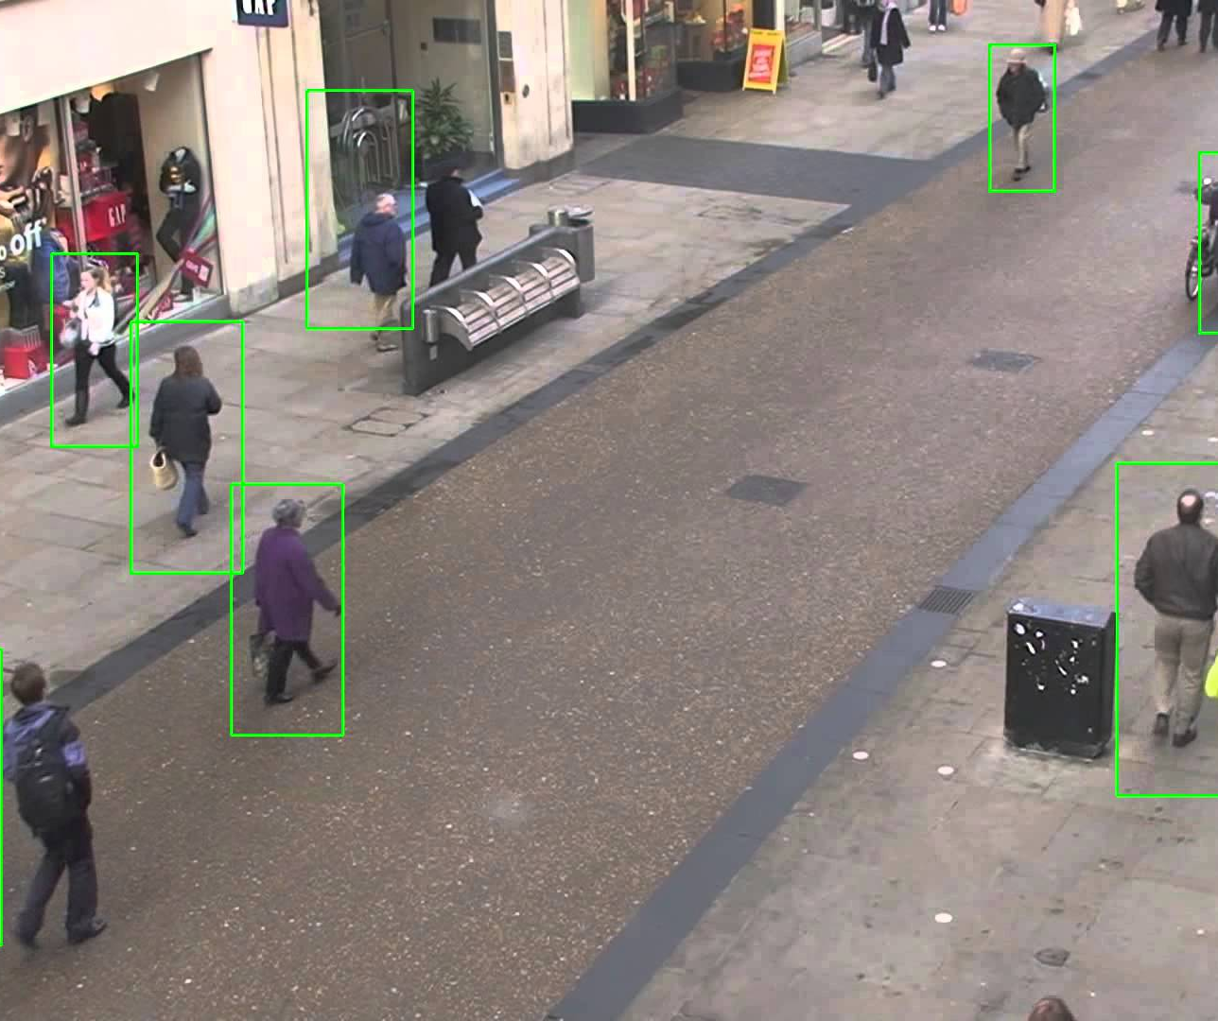
Libraries and Software protocol
Locally runs OPENCV for human/face reignition.
Sends data (Location, Count of People) to server via POST methods over GSM Network (Arduino Shield)
Uses Heroku, AWS, MySQL for mapping and displaying on web interface.

