Slide 1
Myers-Briggs Type Indicator - Analysis
By: Orlando Fuller, Jacob Johnson, Ankita Kapoor, Sania Lari, Eric Linn

Slide 2
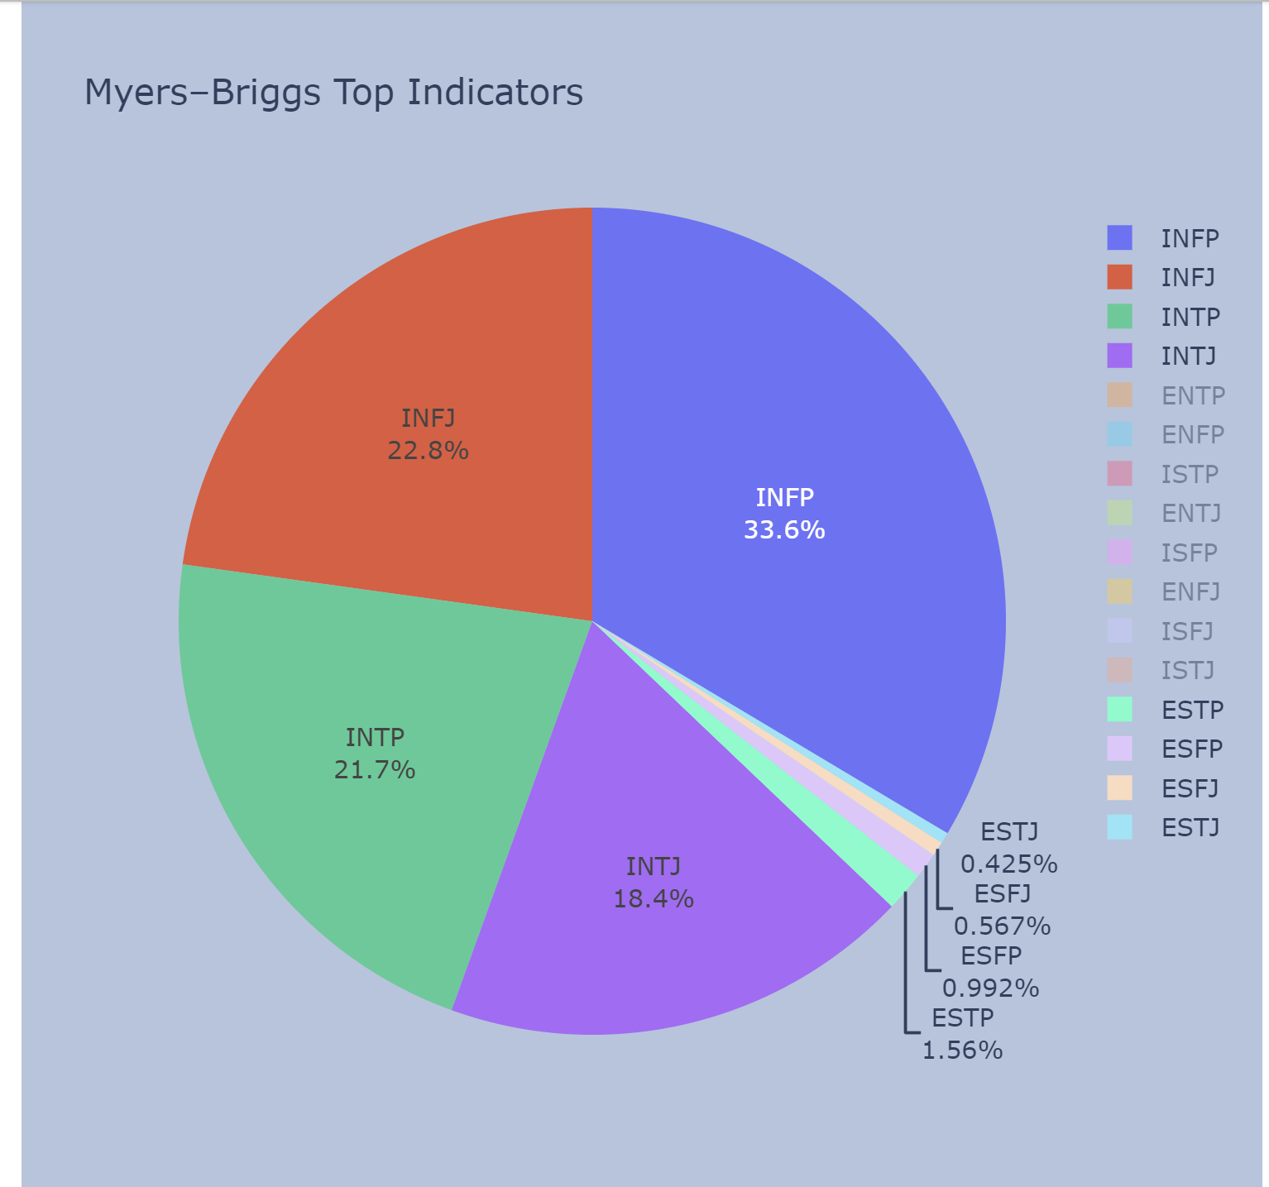
Introduction
Myers–Briggs is a personality test that helps people become more self-aware in how they perceive the world and make decisions.
Four categories:
Introversion or Extraversion
Sensing or Intuition
Thinking or Feeling
Judging or Perceiving
Notes:
Sania Lari

Slide 3
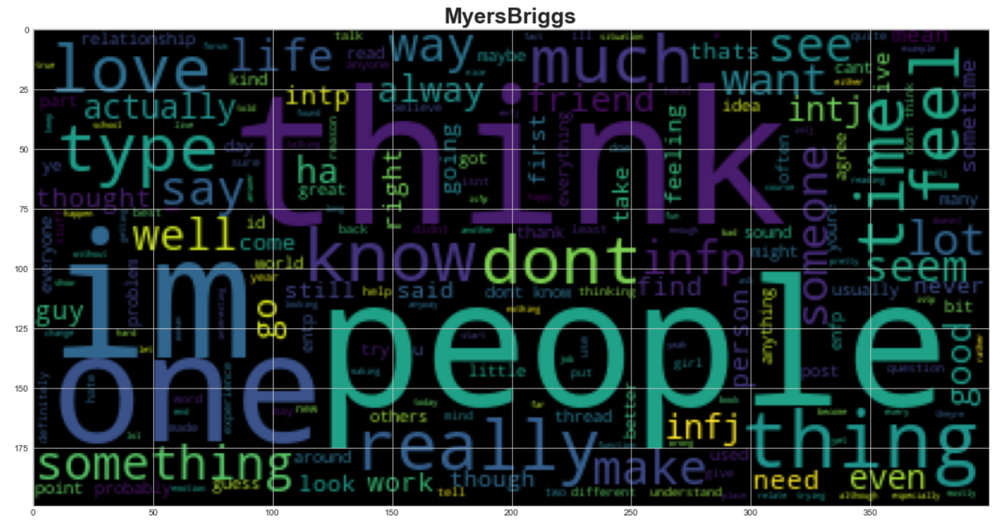
WordCloud
Showcased below are the top used words or phrases that helped determine what Myers- Brigg Personality you belong under.
Notes:
Sania

Slide 4
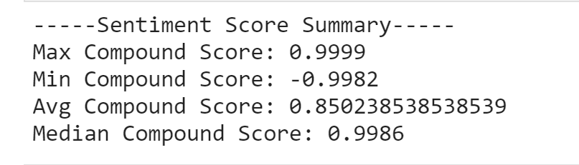
Sentiment Analysis
When analyzing the data we noticed that there was a much greater positive correlation than a negative one.
Notes:
Eric

Slide 5
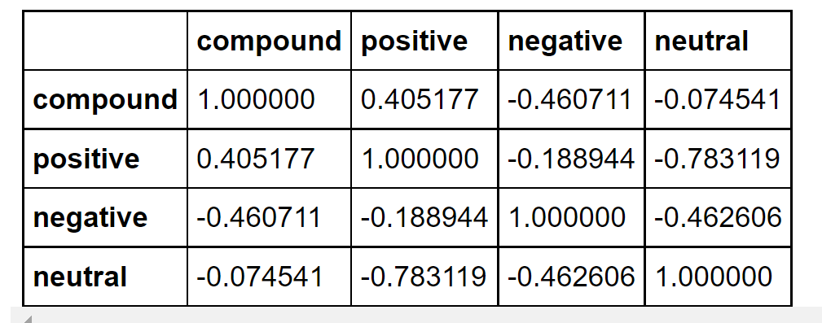
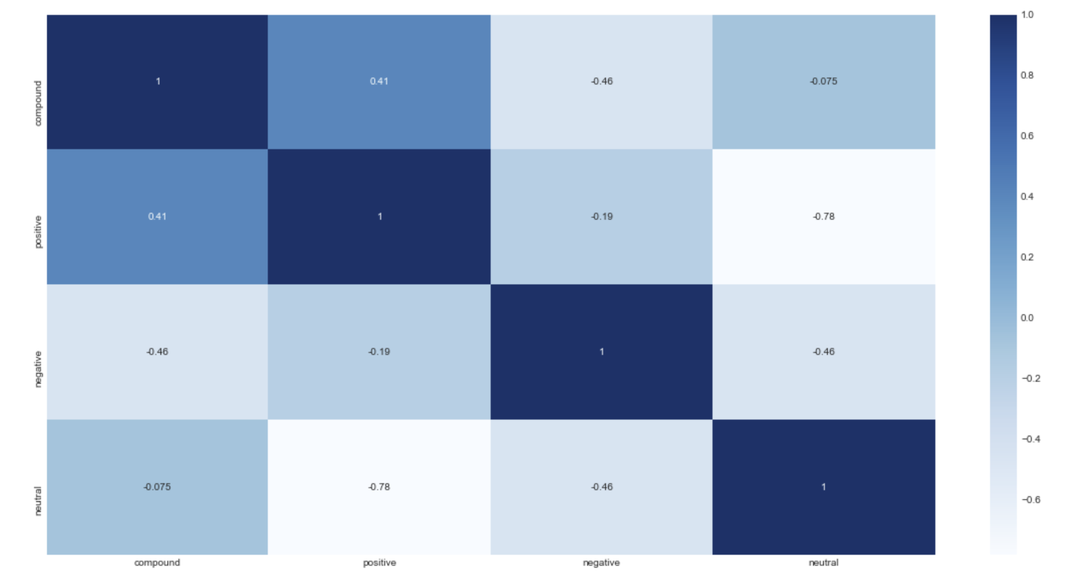
Sentiment Analysis cont.
Notes:
Eric

Slide 6
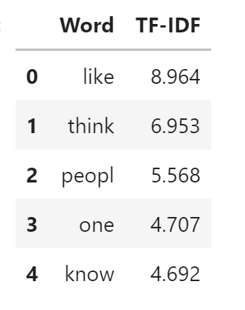
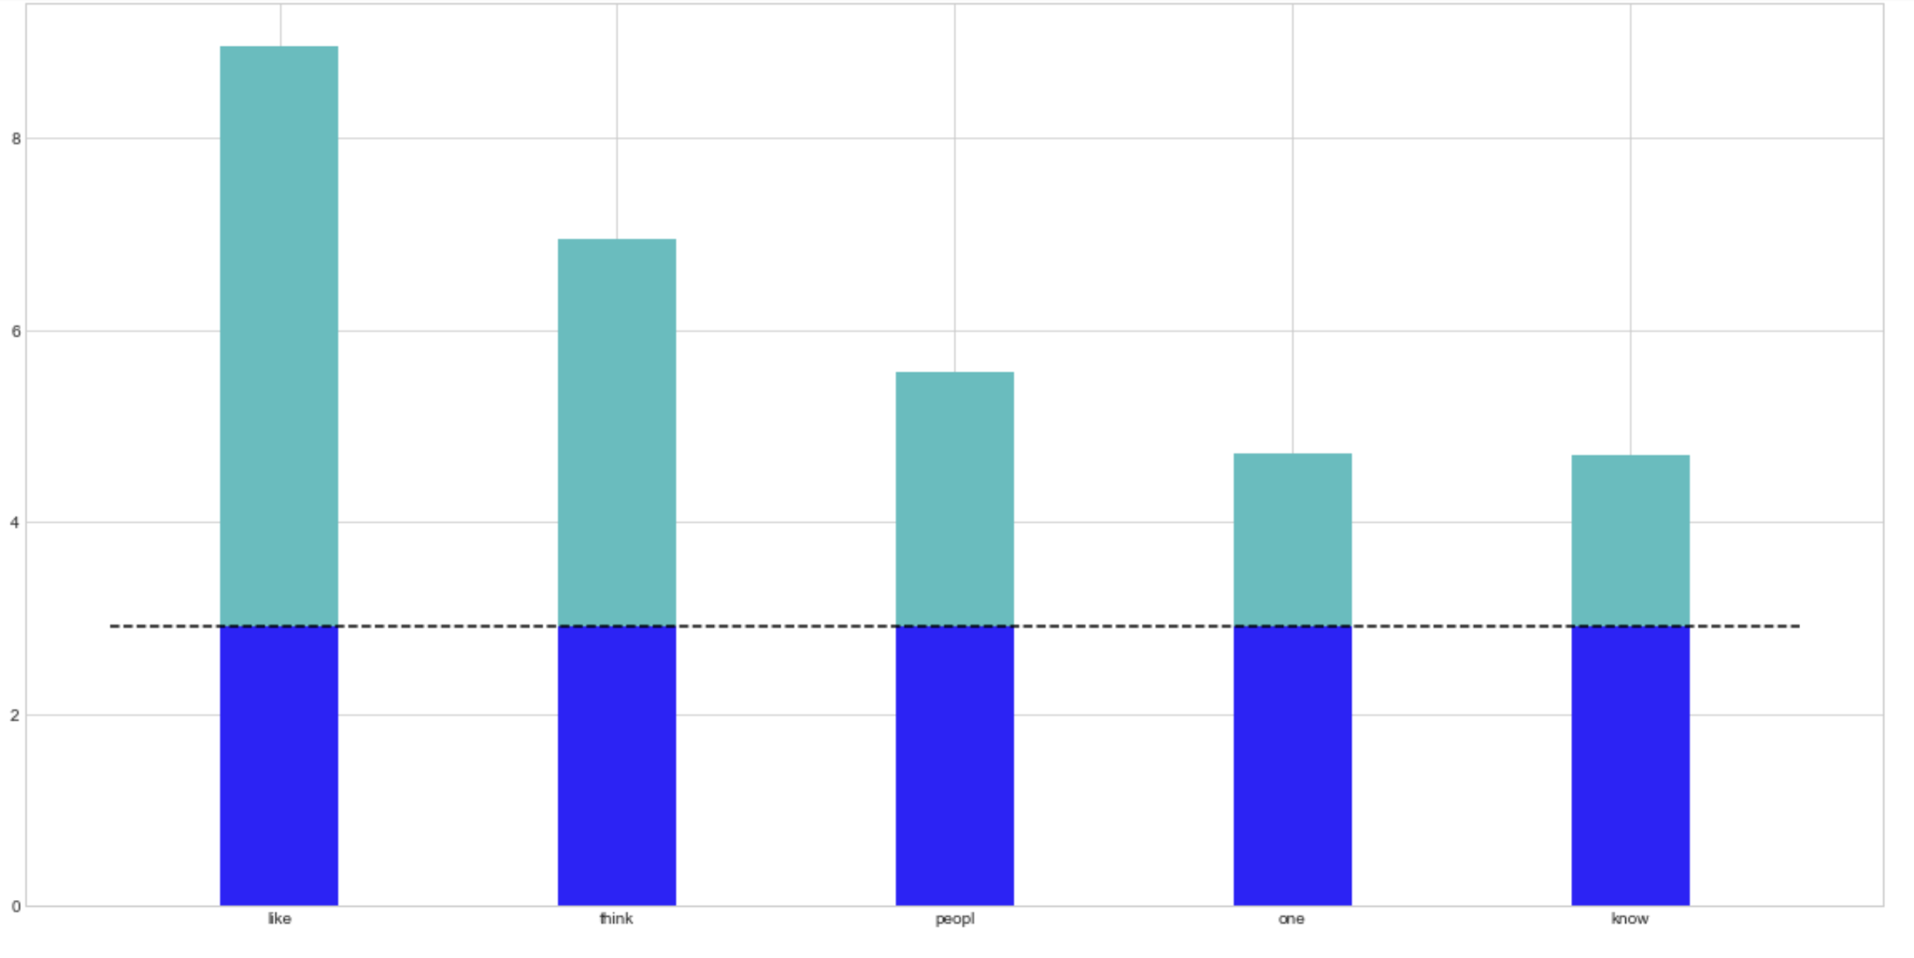
TF-IDF Analysis
We used TF-IDF analysis to determine which words were used most frequently to predict personality types.
Notes:
Ankita

Slide 7
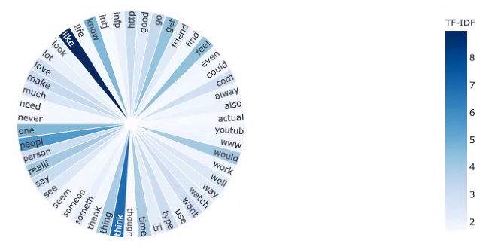
TF-IDF cont.
Notes:
Ankita

Slide 8
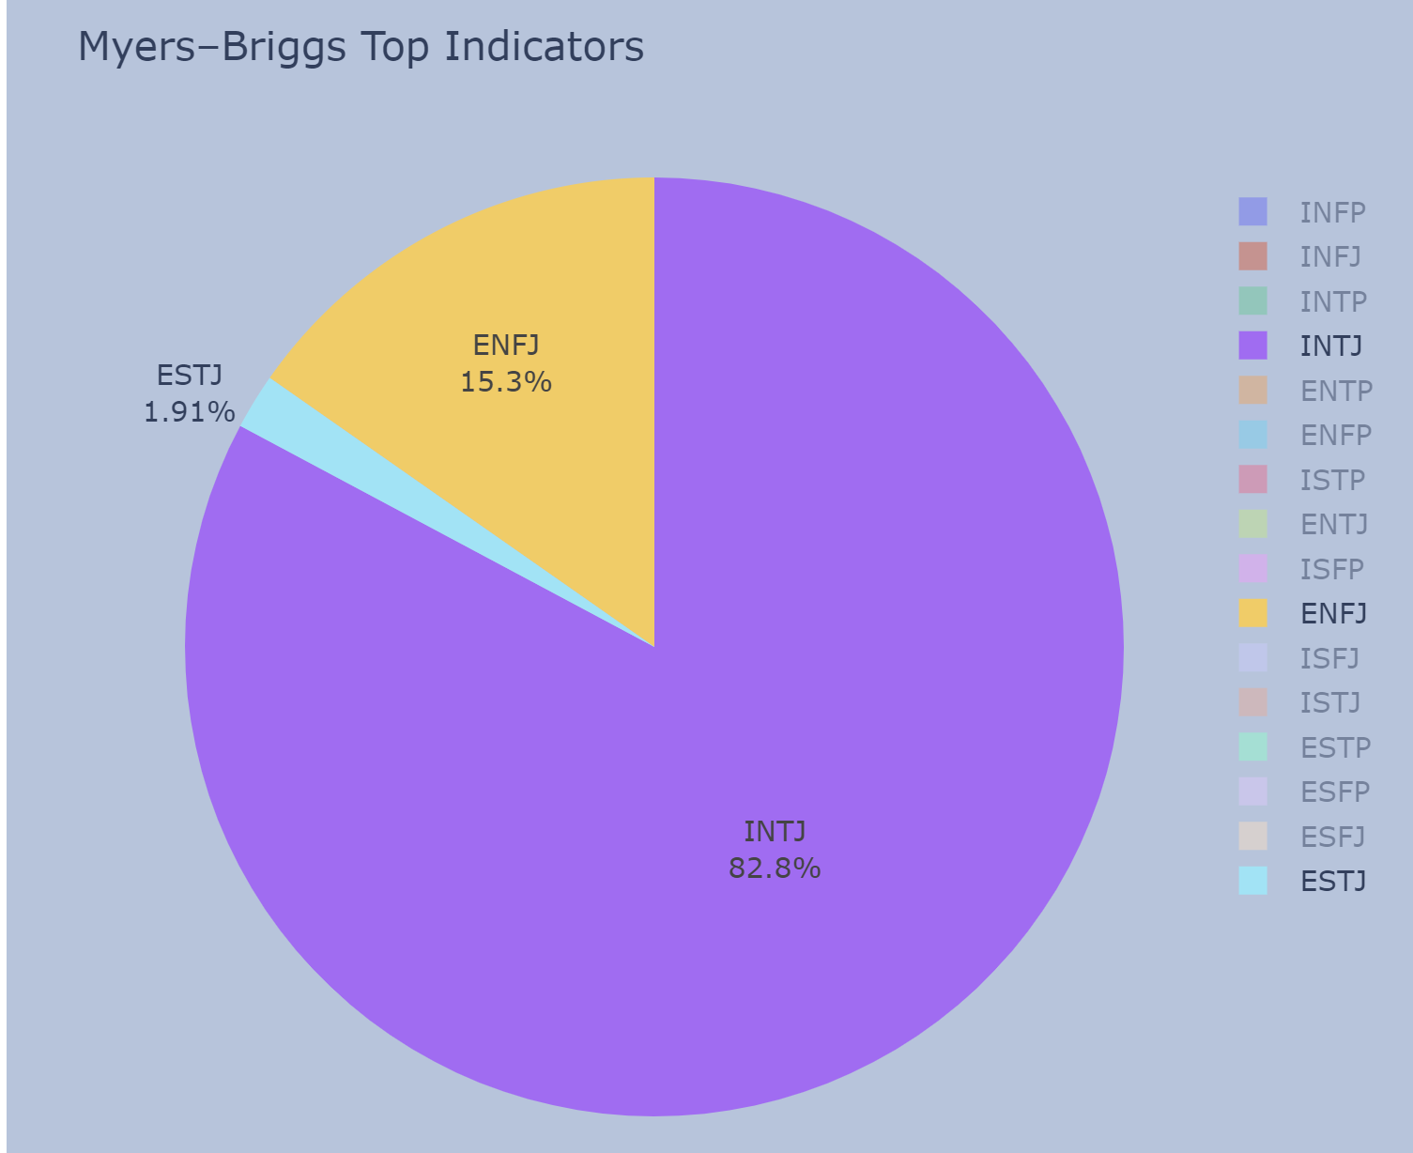
Group Breakdown
3 introverts and 2 extroverts
4 intuitive and 1 observant
4 thinkers and 1 feeler
5 judgers
Notes:
Orlando

Slide 9



INTJ
Introverted, Intuitive, Thinking, and Judging
Known as the Architect
Although this type is very rare we had 3 in our group
Love perfecting the details of life, applying creativity and rationality
Notes:
Orlando

Slide 10

ESTJ
Extroverted, Observant, Thinking and Judging
Known as the Executive
Possess great fortitude, emphatically following their own sensible judgment

Slide 11

ENFJ
Extroverted, Intuitive, Feeling, and Judging
Known as the Protagonist
Warm, forthright types love helping others, and they tend to have strong ideas and values

Slide 12
Take the MBTI
https://www.16personalities.com/
https://jacobj215.github.io/personality-market/frontend/index.html

