Slide 1
Introduction to
Wasserstein distance
Liang Enming
2021/11/01

Slide 2
Content
1. Introduction
2. Computation
3. Application

Slide 3
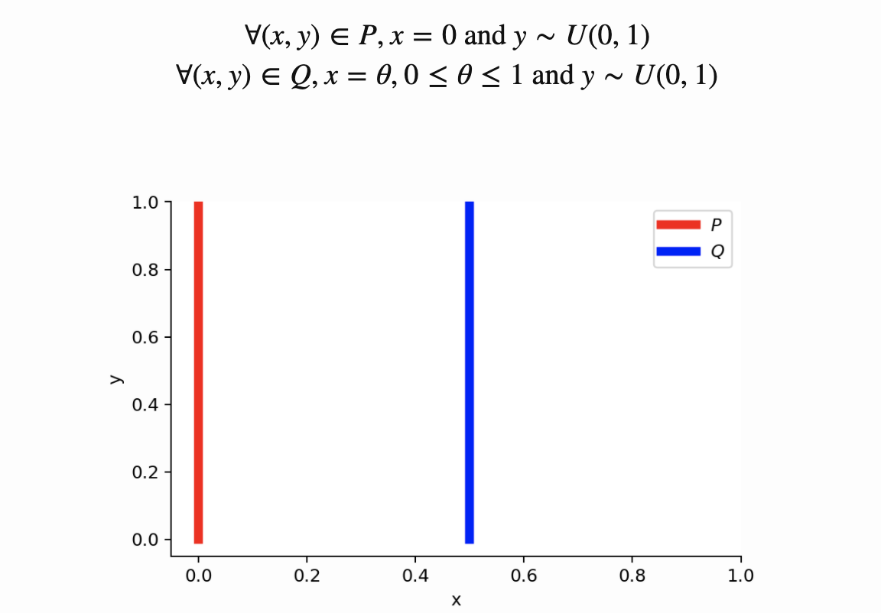
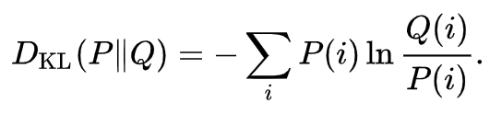
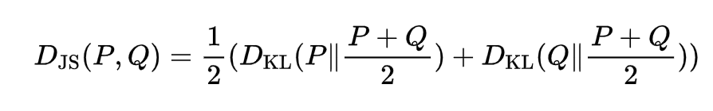
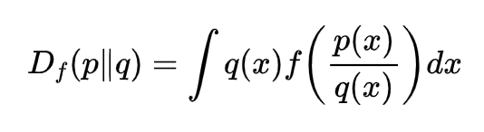
1. Introduction
1.1 Why we need another metric for distributions?
KL-Divergence
JS-Divergence
F-Divergence

Slide 4
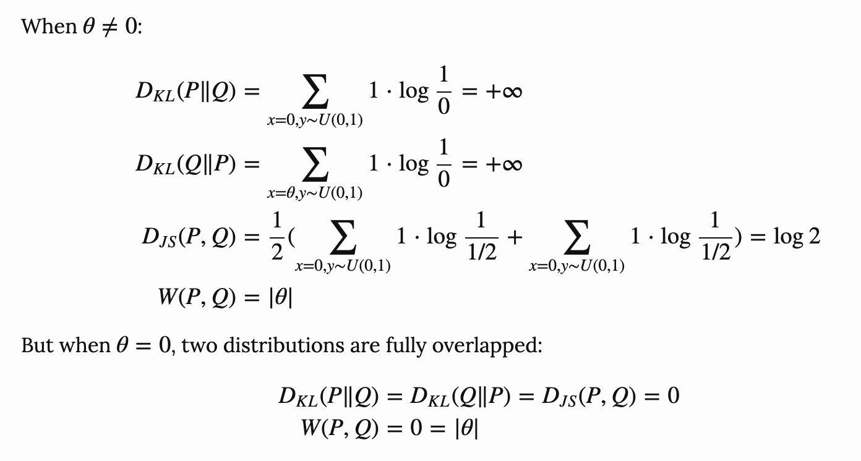
1. Introduction
1.1 Why we need another metric for distributions?
gradient vanishing

Slide 5
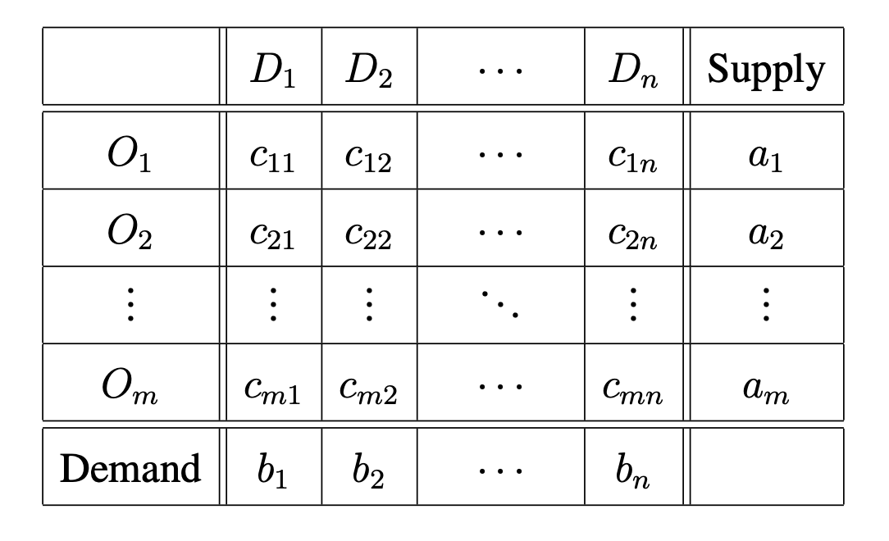
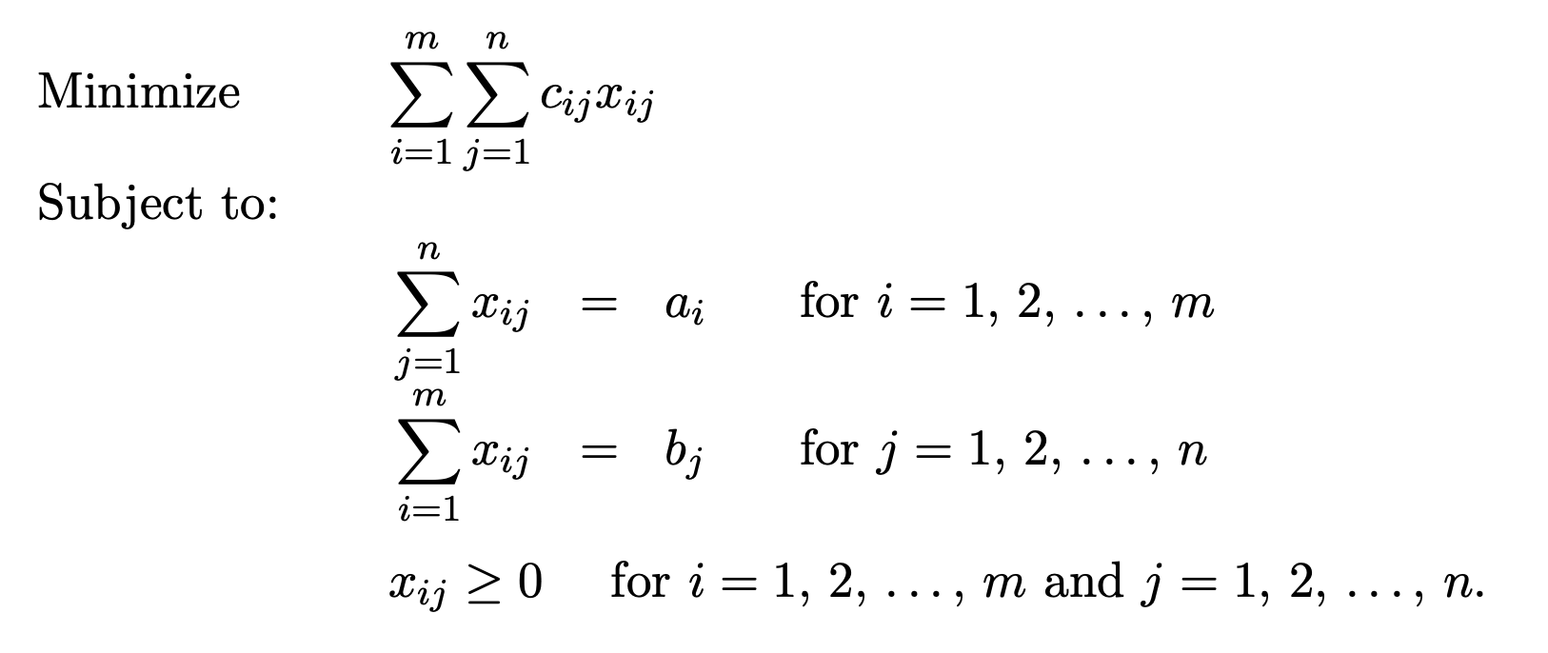
1. Introduction
1.2 Transportation problem
Cost matrix
Linear programming
total transportation cost
supply balance
demand balance

Slide 6
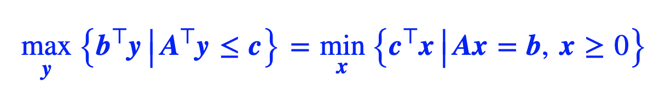
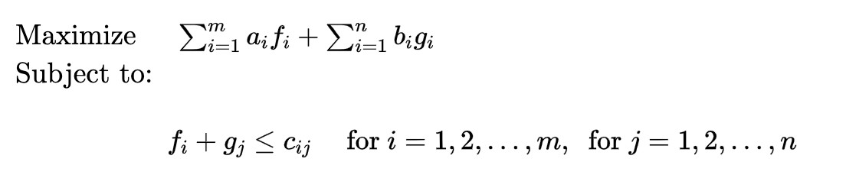
1. Introduction
Primary
1.2 Transportation problem
Strong duality for LP
Dual

Slide 7

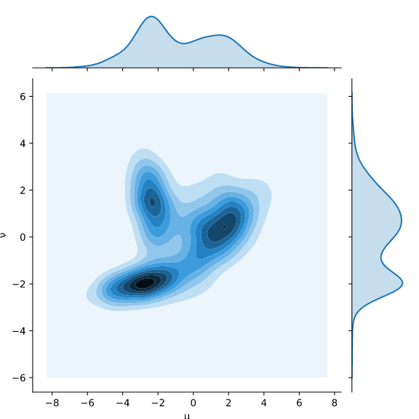
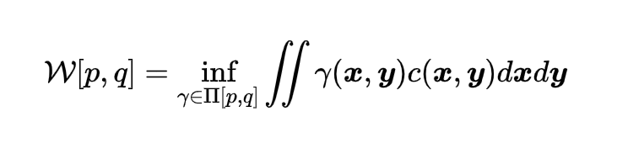


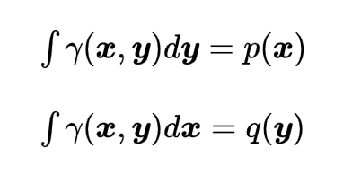

1. Introduction
cost definition
1.3 Wasserstein distance (Kantorovich formulation)
marginal distribution
constraints
find a joint distribution to minimize
the expectation of C

Slide 8
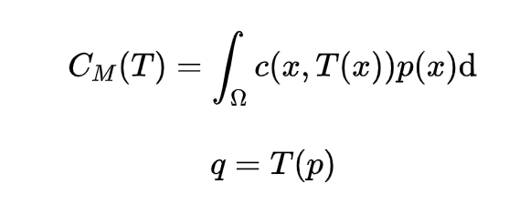
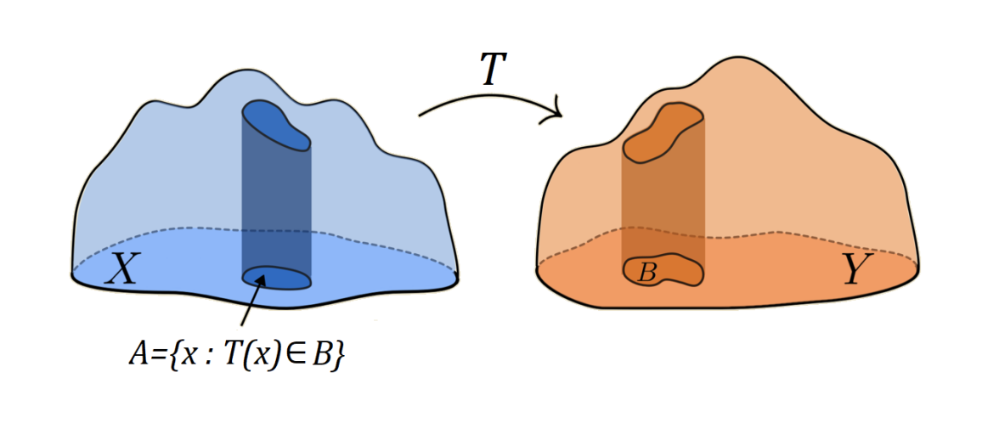
1. Introduction
1.3 Optimal transport -> Wasserstein distance
Monge formulation 1781
Kantorovich formulation
1939
non-linear
linear
Transport map
Transport plan

Slide 9
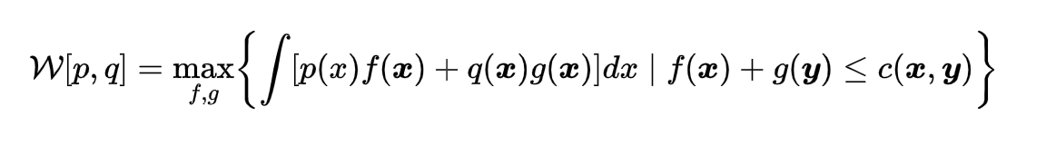

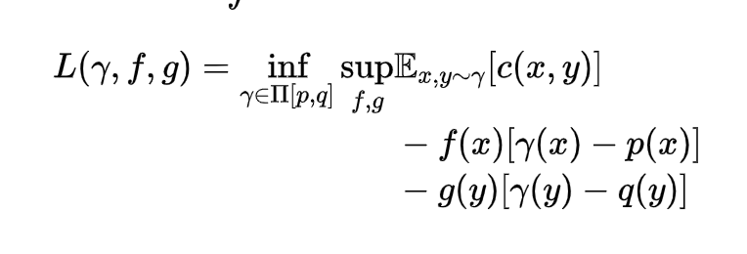

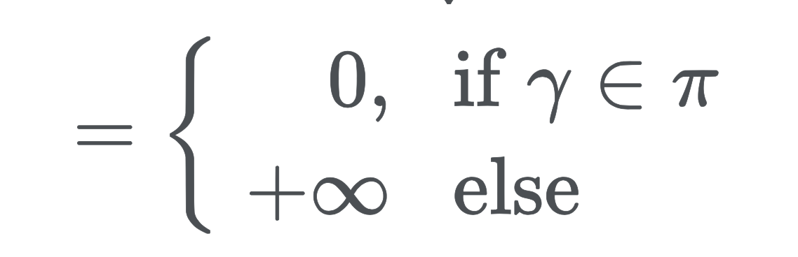
1. Introduction
1.4 Kantorovich-Rubinstein Duality
Primary
Dual 1
Primal-dual optimality condition
Lagrangian
proof
->: if are primal and dual optimal, then:
<-: if , then:

Slide 10

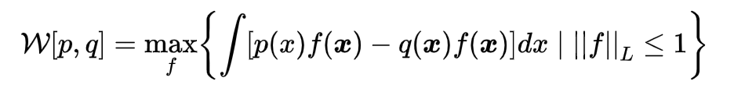

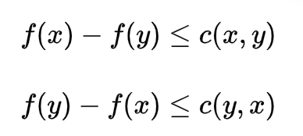
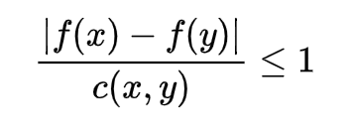
1. Introduction
1.5 Optimality condition
Primary
Dual 1
Primal-dual optimality condition
Dual 2
proof

Slide 11
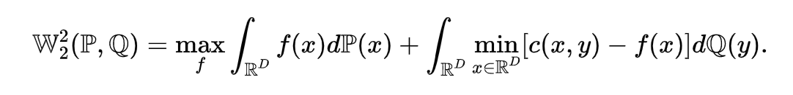
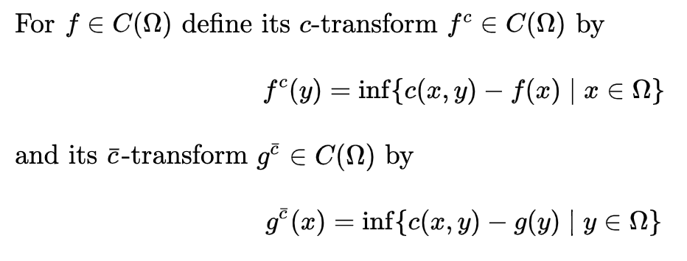

1. Introduction
1.6 Optimality condition
Primary
Dual 1
C-transform
Dual 3
C-transform
proof
->:
<-:

Slide 12
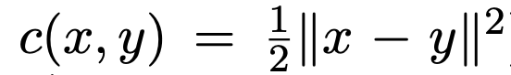
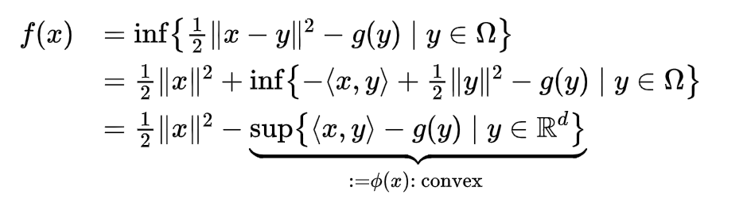
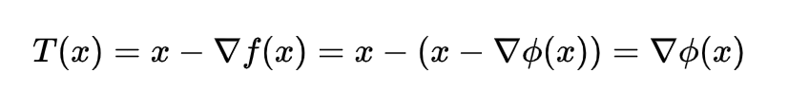
1. Introduction
1.7 Optimality condition
Primary
Dual 1
C-transform
Dual 3
Quadratic case
Brenier theorem

Slide 13
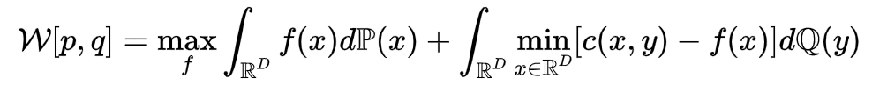
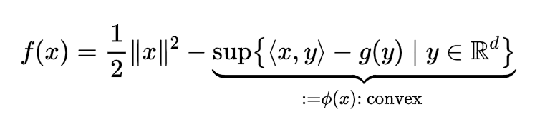

1. Introduction
Primary
Dual 1
Dual 2
C-transform
Dual 3
Discretization
Quadratic cost
Brenier theorem

Slide 14
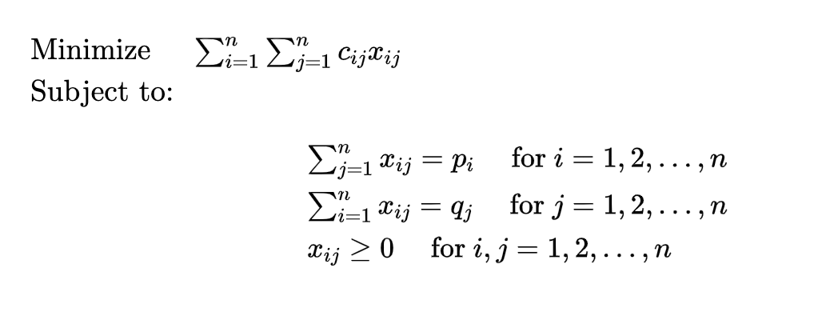
2. Computation
2.1 Discretization -> Transportation problem
Linear programming
solve in dual form
polynomial complexity
not scalable when n is large
Primary

Slide 15
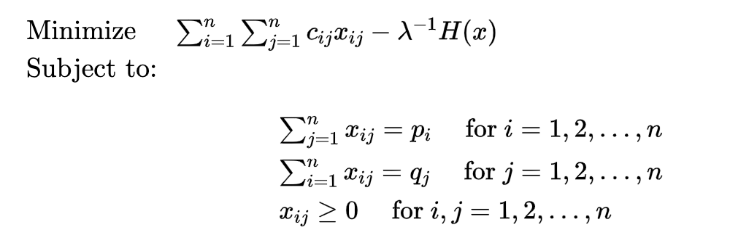
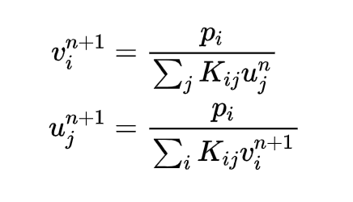

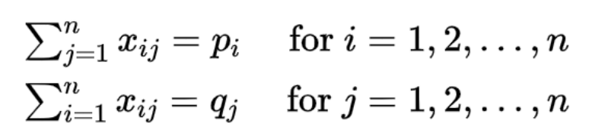
2. Computation
2.2 Discretization + Regularization -> Matrix normalization
Primary
Sinkhorn iteration (Cuturi, 2013)
entropy regulization: H(x)= -xlogx
strongly convex
link between x and (f,g)
Matrix normalization/balancing:
Sinkhorn-Knopp algorithm
limited numerical accuracy
optimal condition
solve equations

Slide 16
2. Computation
2.3 Discretization + Relaxation -> Primary-Dual optimization
Primary
Alternating Direction Method of Multipliers
Bregman ADMM (Ye, 2017)
sGS-ADMM (Yang, 2021)
For optimiation based approaches
Convergence gauranteed
Discretization
Not scalable for in DL

Slide 17
2. Computation
Primary
Dual 1
Dual 2
C-transform
Dual 3
Linear programming
Matrix normalization
Primary-Dual optimization
Discretization
Quadratic cost
Brenier theorem

Slide 18
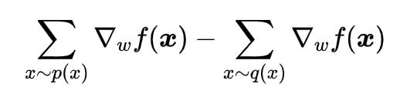
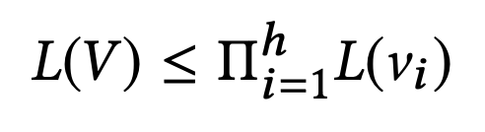
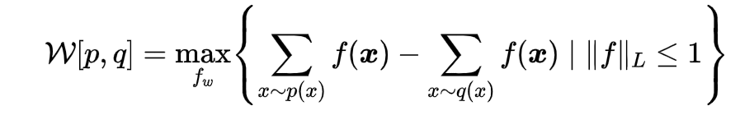
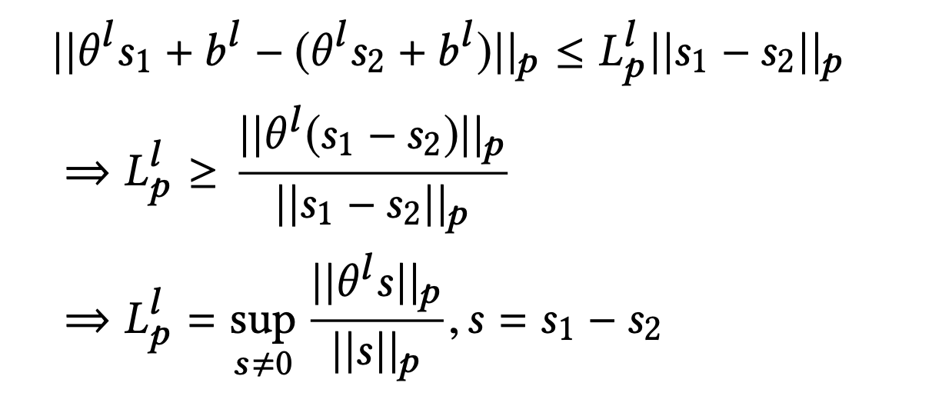

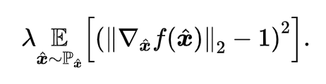
2. Computation
2.4 Dual form -> Unconstrained optimization
Dual 2
Gradient of w-loss
Lipschitz constant of Neural network
Lipschitz constant for each layer
operator norm of weight matrix
batch sample average
Clipping: gradient vanish (W-GAN, 2017)
Lipschitz penalty (WGAN-GP, 2017)

Slide 19
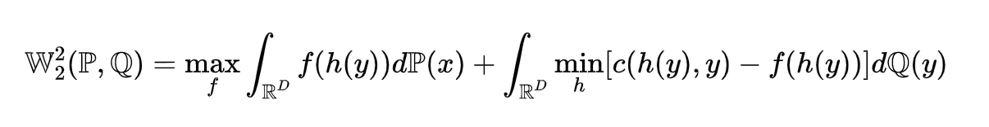
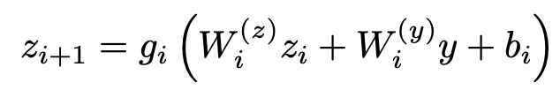
2. Computation
2.5 Dual form + Optimal function class -> Unconstrained optimization
Dual 3
Introduce an inner minmization problem
solve min problem for each y (3P-GAN, 2019)
amortised optimisation
learn x = h(y)
In Quadratic case (Amirhossein, 2019)
f is decomposed
approximating a convex function
Input convex neural network (Amos, 2017)
non-negative weight matrix
convex & non-decreasing activation
amortised optimisation
Quadratic case

Slide 20
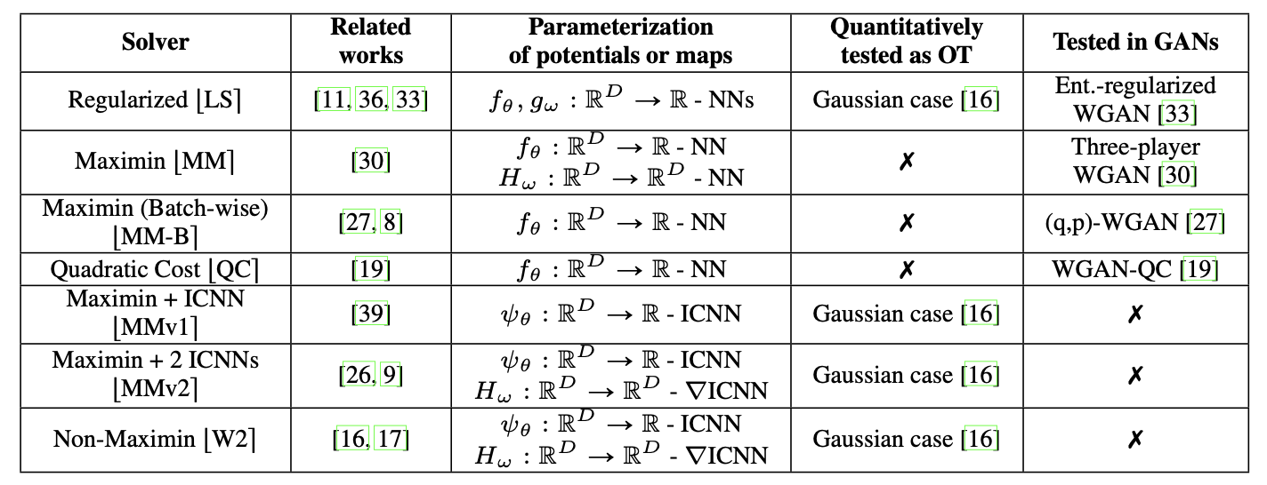
2. Computation
2.6 Summary
Do Neural Optimal Transport Solvers Work? (Alexander, 2021)
Solve 2-Wasserstein distance
Tested in GAN

Slide 21
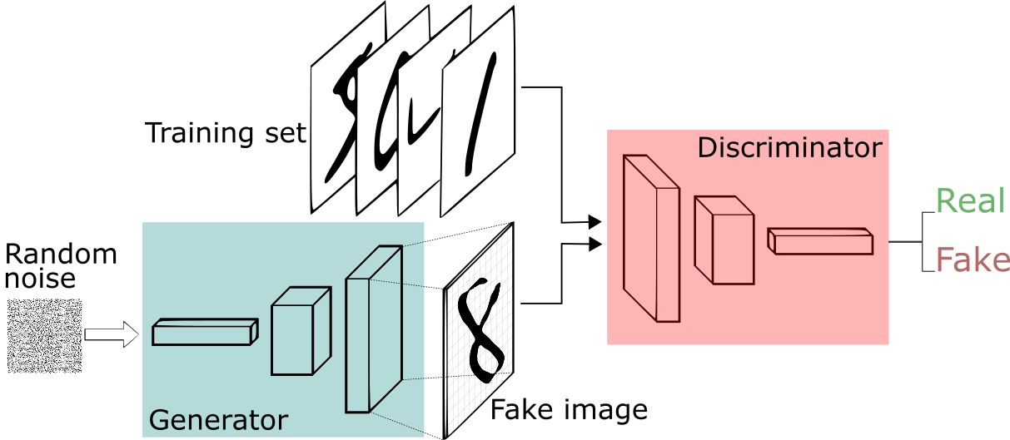
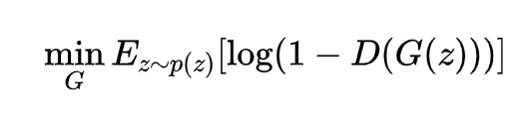

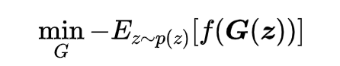
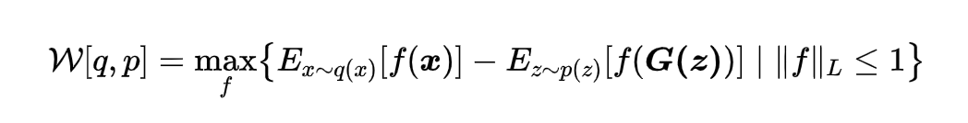
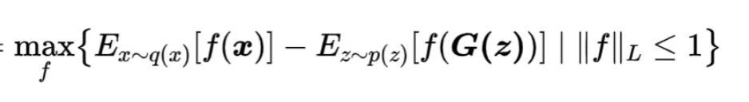
3. Application
3.1 Wasserstein generative adversarial networks
KL loss function for GAN
Generator:
Discriminator
W-loss function for W-GAN
Generator: given f, min W[q,p]
Discriminator: given G, max W[q,p]

Slide 22
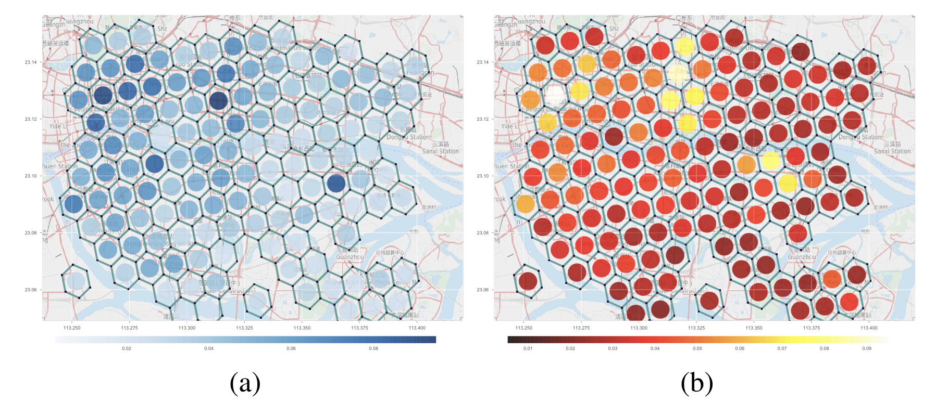
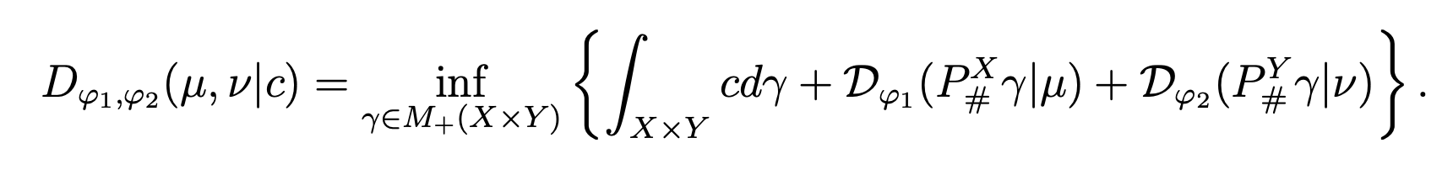
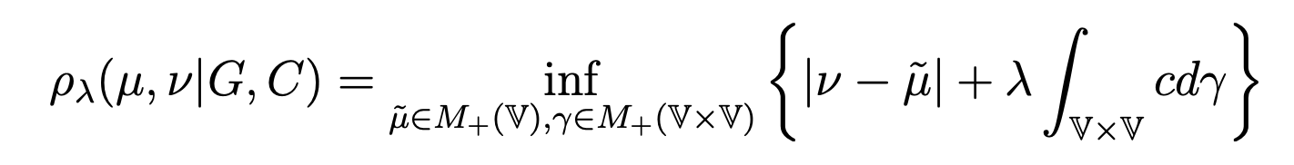
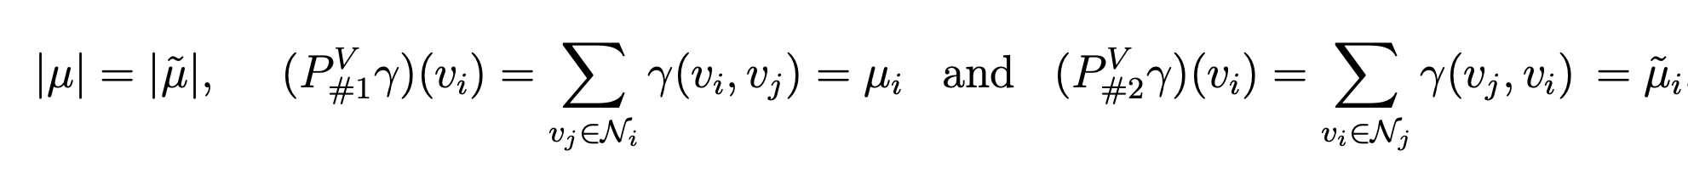
3. Application
3.2 Graph-Based Equilibrium Metrics for Dynamic Supply-Demand Systems. (JASA)
Evaluating supply-demand imbalance
W-distance
time-varying system
neighboor grid constraint
Graph-based Equilibrium Metrics
Computational Approach
linear programming

Slide 23
Reference
[1] Santambrogio, F. (2015). Optimal transport for applied mathematicians. Birkäuser, NY, 55(58-63), 94.
[2] Arjovsky, M., Chintala, S., & Bottou, L. (2017, July). Wasserstein generative adversarial networks. In International conference on machine learning (pp. 214-223). PMLR.
[3] Gulrajani, I., Ahmed, F., Arjovsky, M., Dumoulin, V., & Courville, A. (2017). Improved training of wasserstein gans. arXiv preprint arXiv:1704.00028.
[4] Cuturi, M. (2013). Sinkhorn distances: Lightspeed computation of optimal transport. Advances in neural information processing systems, 26, 2292-2300.
[5] Ye, J., Wu, P., Wang, J. Z., & Li, J. (2017). Fast discrete distribution clustering using Wasserstein barycenter with sparse support. IEEE Transactions on Signal Processing, 65(9), 2317-2332.
[6] Amos, B., Xu, L., & Kolter, J. Z. (2017, July). Input convex neural networks. In International Conference on Machine Learning (pp. 146-155). PMLR.
[7] Taghvaei A, Jalali A. 2-wasserstein approximation via restricted convex potentials with application to improved training for gans[J]. arXiv preprint arXiv:1902.07197, 2019.
[8] Nhan Dam Q H, Le T, Nguyen T D, et al. Threeplayer Wasserstein GAN via amortised duality[C]//Proc. of the 28th Int. Joint Conf. on Artificial Intelligence (IJCAI). 2019.
[9] Korotin A, Li L, Genevay A, et al. Do Neural Optimal Transport Solvers Work? A Continuous Wasserstein-2 Benchmark[J]. arXiv preprint arXiv:2106.01954, 2021.
[10] Zhou F, Luo S, Qie X, et al. Graph-Based Equilibrium Metrics for Dynamic Supply–Demand Systems With Applications to Ride-sourcing Platforms[J]. Journal of the American Statistical Association, 2021: 1-12.

Slide 24
Q&A

