Slide 1
React state

Slide 2
Overview
What is state?
How to set and update a state object
Why we need to use a state hook
Where to define state
Presentation and Container components
Data flows down
Setting and updating state object in a class component

Slide 3
What is a state?
the particular condition that someone or something is in at a specific time

Slide 4
What does this mean in React?
An object that contains data about the component that represents the condition it is in
Ex: whether a modal component is open or closed
Ex: a user component containing the list of users

Slide 5
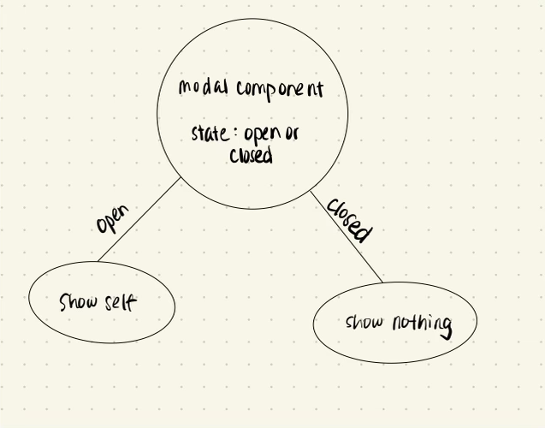

Slide 6
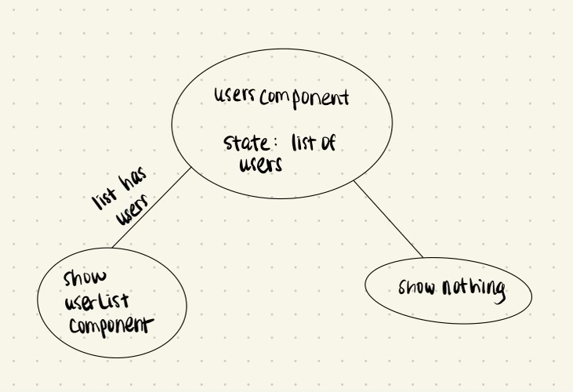

Slide 7
How to set and update the state object
Hook component
useState hook provides a state variable and setter function
Returns an array of both variables as we will the hook multiple times, and we need to have a different name for each instance of the hook
Notes:
Live code counter hook example and explain diff parts

Slide 8
Anytime a component’s state changes, it re-renders. Why?
When the component’s data changes, we want the UI to reflect those changes
Notes:
Refer to counter component and increment functionality

Slide 9
Why not use a local variable?
You cannot retain the local variable’s data between renders
Notes:
Modify counter hook to show this concept before showing animation

Slide 10
Data flows down
State is encapsulated
It is not accessible to any component other than the one that owns and sets it
Component can pass its state down to child components using props
Therefore, the data (state) flows from top to bottom
Aka top-down or unidirectional
Notes:
Show car example

Slide 11
Where do we define state?
Inside container components as opposed to presentation components

Slide 12
Presentation and Container Components
Container component
How things work
May contain both presentation and container components
Usually stateful and provides data to other components
Presentation component
Presents data, aka how things look
Receives data and callbacks from props (unidirectional data flow)
Pros:
Separation of data fetching and presenting that data
Makes presentation component reusable
Notes:
Live code users and components example

Slide 13
State in Class Components
Set:
this.state = {}
Declared in the constructor function
Update:
this.setState({})
Notes:
Show code example
Mention the react regular and beta docs

Slide 14
References
React docs: https://reactjs.org/docs/getting-started.html
React beta docs: https://beta.reactjs.org/
Presentation and container components: https://medium.com/@dan_abramov/smart-and-dumb-components-7ca2f9a7c7d0

