Slide 1
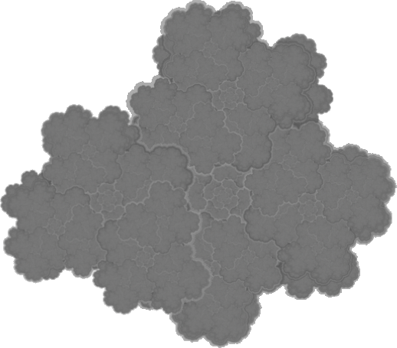

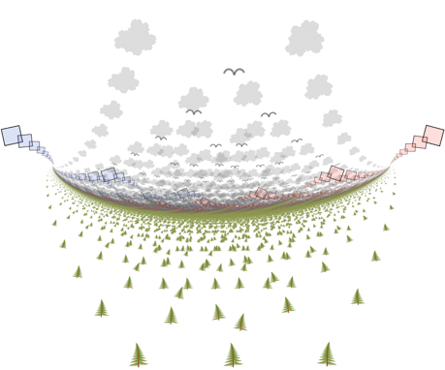
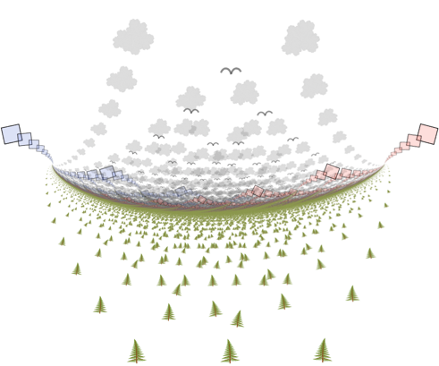
Notes:
Abstract landscape

Slide 2
The tree and the cloud images were themselves generated with PowerPoint.

