Slide 1
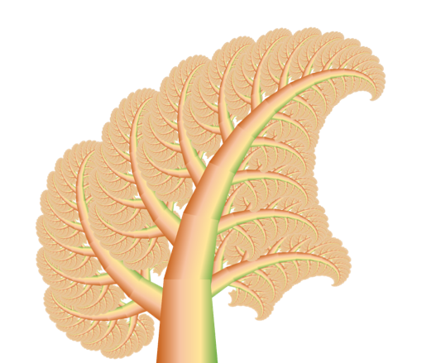





Fractal Cabbage
Notes:
Cabbage leaf

