Slide 1
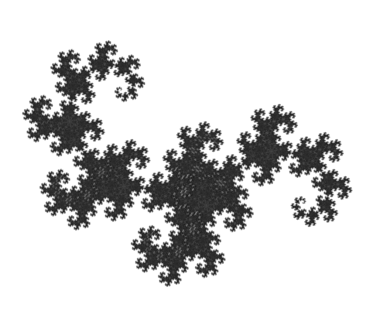
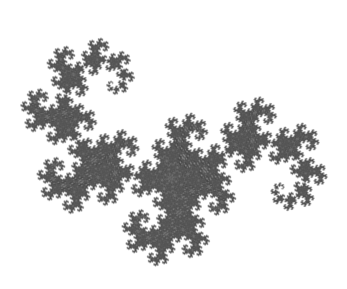
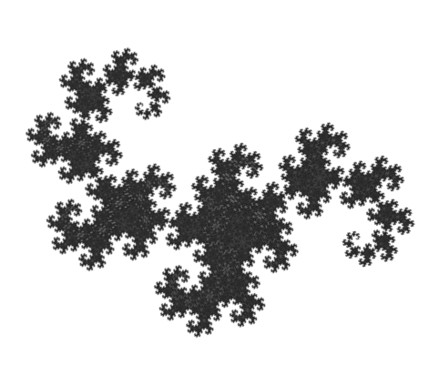
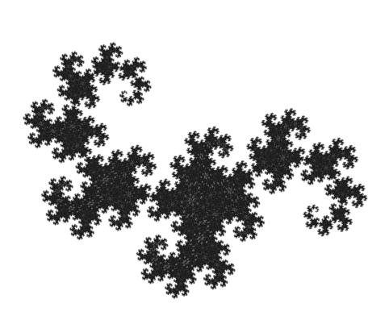
Dragon Curve
Notes:
Heighway Dragon Curve (also known as the Jurassic Park Dragon)
Can be built by repeatedly folding a strip of paper in half, then partially unfolding (from 180 to 90 degrees per fold)
Grey pattern is maybe due to scale factor not being precisely sqrt(2)?

