Slide 1
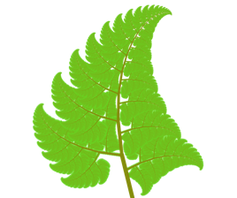


Fractal Fern
Notes:
Branch

