Slide 1
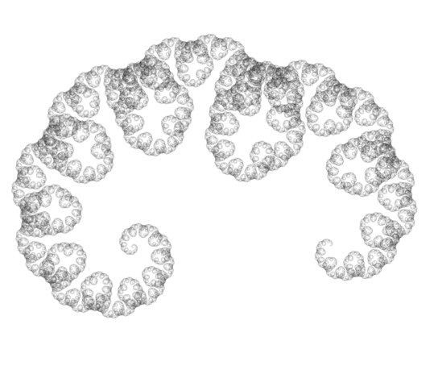
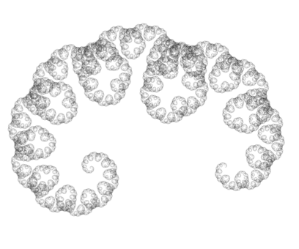
Pythagoras Tree Attractor
Notes:
Pythagoras tree without the trunk (possibly a type of dragon curve?)

