Slide 1
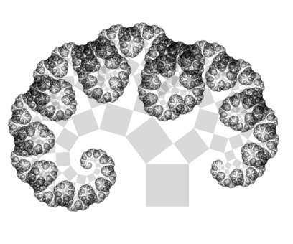
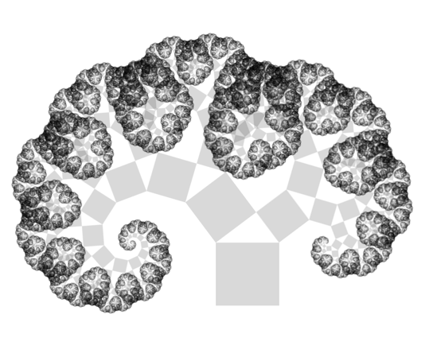
Pythagoras Tree
Notes:
Pythagoras tree

