Slide 1
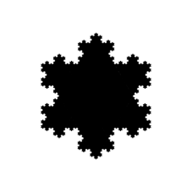
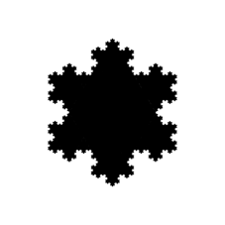
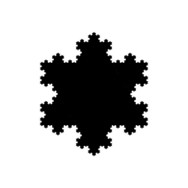
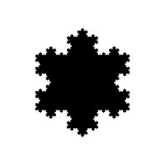
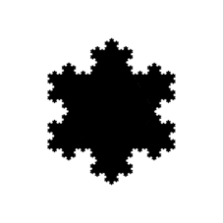
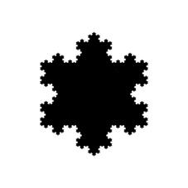
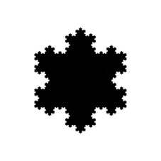
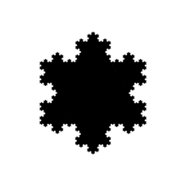
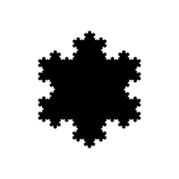
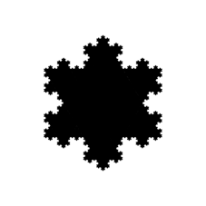
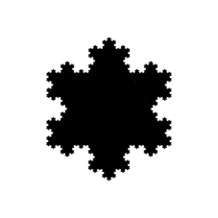
Koch Snowflake
Notes:
Koch snowflake (also known as Koch star or Koch island – the outline is known as the Koch curve)
Outline: D = log(4) / log(3) = 1.2618595071, Area: log(8.5) / log(3) = 1.9479721696 (?)

Slide 2
1
√3 ≃ 1.732
1
x
1/2
2
(1/2)² + x² = 1²
x² = 1 - 1/4 = 3/4
x = √3 / 2 ≃ 0.866

